Slide 2
Jesus One on One
John 3

Slide 3
^{John 2:23} Because of the miraculous signs Jesus did in Jerusalem at the Passover celebration, many began to trust in him. ²⁴ But Jesus didn’t trust them, because he knew all about people. ²⁵ No one needed to tell him about human nature, for he knew what was in each person’s heart.
John 3

Slide 4
^{John 2:23} Because of the miraculous signs Jesus did in Jerusalem at the Passover celebration, many began to trust in him. ²⁴ But Jesus didn’t trust them, because he knew all about people. ²⁵ No one needed to tell him about human nature, for he knew what was in each person’s heart.
^{John 3:1} There was a man named Nicodemus …
John 3

Slide 5
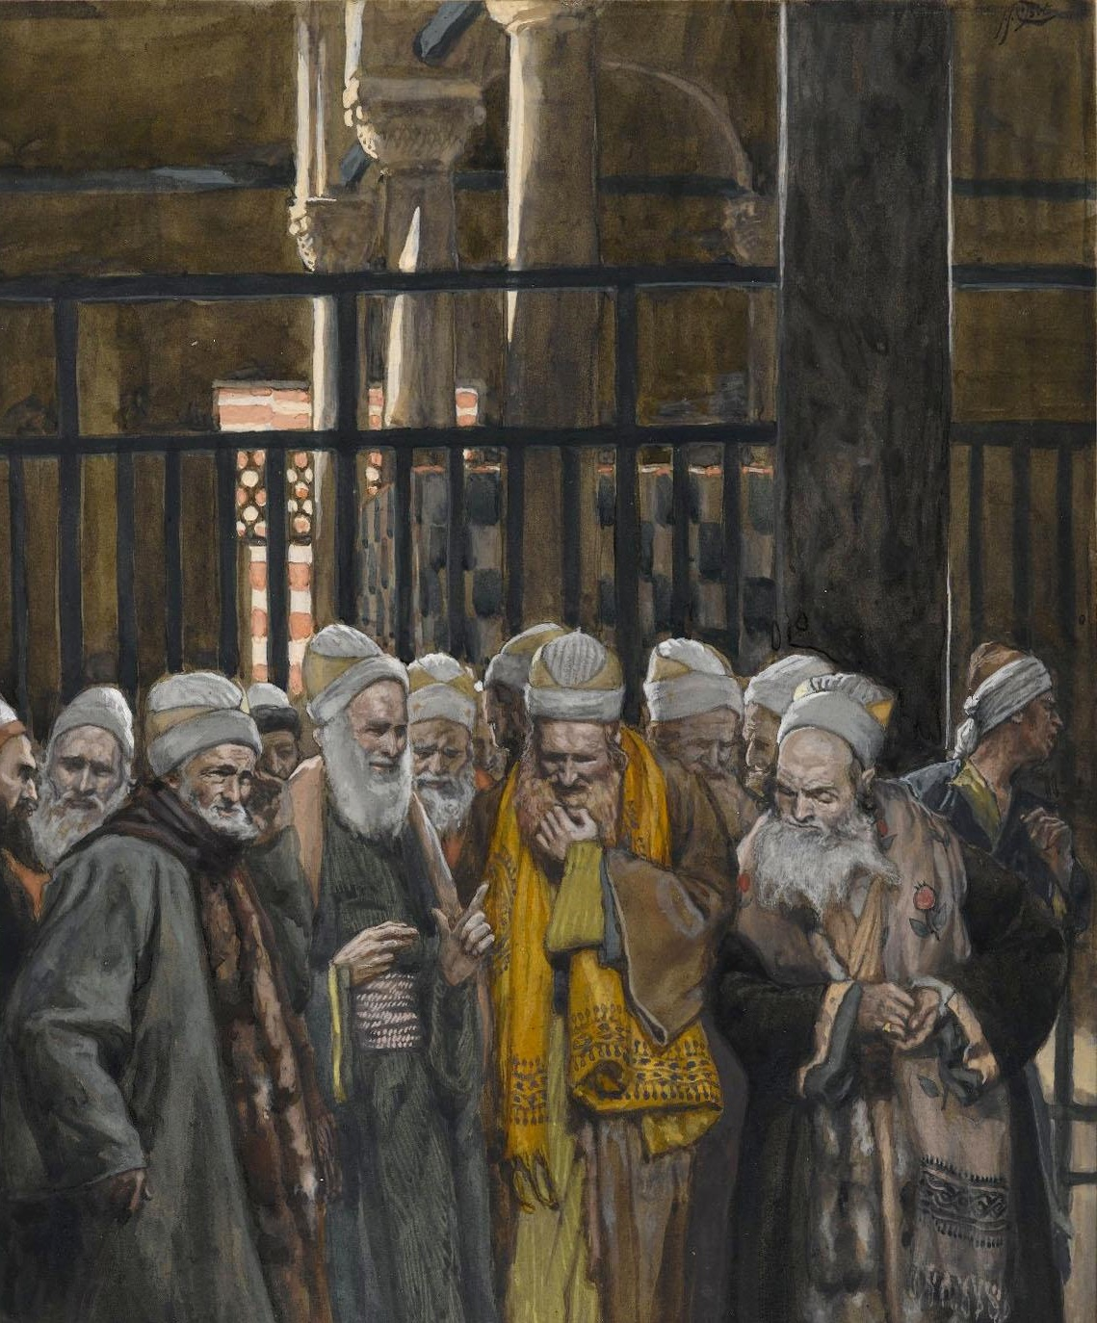
^{John 2:23} Because of the miraculous signs Jesus did in Jerusalem at the Passover celebration, many began to trust in him. ²⁴ But Jesus didn’t trust them, because he knew all about people. ²⁵ No one needed to tell him about human nature, for he knew what was in each person’s heart.
^{John 3:1} There was a man named Nicodemus, a Jewish religious leader who was a Pharisee.
John 3

Slide 6
^{John 2:23} Because of the miraculous signs Jesus did in Jerusalem at the Passover celebration, many began to trust in him. ²⁴ But Jesus didn’t trust them, because he knew all about people. ²⁵ No one needed to tell him about human nature, for he knew what was in each person’s heart.
^{John 3:1} There was a man named Nicodemus, a Jewish religious leader who was a Pharisee.
John 3

Slide 7
^{John 2:23} Because of the miraculous signs Jesus did in Jerusalem at the Passover celebration, many began to trust in him. ²⁴ But Jesus didn’t trust them, because he knew all about people. ²⁵ No one needed to tell him about human nature, for he knew what was in each person’s heart.
Archon: ruler, chief
^{John 3:1} There was a man named Nicodemus, a Jewish religious leader who was a Pharisee.
John 3

Slide 8
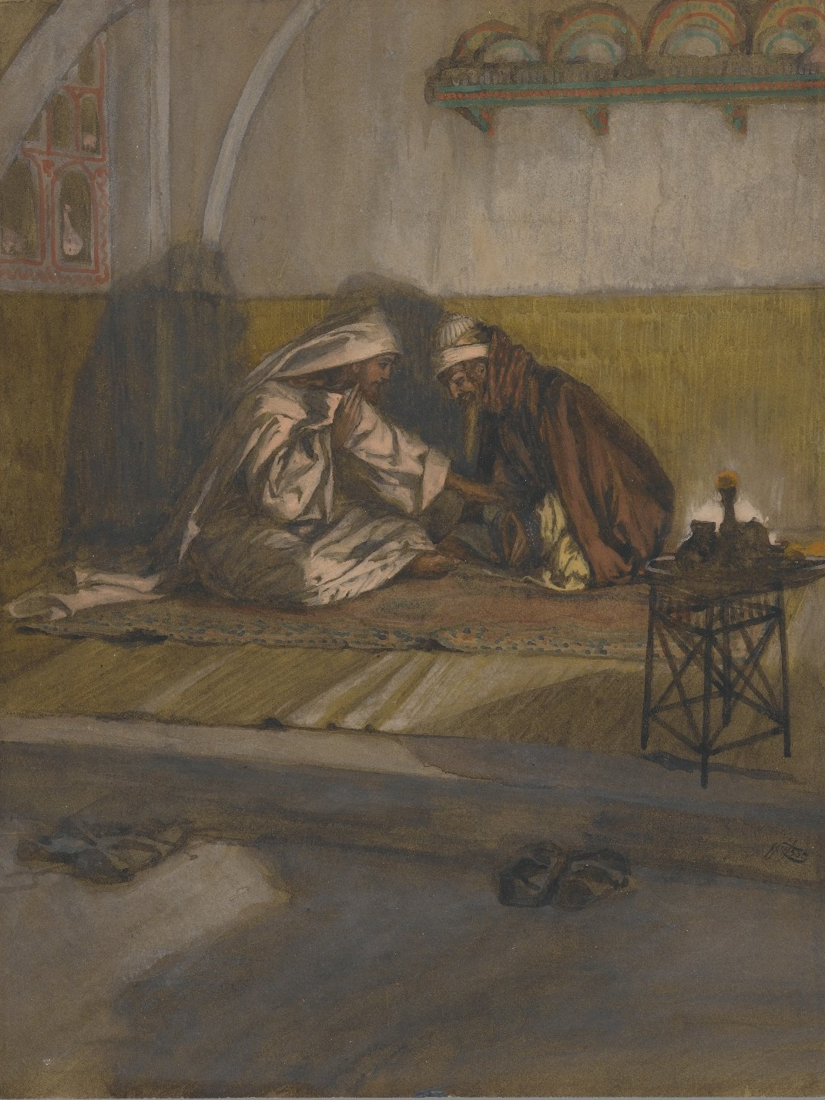
Jesus One on One: Jesus and Nicodemus
^{John 3:2} After dark one evening, he came to speak with Jesus.

Slide 9
Jesus One on One: Jesus and Nicodemus
^{John 3:2} After dark one evening, he came to speak with Jesus.

Slide 10
Jesus One on One: Jesus and Nicodemus
^{John 3:2} After dark one evening, he came to speak with Jesus.

Slide 11
Jesus One on One: Jesus and Nicodemus
^{3:3} “I tell you the truth, unless you are born again, you cannot see the Kingdom of God.”
^{3:2} “Rabbi,”
^{3:2} “we all know that God has sent you to teach us. Your miraculous signs are evidence that God is with you.”
^{3:3} Jesus replied ,
^{3:2} he said,

Slide 12
Jesus One on One: Jesus and Nicodemus
^{3:3} “I tell you the truth, unless you are born again, you cannot see the Kingdom of God.”
^{3:4} “What do you mean?”
^{3:3} Jesus replied ,
^{3:4} Nicodemus exclaimed

Slide 13
Jesus One on One: Jesus and Nicodemus
^{3:3} “I tell you the truth, unless you are born again, you cannot see the Kingdom of God.”
^{3:4} “What do you mean?”
^{3:4} ““How can an old man go back into his mother’s womb and be born again?”
^{3:3} Jesus replied ,
^{3:4} Nicodemus exclaimed

Slide 14
Jesus One on One: Jesus and Nicodemus
^{3:5} “I assure you, no one can enter the Kingdom of God without being born of water and the Spirit. ⁶ Humans can reproduce only human life, but the Holy Spirit gives birth to spiritual life. ⁷ So don’t be surprised when I say, ‘You must be born again.’
^{3:5} Jesus replied,

Slide 15
New Birth
^{3:5} “I assure you, no one can enter the Kingdom of God without being born of water and the Spirit. ⁶ Humans can reproduce only human life, but the Holy Spirit gives birth to spiritual life. ⁷ So don’t be surprised when I say, ‘You must be born again.’
^{3:5} Jesus replied,

Slide 16
New Birth
Something spiritual, not physical
^{3:5} “I assure you, no one can enter the Kingdom of God without being born of water and the Spirit. ⁶ Humans can reproduce only human life, but the Holy Spirit gives birth to spiritual life. ⁷ So don’t be surprised when I say, ‘You must be born again.’
^{3:5} Jesus replied,

Slide 17
New Birth
Something spiritual, not physical
^{3:5} “I assure you, no one can enter the Kingdom of God without being born of water and the Spirit. ⁶ Humans can reproduce only human life, but the Holy Spirit gives birth to spiritual life. ⁷ So don’t be surprised when I say, ‘You must be born again.’
^{3:5} Jesus replied,

Slide 18
New Birth
Something spiritual, not physical
^{3:5} “I assure you, no one can enter the Kingdom of God without being born of water and the Spirit. ⁶ Humans can reproduce only human life, but the Holy Spirit gives birth to spiritual life. ⁷ So don’t be surprised when I say, ‘You must be born again.’
^{3:5} Jesus replied,

Slide 19
New Birth
Something spiritual, not physical
^{3:5} “I assure you, no one can enter the Kingdom of God without being born of water and the Spirit. ⁶ Humans can reproduce only human life, but the Holy Spirit gives birth to spiritual life. ⁷ So don’t be surprised when I say, ‘You must be born again.’
^{3:5} Jesus replied,

Slide 20
New Birth
The ‘new birth’ describes salvation
^{3:5} “I assure you, no one can enter the Kingdom of God without being born of water and the Spirit. ⁶ Humans can reproduce only human life, but the Holy Spirit gives birth to spiritual life. ⁷ So don’t be surprised when I say, ‘You must be born again.’
^{3:5} Jesus replied,

Slide 21
New Birth
The ‘new birth’ describes salvation
^{3:5} “I assure you, no one can enter the Kingdom of God without being born of water and the Spirit. ⁶ Humans can reproduce only human life, but the Holy Spirit gives birth to spiritual life. ⁷ So don’t be surprised when I say, ‘You must be born again.’
^{3:5} Jesus replied,

Slide 22
New Birth
The ‘new birth’ describes salvation
Spiritual “Birth”:
a moment in time … a beginning … trajectory … a terminus
New identity … new faculties & awareness … new abilities
^{3:5} “I assure you, no one can enter the Kingdom of God without being born of water and the Spirit. ⁶ Humans can reproduce only human life, but the Holy Spirit gives birth to spiritual life. ⁷ So don’t be surprised when I say, ‘You must be born again.’
^{3:5} Jesus replied,

Slide 23
New Birth
The ‘new birth’ describes salvation
^{3:8} The wind blows where it wishes, and you hear the sound of it, but you do not know where it is coming from and where it is going; so is everyone who has been born of the Spirit.”
^{3:5} “I assure you, no one can enter the Kingdom of God without being born of water and the Spirit. ⁶ Humans can reproduce only human life, but the Holy Spirit gives birth to spiritual life. ⁷ So don’t be surprised when I say, ‘You must be born again.’
^{3:5} Jesus replied,

Slide 24
New Birth
The ‘new birth’ describes salvation
^{3:8} The wind blows where it wishes, and you hear the sound of it, but you do not know where it is coming from and where it is going; so is everyone who has been born of the Spirit.”
^{3:5} “I assure you, no one can enter the Kingdom of God without being born of water and the Spirit. ⁶ Humans can reproduce only human life, but the Holy Spirit gives birth to spiritual life. ⁷ So don’t be surprised when I say, ‘You must be born again.’
^{3:5} Jesus replied,

Slide 25
New Birth
necessary for salvation
^{3:5} “I assure you, no one can enter the Kingdom of God without being born of water and the Spirit. ⁶ Humans can reproduce only human life, but the Holy Spirit gives birth to spiritual life. ⁷ So don’t be surprised when I say, ‘You must be born again.’
^{3:5} Jesus replied,

Slide 26
New Birth
necessary for salvation
^{3:5} “I assure you, no one can enter the Kingdom of God without being born of water and the Spirit. ⁶ Humans can reproduce only human life, but the Holy Spirit gives birth to spiritual life. ⁷ So don’t be surprised when I say, ‘You must be born again.’
^{3:5} Jesus replied,

Slide 27
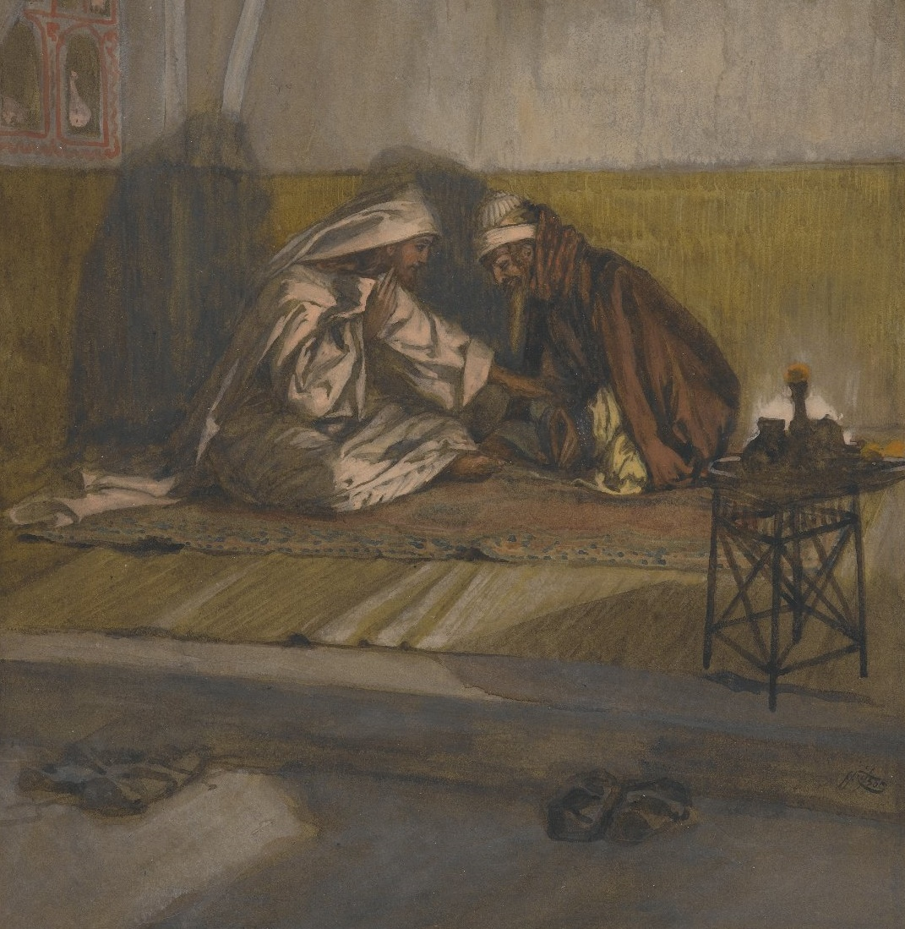
New Birth
necessary for salvation
A decision
^{3:3} “I tell you the truth, unless you are born again, you cannot see the Kingdom of God.”
“I want to receive spiritual life from you”
^{3:5} “I assure you, no one can enter the Kingdom of God without being born of water and the Spirit. ⁶ Humans can reproduce only human life, but the Holy Spirit gives birth to spiritual life. ⁷ So don’t be surprised when I say, ‘You must be born again.’
^{3:5} Jesus replied,

Slide 28
New Birth
^{3:9} “How are these things possible?”
^{3:10} Jesus replied, “You are a respected Jewish teacher, and yet you don’t understand these things? ¹¹ I assure you, we tell you what we know and have seen, and yet you won’t believe our testimony. ¹² But if you don’t believe me when I tell you about earthly things, how can you possibly believe if I tell you about heavenly things?
^{3:10} Jesus replied,
^{3:9} Nicodemus asked

Slide 29
New Birth
^{3:9} “How are these things possible?”
^{3:10} Jesus replied, “You are a respected Jewish teacher, and yet you don’t understand these things? ¹¹ I assure you, we tell you what we know and have seen, and yet you won’t believe our testimony. ¹² But if you don’t believe me when I tell you about earthly things, how can you possibly believe if I tell you about heavenly things?
^{3:10} Jesus replied,
^{3:9} Nicodemus asked

Slide 30
New Birth
Daniel 7
Numbers 21
^{3:13} No one has ever gone to heaven and returned. But the Son of Man has come down from heaven. ¹⁴ And as Moses lifted up the bronze snake on a pole in the wilderness, so the Son of Man must be lifted up, ¹⁵ so that everyone who believes in him will have eternal life.

Slide 31
New Birth
^{Daniel 7:13} I kept looking in the night visions, And behold, with the clouds of heaven One like a Son of Man was coming, And He came up to the Ancient of Days And was presented before Him. ¹⁴ And to Him was given dominion, Glory and a kingdom, That all the peoples, nations and men of every language Might serve Him. His dominion is an everlasting dominion Which will not pass away; And His kingdom is one Which will not be destroyed.
^{3:13} No one has ever gone to heaven and returned. But the Son of Man has come down from heaven. ¹⁴ And as Moses lifted up the bronze snake on a pole in the wilderness, so the Son of Man must be lifted up, ¹⁵ so that everyone who believes in him will have eternal life.

Slide 32
New Birth
^{Daniel 7:13} I kept looking in the night visions, And behold, with the clouds of heaven One like a Son of Man was coming, And He came up to the Ancient of Days And was presented before Him. ¹⁴ And to Him was given dominion, Glory and a kingdom, That all the peoples, nations and men of every language Might serve Him. His dominion is an everlasting dominion Which will not pass away; And His kingdom is one Which will not be destroyed.
^{3:13} No one has ever gone to heaven and returned. But the Son of Man has come down from heaven. ¹⁴ And as Moses lifted up the bronze snake on a pole in the wilderness, so the Son of Man must be lifted up, ¹⁵ so that everyone who believes in him will have eternal life.

Slide 33
New Birth
^{Daniel 7:13} I kept looking in the night visions, And behold, with the clouds of heaven One like a Son of Man was coming, And He came up to the Ancient of Days And was presented before Him. ¹⁴ And to Him was given dominion, Glory and a kingdom, That all the peoples, nations and men of every language Might serve Him. His dominion is an everlasting dominion Which will not pass away; And His kingdom is one Which will not be destroyed.
^{3:13} No one has ever gone to heaven and returned. But the Son of Man has come down from heaven. ¹⁴ And as Moses lifted up the bronze snake on a pole in the wilderness, so the Son of Man must be lifted up, ¹⁵ so that everyone who believes in him will have eternal life.

Slide 34
New Birth
The saving work of the Messiah
^{Daniel 7:13} I kept looking in the night visions, And behold, with the clouds of heaven One like a Son of Man was coming, And He came up to the Ancient of Days And was presented before Him. ¹⁴ And to Him was given dominion, Glory and a kingdom, That all the peoples, nations and men of every language Might serve Him. His dominion is an everlasting dominion Which will not pass away; And His kingdom is one Which will not be destroyed.
^{3:13} No one has ever gone to heaven and returned. But the Son of Man has come down from heaven. ¹⁴ And as Moses lifted up the bronze snake on a pole in the wilderness, so the Son of Man must be lifted up, ¹⁵ so that everyone who believes in him will have eternal life.

Slide 35
New Birth
The saving work of the Messiah
^{Daniel 7:13} I kept looking in the night visions, And behold, with the clouds of heaven One like a Son of Man was coming, And He came up to the Ancient of Days And was presented before Him. ¹⁴ And to Him was given dominion, Glory and a kingdom, That all the peoples, nations and men of every language Might serve Him. His dominion is an everlasting dominion Which will not pass away; And His kingdom is one Which will not be destroyed.
^{3:13} No one has ever gone to heaven and returned. But the Son of Man has come down from heaven. ¹⁴ And as Moses lifted up the bronze snake on a pole in the wilderness, so the Son of Man must be lifted up, ¹⁵ so that everyone who believes in him will have eternal life.

Slide 36
New Birth
The saving work of the Messiah
^{Daniel 7:13} I kept looking in the night visions, And behold, with the clouds of heaven One like a Son of Man was coming, And He came up to the Ancient of Days And was presented before Him. ¹⁴ And to Him was given dominion, Glory and a kingdom, That all the peoples, nations and men of every language Might serve Him. His dominion is an everlasting dominion Which will not pass away; And His kingdom is one Which will not be destroyed.
^{3:13} No one has ever gone to heaven and returned. But the Son of Man has come down from heaven. ¹⁴ And as Moses lifted up the bronze snake on a pole in the wilderness, so the Son of Man must be lifted up, ¹⁵ so that everyone who believes in him will have eternal life.

Slide 37
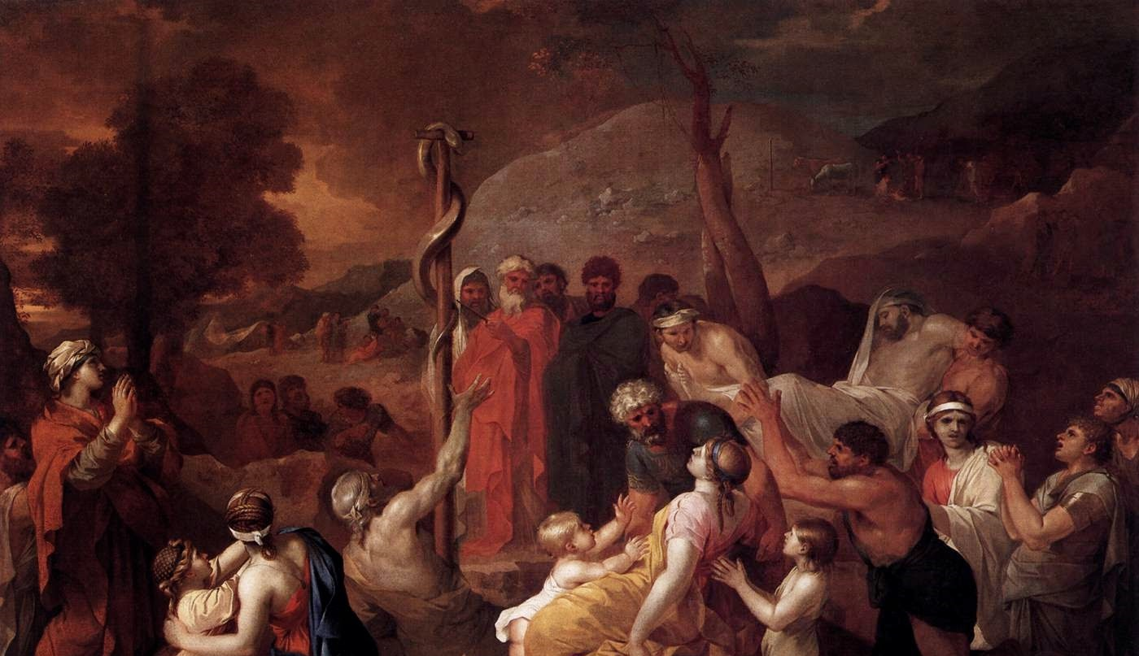
New Birth
The saving work of the Messiah
^{3:13} No one has ever gone to heaven and returned. But the Son of Man has come down from heaven. ¹⁴ And as Moses lifted up the bronze snake on a pole in the wilderness, so the Son of Man must be lifted up, ¹⁵ so that everyone who believes in him will have eternal life.

Slide 38
New Birth
The saving work of the Messiah
The snakes are a symbol of God’s judgement
The bronze serpent is a symbol of God’s salvation
^{3:13} No one has ever gone to heaven and returned. But the Son of Man has come down from heaven. ¹⁴ And as Moses lifted up the bronze snake on a pole in the wilderness, so the Son of Man must be lifted up, ¹⁵ so that everyone who believes in him will have eternal life.

Slide 39
New Birth
The saving work of the Messiah
Jesus is saying, “You need saved, Nicodemus.”
^{3:13} No one has ever gone to heaven and returned. But the Son of Man has come down from heaven. ¹⁴ And as Moses lifted up the bronze snake on a pole in the wilderness, so the Son of Man must be lifted up, ¹⁵ so that everyone who believes in him will have eternal life.

Slide 40
New Birth
All people are under God’s Judgement, but God has provided a way for salvation
Jesus is saying, “You need saved, Nicodemus.”
^{3:13} No one has ever gone to heaven and returned. But the Son of Man has come down from heaven. ¹⁴ And as Moses lifted up the bronze snake on a pole in the wilderness, so the Son of Man must be lifted up, ¹⁵ so that everyone who believes in him will have eternal life.

Slide 41
New Birth
All people are under God’s Judgement, but God has provided a way for salvation
^{3:13} No one has ever gone to heaven and returned. But the Son of Man has come down from heaven. ¹⁴ And as Moses lifted up the bronze snake on a pole in the wilderness, so the Son of Man must be lifted up, ¹⁵ so that everyone who believes in him will have eternal life.

Slide 42
New Birth
All people are under God’s Judgement, but God has provided a way for salvation
Salvation by grace through faith apart from works
“You can’t save yourself, but you can entrust yourself to me”
^{3:13} No one has ever gone to heaven and returned. But the Son of Man has come down from heaven. ¹⁴ And as Moses lifted up the bronze snake on a pole in the wilderness, so the Son of Man must be lifted up, ¹⁵ so that everyone who believes in him will have eternal life.

Slide 43
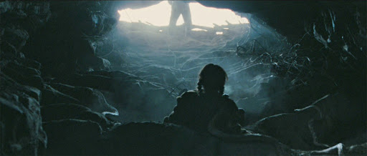
New Birth
All people are under God’s Judgement, but God has provided a way for salvation
Salvation by faith by grace through faith apart from works
^{3:13} No one has ever gone to heaven and returned. But the Son of Man has come down from heaven. ¹⁴ And as Moses lifted up the bronze snake on a pole in the wilderness, so the Son of Man must be lifted up, ¹⁵ so that everyone who believes in him will have eternal life.

Slide 44
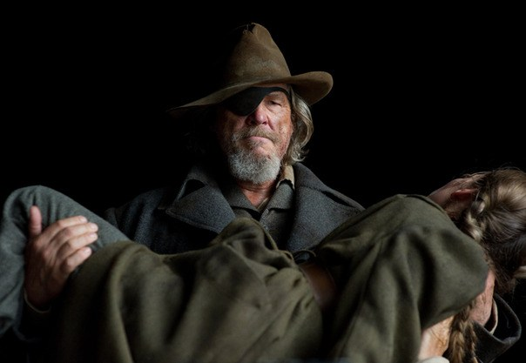
^{3:13} No one has ever gone to heaven and returned. But the Son of Man has come down from heaven. ¹⁴ And as Moses lifted up the bronze snake on a pole in the wilderness, so the Son of Man must be lifted up, ¹⁵ so that everyone who believes in him will have eternal life.

Slide 45
New Birth
^{3:16} “For this is how God loved the world: He gave his one and only Son, so that everyone who believes in him will not perish but have eternal life. ¹⁷ God sent his Son into the world not to judge the world, but to save the world through him.

Slide 46
New Birth
The new birth is offered in sacrificial love
^{3:16} “For this is how God loved the world: He gave his one and only Son, so that everyone who believes in him will not perish but have eternal life. ¹⁷ God sent his Son into the world not to judge the world, but to save the world through him.

Slide 47
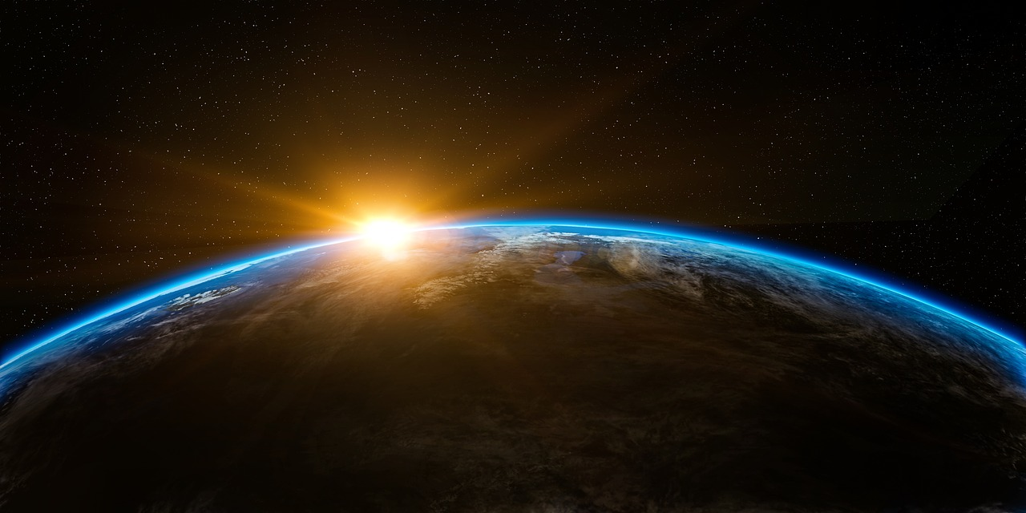
New Birth
The new birth is offered in sacrificial love
^{3:16} “For this is how God loved the world: He gave his one and only Son, so that everyone who believes in him will not perish but have eternal life. ¹⁷ God sent his Son into the world not to judge the world, but to save the world through him.

Slide 48
New Birth
The new birth is offered in sacrificial love
^{3:16} “For this is how God loved the world: He gave his one and only Son, so that everyone who believes in him will not perish but have eternal life. ¹⁷ God sent his Son into the world not to judge the world, but to save the world through him.

Slide 49
New Birth
The new birth is offered in sacrificial love
God does not want anyone to perish!
He wants us to be with Him forever
^{3:16} “For this is how God loved the world: He gave his one and only Son, so that everyone who believes in him will not perish but have eternal life. ¹⁷ God sent his Son into the world not to judge the world, but to save the world through him.

Slide 50
New Birth
The new birth is offered in sacrificial love
God does not want anyone to perish!
He wants us to be with Him forever
And he has made that possible at great personal cost
^{3:16} “For this is how God loved the world: He gave his one and only Son, so that everyone who believes in him will not perish but have eternal life. ¹⁷ God sent his Son into the world not to judge the world, but to save the world through him.

Slide 51
New Birth
The new birth is offered in sacrificial love
When we put our faith in Christ, we pass out of judgement
^{3:18} “There is no judgment against anyone who believes in him. But anyone who does not believe in him has already been judged for not believing in God’s one and only Son.

Slide 52
New Birth
The new birth is offered in sacrificial love
When we put our faith in Christ, we pass out of judgement
But if we refuse his offer of mercy, we choose to remain under his judgement
^{3:18} “There is no judgment against anyone who believes in him. But anyone who does not believe in him has already been judged for not believing in God’s one and only Son.

Slide 53
New Birth
Decisive and Polarizing
^{3:19} And the judgment is based on this fact: God’s light came into the world, but people loved the darkness more than the light, for their actions were evil. ²⁰ All who do evil hate the light and refuse to go near it for fear their sins will be exposed. ²¹ But those who do what is right come to the light so others can see that they are doing what God wants.”

Slide 54
New Birth
Decisive and Polarizing
^{3:16} “… so that everyone who believes in him will not perish but have eternal life.
God wants to save everyone
^{3:19} And the judgment is based on this fact: God’s light came into the world, but people loved the darkness more than the light, for their actions were evil. ²⁰ All who do evil hate the light and refuse to go near it for fear their sins will be exposed. ²¹ But those who do what is right come to the light so others can see that they are doing what God wants.”

Slide 55
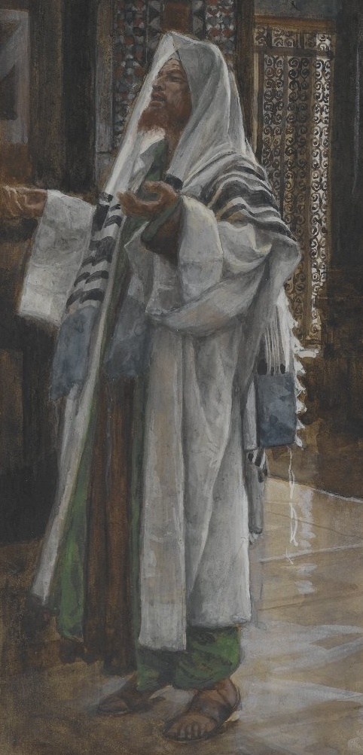
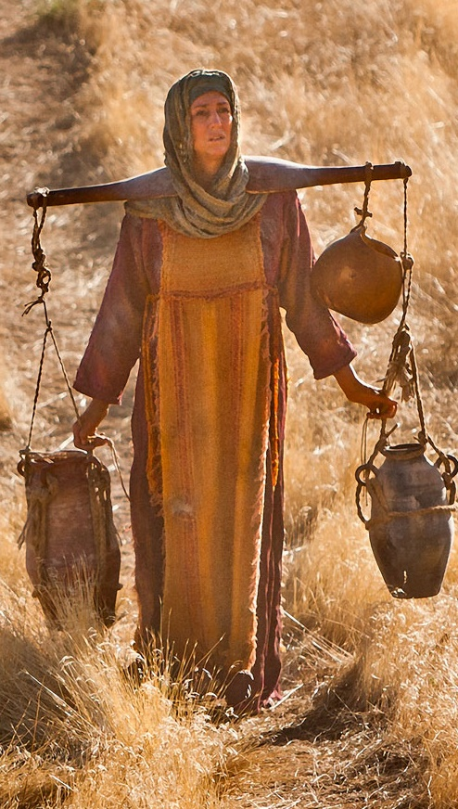
Nicodemus – John 3
Samaritan Woman – John 4
Jewish Man
Wealthy
Member of Sanhedrin
“Teacher of Israel”
Highly respected
Moral “righteousness”
Sought Jesus
INSIDER
Samaritan Woman
Probably not wealthy
Powerless
Alienated faction
Shame & disrepute
Obvious moral guilt
Evasive & cynical
OUTSIDER
“You need rescued!”

Slide 56
Nicodemus – John 3
Samaritan Woman – John 4
Struggled with Jesus’s offer
I’m not acceptable?
Struggled with Jesus’s offer
Am I really acceptable?

Slide 57
Nicodemus – John 3
Samaritan Woman – John 4
Struggled with Jesus’s offer
I’m not acceptable?
Struggled with Jesus’s offer
Am I really acceptable?
You know you’re out … right?
You can be in, y’know …
But you can be in
He’s leading them both to the gospel in love

Slide 58
Nicodemus – John 3
Samaritan Woman – John 4
Struggled with Jesus’s offer
I’m not acceptable?
Do I want helped?
Struggled with Jesus’s offer
Am I really acceptable?
Do I want helped?
The great equalizer

Slide 59
Nicodemus – John 3
Samaritan Woman – John 4
Outcome:
?????
Outcome:
Became a source of spiritual life to many

Slide 60
Nicodemus – John 3
Samaritan Woman – John 4
Outcome:
?????
Outcome:
Became a source of spiritual life to many
^{John 19:38} Now after these things Joseph of Arimathea, being a disciple of Jesus, but a secret one for fear of the Jews, requested of Pilate that he might take away the body of Jesus; and Pilate granted permission. So he came and took away His body. ³⁹ Nicodemus, who had first come to Him by night, also came, bringing a mixture of myrrh and aloes, about a hundred litras weight. ⁴⁰ So they took the body of Jesus and bound it in linen wrappings with the spices, as is the burial custom of the Jews.

