Slide 2
(Mark 10:13) People were bringing little children to Jesus for him to place his hands on them,
but the disciples rebuked them.

Slide 3
(Mark 10:14) When Jesus saw this, he was indignant.
He said to them, “Let the little children come to me, and do not hinder them,
for the kingdom of God belongs to such as these.”
¹⁵ Truly I tell you, anyone who will not receive the kingdom of God like a little child will never enter it.”

Slide 4
(Mark 10:16) And he took the children in his arms, placed his hands on them and blessed them.
What did Jesus see in kids?
Not their gullibility (1 Cor. 13:11; Eph. 4:14).
But their humility.
What did these kids see in Jesus?

Slide 5
(Mark 10:17) As Jesus started on his way, a man ran up to him and fell on his knees before him.
The man was a rich (Mk. 10:22) and “young” (Mt. 19:20) “ruler” (Lk. 18:18).
“Life is going good,
because I’m doing good.”

Slide 6
(Mark 10:17) As Jesus started on his way, a man ran up to him and fell on his knees before him.
“Good teacher,” he asked, “what must I do to inherit eternal life?”
(+) He’s sincerely seeking Jesus.
(+) He’s asking the most important question ever!
(-) His focus is on himself and his good deeds.
“I do… to inherit” (klēronomeō) is in the active voice.
“Whoever does not receive the kingdom of God like a child will not enter it at all” (v.15).

Slide 7
(Mark 10:18) “Why do you call me good?” Jesus answered. “No one is good—except God alone.”
Is Jesus denying that he’s God?
Actually, this argument backfires…
Jesus never denies that he’s “good” or “God.”
“Good teacher” isn’t in Jewish sources.
William Lane, The Gospel of Mark (Grand Rapids, MI: Wm. B. Eerdmans Publishing Co., 1974), p.365.
Leon Morris, Luke (Downers Grove, IL: InterVarsity Press, 1988), p.284.
Jesus is calling his view of “good” into question!

Slide 8
(Mark 10:19) “You know the commandments:
‘You shall not murder,
you shall not commit adultery,
you shall not steal,
you shall not give false testimony,
you shall not defraud,
honor your father and mother.’”

Slide 9
(Mark 10:19) “You know the commandments:
‘You shall not murder,
you shall not commit adultery,
you shall not steal,
you shall not give false testimony,
you shall not defraud,
honor your father and mother.’”
“I’m a good person…”
Murderer
Adulterer
Thief
Liar
Unloving

Slide 10
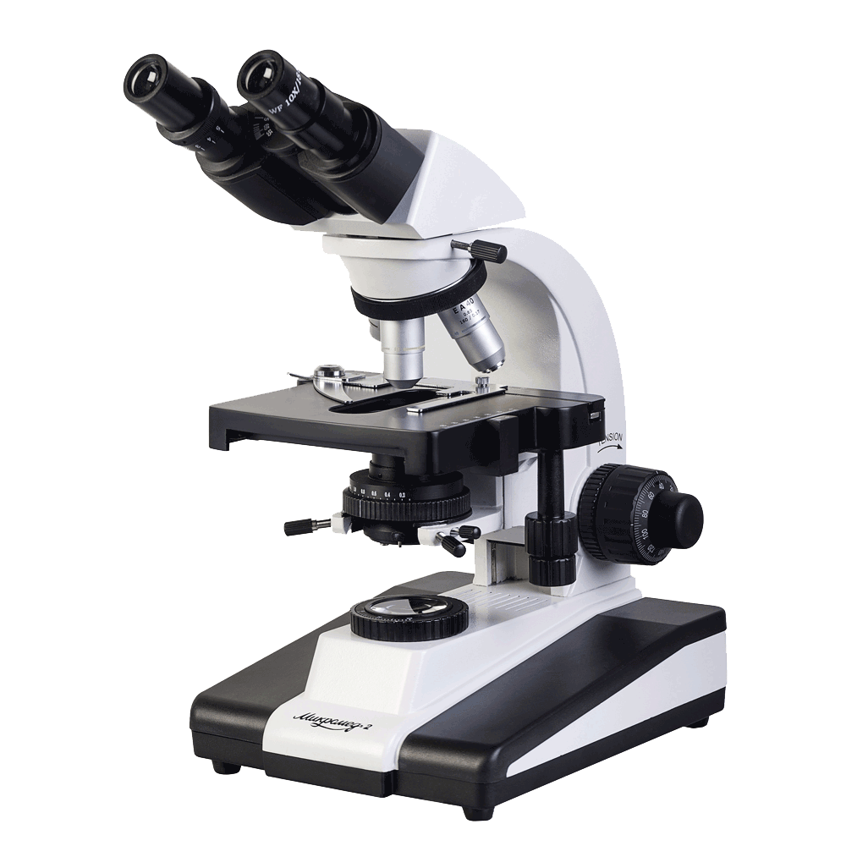
(Mark 10:20) “Teacher,” the man replied,
“I’ve obeyed all these commandments since I was young.
Really??

Slide 11
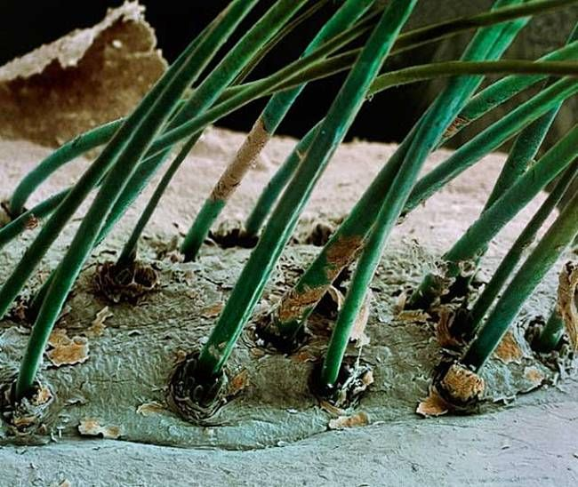

Slide 12
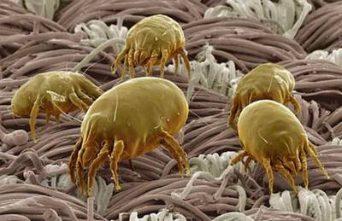

Slide 13
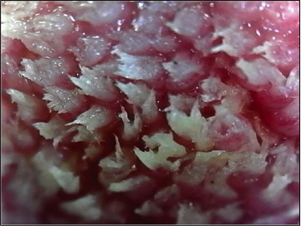

Slide 14
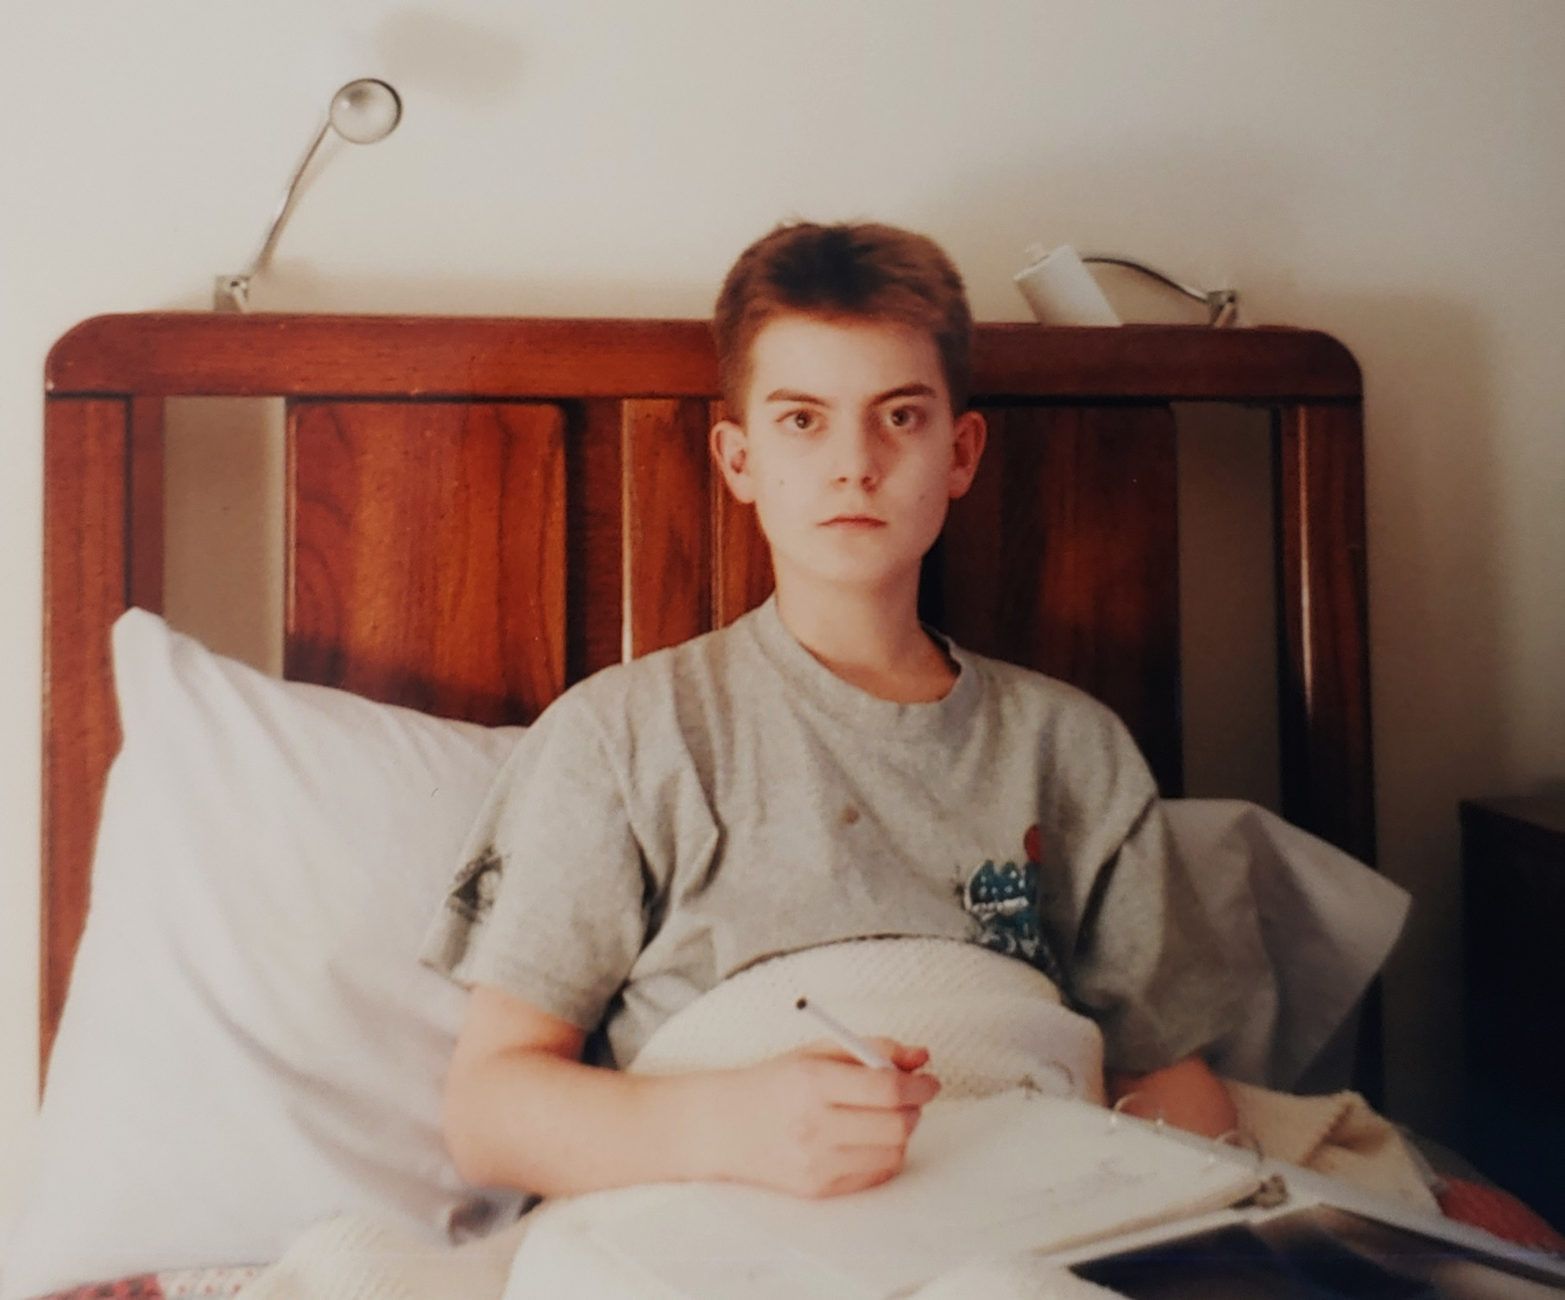

Slide 15
(Mark 10:20) “Teacher,” the man replied,
“I’ve obeyed all these commandments since I was young.
Really??

Slide 16
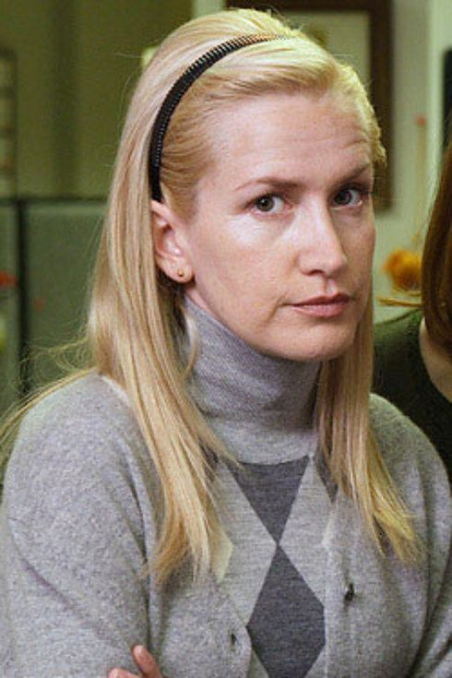
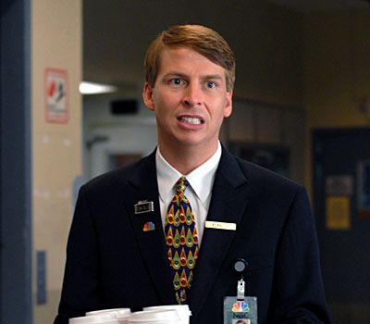
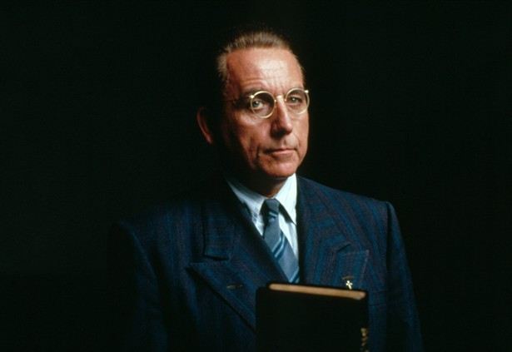

Slide 17
Greater than the Average?
“Eleanor Rigby” (Who wrote more?)
Lennon (70%) and McCartney (80%)
H. Davies, “Decoding ‘Eleanor Rigby,’” Slate, February 19, 2016.
Marriage: Percent of chores?
Consistently over 100%
Nicholas Epley, Mindwise (New York, Vintage Books, 2014), 93.
Students: Group work?
200%
Juliana Schroeder, “Who’s Really Doing the Work?” California Management Review 2017, Vol. 60(1), 91.
Contribution to academic articles?
205-261%
Eugene Caruso (et al.), “The Costs and Benefits of Undoing Egocentric Responsibility Assessments in Groups” Journal of Personality and Social Psychology, 2006, Vol. 91, No. 5, 857–871.

Slide 18
Greater than the Average?
Majority of students with intelligence
R. C. Wylie, The Self-Concept: Theory and Research on Selected Topics, vol. 2 (Lincoln: University of Nebraska Press, 1979).
Majority of managers with competence
L. Larwood and W. Whittaker, “Managerial Myopia: Self-Serving Biases in Organizational Planning,” Journal of Applied Psychology 62: 194-98 (1977).
90% of motorists with skill & safety
D. Walton and J. Bathurst, “An Exploration of the Perceptions of the Average Driver’s Speed Compared to Perceived Driver Safety and Driving Skill,” Accident Analysis and Prevention 30: 821-30 (1998).
94% of professors with teaching
P. Cross, “Not Can but Will College Teachers Be Improved?” New Directions for Higher Education 17: 1-15 (1977).
Majority of ppl think they’re less biased!
E. Pronin, “The Bias Blind Spot: Perceptions of Bias in Self Versus Others,” Personality and Social Psychology Bulletin 28: 369-81 (2002).
“Most of us appear to believe that we are more athletic, intelligent, organized, ethical, logical, interesting, fair-minded, and healthy
—not to mention more attractive—
than the average person.”
J. Kruger, “Lake Wobegon Be Gone! The ‘Below-Average Effect’ and the Egocentric Nature of Comparative Ability Judgments,” Journal of Personality and Social Psychology 77: 221-32 (1999).

Slide 19
Cindi May
(Psychology Prof at College of Charleston)
Cindy May, “Most People Consider Themselves to Be Morally Superior,” Scientific American (January 31, 2017).
When comparing ourselves versus other people, we tend to rate ourselves more highly on a host of positive measures,
including intelligence, ambition, friendliness, and modesty (ha!).

Slide 20
Cindi May
(Psychology Prof at College of Charleston)
Cindy May, “Most People Consider Themselves to Be Morally Superior,” Scientific American (January 31, 2017).
This finding is sometimes called the “self-enhancement” effect.
This self-enhancement effect is most profound for moral characteristics.

Slide 21
Cindi May
(Psychology Prof at College of Charleston)
Cindy May, “Most People Consider Themselves to Be Morally Superior,” Scientific American (January 31, 2017).
We are most irrational…
when we consider moral traits.

Slide 22
(Mark 10:20) “Teacher,” the man replied,
“I’ve obeyed all these commandments since I was young.
Really??

Slide 23
(Mark 10:21) Jesus looked at him and loved him.
“One thing you lack,” he said.
“Go, sell everything you have and give to the poor, and you will have treasure in heaven. Then come, follow me.”
Why this command?

Slide 24
Not know this
Not do this sometimes
Not intend to do this
Not do this better than others
Not make up for not doing this
Law
Love God will all your heart, mind, soul, and strength.
(Lk. 10:27) The man said, “You must love the LORD your God with all your heart, soul, strength, and mind and love your neighbor as yourself.”
²⁸ “Right!” Jesus told him.
“Do this and you will live!”

Slide 25
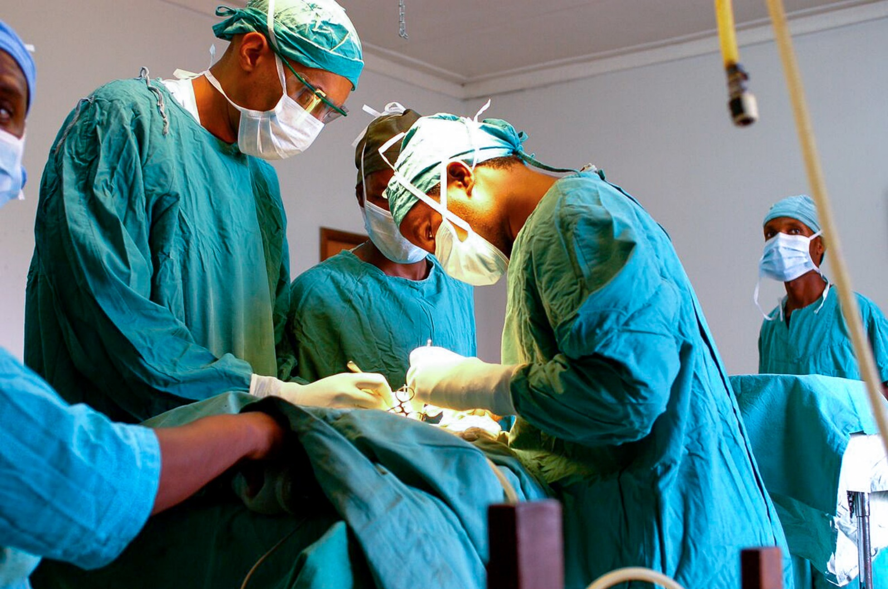
(Jas. 2:10) “Whoever keeps the whole law and yet stumbles in one point,
he has become guilty of all.”
(Gal. 3:10) Cursed is everyone who does not observe and obey
all the commands that are written in the Law.
Law
Love God will all your heart, mind, soul, and strength.
Perfectly keep the Law.

Slide 26
Law
Love God will all your heart, mind, soul, and strength.
Perfectly keep the Law.
Flawless moral character!
(Mt. 5:48) Jesus said, “You are to be perfect, even as your Father in heaven is perfect.”

Slide 27
Law
Love God will all your heart, mind, soul, and strength.
Perfectly keep the Law.
Flawless moral character!
Grace!
(Rom. 3:23) Everyone has sinned.
We all fall short of God’s glorious standard.

Slide 28
Law
Love God will all your heart, mind, soul, and strength.
Perfectly keep the Law.
Flawless moral character!
Grace!
(Rom. 3:24) Yet God, in his grace, freely makes us right in his sight.

Slide 29
Law
Love God will all your heart, mind, soul, and strength.
Perfectly keep the Law.
Flawless moral character!
Grace!
(Rom. 3:24) Yet God, in his grace, freely makes us right in his sight. God did this through Christ Jesus when he freed us from the penalty for our sins.

Slide 30
Law
Love God will all your heart, mind, soul, and strength.
Perfectly keep the Law.
Flawless moral character!
Grace!
(Rom. 3:25) God presented Jesus as the sacrifice for sin.

Slide 31
Law
Love God will all your heart, mind, soul, and strength.
Perfectly keep the Law.
Flawless moral character!
Grace!
(Rom. 3:25) God presented Jesus as the sacrifice for sin. People are made right with God when they believe that Jesus sacrificed his life.

Slide 32
(Mark 10:21) Jesus looked at him and loved him.
“One thing you lack,” he said.
“Go, sell everything you have and give to the poor, and you will have treasure in heaven. Then come, follow me.”
Why this command?
This man had everything…
And he needs to come to Jesus with nothing!
“…like a little child” (v.15).

Slide 33
(Mark 10:22) At this the man’s face fell.
He went away grieving,
because he had great wealth.

Slide 34
(Mark 10:23) Jesus looked around and said to his disciples,
“How hard it is for the rich to enter the kingdom of God!”

Slide 35
(Mark 10:24) The disciples were amazed at his words. But Jesus said again, “Children, how hard it is to enter the kingdom of God!”

Slide 36
(Mark 10:25) “It is easier for a camel to go through the eye of a needle
than for someone who is rich to enter the kingdom of God.”

Slide 37
(Mark 10:26) The disciples were even more amazed, and said to each other,
“Who then can be saved?”
²⁷ Jesus looked at them and said,
“With humans this is impossible,
but not with God;
all things are possible with God.”

Slide 38
(Mark 10:28) Then Peter spoke up,
“We have left everything to follow you!”

Slide 39
(Mark 10:29-30) Jesus said, “Truly I say to you, there is no one who has left house or brothers or sisters or mother or father or children or farms, for My sake and for the gospel’s sake,

Slide 40
(Mark 10:29-30) Jesus said, “Truly I say to you, there is no one who has left house or brothers or sisters or mother or father or children or farms, for My sake and for the gospel’s sake, but that he will receive a hundred times as much now in the present age, houses and brothers and sisters and mothers and children and farms, along with persecutions; and in the age to come, eternal life.
Never worry about outgiving God!

Slide 41
(Mark 10:31) “But many who are first will be last, and the last first.”

Slide 42
Two Choices
(1) Come to God like a rich ruler.
(2) Come to God like a child.

Slide 43
Two Choices
(1) Love God perfectly…
(2) Be loved by God perfectly!

