Slide 2
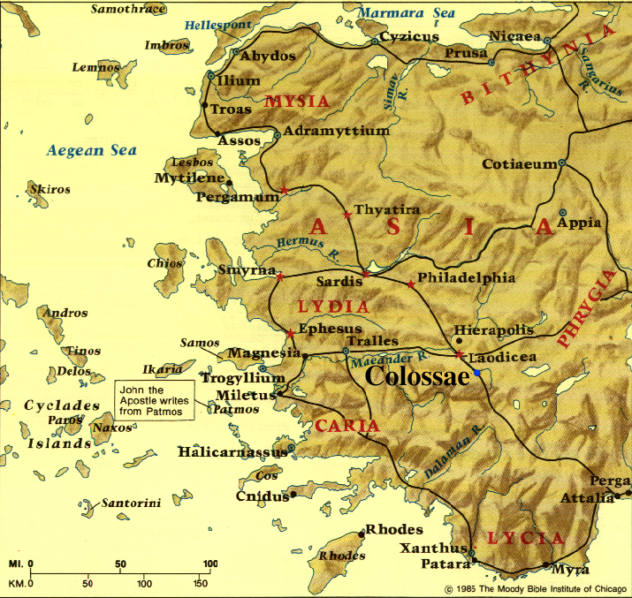

Slide 3
Colossians 3:1-4 The Path to Spiritual Maturity – Part 1
Spiritual maturity starts with cultivating a mental focus on the treasures of God’s great love for you
^{Colossians 3:1} Therefore if you have been raised up with Christ, keep seeking the things above, where Christ is, seated at the right hand of God. ² Set your mind on the things above, not on the things that are on earth. ³ For you have died and your life is hidden with Christ in God. ⁴ When Christ, who is our life, is revealed, then you also will be revealed with Him in glory.

Slide 4
Colossians 3:5-17 The Path to Spiritual Maturity – Part 2
Spiritual maturity starts with cultivating a mental focus on the treasures of God’s great love for you
Spiritual maturity proceeds by embracing a lifestyle of giving God’s love to others (including God)

Slide 5
Colossians 3:5-17 The Path to Spiritual Maturity – Part 2
Spiritual maturity starts with cultivating a mental focus on the treasures of God’s great love for you
Spiritual maturity proceeds by embracing a lifestyle of giving God’s love to others (including God)
GOD
ME
GOD & OTHERS
RECEIVE GOD’S LOVE
GIVE GOD’S LOVE

Slide 6
Colossians 3:5-17 The Path to Spiritual Maturity – Part 2
^{3:12} So, as those who have been chosen of God, holy and beloved . . . ¹⁴ . . . put on love . . .
GOD
ME
GOD & OTHERS
RECEIVE GOD’S LOVE
GIVE GOD’S LOVE

Slide 7
Colossians 3:5-17 The Path to Spiritual Maturity – Part 2
^{3:12} So, as those who have been chosen of God, holy and beloved . . . ¹⁴ . . . put on love . . .
GOD
ME
GOD & OTHERS
RECEIVE GOD’S LOVE
GIVE GOD’S LOVE

Slide 8
Colossians 3:5-17 The Path to Spiritual Maturity – Part 2
PUT ON A LIFESTYLE OF SELF-GIVING LOVE

Slide 9
Colossians 3:5-17 The Path to Spiritual Maturity – Part 2
PUT ASIDE A SELF-CENTERED LIFESTYLE
PUT ON A LIFESTYLE OF SELF-GIVING LOVE

Slide 10
Colossians 3:5-17 The Path to Spiritual Maturity – Part 2
PUT ASIDE A SELF-CENTERED LIFESTYLE
^{3:5} Therefore consider the members of your earthly body as dead to immorality, impurity, passion, evil desire, and greed, which amounts to idolatry. ⁶ For it is because of these things that the wrath of God will come upon the sons of disobedience, ⁷ and in them you also once walked, when you were living in them. ⁸ But now you also, put them all aside: anger, wrath, malice, slander, and abusive speech from your mouth. ⁹ Do not lie to one another, since you laid aside the old self with its evil practices, ¹⁰ and have put on the new self who is being renewed to a true knowledge according to the image of the One who created him—

Slide 11
Colossians 3:5-17 The Path to Spiritual Maturity – Part 2
PUT ASIDE A SELF-CENTERED LIFESTYLE
^{3:5 (NIV)} Put to death, therefore, whatever belongs to your earthly nature . . . since you laid aside the old self . . .

Slide 12
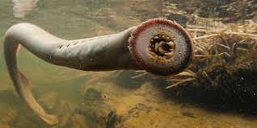
Colossians 3:5-17 The Path to Spiritual Maturity – Part 2
PUT ASIDE A SELF-CENTERED LIFESTYLE
Behaviors that originate from a fallen, ego-centric nature & identity
^{3:5 (NIV)} Put to death, therefore, whatever belongs to your earthly nature . . . since you laid aside the old self . . .

Slide 13
Colossians 3:5-17 The Path to Spiritual Maturity – Part 2
PUT ASIDE A SELF-CENTERED LIFESTYLE
Sexual taking
^{3:5} . . . immorality, impurity, passion . . .

Slide 14
Colossians 3:5-17 The Path to Spiritual Maturity – Part 2
PUT ASIDE A SELF-CENTERED LIFESTYLE
Sexual taking
Materialistic greed
^{3:5} . . . greed, which amounts to idolatry . . .

Slide 15
Colossians 3:5-17 The Path to Spiritual Maturity – Part 2
PUT ASIDE A SELF-CENTERED LIFESTYLE
Sexual taking
Materialistic greed
Relational demandingness & deception
^{3:8} . . . anger, wrath, malice, slander, and abusive speech . . . ⁹ Do not lie to one another . . .

Slide 16
Colossians 3:5-17 The Path to Spiritual Maturity – Part 2
PUT ASIDE A SELF-CENTERED LIFESTYLE: WHY?

Slide 17
Colossians 3:5-17 The Path to Spiritual Maturity – Part 2
PUT ASIDE A SELF-CENTERED LIFESTYLE: WHY?
Because this whole project is headed for God’s judgment
^{3:6} For it is because of these things that the wrath of God will come upon the sons of disobedience . . .

Slide 18
Colossians 3:5-17 The Path to Spiritual Maturity – Part 2
PUT ASIDE A SELF-CENTERED LIFESTYLE: WHY?
Because we have already tried this way of life - & it didn’t fulfill us
^{3:7} . . . and in them you also once walked, when you were living in them . . . (see also Rom. 6:21)

Slide 19
Colossians 3:5-17 The Path to Spiritual Maturity – Part 2
PUT ASIDE A SELF-CENTERED LIFESTYLE: WHY?
Because it no longer fits who we now are
^{3:8} But now you also, put them all aside . . . ⁹ since you laid aside the old self . . . ¹⁰ and have put on the new self . . .

Slide 20
Colossians 3:5-17 The Path to Spiritual Maturity – Part 2
PUT ASIDE A SELF-CENTERED LIFESTYLE: WHY?
Because we now have access to God’s changing power
^{3:10} . . . and have put on the new self who is being renewed . . . according to the image of the One who created him . . .

Slide 21
Colossians 3:5-17 The Path to Spiritual Maturity – Part 2
PUT ASIDE A SELF-CENTERED LIFESTYLE: WHY?
Because this whole project is headed for God’s judgment
Because we have already tried this way of life - & it didn’t fulfill us
Because it no longer fits who we now are
Because we now have access to God’s changing power

Slide 22
Colossians 3:5-17 The Path to Spiritual Maturity – Part 2
In order to truly “put aside,” we must also “put on!”
⁸ But now you also, put them all aside: anger, wrath, malice, slander, and abusive speech from your mouth . . . . ¹² So, as those who have been chosen of God, holy and beloved, put on a heart of compassion, kindness, humility, gentleness and patience . . . ¹⁴ Beyond all these things put on love . . .

Slide 23
Colossians 3:5-17 The Path to Spiritual Maturity – Part 2
In order to truly “put aside,” we must also “put on!” (“THE EXPULSIVE POWER OF A NEW AFFECTION”)
⁸ But now you also, put them all aside: anger, wrath, malice, slander, and abusive speech from your mouth . . . . ¹² So, as those who have been chosen of God, holy and beloved, put on a heart of compassion, kindness, humility, gentleness and patience . . . ¹⁴ Beyond all these things put on love . . .

Slide 24
Colossians 3:5-17 The Path to Spiritual Maturity – Part 2
PUT ON A LIFESTYLE OF SELF-GIVING LOVE
Christ-like love expresses itself in 3 directions:

Slide 25
Colossians 3:5-17 The Path to Spiritual Maturity – Part 2
PUT ON A LIFESTYLE OF SELF-GIVING LOVE
Christ-like love expresses itself in 3 directions:
UPWARD: to God by cultivating thankfulness to Him (3:15b,16b,17b)

Slide 26
Colossians 3:5-17 The Path to Spiritual Maturity – Part 2
PUT ON A LIFESTYLE OF SELF-GIVING LOVE
Christ-like love expresses itself in 3 directions:
UPWARD: to God by cultivating thankfulness to Him (3:15b,16b,17b)
INWARD: to Christian brothers & sisters by building unified relationships with them (3:12-16)

Slide 27
Colossians 3:5-17 The Path to Spiritual Maturity – Part 2
PUT ON A LIFESTYLE OF SELF-GIVING LOVE
Christ-like love expresses itself in 3 directions:
UPWARD: to God by cultivating thankfulness to Him (3:15b,16b,17b)
INWARD: to Christian brothers & sisters by building unified relationships with them (3:12-16)
OUTWARD: to non-Christians by showing & sharing God’s love with them (3:17 – 4:6)

Slide 28
NEXT WEEK:
Colossians 3:15-17 Keys to Authentic Spirituality – Part 3 – LOVING GOD THROUGH THANKFULNESS

