Slide 2
RECAP
Moses faced public humiliation and threats from Pharaoh.
Moses experienced abandonment and threats from the leaders of Israel.
But God stands with Moses!

Slide 3
(Ex. 7:1) The Lord said to Moses,
“See, I have made you like God to Pharaoh, and your brother Aaron will be your prophet.
² You are to say everything I command you, and your brother Aaron is to tell Pharaoh to let the Israelites go out of his country.”

Slide 4
(Ex. 7:3) “But I will harden Pharaoh’s heart, and though I multiply my signs and wonders in Egypt, he will not listen to you.”
“Harden” (chazaq) Pharaoh?
This means to “strengthen.”
Outside Exodus 4-14, it is rendered “encourage,” “repair,” “maintain,” or “strengthen.”

Slide 5
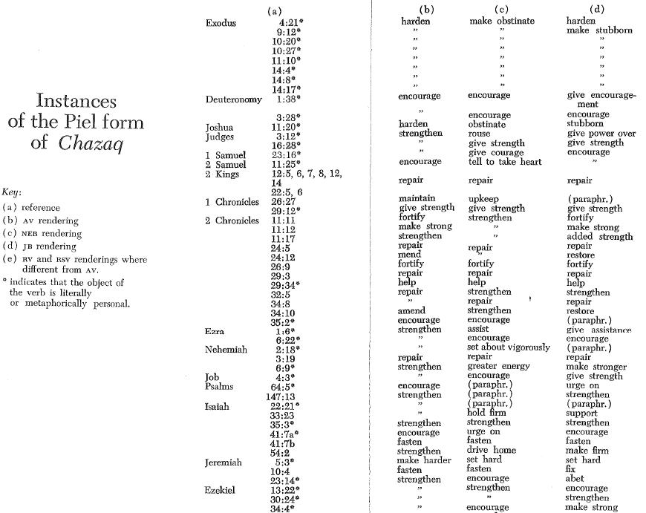
Exodus
Always translated “harden.”
Almost never translated “harden”!
Rest of the OT

Slide 6
(Ex. 7:3) “But I will harden Pharaoh’s heart, and though I multiply my signs and wonders in Egypt, he will not listen to you.”
“Harden” (chazaq) Pharaoh?
This means to “strengthen.”
Outside Exodus 4-14, it is rendered “encourage,” “repair,” “maintain,” or “strengthen.”
Pharaoh strengthened his heart first.
Exodus 7:13; 8:15, 19; 8:32; 9:7, 34-35
God doesn’t act until Exodus 9:12.

Slide 7
(Ex. 7:4) “Then I will lay my hand on Egypt and with mighty acts of judgment I will bring out my divisions, my people the Israelites.
⁵ And the Egyptians will know that I am the Lord when I stretch out my hand against Egypt and bring the Israelites out of it.”

Slide 8
(Ex. 7:4) “Then I will lay my hand on Egypt and with mighty acts of judgment I will bring out my divisions, my people the Israelites.
⁵ And the Egyptians will know that I am the Lord when I stretch out my hand against Egypt and bring the Israelites out of it.”
Why the Ten Plagues?
(1) Dispense justice on Egypt.
Infanticide (Ex. 1:22), multi-generational slavery (Gen. 15:13), and beatings (Ex. 5:14-16)
(2) Expose the Egyptian gods.
Exodus 12:12; Numbers 33:4

Slide 9
(Ex. 7:4) “Then I will lay my hand on Egypt and with mighty acts of judgment I will bring out my divisions, my people the Israelites.
⁵ And the Egyptians will know that I am the Lord when I stretch out my hand against Egypt and bring the Israelites out of it.”
(Ex. 12:12) I will execute judgment against all the gods of Egypt, for I am the LORD!
(Num. 33:4) The LORD had defeated the gods of Egypt that night with great acts of judgment!
Why the Ten Plagues?
(1) Dispense justice on Egypt.
Infanticide (Ex. 1:22), multi-generational slavery (Gen. 15:13), and beatings (Ex. 5:14-16)
(2) Expose the Egyptian gods.
Exodus 12:12; Numbers 33:4

Slide 10
(Ex. 7:4) “Then I will lay my hand on Egypt and with mighty acts of judgment I will bring out my divisions, my people the Israelites.
⁵ And the Egyptians will know that I am the Lord when I stretch out my hand against Egypt and bring the Israelites out of it.”
(Ex. 14:31) When the people of Israel saw the mighty power that the LORD had unleashed against the Egyptians…
They put their faith in the LORD and Moses.
(Ex. 12:38) A “mixed multitude” escaped Egypt.
Why the Ten Plagues?
(1) Dispense justice on Egypt.
Infanticide (Ex. 1:22), multi-generational slavery (Gen. 15:13), and beatings (Ex. 5:14-16)
(2) Expose the Egyptian gods.
Exodus 12:12; Numbers 33:4
(3) Bring many people to faith!
Israelites (Ex. 10:2; 14:31; 2 Sam. 7:23)
Egyptians (Ex. 9:19-21; 12:38, 48)
Jethro (Ex. 18:11) and Rahab (Josh. 2:9-11)

Slide 11
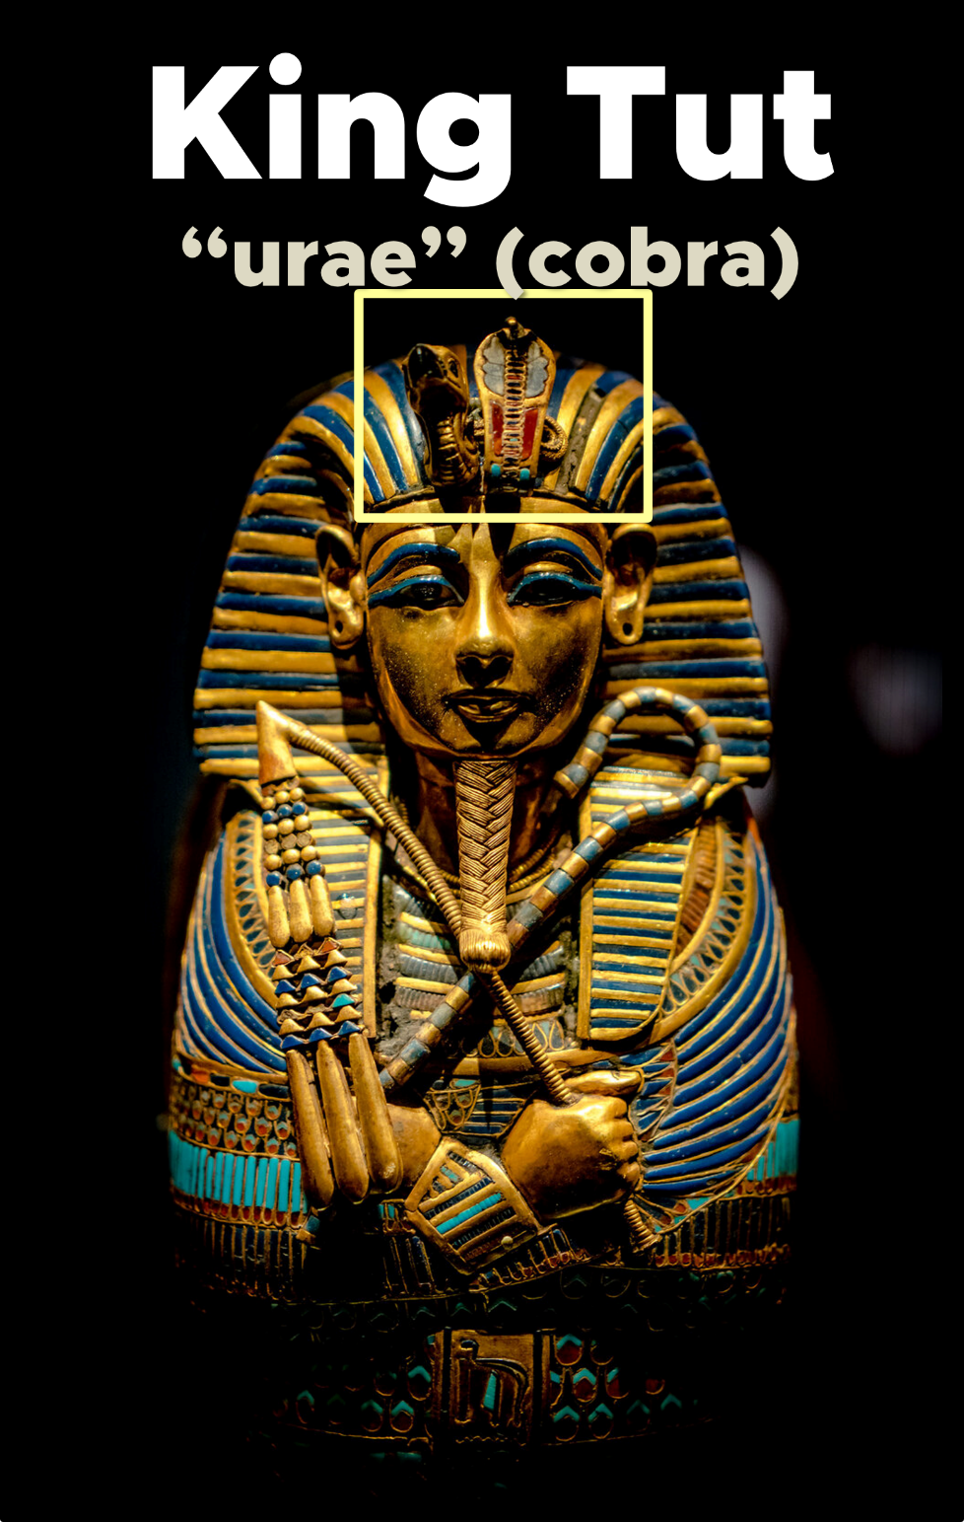
(Ex. 7:10) So Moses and Aaron went to Pharaoh and did just as the Lord commanded.
Aaron threw his staff down in front of Pharaoh and his officials,
and it became a snake.
“The cobra or ‘urae’ was a symbol of ruling power…
To overcome the cobra symbol
is to overcome the power of pharaoh.”
Livingston, David P. “The Plagues And The Exodus.” The Bible and Spade, 4:1. (Winter 1991).

Slide 12
(Ex. 7:11) Pharaoh then summoned wise men and sorcerers,
and the Egyptian magicians also did the same things by their secret arts.
Satan is a supernatural agent who can bring:
“fire… from heaven” (Job 1:16)
“great wind” (Job 1:19)
“boils” (Job 2:7).

Slide 13
(Ex. 7:11) Pharaoh then summoned wise men and sorcerers,
and the Egyptian magicians also did the same things by their secret arts.
¹² But Aaron’s staff swallowed up their staffs.

Slide 14
(Ex. 7:13) Yet Pharaoh’s heart became hard and he would not listen to them, just as the Lord had said.

Slide 15
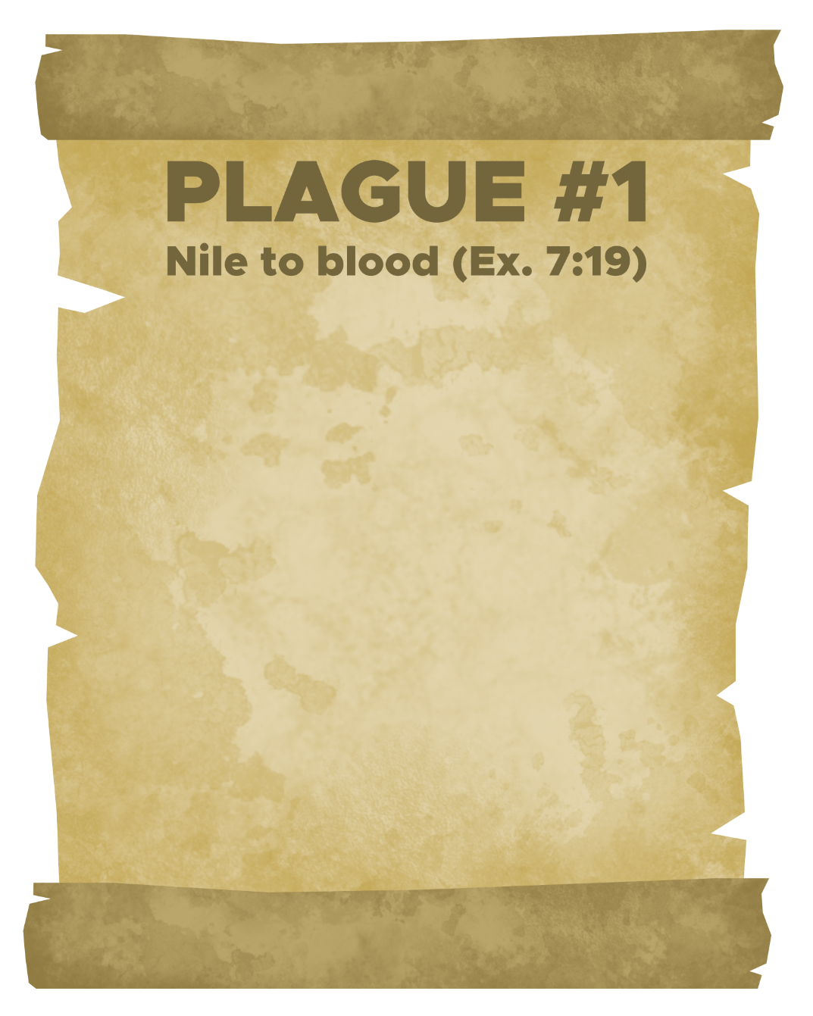
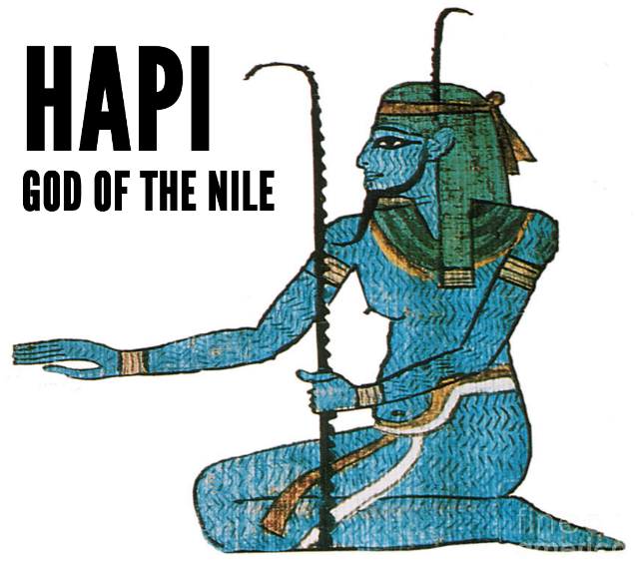
(Ex. 7:14) The Lord said to Moses,
“Pharaoh’s heart is unyielding. He refuses to let the people go.
¹⁵ Go to Pharaoh in the morning as he goes out to the river. Confront him on the bank of the Nile River.”
This river had drowned the Hebrew infant boys (Ex. 1:16, 22).

Slide 16
(Ex. 7:19) The Lord said to Moses,
“Take your staff and stretch out your hand over the waters of Egypt… and they will turn to blood. Blood will be everywhere in Egypt, even in vessels of wood and stone.”
This river had drowned the Hebrew infant boys (Ex. 1:16, 22).

Slide 17
(Ex. 7:20) So Moses raised his staff in the presence of Pharaoh and his officials and struck the water of the Nile, and all the water was changed into blood.
²¹ The fish in the Nile died, and the river smelled so bad that the Egyptians could not drink its water. Blood was everywhere in Egypt.
This river had drowned the Hebrew infant boys (Ex. 1:16, 22).

Slide 18
(Ex. 7:22) But the Egyptian magicians did the same things by their secret arts.
This river had drowned the Hebrew infant boys (Ex. 1:16, 22).
The real question:
“Why not turn the blood back into water??”

Slide 19
(Ex. 7:22) But Pharaoh would not listen to Moses and Aaron, just as the Lord had said.
²³ Instead, he turned and went into his palace, and did not take even this to heart.
Seven days passed…

Slide 20
(Ex. 8:1) The Lord said to Moses,
“Let my people go.
² If you refuse to let them go, I will send a plague of frogs on your whole country.”

Slide 21
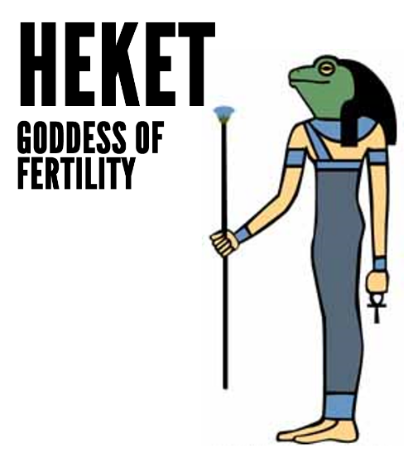
(Ex. 8:3) The Nile will teem with frogs.
They will come up into your palace and your bedroom and onto your bed, and into your ovens and kneading troughs.
“Teem” (šrṣ) earlier refers to the “teeming” of the Hebrews (Ex. 1:7).

Slide 22
(Ex. 8:6) And so, the frogs came up and covered the land.
⁷ But the magicians did the same things by their secret arts. They also made frogs come up on the land of Egypt.
“Teem” (šrṣ) earlier refers to the “teeming” of the Hebrews (Ex. 1:7).
Again, the real question:
“Why not get rid of the frogs??”

Slide 23
(Ex. 8:8) Pharaoh summoned Moses and Aaron and said,
“Pray to the Lord to take the frogs away from me and my people,
and I will let your people go to offer sacrifices to the Lord.”
“Teem” (šrṣ) earlier refers to the “teeming” of the Hebrews (Ex. 1:7).

Slide 24
(Ex. 8:12) After Moses and Aaron left Pharaoh, Moses cried out to the Lord about the frogs he had brought on Pharaoh.
¹³ And the Lord did what Moses asked. The frogs died in the houses, in the courtyards and in the fields.

Slide 25
(Ex. 8:14) They were piled into heaps, and the land reeked of them.
¹⁵ But when Pharaoh saw that there was relief from the frogs,
he hardened his heart and would not listen to Moses and Aaron, just as the Lord had said.

Slide 26
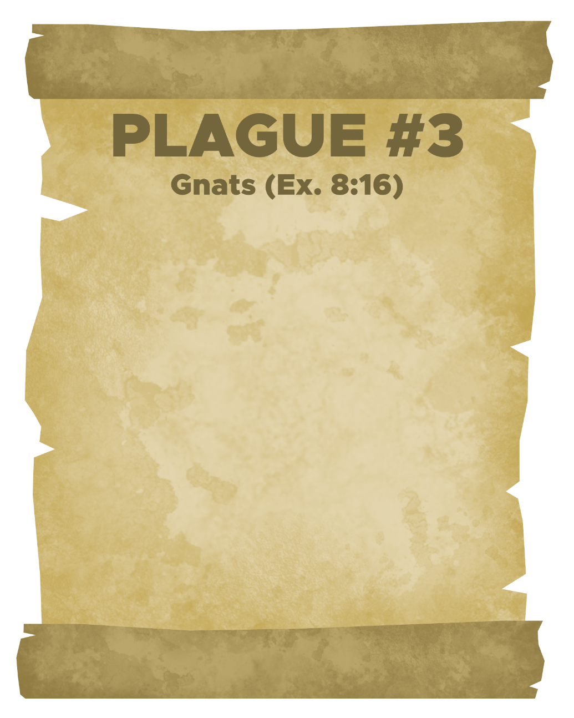
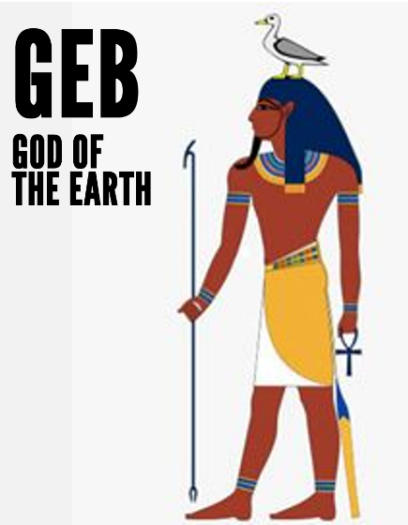
(Ex. 8:16) The Lord said to Moses,
“Tell Aaron, ‘Stretch out your staff and strike the dust of the ground,’ and throughout the land of Egypt the dust will become gnats.”
“Gnats” (kinnı̂m) refers to “virtually any two-winged biting insects, including mosquitoes.”
Douglas K. Stuart, Exodus, vol. 2, The New American Commentary (Nashville: Broadman & Holman Publishers, 2006), 211.

Slide 27
(Ex. 8:17) When Aaron stretched out his hand with the staff and struck the dust of the ground, gnats came on people and animals.
All the dust throughout the land of Egypt became gnats.
¹⁸ But when the magicians tried to produce gnats by their secret arts,
they could not.

Slide 28
(Ex. 8:19) The magicians said to Pharaoh,
“This is the finger of God.”
But Pharaoh’s heart was hard and he would not listen, just as the Lord had said.

Slide 29
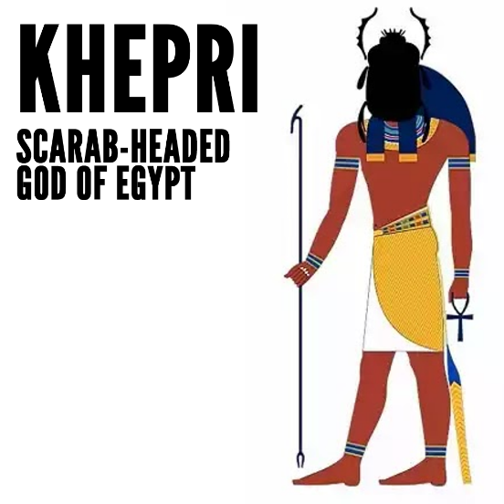
(Ex. 8:20) Then the Lord said to Moses, “Get up early in the morning and confront Pharaoh.
²¹ Tell him, ‘If you do not let my people go, I will send swarms of flies on you and your officials, on your people and into your houses.
The houses of the Egyptians will be full of flies. Even the ground will be covered with them.’”

Slide 30
(Ex. 8:22) “But on that day I will deal differently with the land of Goshen, where my people live.
No swarms of flies will be there, so that you will know that I, the Lord, am in this land.”

Slide 31
(Ex. 8:24) And the Lord did this.
Throughout Egypt the land was ruined by the flies.
²⁵ Then Pharaoh summoned Moses and Aaron and said,
“Go, sacrifice to your God
here in the land.”
Bargaining!

Slide 32
(Ex. 8:26) But Moses said, “No, that would not be right…”
²⁸ Pharaoh said, “I will let you go to offer sacrifices to the Lord your God in the wilderness,
but you must not go far.
Now pray for me.”

Slide 33
(Ex. 8:29) Moses answered,
“As soon as I leave you, I will pray to the Lord, and tomorrow the flies will leave Pharaoh and his officials and his people.
Only let Pharaoh be sure that he does not act deceitfully again by not letting the people go to offer sacrifices to the Lord.”

Slide 34
(Ex. 8:30) Then Moses left Pharaoh and prayed to the Lord, and not a fly remained.
³² But this time also
Pharaoh hardened his heart and would not let the people go.

Slide 35
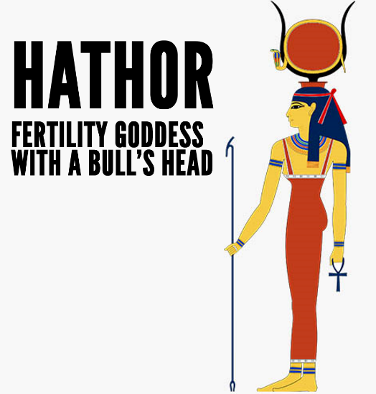
(Ex. 9:1) Then the Lord said to Moses,
“Go to Pharaoh and say to him,
² ‘If you refuse to let my people go,
³ the hand of the Lord will bring a terrible plague on your livestock in the field—on your horses, donkeys and camels and on your cattle, sheep and goats.

Slide 36
(Ex. 9:4) “But the Lord will make a distinction between the livestock of Israel and that of Egypt, so that no animal belonging to the Israelites will die.”

Slide 37
(Ex. 9:6) The next day the Lord did it:
All the livestock of the Egyptians died,
but not one animal belonging to the Israelites died.

Slide 38
(Ex. 9:7) Pharaoh investigated and found that not even one of the animals of the Israelites had died.
Yet his heart was unyielding and he would not let the people go.

Slide 39
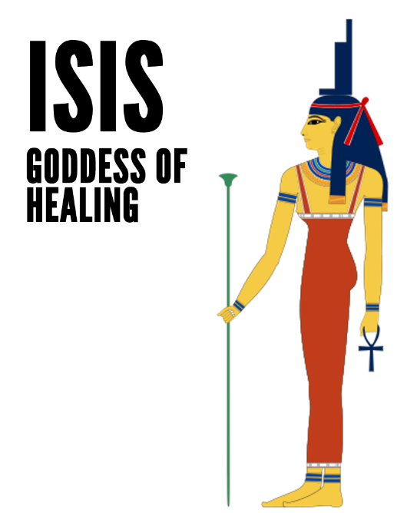
(Ex. 9:8) Then the Lord said,
“Take handfuls of soot from a brick kiln and have Moses toss it into the air in the presence of Pharaoh.
⁹ Festering boils will break out on people and animals throughout the land.”
Hebrew slaves used these furnaces to make bricks for Pharaoh!

Slide 40
(Ex. 9:11) The magicians could not stand before Moses because of the boils that were on them and on all the Egyptians.
¹² But the Lord hardened Pharaoh’s heart and he would not listen to Moses and Aaron.
Hebrew slaves used these furnaces to make bricks for Pharaoh!

Slide 41
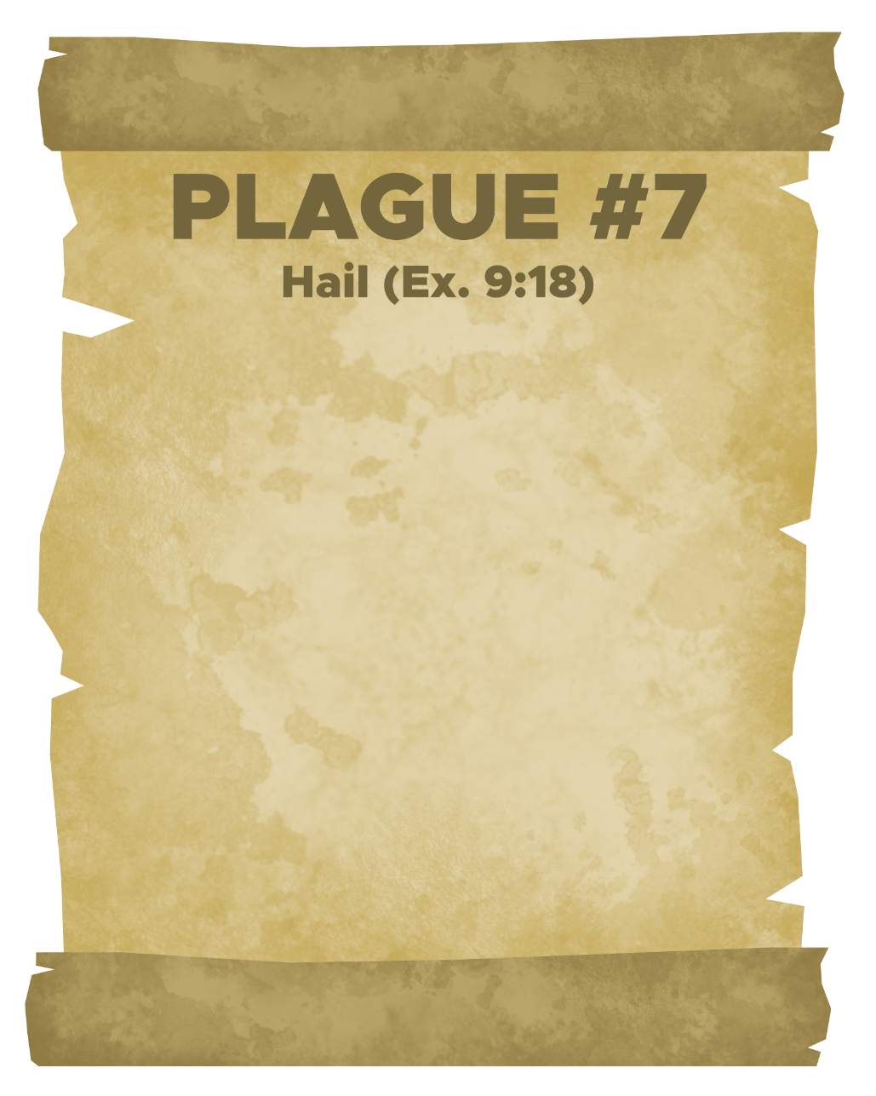
(Ex. 9:17) Moses told Pharaoh,
“You still set yourself against my people and will not let them go.
¹⁸ Therefore, at this time tomorrow
I will send the worst hailstorm that has ever fallen on Egypt, from the day it was founded till now.”

Slide 42
(Ex. 9:19) “Give an order now to bring your livestock and everything you have in the field to a place of shelter.
The hail will fall on every person and animal that has not been brought in and is still out in the field, and they will die.”

Slide 43
(Ex. 9:20) Those officials of Pharaoh who feared the word of the Lord hurried to bring their slaves and their livestock inside.
²¹ But those who ignored the word of the Lord left their slaves and livestock in the field.

Slide 44
(Ex. 9:23) When Moses stretched out his staff toward the sky, the Lord sent thunder and hail, and lightning flashed down to the ground.

Slide 45
(Ex. 9:25) Throughout Egypt hail struck everything in the fields—both people and animals.
It beat down everything growing in the fields and stripped every tree.
²⁶ The only place it did not hail was the land of Goshen, where the Israelites were.

Slide 46
(Ex. 9:27) Then Pharaoh summoned Moses and Aaron.
“This time I have sinned,” he said.
“The Lord is in the right, and I and my people are in the wrong.
²⁸ Pray to the Lord, for we have had enough thunder and hail.
I will let you go.
You don’t have to stay any longer.”

Slide 47
(Ex. 9:29) Moses replied,
“I will spread out my hands in prayer to the Lord.
³⁰ But I know that you and your officials still do not fear the Lord God.”

Slide 48
(Ex. 9:33) Moses spread out his hands toward the Lord, and the thunder and hail stopped.
³⁴ When Pharaoh saw that the rain and hail and thunder had stopped,
he and his officials hardened their hearts.

Slide 49
(Ex. 10:3) Moses and Aaron went to Pharaoh and said to him,
“This is what the Lord says,
‘How long will you refuse to humble yourself before me? Let my people go, so that they may worship me.’”

Slide 50
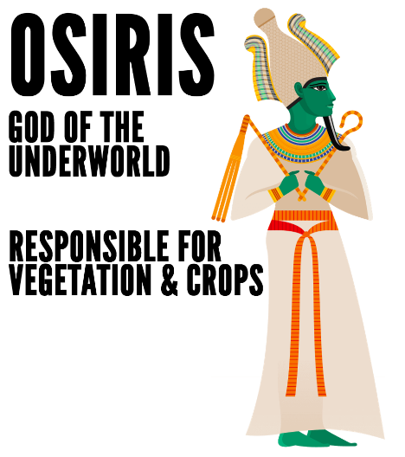
(Ex. 10:4) “If you refuse
I will bring locusts into your country tomorrow.
⁵ They will cover the face of the ground so that it cannot be seen.
They will devour what little you have left after the hail.”

Slide 51
(Ex. 10:7) Pharaoh’s officials said,
“Let the people go. Do you not yet realize that Egypt is ruined?”
⁸ Then Moses and Aaron were brought back to Pharaoh.
“Go, worship the Lord,” he said.
“But tell me who will be going.”
More bargaining! More conditions!

Slide 52
(Ex. 10:9) Moses answered,
“We will go with our young and our old, with our sons and our daughters, and with our flocks and herds, because we are to celebrate a festival to the Lord.”

Slide 53
(Ex. 10:10) Pharaoh said,
“The LORD will certainly need to be with you if I let you take your little ones! I can see through your evil plan.
¹¹ Never! Only the men may go and worship the LORD, since that is what you requested.” And Pharaoh threw them out of the palace.

Slide 54
(Ex. 10:12) The Lord said to Moses,
“Stretch out your hand over Egypt so that locusts swarm over the land and devour everything growing in the fields, everything left by the hail.”

Slide 55
(Ex. 10:13) The Lord made an east wind blow across the land all that day and all that night. By morning the wind had brought the locusts.

Slide 56
(Ex. 10:14) Never before had there been such a plague of locusts, nor will there ever be again.
¹⁵ Nothing green remained on tree or plant in all the land of Egypt.

Slide 57
(Ex. 10:16) Pharaoh summoned Moses and Aaron and said,
“I have sinned against the Lord your God and against you.
¹⁷ Now forgive my sin once more and pray to the Lord your God to take this deadly plague away from me.”
¹⁸ Moses then left Pharaoh and prayed to the Lord.

Slide 58
(Ex. 10:19) The Lord changed the wind to a very strong west wind. Not a locust was left anywhere in Egypt.
²⁰ But the Lord hardened Pharaoh’s heart, and he would not let the Israelites go.

Slide 59
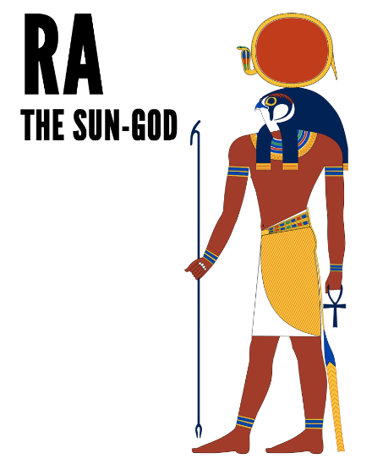
(Ex. 10:21) The Lord said to Moses,
“Stretch out your hand toward the sky so that darkness spreads over Egypt—darkness that can be felt.”

Slide 60
(Ex. 10:22) Moses stretched his hand toward the sky, and total darkness covered all Egypt for three days.
No one could see anyone else or move about for three days.
Yet all the Israelites had light in the places where they lived.

Slide 61
(Ex. 10:28) Pharaoh said to Moses,
“Get out of my sight!
Make sure you do not appear before me again!
The day you see my face you will die!”

Slide 62
(Ex. 10:29) “Just as you say,” Moses replied. “I will never appear before you again.”

Slide 63
(1) What do we learn about spiritual reality?
The Egyptian deities were clearly invented by the human imagination.
But how do you know your beliefs aren’t just a product of your imagination?

Slide 64
(1) What do we learn about spiritual reality?
(2) What do we learn from Pharaoh?

Slide 65
Pharaoh’s main problem?
(Ex. 7:23) [Pharaoh] did not take this to heart.
(Ex. 8:15) When Pharaoh saw that there was relief, he hardened his heart.
(Ex. 8:25) “Go… here in the land.”
(Ex. 8:28) “Go… But you must not go far.”
(Ex. 9:7) Pharaoh investigated… Yet his heart was unyielding.
(Ex. 10:11) “Have only the men.”
(Ex. 10:24) “Leave your flocks and herds.”
(1) What do we learn about spiritual reality?
(2) What do we learn from Pharaoh?

Slide 66
Pharaoh’s main problem?
(Ex. 7:23) [Pharaoh] did not take this to heart.
(Ex. 8:15) When Pharaoh saw that there was relief, he hardened his heart.
(Ex. 8:25) “Go… here in the land.”
(Ex. 8:28) “Go… But you must not go far.”
(Ex. 9:7) Pharaoh investigated… Yet his heart was unyielding.
(Ex. 10:11) “Have only the men.”
(Ex. 10:24) “Leave your flocks and herds.”
(1) What do we learn about spiritual reality?
(2) What do we learn from Pharaoh?
Humility!!

Slide 67
Pharaoh’s main problem?
(Ex. 7:23) [Pharaoh] did not take this to heart.
(Ex. 8:15) When Pharaoh saw that there was relief, he hardened his heart.
(Ex. 8:25) “Go… here in the land.”
(Ex. 8:28) “Go… But you must not go far.”
(Ex. 9:7) Pharaoh investigated… Yet his heart was unyielding.
(Ex. 10:11) “Have only the men.”
(Ex. 10:24) “Leave your flocks and herds.”
(1) What do we learn about spiritual reality?
(2) What do we learn from Pharaoh?
(Ex. 10:3) God asked, “How long will you refuse to humble yourself before me?”

Slide 68
Pharaoh’s main problem?
(Ex. 7:23) [Pharaoh] did not take this to heart.
(Ex. 8:15) When Pharaoh saw that there was relief, he hardened his heart.
(Ex. 8:25) “Go… here in the land.”
(Ex. 8:28) “Go… But you must not go far.”
(Ex. 9:7) Pharaoh investigated… Yet his heart was unyielding.
(Ex. 10:11) “Have only the men.”
(Ex. 10:24) “Leave your flocks and herds.”
(1) What do we learn about spiritual reality?
(2) What do we learn from Pharaoh?
(Mt. 18:4) Jesus said, “Anyone who becomes as humble as this little child is the greatest in the Kingdom of Heaven.”

Slide 69
God will eventually judge
The Divine Dilemma of Justice:
(1) When God doesn’t judge, we criticize his character.
(2) When God does judge, we criticize his character.
God isn’t asking for your opinion any more than he was asking for Pharaoh’s.
Will you humble yourself and receive his forgiveness, or harden your heart?
(1) What do we learn about spiritual reality?
(2) What do we learn from Pharaoh?
(3) What do we learn about God?

