Slide 1
James 1
No Pain, No Gain

Slide 2
The Book of James
James 1:1 – James, a bond-servant of God and of the Lord Jesus Christ

Slide 3
The Book of James
James 1:1 – James, a bond-servant of God and of the Lord Jesus Christ
James, son of Zebedee? (Matt 4:21)
James, son of Alphaeus? (Matt 10:3)
James, the half brother of Jesus (Mark 6:3)

Slide 4
The Book of James
James 1:1 – James, a bond-servant of God and of the Lord Jesus Christ
James, son of Zebedee? (Matt 4:21)
James, son of Alphaeus? (Matt 10:3)
James, the half brother of Jesus (Mark 6:3)
Jesus was the Son of God, born of a virgin
Mary & Joseph had at least 6 other kids (Mark 6:3)

Slide 5
The Book of James
James 1:1 – James, a bond-servant of God and of the Lord Jesus Christ
James, son of Zebedee? (Matt 4:21)
James, son of Alphaeus? (Matt 10:3)
James, the half brother of Jesus (Mark 6:3)
He knew the human side of Jesus
Closeness gave way to cynicism and alienation

Slide 6
The Book of James
Even his own brothers did not believe in him (John 7:5)
When his family heard what was happening, they tried to take him away. “He’s out of his mind,” they said. (Mark 3:21)
James 1:1 – James, a bond-servant of God and of the Lord Jesus Christ
James, son of Zebedee? (Matt 4:21)
James, son of Alphaeus? (Matt 10:3)
James, the half brother of Jesus (Mark 6:3)
He knew the human side of Jesus
Closeness gave way to cynicism and alienation

Slide 7
The Book of James
Jesus replied, “Who is my mother? Who are my brothers?”… “Anyone who does God’s will is my brother and sister and mother.” (Mark 3:33-35)
See John 19:26-27
James 1:1 – James, a bond-servant of God and of the Lord Jesus Christ
James, son of Zebedee? (Matt 4:21)
James, son of Alphaeus? (Matt 10:3)
James, the half brother of Jesus (Mark 6:3)
He knew the human side of Jesus
Closeness gave way to cynicism and alienation

Slide 8
The Book of James
“Then he appeared to James” (1 Cor 15:7)
James became known as one of “the pillars of the church” (Gal 2:9)
James 1:1 – James, a bond-servant of God and of the Lord Jesus Christ
James, son of Zebedee? (Matt 4:21)
James, son of Alphaeus? (Matt 10:3)
James, the half brother of Jesus (Mark 6:3)
But then something amazing happens…

Slide 9
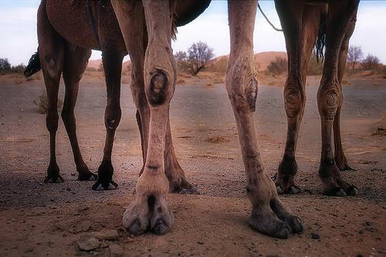
The Book of James
“Then he appeared to James” (1 Cor 15:7)
James became known as one of “the pillars of the church” (Gal 2:9)
James 1:1 – James, a bond-servant of God and of the Lord Jesus Christ
James, son of Zebedee? (Matt 4:21)
James, son of Alphaeus? (Matt 10:3)
James, the half brother of Jesus (Mark 6:3)
But then something amazing happens…
“his knees became hard like those of a camel” (Hegesippus, 100s AD)

Slide 10
The Book of James
“Then he appeared to James” (1 Cor 15:7)
James became known as one of “the pillars of the church” (Gal 2:9)
Acts 1 – gathered with the believers in Jerusalem
Acts 15, 21 – the leader of the Jerusalem church?
James 1:1 – James, a bond-servant of God and of the Lord Jesus Christ
James, son of Zebedee? (Matt 4:21)
James, son of Alphaeus? (Matt 10:3)
James, the half brother of Jesus (Mark 6:3)
But then something amazing happens…

Slide 11
Josephus
Jewish Roman Historian, 1st century AD
Josephus, Book 20, Chapter 9 of Antiquities of the Jews
~62AD: He assembled the Sanhedrin of judges, and brought before them the brother of Jesus, who was called Christ, whose name was James,
and some others, and when he had formed an accusation against them as breakers of the law, he delivered them to be stoned

Slide 12
James 1
1 James, a bond-servant of God and of the Lord Jesus Christ
To the twelve tribes who are dispersed abroad: Greetings.
Audience:
Jewish Christians suffering and scattered by persecution (Acts 8; also Acts 2)
Reads a lot like Jewish wisdom literature
Simple and to the point

Slide 13
James 1
1 James, a bond-servant of God and of the Lord Jesus Christ
To the twelve tribes who are dispersed abroad: Greetings.
Date:
Probably the mid-40s AD (earliest NT book)
Possibly after a major famine left the poor Jewish Christians even poorer (Acts 11:28)

Slide 14
James 1
2 Consider it all joy, my brethren,
when you encounter various trials,

Slide 15
James 1
2 Consider it all joy, my brethren,
when you encounter various trials,
Physical pain. (Chronic pain, sickness, injuries)
Relational pain
Friends & family who betray you or let you down
Romantic pain
Dating relationship isn’t working
Singleness
Marriage problems

Slide 16
James 1
2 Consider it all joy, my brethren,
when you encounter various trials,
Physical pain. (Chronic pain, injuries)
Relational pain
Sickness or death of someone you love (parent, spouse, child, friend)
Persecution from family or others
Busyness of life
The week before final exams
Deadlines at work

Slide 17
James 1
2 Consider it all joy, my brethren,
when you encounter various trials,
Money troubles, unemployment
Abuse, and memories of it that make it hard to sleep at night
Failure – moral or ministry
Confusion about what direction to take
Natural disasters and weather

Slide 18
James 1
2 Consider it all joy, my brethren,
when you encounter various trials,
3 knowing that the testing of your faith produces endurance.
1. Consider it all joy

Slide 19
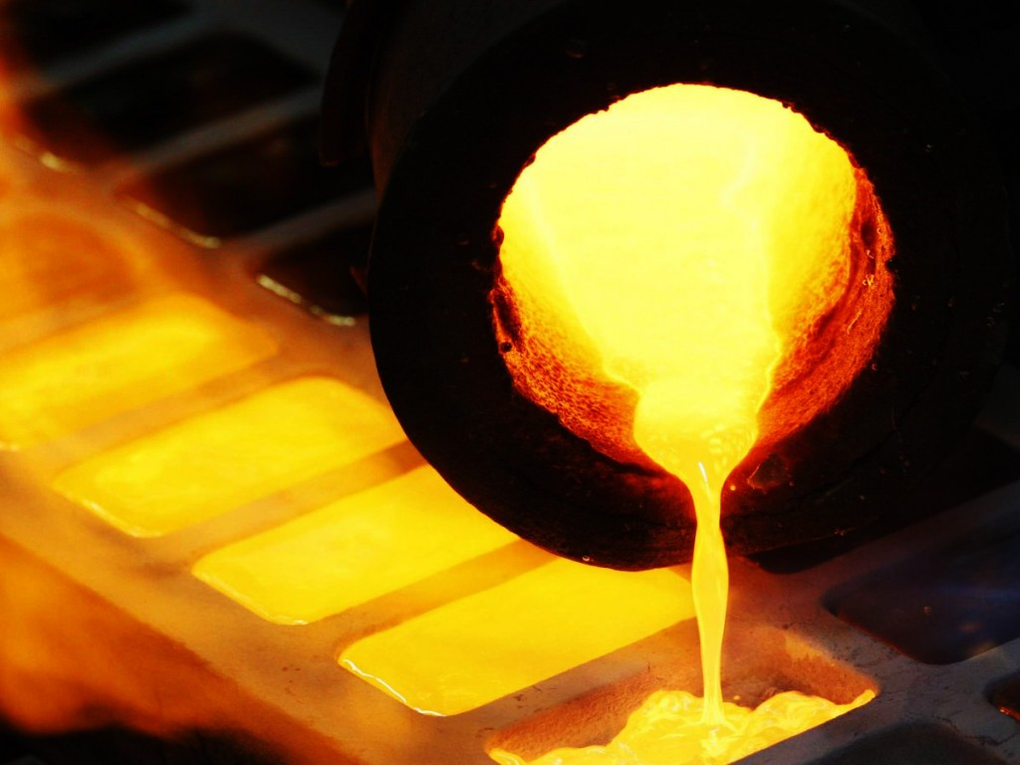
James 1
2 Consider it all joy, my brethren,
when you encounter various trials,
3 knowing that the testing of your faith produces endurance.
1 metric ton of gold (2200 lbs) yields…
1.5 grams of gold
Must be ground to powder and heated to ~2000F
1. Consider it all joy

Slide 20
James 1
2 Consider it all joy, my brethren,
when you encounter various trials,
3 knowing that the testing of your faith produces endurance.
We need to start to see our suffering as short term pain for long term results
Jesus’s seed illustration (John 12)
E.g. My baseball glove
E.g. the eagle and the eaglet
1. Consider it all joy

Slide 21
James 1
2 Consider it all joy, my brethren,
when you encounter various trials,
3 knowing that the testing of your faith produces endurance.
We need to start to see our suffering as short term pain for long term results
Why does an athlete hire a personal trainer?
Why does the student hire a tutor?
Why does the sick patient go in for surgery?
1. Consider it all joy

Slide 22
James 1
4 And let endurance have its perfect result, so that you may be perfect and complete, lacking in nothing.
Let’s say you want to become a more patient person…
2. Let endurance finish

Slide 23
Oswald Sanders
Christian Author
Sanders, Enjoying Intimacy with God, the chapter titled "Intimacy is Deepened by Discipline"
Against the senseless and furious rush of our times, God often seems unduly leisurely in His intervention in our affairs.
We want an answer, and we want it at once. But God does not always oblige. He refuses to be stampeded into premature action.

Slide 24
Oswald Sanders
Christian Author
Sanders, Enjoying Intimacy with God, the chapter titled "Intimacy is Deepened by Discipline"
Our urgency and impatience stem from the shortness of our vision and the imperfection of our knowledge of all the facts.
God’s seeming leisureliness arises from His perfect knowledge of all the facts and His perfect control of all the circumstances. Nor does He always explain His tardiness.

Slide 25
James 1
4 And let endurance have its perfect result, so that you may be perfect and complete, lacking in nothing.
Not all those who grow old, grow up
There’s a big difference between age and maturity
Redpath: “If you want to serve Christ you need to have the mind of a scholar, the heart of a child and the hide of a rhinoceros”
2. Let endurance finish

Slide 26
James 1
5 But if any of you lacks wisdom, let him ask of God, who gives to all generously and without reproach, and it will be given to him.
3. Ask God for wisdom

Slide 27
James 1
5 But if any of you lacks wisdom, let him ask of God, who gives to all generously and without reproach, and it will be given to him.
Suffering is what brought me to Christ in the first place
Suffering is the best thing that has ever happened to my prayer life
3. Ask God for wisdom

Slide 28
Ole Hallesby
20th c. Christian Author
Hallesby, Under His Wings, p. 66-67
There are times in our lives when our little life-boats sail along quietly and smoothly. We encounter no difficulty with adverse winds and currents.
Our health is good. Our work prospers. Everything goes along well in our homes; everything is peaceful and congenial from day to day.

Slide 29
Ole Hallesby
20th c. Christian Author
Hallesby, Under His Wings, p. 66-67
Financially we get along well also. Now and then we have a few difficulties, but on the whole everything seems to work out wonderfully well.
In such times many Christians forget to go to the secret place of the Most High.
Prosperous times make it easy to “believe” in God.

Slide 30
Ole Hallesby
20th c. Christian Author
Hallesby, Under His Wings, p. 66-67
People think that God is good. Men give advice right and left about believing in God.
Without a doubt, many a Christian has lost his spiritual life. in the sunny, but dry air of prosperity.
Only a few can weather prosperity and be none the worse for it…

Slide 31
Ole Hallesby
20th c. Christian Author
Hallesby, Under His Wings, p. 66-67
There are other times in our lives when adverse winds and storms let loose their fury against our little skiff. All our plans are crossed; all our hopes are dashed to pieces.
Illness, sorrow, and the vacant chair find their way into our homes.

Slide 32
Ole Hallesby
20th c. Christian Author
Hallesby, Under His Wings, p. 66-67
Impaired health makes work a burden and leaves us in straightened financial circumstances.
One difficulty follows hard upon the other. There is scarcely time to catch one’s breath between the breakers.

Slide 33
Ole Hallesby
20th c. Christian Author
Hallesby, Under His Wings, p. 66-67
Then it is well to know the way to the secret place of the Most High.
Blessed is he who has learned to flee to God, to seek refuge under His wings, and to find a haven from storm and tempest…

Slide 34
Ole Hallesby
20th c. Christian Author
Hallesby, Under His Wings, p. 69-70
To flee to God is without question the highest art in life. And it is by no means easy to learn.
But God helps us by sending us suffering and tribulation.
Tribulation makes us weary of the ways of the world and thereby enables us the more easily to choose the way of life.

Slide 35
Ole Hallesby
20th c. Christian Author
Hallesby, Under His Wings, p. 69-70
Most of us do not learn to know what the world is really like until it turns its wrong side toward us and we cut ourselves upon its sharply protruding edges.
Not until then do we learn to desist from proud words and haughty bearing.

Slide 36
Ole Hallesby
20th c. Christian Author
Hallesby, Under His Wings, p. 69-70
Not until we have been plucked to the skin of all our feathers do we seek refuge in our helplessness in the secret place of the Most High.
What we then experience often becomes determining for the rest of our lives.

Slide 37
Ole Hallesby
20th c. Christian Author
Hallesby, Under His Wings, p. 69-70
The reality, the depth, and the riches of grace which we then experience give us a personal acquaintanceship with our Lord which comes to mean something to us also when our troubles are over.

Slide 38
Ole Hallesby
20th c. Christian Author
Hallesby, Under His Wings, p. 69-70
We have learned the art, the secret, of taking refuge under His wings.
We have begun to see that this is the Simple solution of all of life’s problems.

Slide 39
James 1
5 But if any of you lacks wisdom, let him ask of God,
who gives to all generously and without reproach, and it will be given to him.
3. Ask God for wisdom

Slide 40
James 1
6 But he must ask in faith without any doubting, for the one who doubts is like the surf of the sea, driven and tossed by the wind.
7 For that man ought not to expect that he will receive anything from the Lord,
8 being a double-minded man, unstable in all his ways.
NLT: “Their loyalty is divided between God and the world, and they are unstable in everything they do.” (cf. James 4:4, 8)
3. Ask God for wisdom

Slide 41
James 1
9 But the brother of humble circumstances is to glory in his high position;
10 and the rich man is to glory in his humiliation,
4. Glory in your suffering

Slide 42
James 1
9 But the brother of humble circumstances is to glory in his high position;
10 and the rich man is to glory in his humiliation,
2 Cor 12:9-10
The Lord has said to me, “My grace is sufficient for you, for power is perfected in weakness.”
Most gladly, therefore, I will rather boast about my weaknesses, so that the power of Christ may dwell in me... For when I am weak, then I am strong.
4. Glory in your suffering

Slide 43
James 1
9 But the brother of humble circumstances is to glory in his high position;
10 and the rich man is to glory in his humiliation,
because like flowering grass he will pass away.
11 For the sun rises with a scorching wind and withers the grass; and its flower falls off and the beauty of its appearance is destroyed; so too the rich man in the midst of his pursuits will fade away.
4. Glory in your suffering

Slide 44
James 1
12 Happy is a man who perseveres under trial;
for once he has been approved, he will receive the crown of life which the Lord has promised to those who love Him.
It’s not just what suffering gets us this life, but even more what we get in the next life!
4. Glory in your suffering

Slide 45
Randy Alcorn
Christian Author
Alcorn, Randy. Happiness (p. 202). Tyndale House Publishers, Inc.. Kindle Edition.
The Christ who indwells us now is the same Christ who will bring us joy throughout eternity.
We have God’s Word, through which he speaks happiness into our lives, and God’s people, who despite their imperfections are often his instruments of love and encouragement.

Slide 46
Randy Alcorn
Christian Author
Alcorn, Randy. Happiness (p. 202). Tyndale House Publishers, Inc.. Kindle Edition.
Many have found happiness in times of hardship by anticipating the glory and goodness that await us, compared to which our present troubles are called “light and momentary” (2 Corinthians 4:17, NIV).

Slide 47
Randy Alcorn
Christian Author
Alcorn, Randy. Happiness (p. 202). Tyndale House Publishers, Inc.. Kindle Edition.
A trapped miner, in pain from broken bones, can be overwhelmed with joy as he hears his rescuers making their way toward him—
even though the actual rescue may not take place for hours or even days.
Though knowing he’ll still be suffering awhile, he rejoices that help is on its way.

Slide 48
Randy Alcorn
Christian Author
Alcorn, Randy. Happiness (p. 202). Tyndale House Publishers, Inc.. Kindle Edition.
The husband at war overseas can write to his bride, who is facing difficult circumstances, “Be happy because I love you, and I’ll come back for you.”
Her condition may be unpleasant and the separation difficult, but she can still be happy now because of her beloved’s promise and her anticipation of his return.

Slide 49
In this life: “No pain, No gain”
In the next life: “No pain”

Slide 50
In this life: “No pain, No gain”
In the next life: “No pain”
“He will wipe every tear from their eyes, and there will be no more death or sorrow or crying or pain.
All these things are gone forever.”
And the one sitting on the throne said, “Look, I am making everything new!” (Rev. 21:4-5)

