Slide 2
Jesus One on One: Jesus and John the Baptist
Matthew 3

Slide 3
Jesus One on One: Jesus and John the Baptist
Matthew 3

Slide 4
Jesus One on One: Jesus and John the Baptist
^{Matt 3:1} Now in those days John the Baptist came, preaching in the wilderness of Judea, saying, ² “Repent, for the kingdom of heaven is at hand.” ³ For this is the one referred to by Isaiah the prophet when he said,
“The voice of one calling out in the wilderness, ‘Prepare the way of the Lord, Make His paths straight!’”

Slide 5
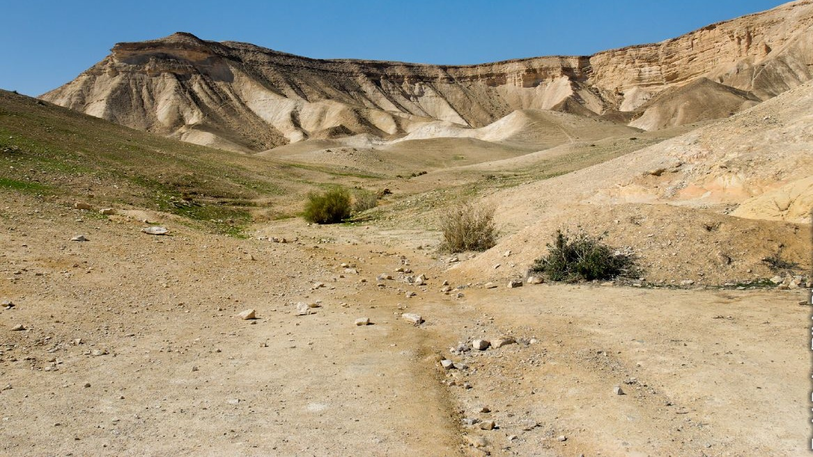
Jesus One on One: Jesus and John the Baptist
John the Baptist
^{Matt 3:1} Now in those days John the Baptist came, preaching in the wilderness of Judea, saying, ² “Repent, for the kingdom of heaven is at hand.” ³ For this is the one referred to by Isaiah the prophet when he said,
“The voice of one calling out in the wilderness, ‘Prepare the way of the Lord, Make His paths straight!’”

Slide 6
Jesus One on One: Jesus and John the Baptist
John the Baptist
^{Matt 3:1} Now in those days John the Baptist came, preaching in the wilderness of Judea, saying, ² “Repent, for the kingdom of heaven is at hand.” ³ For this is the one referred to by Isaiah the prophet when he said,
“The voice of one calling out in the wilderness, ‘Prepare the way of the Lord, Make His paths straight!’”

Slide 7
Jesus One on One: Jesus and John the Baptist
John the Baptist
^{Matt 3:1} Now in those days John the Baptist came, preaching in the wilderness of Judea, saying, ² “Repent, for the kingdom of heaven is at hand.” ³ For this is the one referred to by Isaiah the prophet when he said,
“The voice of one calling out in the wilderness, ‘Prepare the way of the Lord, Make His paths straight!’”

Slide 8
Jesus One on One: Jesus and John the Baptist
John the Baptist
Isaiah 40:3
^{Matt 3:1} Now in those days John the Baptist came, preaching in the wilderness of Judea, saying, ² “Repent, for the kingdom of heaven is at hand.” ³ For this is the one referred to by Isaiah the prophet when he said,
“The voice of one calling out in the wilderness, ‘Prepare the way of the Lord, Make His paths straight!’”

Slide 9
Jesus One on One: Jesus and John the Baptist
John the Baptist
A Forerunner
A Prophet
^{Matt 3:1} Now in those days John the Baptist came, preaching in the wilderness of Judea, saying, ² “Repent, for the kingdom of heaven is at hand.” ³ For this is the one referred to by Isaiah the prophet when he said,
“The voice of one calling out in the wilderness, ‘Prepare the way of the Lord, Make His paths straight!’”

Slide 10
Jesus One on One: Jesus and John the Baptist
John the Baptist
A Forerunner
A Prophet
^{Matt 3:4} Now John himself had a garment of camel’s hair and a leather belt around his waist; and his food was locusts and wild honey. ⁵ At that time Jerusalem was going out to him, and all Judea and all the region around the Jordan; ⁶ and they were being baptized by him in the Jordan River, as they confessed their sins.

Slide 11
Jesus One on One: Jesus and John the Baptist
John the Baptist
A Forerunner
A Prophet
^{Matt 3:4} Now John himself had a garment of camel’s hair and a leather belt around his waist; and his food was locusts and wild honey. ⁵ At that time Jerusalem was going out to him, and all Judea and all the region around the Jordan; ⁶ and they were being baptized by him in the Jordan River, as they confessed their sins.

Slide 12
Jesus One on One: Jesus and John the Baptist
John the Baptist
A Forerunner
A Prophet
John’s baptism
^{Matt 3:4} Now John himself had a garment of camel’s hair and a leather belt around his waist; and his food was locusts and wild honey. ⁵ At that time Jerusalem was going out to him, and all Judea and all the region around the Jordan; ⁶ and they were being baptized by him in the Jordan River, as they confessed their sins.

Slide 13
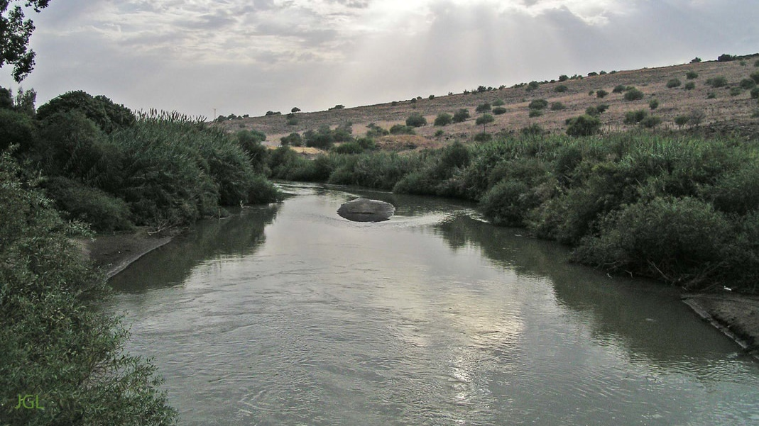
^{Matt 3:4} Now John himself had a garment of camel’s hair and a leather belt around his waist; and his food was locusts and wild honey. ⁵ At that time Jerusalem was going out to him, and all Judea and all the region around the Jordan; ⁶ and they were being baptized by him in the Jordan River, as they confessed their sins.

Slide 14
John knew exactly who Jesus was
^{Matt 3:13} Then Jesus arrived from Galilee at the Jordan, coming to John to be baptized by him.

Slide 15
John knew exactly who Jesus was
^{Matt 3:11} “As for me, I baptize you with water for repentance, but He who is coming after me is mightier than I, and I am not fit to remove His sandals; He will baptize you with the Holy Spirit and fire. ¹² His winnowing fork is in His hand, and He will thoroughly clear His threshing floor; and He will gather His wheat into the barn, but He will burn up the chaff with unquenchable fire.”

Slide 16
John knew exactly who Jesus was
^{Matt 3:11} “As for me, I baptize you with water for repentance, but He who is coming after me is mightier than I, and I am not fit to remove His sandals; He will baptize you with the Holy Spirit and fire. ¹² His winnowing fork is in His hand, and He will thoroughly clear His threshing floor; and He will gather His wheat into the barn, but He will burn up the chaff with unquenchable fire.”

Slide 17
John knew exactly who Jesus was
^{Matt 3:11} “As for me, I baptize you with water for repentance, but He who is coming after me is mightier than I, and I am not fit to remove His sandals; He will baptize you with the Holy Spirit and fire. ¹² His winnowing fork is in His hand, and He will thoroughly clear His threshing floor; and He will gather His wheat into the barn, but He will burn up the chaff with unquenchable fire.”

Slide 18
John knew exactly who Jesus was
^{Matt 3:11} “As for me, I baptize you with water for repentance, but He who is coming after me is mightier than I, and I am not fit to remove His sandals; He will baptize you with the Holy Spirit and fire. ¹² His winnowing fork is in His hand, and He will thoroughly clear His threshing floor; and He will gather His wheat into the barn, but He will burn up the chaff with unquenchable fire.”

Slide 19
Baptism:
Baptiso: dip, sink, immerse
^{Matt 3:11} “As for me, I baptize you with water for repentance, but He who is coming after me is mightier than I, and I am not fit to remove His sandals; He will baptize you with the Holy Spirit and fire. ¹² His winnowing fork is in His hand, and He will thoroughly clear His threshing floor; and He will gather His wheat into the barn, but He will burn up the chaff with unquenchable fire.”

Slide 20
Baptism:
^{Matt 3:11} “As for me, I baptize you with water for repentance, but He who is coming after me is mightier than I, and I am not fit to remove His sandals; He will baptize you with the Holy Spirit and fire. ¹² His winnowing fork is in His hand, and He will thoroughly clear His threshing floor; and He will gather His wheat into the barn, but He will burn up the chaff with unquenchable fire.”

Slide 21
Baptism:
^{Matt 3:11} “As for me, I baptize you with water for repentance, but He who is coming after me is mightier than I, and I am not fit to remove His sandals; He will baptize you with the Holy Spirit and fire. ¹² His winnowing fork is in His hand, and He will thoroughly clear His threshing floor; and He will gather His wheat into the barn, but He will burn up the chaff with unquenchable fire.”

Slide 22
Baptism with the Holy Spirit
^{Matt 3:11} “As for me, I baptize you with water for repentance, but He who is coming after me is mightier than I, and I am not fit to remove His sandals; He will baptize you with the Holy Spirit and fire. ¹² His winnowing fork is in His hand, and He will thoroughly clear His threshing floor; and He will gather His wheat into the barn, but He will burn up the chaff with unquenchable fire.”

Slide 23
Baptism with the Holy Spirit
The essence of salvation
^{Matt 3:11} “As for me, I baptize you with water for repentance, but He who is coming after me is mightier than I, and I am not fit to remove His sandals; He will baptize you with the Holy Spirit and fire. ¹² His winnowing fork is in His hand, and He will thoroughly clear His threshing floor; and He will gather His wheat into the barn, but He will burn up the chaff with unquenchable fire.”

Slide 24
Baptism with the Holy Spirit
The gift of salvation
^{Matt 3:11} “As for me, I baptize you with water for repentance, but He who is coming after me is mightier than I, and I am not fit to remove His sandals; He will baptize you with the Holy Spirit and fire. ¹² His winnowing fork is in His hand, and He will thoroughly clear His threshing floor; and He will gather His wheat into the barn, but He will burn up the chaff with unquenchable fire.”

Slide 25
Baptism with the Holy Spirit
Baptism with fire?
^{Matt 3:11} “As for me, I baptize you with water for repentance, but He who is coming after me is mightier than I, and I am not fit to remove His sandals; He will baptize you with the Holy Spirit and fire. ¹² His winnowing fork is in His hand, and He will thoroughly clear His threshing floor; and He will gather His wheat into the barn, but He will burn up the chaff with unquenchable fire.”

Slide 26
Baptism with the Holy Spirit
Baptism with fire?
^{Matt 3:11} “As for me, I baptize you with water for repentance, but He who is coming after me is mightier than I, and I am not fit to remove His sandals; He will baptize you with the Holy Spirit and fire. ¹² His winnowing fork is in His hand, and He will thoroughly clear His threshing floor; and He will gather His wheat into the barn, but He will burn up the chaff with unquenchable fire.”

Slide 27
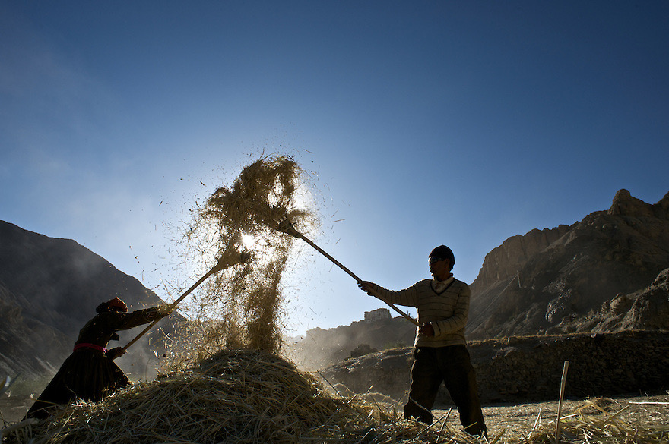
^{Matt 3:11} “As for me, I baptize you with water for repentance, but He who is coming after me is mightier than I, and I am not fit to remove His sandals; He will baptize you with the Holy Spirit and fire. ¹² His winnowing fork is in His hand, and He will thoroughly clear His threshing floor; and He will gather His wheat into the barn, but He will burn up the chaff with unquenchable fire.”

Slide 28
^{Matt 3:11} “As for me, I baptize you with water for repentance, but He who is coming after me is mightier than I, and I am not fit to remove His sandals; He will baptize you with the Holy Spirit and fire. ¹² His winnowing fork is in His hand, and He will thoroughly clear His threshing floor; and He will gather His wheat into the barn, but He will burn up the chaff with unquenchable fire.”

Slide 29
^{Matt 3:11} “As for me, I baptize you with water for repentance, but He who is coming after me is mightier than I, and I am not fit to remove His sandals; He will baptize you with the Holy Spirit and fire. ¹² His winnowing fork is in His hand, and He will thoroughly clear His threshing floor; and He will gather His wheat into the barn, but He will burn up the chaff with unquenchable fire.”

Slide 30
^{Matt 3:13} Then Jesus arrived from Galilee at the Jordan, coming to John to be baptized by him.

Slide 31
^{Matt 3:13} Then Jesus arrived from Galilee at the Jordan, coming to John to be baptized by him.

Slide 32
^{Matt 3:14} But John tried to prevent Him, saying, “I have the need to be baptized by You, and yet You are coming to me?”

Slide 33
^{Matt 3:14} But John tried to prevent Him, saying, “I have the need to be baptized by You, and yet You are coming to me?”

Slide 34
Jesus is blowing John’s mind!
^{Matt 3:15} But Jesus, answering, said to him, “Allow it at this time; for in this way it is fitting for us to fulfill all righteousness.”

Slide 35
Jesus is blowing John’s mind!
^{Matt 3:15} But Jesus, answering, said to him, “Allow it at this time; for in this way it is fitting for us to fulfill all righteousness.”

Slide 36
Jesus is blowing John’s mind!
Jesus is the Messiah – He has come to reconcile humanity to the Father… but in order to do that, He’s got to meet us where we’re at.
^{Matt 3:15} But Jesus, answering, said to him, “Allow it at this time; for in this way it is fitting for us to fulfill all righteousness.”

Slide 37
Jesus is blowing John’s mind!
^{Hebrews 2:17} Therefore, it was necessary for Him to be made in every respect like us, his brothers and sisters, so that He could be our merciful and faithful High Priest before God. Then He could offer a sacrifice that would take away the sins of the people.
^{Matt 3:15} But Jesus, answering, said to him, “Allow it at this time; for in this way it is fitting for us to fulfill all righteousness.”

Slide 38
Jesus is blowing John’s mind!
^{Hebrews 2:17} Therefore, it was necessary for him to be made in every respect like us, his brothers and sisters, so that he could be our merciful and faithful High Priest before God. Then he could offer a sacrifice that would take away the sins of the people.
^{Matt 3:15} But Jesus, answering, said to him, “Allow it at this time; for in this way it is fitting for us to fulfill all righteousness.”

Slide 39
Jesus is blowing John’s mind!
^{Hebrews 2:17} Therefore, it was necessary for him to be made in every respect like us, his brothers and sisters, so that he could be our merciful and faithful High Priest before God. Then he could offer a sacrifice that would take away the sins of the people.
^{Matt 3:15} But Jesus, answering, said to him, “Allow it at this time; for in this way it is fitting for us to fulfill all righteousness.”

Slide 40
Jesus is blowing John’s mind!
^{Hebrews 2:17} Therefore, it was necessary for him to be made in every respect like us, his brothers and sisters, so that he could be our merciful and faithful High Priest before God. Then he could offer a sacrifice that would take away the sins of the people.
^{John 1:29} he saw Jesus coming to him and said “Behold, the Lamb of God who takes away the sin of the world!”
^{Matt 3:15} But Jesus, answering, said to him, “Allow it at this time; for in this way it is fitting for us to fulfill all righteousness.”

Slide 41
Jesus is blowing John’s mind!
Baptism was “fitting,” not because Jesus needed it. But because of what He came to do: to identify himself with our sin, and take it to death on the cross once for all
^{Matt 3:15} But Jesus, answering, said to him, “Allow it at this time; for in this way it is fitting for us to fulfill all righteousness.”

Slide 42
Jesus is blowing John’s mind!
^{2 Corinthians 5:21} “He made Him who knew no sin to be sin on our behalf, so that we might become the righteousness of God in Him.”
^{Matt 3:15} But Jesus, answering, said to him, “Allow it at this time; for in this way it is fitting for us to fulfill all righteousness.”

Slide 43
^{Matt 3:15} Then he allowed Him.

Slide 44
^{Matt 3:16} After He was baptized, Jesus came up immediately from the water; and behold, the heavens were opened, and he saw the Spirit of God descending as a dove and settling on Him, ¹⁷ and behold, a voice from the heavens said, “This is My beloved Son, with whom I am well pleased.”

Slide 45
^{Matt 3:16} After He was baptized, Jesus came up immediately from the water; and behold, the heavens were opened, and he saw the Spirit of God descending as a dove and settling on Him, ¹⁷ and behold, a voice from the heavens said, “This is My beloved Son, with whom I am well pleased.”

Slide 46
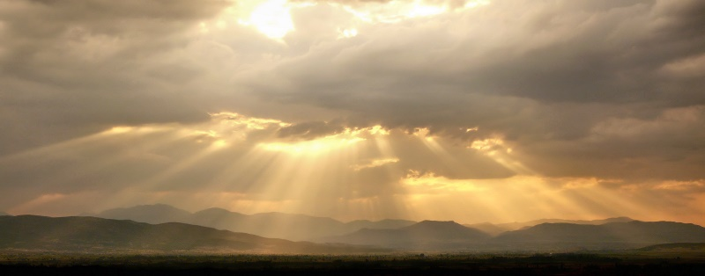
^{Matt 3:16} After He was baptized, Jesus came up immediately from the water; and behold, the heavens were opened, and he saw the Spirit of God descending as a dove and settling on Him, ¹⁷ and behold, a voice from the heavens said, “This is My beloved Son, with whom I am well pleased.”

Slide 47
^{Matt 3:16} After He was baptized, Jesus came up immediately from the water; and behold, the heavens were opened, and he saw the Spirit of God descending as a dove and settling on Him, ¹⁷ and behold, a voice from the heavens said, “This is My beloved Son, with whom I am well pleased.”

Slide 48
^{Matt 3:16} After He was baptized, Jesus came up immediately from the water; and behold, the heavens were opened, and he saw the Spirit of God descending as a dove and settling on Him, ¹⁷ and behold, a voice from the heavens said, “This is My beloved Son, with whom I am well pleased.”

Slide 49
^{Matt 3:16} After He was baptized, Jesus came up immediately from the water; and behold, the heavens were opened, and he saw the Spirit of God descending as a dove and settling on Him, ¹⁷ and behold, a voice from the heavens said, “This is My beloved Son, with whom I am well pleased.”

Slide 50
Now John’s double shocked!
^{Matt 3:16} After He was baptized, Jesus came up immediately from the water; and behold, the heavens were opened, and he saw the Spirit of God descending as a dove and settling on Him, ¹⁷ and behold, a voice from the heavens said, “This is My beloved Son, with whom I am well pleased.”

Slide 51
Jesus is shocking
^{Matt 3:16} After He was baptized, Jesus came up immediately from the water; and behold, the heavens were opened, and he saw the Spirit of God descending as a dove and settling on Him, ¹⁷ and behold, a voice from the heavens said, “This is My beloved Son, with whom I am well pleased.”

Slide 52
Jesus the expected savior coming in the most unexpected way
^{Matt 3:16} After He was baptized, Jesus came up immediately from the water; and behold, the heavens were opened, and he saw the Spirit of God descending as a dove and settling on Him, ¹⁷ and behold, a voice from the heavens said, “This is My beloved Son, with whom I am well pleased.”

Slide 53
What does this encounter teach us about God?
^{Matt 3:16} After He was baptized, Jesus came up immediately from the water; and behold, the heavens were opened, and he saw the Spirit of God descending as a dove and settling on Him, ¹⁷ and behold, a voice from the heavens said, “This is My beloved Son, with whom I am well pleased.”

Slide 54
What does this encounter teach us about ourselves?
^{Matt 3:16} After He was baptized, Jesus came up immediately from the water; and behold, the heavens were opened, and he saw the Spirit of God descending as a dove and settling on Him, ¹⁷ and behold, a voice from the heavens said, “This is My beloved Son, with whom I am well pleased.”

Slide 55
What does this encounter teach us about salvation?
^{Matt 3:16} After He was baptized, Jesus came up immediately from the water; and behold, the heavens were opened, and he saw the Spirit of God descending as a dove and settling on Him, ¹⁷ and behold, a voice from the heavens said, “This is My beloved Son, with whom I am well pleased.”

Slide 57
Baptism with the Holy Spirit
^{Exekiel 36:25-27} Then I will sprinkle clean water on you, and you will be clean; I will cleanse you from all your filthiness and from all your idols. 26 Moreover, I will give you a new heart and put a new spirit within you; and I will remove the heart of stone form your flesh and give you a heart of flesh. 27 And I will put My Spirit within you and bring it about that you walk in My statues, and are careful and follow My ordinances.
^{Matt 3:11} “As for me, I baptize you with water for repentance, but He who is coming after me is mightier than I, and I am not fit to remove His sandals; He will baptize you with the Holy Spirit and fire. ¹² His winnowing fork is in His hand, and He will thoroughly clear His threshing floor; and He will gather His wheat into the barn, but He will burn up the chaff with unquenchable fire.”

