Slide 2
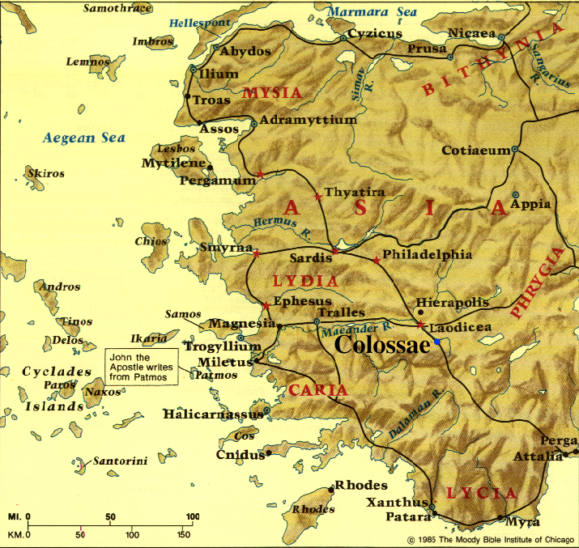

Slide 3
Spiritual maturity starts with cultivating a mental focus on the treasures of God’s great love for you

Slide 4
Spiritual maturity starts with cultivating a mental focus on the treasures of God’s great love for you
Spiritual maturity proceeds by embracing a lifestyle of giving God’s love to others (including God)
GOD
ME
GOD & OTHERS
RECEIVE GOD’S LOVE
GIVE GOD’S LOVE

Slide 5
Spiritual maturity starts with cultivating a mental focus on the treasures of God’s great love for you
Spiritual maturity proceeds by embracing a lifestyle of giving God’s love to others (including God)
TOWARD GOD
TOWARD OTHER CHRISTIANS
TOWARD NON-CHRISTIANS

Slide 6
Colossians 3:15-17 Loving God through Thankfulness
^{3:15} Let the peace of Christ rule in your hearts, to which indeed you were called in one body; and be thankful. ¹⁶ Let the word of Christ richly dwell within you, with all wisdom teaching and admonishing one another with psalms and hymns and spiritual songs, singing with thankfulness in your hearts to God. ¹⁷ Whatever you do in word or deed, do all in the name of the Lord Jesus, giving thanks through Him to God the Father.

Slide 7
Colossians 3:15-17 Loving God through Thankfulness
WHAT IS BIBLICAL THANKFULNESS?
WHY IS IT SO IMPORTANT?
HOW CAN WE CULTIVATE IT?

Slide 8
Colossians 3:15-17 Loving God through Thankfulness
WHAT IS BIBLICAL THANKFULNESS?
Directed to the God of the Bible
^{1:3} We give thanks to God, the Father of our Lord Jesus Christ . . . (see also Jas. 1:17)

Slide 9
Colossians 3:15-17 Loving God through Thankfulness
WHAT IS BIBLICAL THANKFULNESS?
Directed to the God of the Bible
Focused especially on God’s gift of salvation
^{1:12} . . . giving thanks to the Father, who has qualified us to share in the inheritance of the saints in Light. ¹³ For He rescued us from the domain of darkness, and transferred us to the kingdom of His beloved Son, ¹⁴ in whom we have redemption, the forgiveness of sins.

Slide 10
Colossians 3:15-17 Loving God through Thankfulness
WHAT IS BIBLICAL THANKFULNESS?
Directed to the God of the Bible
Focused especially on God’s gift of salvation
A lifestyle & developed disposition
^{3:15} . . . be thankful. ¹⁶ . . . singing with thankfulness in your hearts to God. ¹⁷ . . . giving thanks through Him to God the Father. (present/continuous tenses)
^{2:7} . . . having been firmly rooted and now being built up in Christ and . . . overflowing with gratitude.

Slide 11
Colossians 3:15-17 Loving God through Thankfulness
WHAT IS BIBLICAL THANKFULNESS?
Directed to the God of the Bible
Focused especially on God’s gift of salvation
A lifestyle & developed disposition
Rooted in choice – not in feelings
^{3:15} Let the peace of Christ rule in your hearts . . . be thankful.

Slide 12
Colossians 3:15-17 Loving God through Thankfulness
WHAT IS BIBLICAL THANKFULNESS?
Directed to the God of the Bible
Focused especially on God’s gift of salvation
A lifestyle & developed disposition
Rooted in choice – not in feelings
A key priority in spiritual development
^{4:2} Devote yourselves to prayer, keeping alert in it with an attitude of thanksgiving. (over 40 times in NT; 1 Thess. 5:18)

Slide 13
Colossians 3:15-17 Loving God through Thankfulness
WHY IS IT SO IMPORTANT?
Because it is the only sane response to God’s grace

Slide 14
Colossians 3:15-17 Loving God through Thankfulness
WHY IS IT SO IMPORTANT?
Because it is a key to putting aside a self-centered lifestyle
^{Romans 1:21} For even though they knew God, they did not honor Him as God or give thanks . . . ²⁴ Therefore God gave them over in the lusts of their hearts to impurity . . .
^{Ephesians 5:3} But immorality or any impurity or greed must not even be named among you, as is proper among saints; ⁴ and there must be no filthiness and silly talk, or coarse jesting, which are not fitting, but rather giving of thanks.

Slide 15
Colossians 3:15-17 Loving God through Thankfulness
WHY IS IT SO IMPORTANT?
Because it is a key to putting aside a self-centered lifestyle
^{Romans 1:21} For even though they knew God, they did not honor Him as God or give thanks . . . ²⁴ Therefore God gave them over in the lusts of their hearts to impurity . . .
^{Ephesians 5:3} But immorality or any impurity or greed must not even be named among you, as is proper among saints; ⁴ and there must be no filthiness and silly talk, or coarse jesting, which are not fitting, but rather giving of thanks.

Slide 16
Colossians 3:15-17 Loving God through Thankfulness
WHY IS IT SO IMPORTANT?
Because it is a key to putting aside a self-centered lifestyle
“So powerful is the influence exerted by ingratitude, that when we displace it with gratitude, we will likely find a multitude of other sins dislodged from our lives . . . . . .”
Nancy Leigh DeMoss, Choosing Gratitude, pp. 56,57.

Slide 17
Colossians 3:15-17 Loving God through Thankfulness
WHY IS IT SO IMPORTANT?
Because it leads to loving other people more

Slide 18
Colossians 3:15-17 Loving God through Thankfulness
WHY IS IT SO IMPORTANT?
Because it leads to increasing personal well-being
“How happy a person is depends upon the depth of his gratitude.”
Jack Miller, cited by Ajith Fernando, The Fullness of Christ, p. 89.

Slide 19
Colossians 3:15-17 Loving God through Thankfulness
WHY IS IT SO IMPORTANT?
Because it leads to increasing personal well-being
GRACE >> THANKSGIVING >> JOY
charis >> eucharisto >> chara

Slide 20
Colossians 3:15-17 Loving God through Thankfulness
WHY IS IT SO IMPORTANT?
Because it leads to increasing personal well-being
“Over time, choosing gratitude means choosing joy. But that choice doesn’t come without effort and intentionality . . . until a grateful spirit becomes (our) reflexive response to all of life.”
Nancy Leigh DeMoss, Choosing Gratitude, p. 17.

Slide 21
Colossians 3:15-17 Loving God through Thankfulness
HOW CAN WE CULTIVATE IT?
Ask God to sensitize you to your ingratitude
Appreciate all of your temporal blessings
Focus especially on your spiritual blessings
Start most prayer times with thanksgiving
Help each other away from negativity & toward thanksgiving
Be generous in your thanks to other people

Slide 22
Colossians 3:15-17 Loving God through Thankfulness
HOW CAN WE CULTIVATE IT?
Read this book!!!

Slide 23
NEXT WEEK:
Colossians 3:12-16 Keys to Spiritual Development Part 4 – LOVING OTHER CHRISTIANS

