Slide 1
1 Peter 3
The Days of Noah

Slide 2
1 Peter
When you are suffering for following God, you will temporarily look foolish, and your opponents will temporarily look like they are right.
But someday soon, those roles will be reversed.
There will come a time when, suddenly, you will be permanently vindicated, and your opponents will be permanently shown to be wrong
Two examples…

Slide 3
1 Peter 3
17 For it is better, if God should will it so, that you suffer for doing what is right rather than for doing what is wrong.
The Example of Christ

Slide 4
1 Peter 3
18 For Christ also died for sins once for all, the just for the unjust, so that He might bring us to God,
having been put to death in the flesh, but made alive in the spirit;
The Example of Christ

Slide 5
1 Peter 3
Jesus:
The Example of Christ

Slide 6
1 Peter 3
Jesus:
Warning, pleading
Loving his enemies
Doing what is right
Trusting the Father
Opponents:
The Example of Christ

Slide 7
1 Peter 3
Jesus:
Warning, pleading
Loving his enemies
Doing what is right
Trusting the Father
Opponents:
Mocking, ignoring
Living life their way
Crucified him!
The Example of Christ

Slide 8
1 Peter 3
Jesus:
Temporarily looked foolish
Jesus “is at the right hand of God, having gone into heaven, after angels and authorities and powers had been subjected to Him” (1 Peter 3:22)
Opponents:
Temporarily looked like they were right
The Example of Christ

Slide 9
1 Peter 3
20 … the patience of God kept waiting in the days of Noah,
during the construction of the ark,
in which a few, that is, eight persons, were brought safely through the water.
The Example of Noah

Slide 10
The Days of Noah
Yahweh observed the extent of human wickedness on the earth, and he saw that everything they thought or imagined was consistently and totally evil. (Genesis 6:5)

Slide 11
The Days of Noah
So Yahweh was sorry he had ever made them and put them on the earth.
It broke his heart.
And Yahweh said, “I will wipe this human race I have created from the face of the earth.” (Genesis 6:6-7)

Slide 12
The Days of Noah
So Yahweh was sorry he had ever made them and put them on the earth.
It broke his heart.
And Yahweh said, “I will wipe this human race I have created from the face of the earth.” (Genesis 6:6-7)
God is the Judge over all
God’s sorrow over this judgment

Slide 13
The Days of Noah
“Build a large boat from cypress wood and waterproof it with tar, inside and out…

Slide 14
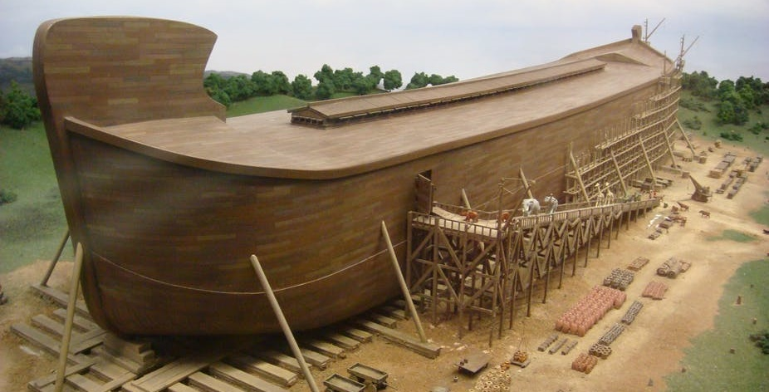
The Days of Noah
Then construct decks and stalls throughout its interior. Make the boat 450 feet long, 75 feet wide, and 45 feet high.

Slide 15
The Days of Noah
Leave an 18-inch opening below the roof all the way around the boat.

Slide 16
The Days of Noah
Put the door on the side, and build three decks inside the boat—lower, middle, and upper.

Slide 17
The Days of Noah
“Look! I am about to cover the earth with a flood…” (Genesis 6:14-17)
Was this a local or universal flood?

Slide 18
The Days of Noah
God asks Noah to devote his life to building a boat in the middle of the desert
In a day before power tools, sawmills, etc.
He was also a “preacher of righteousness” (2 Pet 2:5)
How foolish this would look
Finally he finished, and still no flood!
“Go into the boat with all your family” (Gen. 7:1)

Slide 19
The Days of Noah
And still the neighbors laughed and mocked and made excuses
“I’m busy”
“I’m basically on the boat”
“I’ll probably get my own boat together”
“I’m a pretty good swimmer”
To get on the boat was to admit wrong

Slide 20
The Days of Noah
Then Yahweh closed the door behind them.
All the underground waters erupted from the earth, and the rain fell in mighty torrents from the sky. (Gen 7:11, 16)
Only a few, that is, eight persons, were brought safely through the water. (1 Peter 3:20)

Slide 21
The Days of Noah
Noah:
Temporarily looked foolish
Permanently vindicated
Opponents:
Temporarily looked like they were right
Permanently shown to be wrong

Slide 22
Relevance For Today
The flood contains pictures of future events:
1. The worldwide judgment at Christ’s return
“When the Son of Man returns, it will be like it was in Noah’s day.
In those days, the people enjoyed banquets and parties and weddings right up to the time Noah entered his boat and the flood came and destroyed them all.” (Luke 17:26-27)

Slide 23
Relevance For Today
The flood contains pictures of future events:
2. The ark is a picture of Christ
Corresponding to that, baptism now saves you—
not the removal of dirt from the flesh, but an appeal to God for a good conscience—through the resurrection of Jesus Christ (1 Peter 3:21)

Slide 24
Relevance For Today
The flood contains pictures of future events:
2. The ark is a picture of Christ
Corresponding to that, baptism now saves you—
not the removal of dirt from the flesh, but an appeal to God for a good conscience—through the resurrection of Jesus Christ (1 Peter 3:21)
Not baptized into water
Baptized into Christ (1 Cor 12:13)

Slide 25
Relevance For Today
The flood contains pictures of future events:
2. The ark is a picture of Christ
On the seventeenth day of the seventh month the ark came to rest on the mountains of Ararat (Gen.8:4)
= The 17th of Nisan
Passover = The 14th of Nisan

Slide 26
Relevance For Today
The flood contains pictures of future events:
3. God’s patience with them parallels his patience with us today
“The patience of God kept waiting” (1 Pet. 3:20; cf. 2 Pet 3:9)
But his patience only lasts so long
What a horrible feeling to get shut out of the ark!

Slide 27
Application:
For Christians?
Be willing to endure the temporary illusion of foolishness…
Knowing that soon God will permanently reveal that you have been on the right side all along

Slide 28
Application:
For seekers?
Get on the boat!

Slide 29
1 Peter 3
Questions?
Comments?
Experiences?
risleys@dwellcc.org
See the Dwell App OR teachings.dwellcc.org
Next time: 1 Peter 4 – Living in Light of the End

