Slide 1
FIRST PETER
THE BOOK OF

Slide 2
1 Peter 1
²³ For you have been born again not of seed which is perishable but imperishable, that is, through the living and enduring word of God.

Slide 3
1 Peter 1
²³ For you have been born again not of seed which is perishable but imperishable, that is, through the living and enduring word of God.
Genesis 1:3: “Then God said, “Let there be light”; and there was light.”
» “God said” and “there was.”
Psalm 33:6, 9: “By the word of the Lord were the heavens made, their starry host by the breath of his mouth…For he spoke, and it [earth] came to be; he commanded, and it stood firm.”

Slide 4
1 Peter 1
²³ For you have been born again not of seed which is perishable but imperishable, that is, through the living and enduring word of God.
God chose language to communicate to the human race.
2 Timothy 3:16: “All Scripture is God-breathed…”

Slide 5
1 Peter 1
²³ For you have been born again not of seed which is perishable but imperishable, that is, through the living and enduring word of God.
God chose language to communicate to the human race.
Isaiah 55:10-12: “For as the rain and the snow come down from heaven, and do not return there without watering the earth…

Slide 6
1 Peter 1
²³ For you have been born again not of seed which is perishable but imperishable, that is, through the living and enduring word of God.
God chose language to communicate to the human race.
Isaiah 55:10-12: “So will My word…which goes forth from My mouth; it will not return to Me empty, without accomplishing what I desire, and without succeeding in the matter for which I sent it.”

Slide 7
1 Peter 1
²³ For you have been born again not of seed which is perishable but imperishable, that is, through the living and enduring word of God.

Slide 8
1 Peter 1
²³ For you have been born again not of seed which is perishable but imperishable, that is, through the living and enduring word of God.
God’s word is living and speaks to our present day.
Psalm 102:18: Let this be written for a future generation, that a people not yet created may praise the LORD.

Slide 9
1 Peter 1
²³ For you have been born again not of seed which is perishable but imperishable, that is, through the living and enduring word of God.
God’s word is living and speaks to our present day.
Hebrews 4:12: “For the word of God is alive and powerful. It is sharper than the sharpest two-edged sword, cutting between soul and spirit, between joint and marrow. It exposes our innermost thoughts and desires.”

Slide 10
1 Peter 1
²³ For you have been born again not of seed which is perishable but imperishable, that is, through the living and enduring word of God.
Matthew 24:35: “Heaven and earth will pass away, but my words will never pass away.”

Slide 11
1 Peter 1
²⁴ For,
“ALL [PEOPLE ARE] LIKE GRASS,
AND ALL [THEIR] GLORY [IS] LIKE THE FLOWER OF GRASS.
THE GRASS WITHERS,
AND THE FLOWER FALLS OFF,
²⁵ BUT THE WORD OF THE LORD ENDURES FOREVER.”
And this is the word which was preached to you.

Slide 12
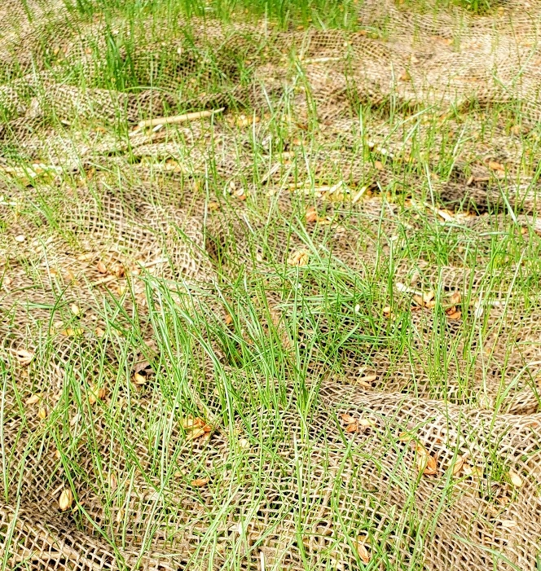
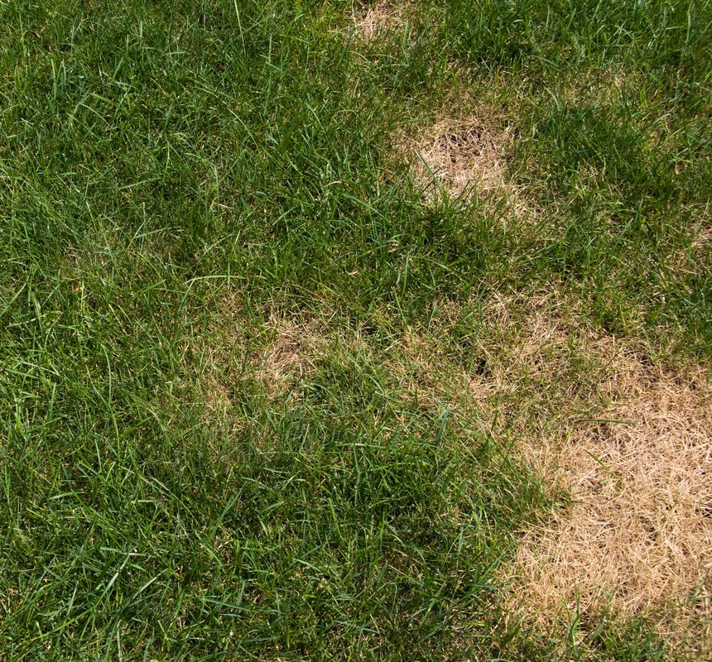
1 Peter 1
²⁴ For,
“ALL [PEOPLE ARE] LIKE GRASS,
AND ALL [THEIR] GLORY [IS] LIKE THE FLOWER OF GRASS.
THE GRASS WITHERS,
AND THE FLOWER FALLS OFF,
²⁵ BUT THE WORD OF THE LORD ENDURES FOREVER.”
And this is the word which was preached to you.

Slide 13
1 Peter 1
²⁴ For,
“ALL [PEOPLE ARE] LIKE GRASS,
AND ALL [THEIR] GLORY [IS] LIKE THE FLOWER OF GRASS.
THE GRASS WITHERS,
AND THE FLOWER FALLS OFF,
²⁵ BUT THE WORD OF THE LORD ENDURES FOREVER.”
And this is the word which was preached to you.

Slide 14
1 Peter 1
²⁴ For,
“ALL [PEOPLE ARE] LIKE GRASS,
AND ALL [THEIR] GLORY [IS] LIKE THE FLOWER OF GRASS.
THE GRASS WITHERS,
AND THE FLOWER FALLS OFF,
²⁵ BUT THE WORD OF THE LORD ENDURES FOREVER.”
And this is the word which was preached to you.
People, nations, and cultures are like grass and flowers –they go away.

Slide 15
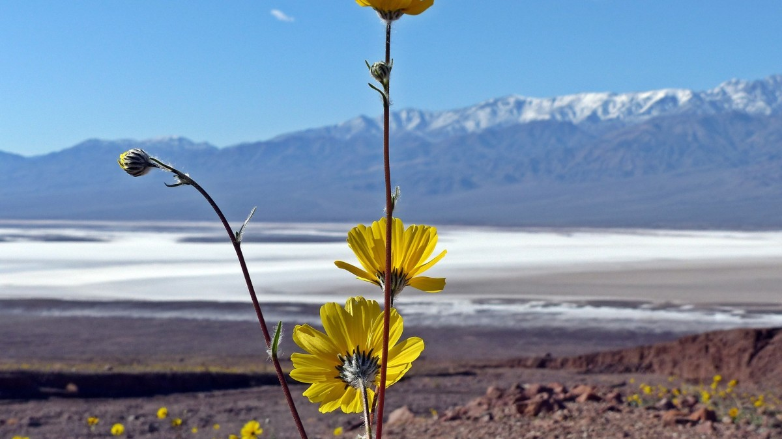

Slide 16
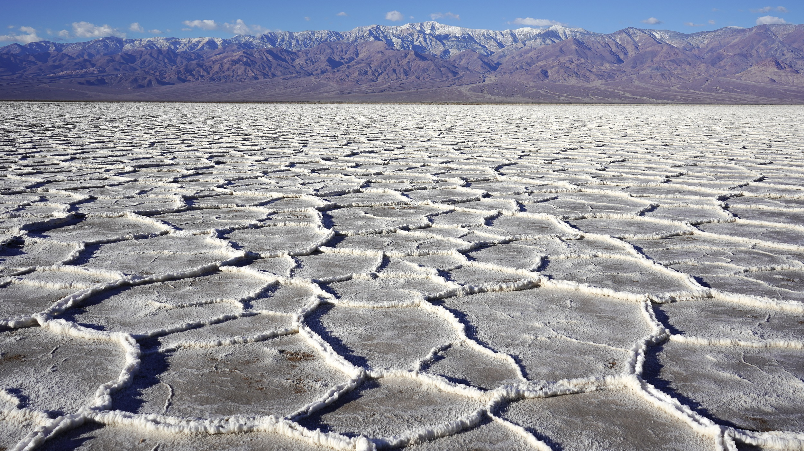

Slide 17
1 Peter 1
²⁴ For,
“ALL [PEOPLE ARE] LIKE GRASS,
AND ALL [THEIR] GLORY [IS] LIKE THE FLOWER OF GRASS.
THE GRASS WITHERS,
AND THE FLOWER FALLS OFF,
²⁵ BUT THE WORD OF THE LORD ENDURES FOREVER.”
And this is the word which was preached to you.
People, nations, and cultures are like grass and flowers –they go away.

Slide 18
1 Peter 1
²⁴ For,
“ALL [PEOPLE ARE] LIKE GRASS,
AND ALL [THEIR] GLORY [IS] LIKE THE FLOWER OF GRASS.
THE GRASS WITHERS,
AND THE FLOWER FALLS OFF,
²⁵ BUT THE WORD OF THE LORD ENDURES FOREVER.”
And this is the word which was preached to you.
Because man himself is transient, therefore his word transient.

Slide 19
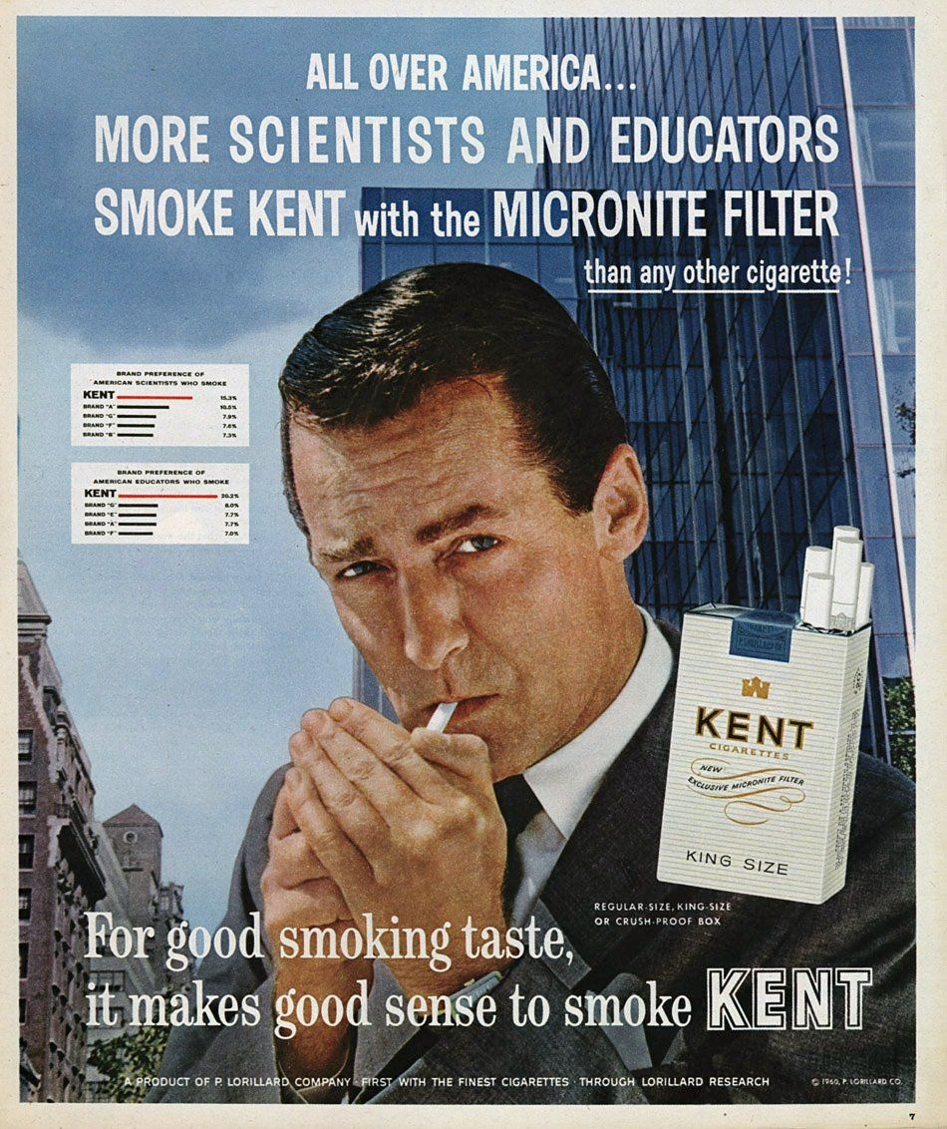

Slide 20
1 Peter 1
²⁴ For,
“ALL [PEOPLE ARE] LIKE GRASS,
AND ALL [THEIR] GLORY [IS] LIKE THE FLOWER OF GRASS.
THE GRASS WITHERS,
AND THE FLOWER FALLS OFF,
²⁵ BUT THE WORD OF THE LORD ENDURES FOREVER.”
And this is the word which was preached to you.
You see, when humans reason out from themselves, they start with a temporal perspective.

Slide 21
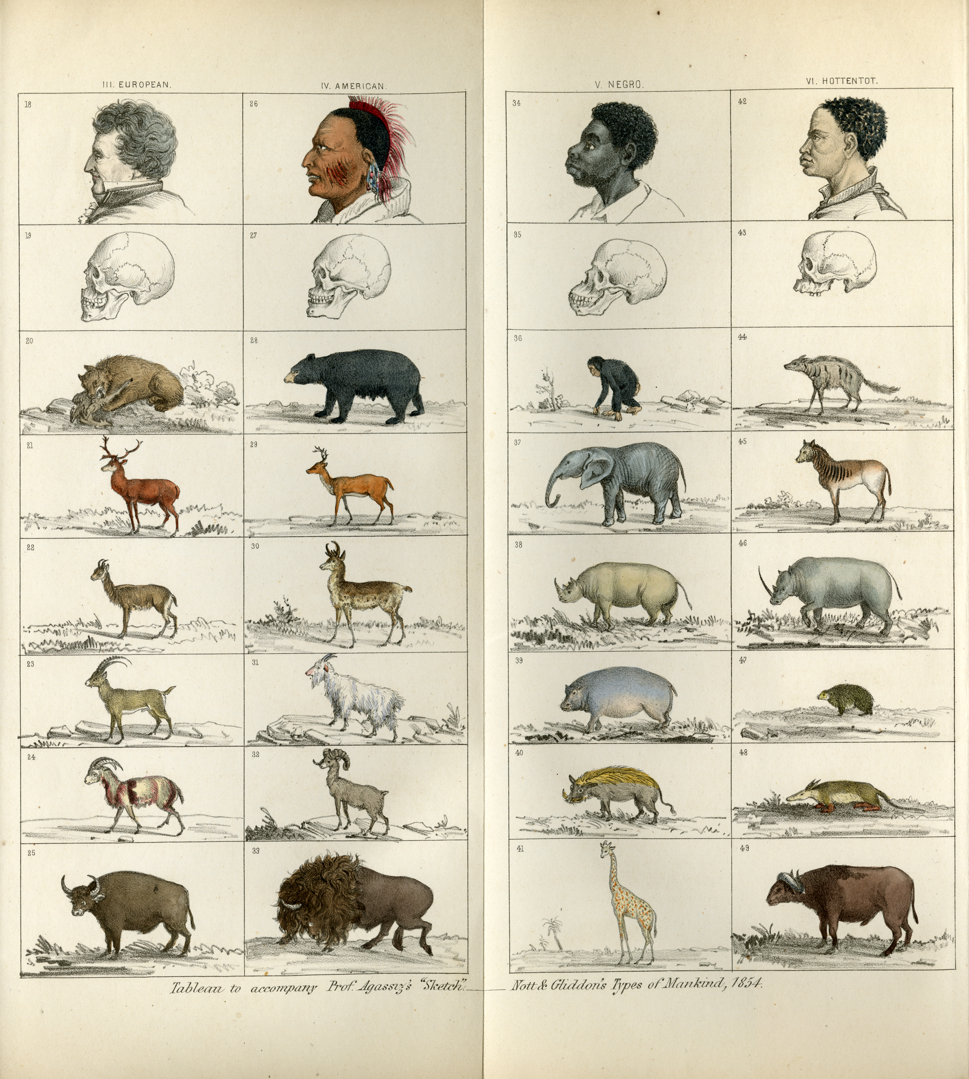
POLYGENISM

Slide 22
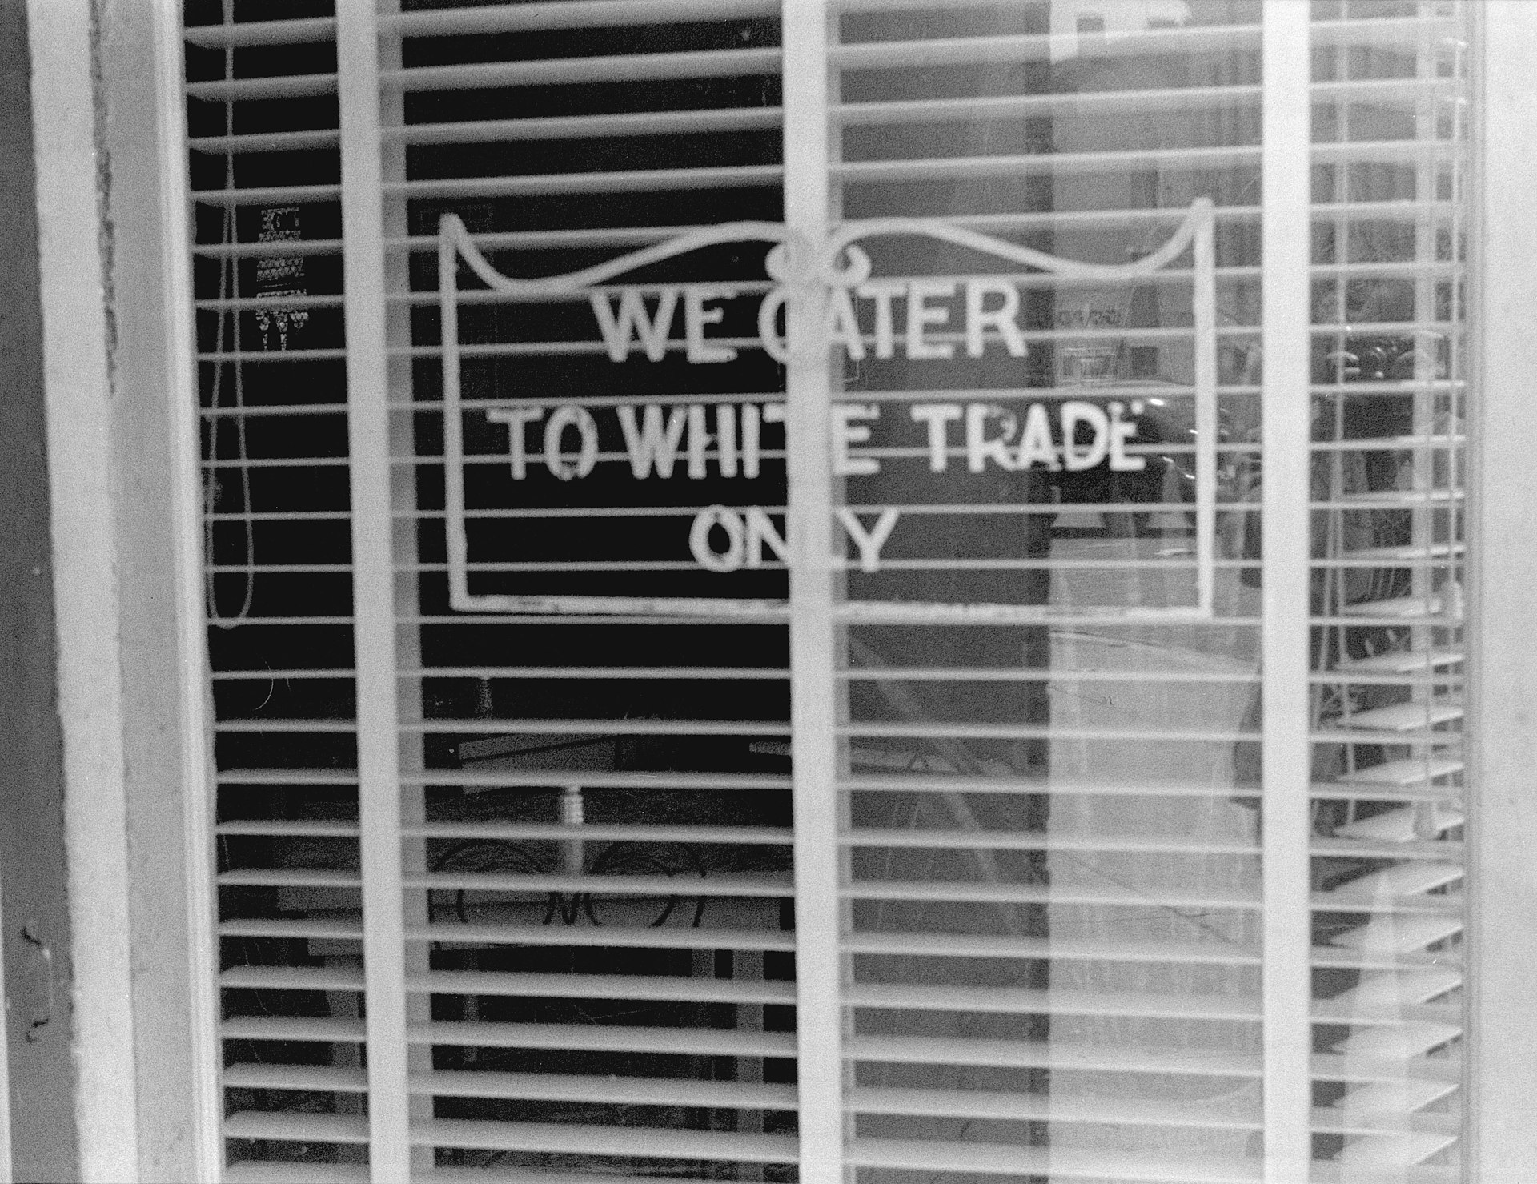
JIM CROW

Slide 23
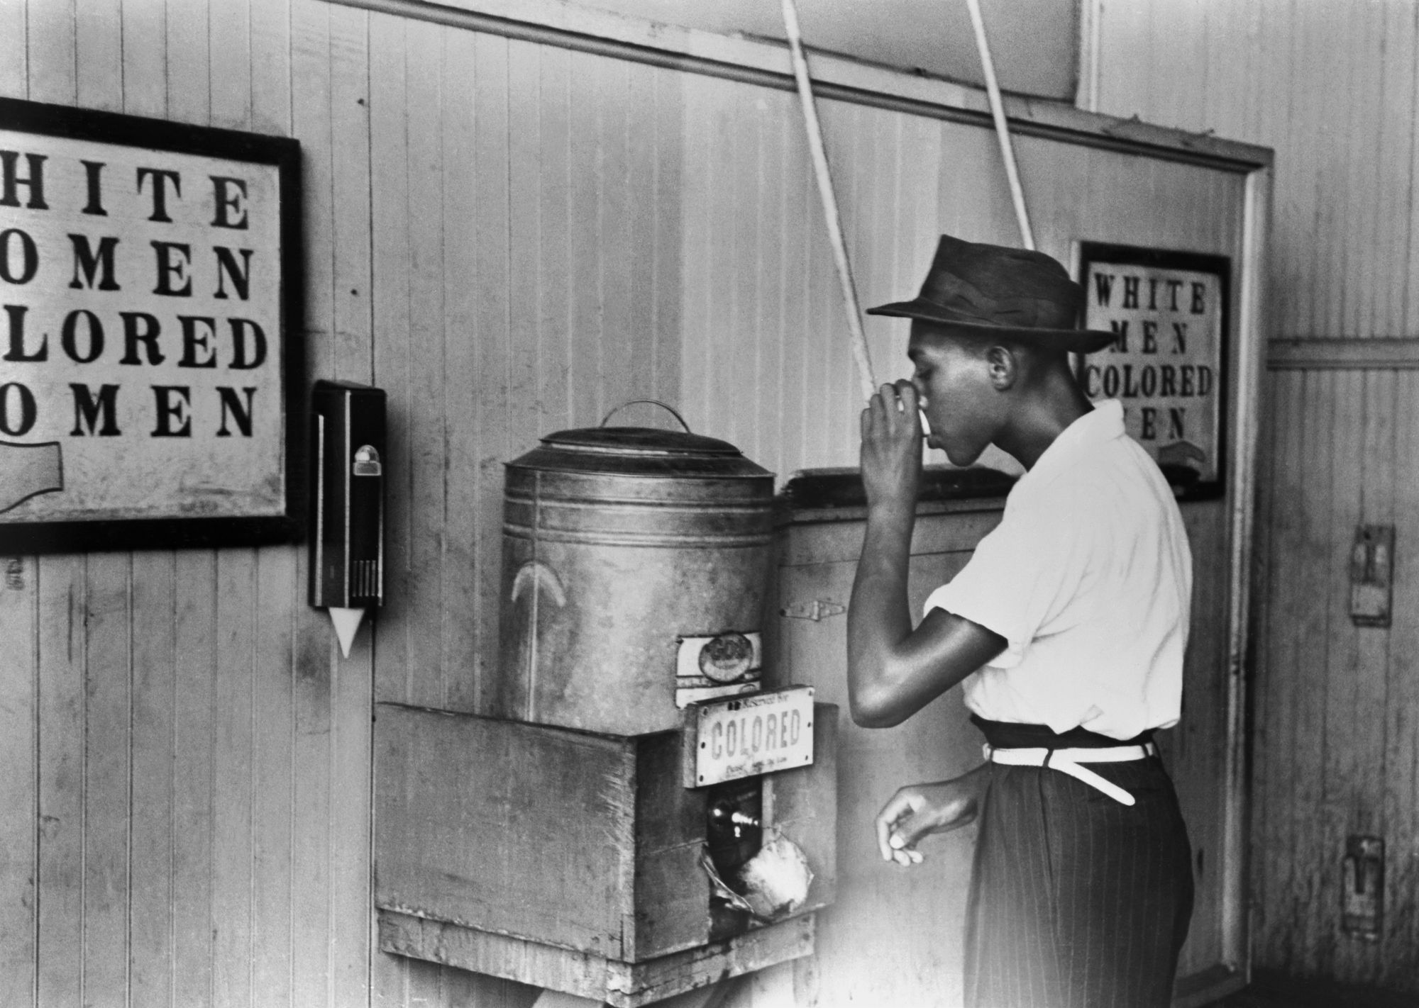
JIM CROW

Slide 24
1 Peter 1
²⁴ For,
“ALL [PEOPLE ARE] LIKE GRASS,
AND ALL [THEIR] GLORY [IS] LIKE THE FLOWER OF GRASS.
THE GRASS WITHERS,
AND THE FLOWER FALLS OFF,
²⁵ BUT THE WORD OF THE LORD ENDURES FOREVER.”
And this is the word which was preached to you.
You see, when humans reason out from themselves, they start with a temporal perspective.

Slide 25
1 Peter 1
²⁴ For,
“ALL [PEOPLE ARE] LIKE GRASS,
AND ALL [THEIR] GLORY [IS] LIKE THE FLOWER OF GRASS.
THE GRASS WITHERS,
AND THE FLOWER FALLS OFF,
²⁵ BUT THE WORD OF THE LORD ENDURES FOREVER.”
And this is the word which was preached to you.
“If I had a tape recording of everything you said five years ago, would you stand by everything you said?”

Slide 26
1 Peter 2
¹ Therefore, putting aside all malice and all deceit and hypocrisy and envy and all slander,
² like newborn babies, long for the pure milk of the word, so that by it you may grow in respect to salvation,
³ if you have tasted the kindness of the Lord.

Slide 27
1 Peter 2
¹ Therefore, putting aside all malice and all deceit and hypocrisy and envy and all slander,
² like newborn babies, long for the pure milk of the word, so that by it you may grow in respect to salvation,
³ if you have tasted the kindness of the Lord.

Slide 28
1 Peter 2
¹ Therefore, putting aside all malice and all deceit and hypocrisy and envy and all slander,
² like newborn babies, long for the pure milk of the word, so that by it you may grow in respect to salvation,
³ if you have tasted the kindness of the Lord.

Slide 29
1 Peter 2
¹ Therefore, putting aside all malice and all deceit and hypocrisy and envy and all slander,
² like newborn babies, long for the pure milk of the word, so that by it you may grow in respect to salvation,
³ if you have tasted the kindness of the Lord.

Slide 30
1 Peter 2
¹ Therefore, putting aside all malice and all deceit and hypocrisy and envy and all slander,
² like newborn babies, long for the pure milk of the word, so that by it you may grow in respect to salvation,
³ if you have tasted the kindness of the Lord.

Slide 31
1 Peter 2
¹ Therefore, putting aside all malice and all deceit and hypocrisy and envy and all slander,
² like newborn babies, long for the pure milk of the word, so that by it you may grow in respect to salvation,
³ if you have tasted the kindness of the Lord.

Slide 32
1 Peter 2
¹ Therefore, putting aside all malice and all deceit and hypocrisy and envy and all slander,
² like newborn babies, long for the pure milk of the word, so that by it you may grow in respect to salvation,
³ if you have tasted the kindness of the Lord.
If you find that you are not growing with God, this may be the reason why.

Slide 33
1 Peter 2
¹ Therefore, putting aside all malice and all deceit and hypocrisy and envy and all slander,
² like newborn babies, long for the pure milk of the word, so that by it you may grow in respect to salvation,
³ if you have tasted the kindness of the Lord.

Slide 34
1 Peter 2
¹ Therefore, putting aside all malice and all deceit and hypocrisy and envy and all slander,
² like newborn babies, long for the pure milk of the word, so that by it you may grow in respect to salvation,
³ if you have tasted the kindness of the Lord.
Longing for the word of God and spiritual growth replaces your old way of life.

Slide 35
1 Peter 2
¹ Therefore, putting aside all malice and all deceit and hypocrisy and envy and all slander,
² like newborn babies, long for the pure milk of the word, so that by it you may grow in respect to salvation,
³ if you have tasted the kindness of the Lord.
My complicated relationship with SPAM

Slide 36
1 Peter 2
¹ Therefore, putting aside all malice and all deceit and hypocrisy and envy and all slander,
² like newborn babies, long for the pure milk of the word, so that by it you may grow in respect to salvation,
³ if you have tasted the kindness of the Lord.
If you don't put aside this old pattern of life, it will block you from longing for God's word.

Slide 37
1 Peter 2
¹ Therefore, putting aside all malice and all deceit and hypocrisy and envy and all slander,
² like newborn babies, long for the pure milk of the word, so that by it you may grow in respect to salvation,
³ if you have tasted the kindness of the Lord.
How do we develop a taste for God’s word?
» Start small
» Start in the New Testament
» Start with a plan.

Slide 38
1 Peter 2
¹ Therefore, putting aside all malice and all deceit and hypocrisy and envy and all slander,
² like newborn babies, long for the pure milk of the word, so that by it you may grow in respect to salvation,
³ if you have tasted the kindness of the Lord.
Matthew 7:24-27: Anyone who listens to my teaching and follows it is wise, like a person who builds a house on solid rock. Though the rain comes in torrents and the floodwaters rise and the winds beat against that house, it won’t collapse because it is built on bedrock…

Slide 39
1 Peter 1
¹ Therefore, putting aside all malice and all deceit and hypocrisy and envy and all slander,
² like newborn babies, long for the pure milk of the word, so that by it you may grow in respect to salvation,
³ if you have tasted the kindness of the Lord.
Matthew 7:24-27: But anyone who hears my teaching and doesn’t obey it is foolish, like a person who builds a house on sand. When the rains and floods come and the winds beat against that house, it will collapse with a mighty crash.

Slide 40
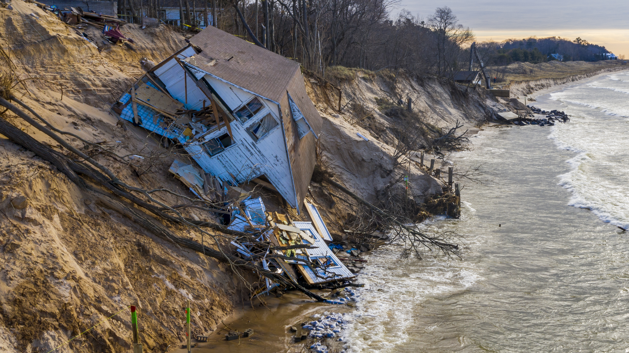

Slide 41
FIRST PETER
THE BOOK OF

