Slide 1
Discipline with the End in Mind
By Cindy Botti

Slide 2
What is Discipline?

Slide 3
Discipline is not…
punishment
domineering & controlling
power struggles
a way to get revenge
so our life will go smoother

Slide 4
Discipline is…
instruction
training
focused on personal growth
focused on the future

Slide 5
Punishment vs Discipline
 | Punishment | Discipline
Purpose | to inflict penalty for an offense | to train for correction and maturity
Focus
Attitude
Resulting Emotion in the child

Slide 6
Punishment vs Discipline
 | Punishment | Discipline
Purpose | to inflict penalty for an offense | to train for correction and maturity
Focus | Past misdeeds | Future correct deeds
Attitude
Resulting Emotion in the child

Slide 7
Punishment vs Discipline
 | Punishment | Discipline
Purpose | to inflict penalty for an offense | to train for correction and maturity
Focus | Past misdeeds | Future correct deeds
Attitude | Hostility and frustration on the part of the parent | love and concern on the part of the parent
Resulting Emotion in the child

Slide 8
Punishment vs Discipline
 | Punishment | Discipline
Purpose | to inflict penalty for an offense | to train for correction and maturity
Focus | Past misdeeds | Future correct deeds
Attitude | Hostility and frustration on the part of the parent | love and concern on the part of the parent
Resulting Emotion in the child | fear and guilt (rebellion) | security

Slide 9
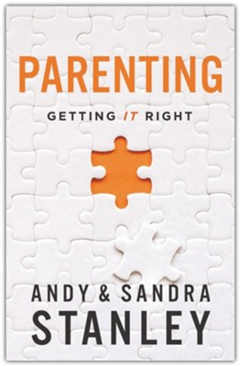
Discipline makes a person better. Punishment rarely makes anybody better. It simply makes them more careful. And perhaps bitter. Not better.

Slide 10
The message of punishment is this: If you don’t obey me, bad things will happen to you. If you inconvenience or embarrass me, I’ll inconvenience or embarrass you.

Slide 11
The message of punishment is this: If you don’t obey me, bad things will happen to you. If you inconvenience or embarrass me, I’ll inconvenience or embarrass you. There’s rarely any positive or permanent change, other than to the relationship (77).

Slide 12
Why Discipline?

Slide 13
God disciplines us
Hebrews 12:6 “The Lord disciplines the one He loves, and He chastens everyone he accepts as His son.”

Slide 14
God assumes we do the same
7 …For what children are not disciplined by their father? 8 If you are not disciplined—and everyone undergoes discipline—then you are not legitimate, not true sons and daughters at all.

Slide 15
God assumes we do the same
9 Moreover, we have all had human fathers who disciplined us and we respected them for it. How much more should we submit to the Father of spirits and live!

Slide 16
God assumes we do the same
10They disciplined us for a little while as they thought best; but God disciplines us for our good, in order that we may share in his holiness.

Slide 17
Kids need boundaries

Slide 18
A boundary is a “property line” that defines a person; it defines where one person ends and someone else begins. A child needs to know where she begins, what she needs to take responsibility for.

Slide 19
Boundary Illustration
Your
Neighbor’s

Slide 20
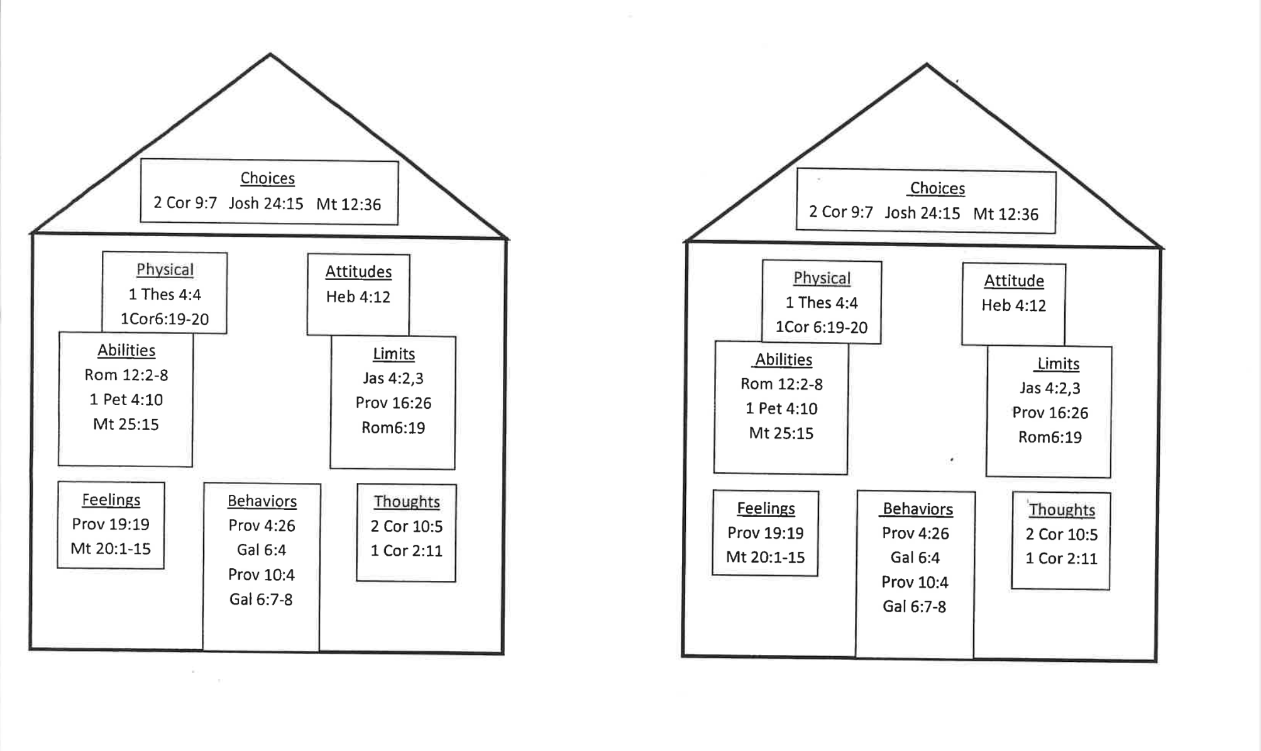
Relationship Boundaries

Slide 21
Children are not born with boundaries–they internalize boundaries from external relationships and discipline.

Slide 22
In order for children to learn who they are and what they are responsible for, their parents have to have clear boundaries with them and relate to them in ways that help them learn their own boundaries (p 17-18).

Slide 23
What was once external becomes internal

Slide 24
If boundaries are clear…
A well-defined sense of who they are
Know what they are responsible for
Know they have the ability to choose
Understand choices have consequences
Potential for healthy relationships

Slide 25
If children don’t develop boundaries
Inability to say “no” to hurtful people
Inability to say “no” to their own impulses
Inability to hear “no” from others
Inability to have healthy relationships

Slide 26
We need to discipline our kids

Slide 27
What are we disciplining them toward?

Slide 28
Our observation is that most parents are so busy parenting, they never stop to consider what they are parenting to.

Slide 29
Our observation is that most parents are so busy parenting, they never stop to consider what they are parenting to. What they are parenting for. They are too busy to stop and consider the end game. The goal. The prize. The win.

Slide 30
If you don’t hit pause long enough to consider the direction in which you are parenting, you may wake up one day to the realization that you parented in the wrong direction.

Slide 31
By “wrong” I mean you parented in a direction you would not have chose had you stopped long enough to choose. The folks who decide on a direction ahead of time usually end up somewhere on purpose.
Direction determines destination.

Slide 32
If your parenting style– habits, responses, approach to discipline– is not dictated by a predetermined win, it will be dictated by circumstances, culture, the reactions of your children, and the expectations of others.

Slide 33
Parenting becomes a whirlwind. In the whirlwind, parenting is reduced to reacting rather than leading, reacting to the immediate instigation rather than leading toward a predetermined destination.

Slide 34
Discipline with the end in mind

Slide 35
What is the end in mind?

Slide 36
Our Goal: Healthy Independence
0 1 2 3 4 5 6 7 8 9 10 11 12 13 14 15 16 17 18

Slide 37
Our Goal: Healthy Independence
High Independence
Internal control
0 1 2 3 4 5 6 7 8 9 10 11 12 13 14 15 16 17 18

Slide 38
Our Goal: Healthy Independence
High Independence
Internal control
Make their own decisions
0 1 2 3 4 5 6 7 8 9 10 11 12 13 14 15 16 17 18

Slide 39
Our Goal: Healthy Independence
High Independence
Internal control
Make their own decisions
Defend their own values
0 1 2 3 4 5 6 7 8 9 10 11 12 13 14 15 16 17 18

Slide 40
Our Goal: Healthy Independence
High Independence
Internal control
Make their own decisions
Defend their own values
Build healthy relationships
0 1 2 3 4 5 6 7 8 9 10 11 12 13 14 15 16 17 18

Slide 41
Our Goal: Healthy Independence
High Independence
Internal control
Make their own decisions
Defend their own values
Build healthy relationships
Productive member of society & BOC
0 1 2 3 4 5 6 7 8 9 10 11 12 13 14 15 16 17 18

Slide 42
Our Goal: Healthy Independence
High Independence
Strong Relationships
Strong Character
God values relationships & character
0 1 2 3 4 5 6 7 8 9 10 11 12 13 14 15 16 17 18

Slide 43
Galatians 5:22-23
But the fruit of the Spirit is love, joy, peace, forbearance, kindness, goodness, faithfulness, gentleness and self-control.
Matthew 22:37-39
‘Love the Lord your God with all your heart and with all your soul and with all your mind.’ This is the first and greatest commandment. And the second is like it: ‘Love your neighbor as yourself.’

Slide 44
The Role of Discipline
High Independence
Discipline
Low Independence
0 1 2 3 4 5 6 7 8 9 10 11 12 13 14 15 16 17 18

Slide 45
The Role of Discipline
High Independence
Low parental control
High parental control
Discipline
Low Independence
0 1 2 3 4 5 6 7 8 9 10 11 12 13 14 15 16 17 18

Slide 46
Parental Error!
Low
Independence
High Independence
Low parental control
High parental control
0 1 2 3 4 5 6 7 8 9 10 11 12 13 14 15 16 17 18

Slide 47
Discipline with the end in mind

Slide 48
How do we get there?

Slide 49
Relational Investment

Slide 50
Every child has an emotional tank, a place of emotional strength that can fuel him through the challenging days of childhood and adolescence.

Slide 51
By speaking your child’s love language, you can fill his “emotional tank” with love.

Slide 52
By speaking your child’s love language, you can fill his “emotional tank” with love. When your child feels loved, he is much easier to discipline and train than when his “emotional tank” is running near empty (17).

Slide 53
Words of Affirmation
Quality Time
Physical Touch
Acts of Service
Receiving Gifts

Slide 54
Relational Investment gives you influence
Dates with each kid

Slide 56
How do we get there?

Slide 57
Four Stages of Parenting
Discipline 0-5 yrs
Training 5-12 yrs
Coaching 12-18 yrs
Friendship 18+ yrs

Slide 58
These four stages provide a framework for evolving the parent-child relationship as our kids grow up and move from one stage to another.

Slide 59
These four stages provide a framework for evolving the parent-child relationship as our kids grow up and move from one stage to another.
In each stage the approach to parenting is different.

Slide 60
A Common Issue
Kids move from one stage to the next without thought or effort.
But parents don’t.

Slide 61
Parents have to consciously adjust their approach as kids seamlessly transition from one stage to the next. Too many parents never do.

Slide 62
You’ve probably seen a dad who seems stuck in the discipline years.

Slide 63
You’ve probably seen a dad who seems stuck in the discipline years. His child may be in middle school, yet he employs the immediate consequences that were necessary when the child was two, not twelve.

Slide 64
Or maybe you know a mom who is stuck in the coaching stage even though her child is grown.

Slide 65
Or maybe you know a mom who is stuck in the coaching stage even though her child is grown. She sees their phone calls home as opportunities to offer unsolicited advice and unasked-for opinions.

Slide 66
Even worse, we’ve all encountered that mom or dad who decides to be friends with their child too early.

Slide 67
Even worse, we’ve all encountered that mom or dad who decides to be friends with their child too early. They neglect training and coaching in a effort to be liked by their kid and their kids’ friends (26).

Slide 68
When parents don’t evolve their parenting as their child develops, they undermine their influence with their child.

Slide 69
When parents don’t evolve their parenting as their child develops, they undermine their influence with their child.
Remember your kids move on to the next stage whether you do or not.

Slide 70
Discipline
0-5 years
Teach your child there are consequences to their actions- good or bad
Strengthen your child’s obedience muscle through multiple reps and appropriate consequences

Slide 71
Someone will discipline your kids. It can be you, starting early and being consistent while the stakes are low.

Slide 72
Someone will discipline your kids. It can be you, starting early and being consistent while the stakes are low.
Or later it can be a teacher or principal, with consequences like failing grades and suspensions.

Slide 73
Or it can be a police officer and judge, with fines, community service, or sadly, jail time or prison (30-31).

Slide 74
Discipline needs to start early. It needs to be consistent. And the consequences during the discipline years need to be immediate.

Slide 75
Discipline
0-5 years
Set clear boundaries
Clear expectations
Focus?

Slide 76
The 3 D’s
Disobedience
Dishonesty
Disrespect

Slide 77
The 3 D’s
Disobedience
Dishonesty
Disrespect

Slide 78
Childish Irresponsibility vs
Willful Defiance
Willful defiance, as the name implies, is a deliberate act of disobedience. It occurs only when the child knows what his parents expect and then is determined to do the opposite.

Slide 79
Childish Irresponsibility vs
Willful Defiance
Willful defiance, as the name implies, is a deliberate act of disobedience. It occurs only when the child knows what his parents expect and then is determined to do the opposite. In short, it is a refusal to accept parental leadership, such as running away when called, screaming insults, acts of outright disobedience, etc.

Slide 80
Childish Irresponsibility vs
Willful Defiance
By contrast, childish irresponsibility results from forgetting, accidents, mistakes, a short attention span, a low frustration tolerance, and immaturity.

Slide 81
Childish Irresponsibility vs
Willful Defiance
By contrast, childish irresponsibility results from forgetting, accidents, mistakes, a short attention span, a low frustration tolerance, and immaturity. In the first instance, the child knows he was wrong and is waiting to see what his parent can do about it;

Slide 82
Childish Irresponsibility vs
Willful Defiance
in the second, he has simply blundered into a consequence he did not plan. It is wrong, in my view, to resort to corporal punishment for the purpose of instilling responsibility (unless, off course, the child has defiantly refused to accept it).

Slide 83
Know the different types of discipline

Slide 84
Type of Discipline | Definition
Natural Consequences | Natural consequences are the automatic results of actions.
Many of your child’s misbehaviors have painful built-in consequences that teach them great lessons if you stay out of the way long enough to let them learn (66).

Slide 85
Type of Discipline | Definition
Natural Consequences | Natural consequences are the automatic results of actions.
Logical Consequences | The consequences are logical because they make sense according to the behavior.

Slide 86
Type of Discipline | Definition
Natural Consequences | Natural consequences are the automatic results of actions.
Logical Consequences | The consequences are logical because they make sense according to the behavior.
Physical Consequences | Consequences that involve the child physically as in “time outs”, removing them from the situation or spanking.

Slide 87
Type of Discipline | Definition
Reinforcement | Reinforcing praiseworthy behavior through reward or praise.

Slide 88
Type of Discipline | Definition
Reinforcement | Reinforcing praiseworthy behavior through reward or praise.
Extinction | a form of discipline that eliminates inadvertent positive reinforcement for unacceptable behavior. Ignoring the behavior of toddlers who whine or have tantrums eliminates the positive reinforcement of a response to that behavior.

Slide 89
DQ: What could be an effective way to discipline whining or tantrums?

Slide 90
Training
5-12 years
Explain the why behind your rules and expectations

Slide 91
The skills we want our kids to have in public, we must train them in private. And that’s what the training years are for:
Helping our kids gain the skills and values they need to succeed.

Slide 92
There are still consequences connected to actions, but there’s a lot more explaining to the training (35).
Just as an athlete needs tons of practice, so do our kids.

Slide 93
Practicing is great during the early training years because everything is fun and nothing is dumb.
Later, everything is dumb and nothing is fun. So do it while you can.

Slide 94
Training
5-12 years
You tell your child what to do

Slide 95
Training
5-12 years
You tell your child what to do
You explain why it is important

Slide 96
Training
5-12 years
You tell your child what to do
You explain why it is important
Then you help them practice and turn those things into habits

Slide 97
Restoring Relationships
When honoring others is the chief value in a family, disobedience, dishonesty, and disrespect are problematic because they dishonor another person. They damage the relationship (77).

Slide 98
Restoring Relationships
The goal of discipline is to teach your child how to restore the relationship they damaged.

Slide 99
Restoring Relationships
The goal of discipline is to teach your child how to restore the relationship they damaged. You’ve met plenty adults who can eat with a fork and tie their shoes but who never learned to restore a broken relationship (78).

Slide 100
For Example:
Their boys were 8 & 10 and were extremely disrespectful to a babysitter

Slide 101
DQ: What are other skills they could practice in this stage that would prepare them for the future?

Slide 102
Coaching
12-18 years
The teenage years!!!

Slide 103
Kids hit puberty and start thinking we know nothing at all. In a flash they move from being our most adoring fans to slinking in the corners of public places so they don’t die of embarrassment over us (Stanley 42).
How do we parent in these years?

Slide 104
Coaching
12-18 years
You connect more than correct
You loosen the tight reins of the training years and move to the sidelines of coaching

Slide 105
Coaches don’t leave the field and they don’t get distracted by other stuff.

Slide 106
Coaches don’t leave the field and they don’t get distracted by other stuff.
They watch carefully, call some plays, and pull their players off the field from time to time.

Slide 107
They encourage their players to run the plays and respond to situations according to the training that came before.
Your goal is to keep them coming to you for guidance and support.

Slide 108
3 Things that help connecting:

Slide 109
3 Things that help connecting:
Cultivate conversations

Slide 110
Don’t freak out! Whatever you do, don’t freak out in front of your teenager. And their definition of “freaking out” is any strong emotion. So dial it back.

Slide 111
Teaching your student to drive

Slide 112
3 Things that help connecting:
Cultivate conversations
2. Don’t bail; let ‘em fail

Slide 113
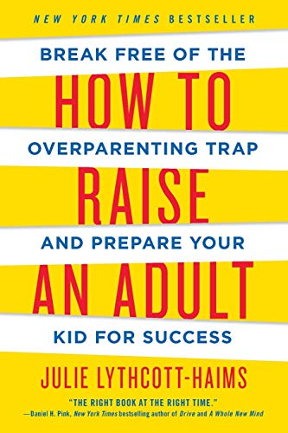
Deciding to allow our kids to have those essential experiences– to flail, fail, and fall– isn’t just a good way to help them learn and grow, it’s the best way.

Slide 114
Deciding to allow our kids to have those essential experiences– to flail, fail, and fall– isn’t just a good way to help them learn and grow, it’s the best way.
Mistakes can be life’s greatest teacher.

Slide 115
Mistakes and Curveballs you must let your kid experience:
Not being invited to a party
Procrastinating on a paper
Missing a show because she was helping grandma
Coming in last at something
Forgetting his lunch
Losing a game

Slide 116
3 Things that help connecting:
Cultivate conversations
2. Don’t bail; let ‘em fail
3. Get interested in what
interests them

Slide 117
Friendship
18+ years
Dial it back
You are no longer involved in the minutiae of their life
Your relationship is more like friendship

Slide 118
Helpful tips
Ask don’t tell
Know your tendencies
Pray Pray Pray

Slide 119
Final Thought

Slide 120
“The goal of parenting is not for us to decide what we want our children to become and then ruthlessly teach, train, squeeze, badger, and cajole them into that mold. Instead, we must recognize that God has already designed them.”

Slide 121
“God already has a mature person and long-range purpose in mind. Our job is to see our children as God does- and to involve ourselves in God’s plans for them. Like a sculptor, we must try to see the final form straining to break out of the uncut stone.” (89)

Slide 122
Psalm 139:13
You made all the delicate, inner parts of my body
and knit me together in my mother’s womb.

Slide 123
Psalm 139:15
You watched me as I was being formed in utter seclusion, as I was woven together in the dark of the womb.

Slide 124
Psalm 139:16
You saw me before I was born. Every day of my life was recorded in your book.
Every moment was laid out
before a single day had passed.

Slide 125
A Promise
Proverbs 3:5-6
Trust in the Lord with all your heart and do not lean on your own understanding. Acknowledge Him in all your ways and He will make your path straight.

Slide 126
Resources

