Slide 4
“This is a book about outrage. It’s an acknowledgment that our world, or at least our part in it, seems awash in anger, division, and hostility. Outrage is all around, so we have to decide how to walk through this. We are living in a day – and this is indeed our moment – when we need to live like Christ, as gospel Christians in the midst of shouting, anger, and hatred. And it’s going to get worse.” (xv)

Slide 5
Loving Outrageous People
^{Luke 19:1}

Slide 6
Loving Outrageous People
^{Luke 19:1} He entered Jericho and was passing through.

Slide 7
Loving Outrageous People
^{Luke 19:2} And there was a man called by the name of Zacchaeus; he was a chief tax collector and he was rich. ³ Zacchaeus was trying to see who Jesus was, and was unable because of the crowd, for he was small in stature.

Slide 8
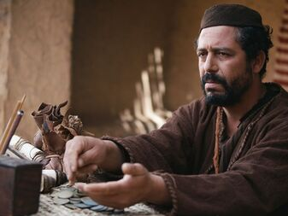
^{Luke 19:2} And there was a man called by the name of Zacchaeus; he was a chief tax collector and he was rich. ³ Zacchaeus was trying to see who Jesus was, and was unable because of the crowd, for he was small in stature.

Slide 9
: Jesus and Zacchaeus
Powerful
^{Luke 19:2} And there was a man called by the name of Zacchaeus; he was a chief tax collector and he was rich. ³ Zacchaeus was trying to see who Jesus was, and was unable because of the crowd, for he was small in stature.

Slide 10
Powerful
Rich
Corrupt
^{Luke 19:2} And there was a man called by the name of Zacchaeus; he was a chief tax collector and he was rich. ³ Zacchaeus was trying to see who Jesus was, and was unable because of the crowd, for he was small in stature.

Slide 11
Powerful
Rich
Corrupt
Notorious
^{Luke 19:2} And there was a man called by the name of Zacchaeus; he was a chief tax collector and he was rich. ³ Zacchaeus was trying to see who Jesus was, and was unable because of the crowd, for he was small in stature.

Slide 12
Powerful
Rich
Corrupt
Notorious
Short
^{Luke 19:2} And there was a man called by the name of Zacchaeus; he was a chief tax collector and he was rich. ³ Zacchaeus was trying to see who Jesus was, and was unable because of the crowd, for he was small in stature.

Slide 13
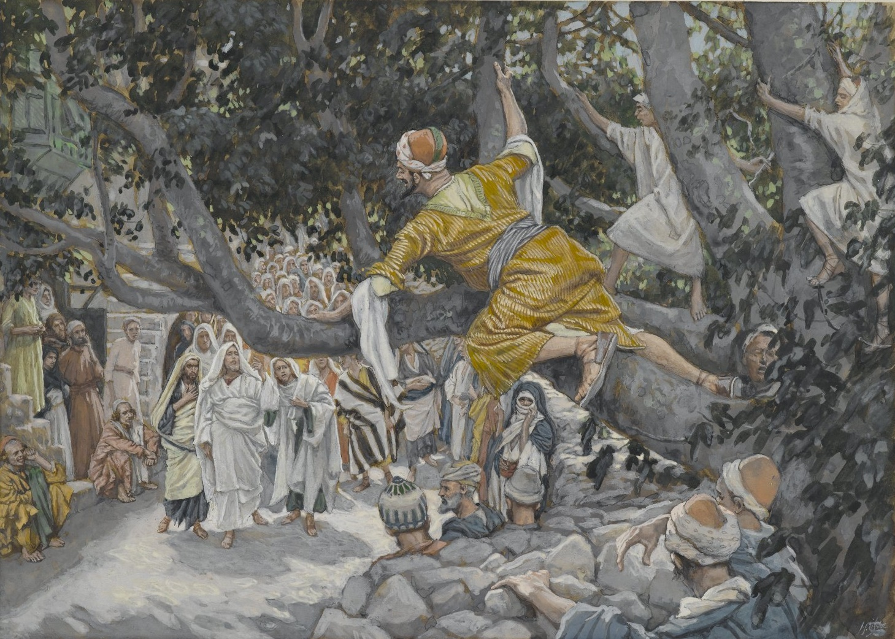
^{Luke 19:4} So he ran on ahead and climbed up into a sycamore tree in order to see Him, for He was about to pass through that way.

Slide 14
^{Luke 19:5} When Jesus came to the place, He looked up and said to him, “Zacchaeus, hurry and come down, for today I must stay at your house.”
⁶ And he hurried and came down and received Him gladly.

Slide 15
^{Luke 19:5} When Jesus came to the place, He looked up and said to him, “Zacchaeus, hurry and come down, for today I must stay at your house.”
⁶ And he hurried and came down and received Him gladly.

Slide 16
^{Luke 19:7} When they saw it, they all began to grumble, saying, “He has gone to be the guest of a man who is a sinner.”

Slide 17
^{Luke 19:7} When they saw it, they all began to grumble, saying, “He has gone to be the guest of a man who is a sinner.”
Why are they scandalized by this?

Slide 18
^{Luke 19:7} When they saw it, they all began to grumble, saying, “He has gone to be the guest of a man who is a sinner.”
But Jesus knew what he was doing…

Slide 19
^{Luke 19:8} Zacchaeus stopped and said to the Lord,
“Behold, Lord, half of my possessions I will give to the poor, and if I have defrauded anyone of anything, I will give back four times as much.”

Slide 20
^{Luke 19:8} Zacchaeus stopped and said to the Lord,
“Behold, Lord, half of my possessions I will give to the poor, and if I have defrauded anyone of anything, I will give back four times as much.”

Slide 21
^{Luke 19:8} Zacchaeus stopped and said to the Lord,
“Behold, Lord, half of my possessions I will give to the poor, and if I have defrauded anyone of anything, I will give back four times as much.”

Slide 22
^{Luke 19:8} Zacchaeus stopped and said to the Lord,
“Behold, Lord, half of my possessions I will give to the poor, and if I have defrauded anyone of anything, I will give back four times as much.”
sudden and dramatic transformation!

Slide 23
^{Luke 19:9} And Jesus said to him, “Today salvation has come to this house, because he, too, is a son of Abraham.
¹⁰ For the Son of Man has come to seek and to save that which was lost.

Slide 24
Contrast: Jesus viewed Zacchaeus entirely differently than the crowd
Ew! He is disgusting!
He’s one of them, and he’ll never be one of us
He doesn’t deserve honor…
He deserves shame and punishment
In short, they’re outraged
He needs to be defeated!
Sound familiar?
This is so unfair!

Slide 25
Contrast: Jesus viewed Zacchaeus entirely differently than the crowd
Ew! He is disgusting!
He’s one of them, and he’ll never be one of us
He doesn’t deserve honor…
Pretty hard to argue with any of these points, BTW!
He deserves shame and punishment
So did Jesus get the situation wrong?
He needs to be defeated!
This is so unfair!

Slide 26
Why did Jesus choose Zacchaeus?
Because Jesus is on a mission to seek and save lost things
¹⁰ For the Son of Man has come to seek and to save that which was lost.

Slide 27
Why did Jesus choose Zacchaeus?
“we like to go our own way… until we don’t”
^{Luke 19:4} So he ran on ahead and climbed up into a sycamore tree in order to see Him… ⁶ And he hurried and came down and received Him gladly.
Zacchaeus was lost
And he knew it
¹⁰ For the Son of Man has come to seek and to save that which was lost.

Slide 28
Why did Jesus choose Zacchaeus?
“If you don’t surrender to God don’t think you don’t surrender. Everybody surrenders to something. Some surrender to themselves as God. If you surrender to yourself as God, you won’t like your God. You will do as you like and then you won’t like what you do. You will express yourself and you won’t like the self you express. You won’t like yourself and no one else will like you.
- Ajith Fernando: Reclaiming Love – Victory through surrender
^{Luke 19:4} So he ran on ahead and climbed up into a sycamore tree in order to see Him… ⁶ And he hurried and came down and received Him gladly.
Zacchaeus was lost
And he knew it
¹⁰ For the Son of Man has come to seek and to save that which was lost.

Slide 29
Why did Jesus choose Zacchaeus?
^{Luke 19:4} So he ran on ahead and climbed up into a sycamore tree in order to see Him… ⁶ And he hurried and came down and received Him gladly.
Zacchaeus was lost
And he knew it
Jesus knew it too
¹⁰ For the Son of Man has come to seek and to save that which was lost.

Slide 30
Why did Jesus choose Zacchaeus?
^{Luke 19:5} When Jesus came to the place, He looked up and said to him, “Zacchaeus, hurry and come down, for today I must stay at your house.”
Zacchaeus was lost
And he knew it
Jesus knew it too
¹⁰ For the Son of Man has come to seek and to save that which was lost.

Slide 31
Why did Jesus choose Zacchaeus?
Jesus saw that Zacchaeus was 2 things:
Lost and ready to be found
^{Luke 19:5} When Jesus came to the place, He looked up and said to him, “Zacchaeus, hurry and come down, for today I must stay at your house.” ⁶ And he hurried and came down and received Him gladly.
Zacchaeus was lost
And he knew it
Jesus knew it too
¹⁰ For the Son of Man has come to seek and to save that which was lost.

Slide 32
Why did Jesus choose Zacchaeus?
Jesus saw that Zacchaeus was 2 things:
Lost and ready to be found
^{Luke 19:5} When Jesus came to the place, He looked up and said to him, “Zacchaeus, hurry and come down, for today I must stay at your house.” ⁶ And he hurried and came down and received Him gladly.
And “lost” is Jesus’s business
¹⁰ For the Son of Man has come to seek and to save that which was lost.

Slide 33
Why did Jesus choose Zacchaeus?
Jesus saw that Zacchaeus was 2 things:
Lost and ready to be found
^{Luke 19:5} When Jesus came to the place, He looked up and said to him, “Zacchaeus, hurry and come down, for today I must stay at your house.” ⁶ And he hurried and came down and received Him gladly.
And “lost” is Jesus’s business
¹⁰ For the Son of Man has come to seek and to save that which was lost.

Slide 34
Why did Jesus choose Zacchaeus?
^{Luke 19:5} When Jesus came to the place, He looked up and said to him, “Zacchaeus, hurry and come down, for today I must stay at your house.” ⁶ And he hurried and came down and received Him gladly.
And “lost” is Jesus’s business
¹⁰ For the Son of Man has come to seek and to save that which was lost.

Slide 35
Jesus viewed Zacchaeus:
As a “Lost” Person
That’s his paradigm for viewing people
Jesus was constantly moving toward lost people
¹⁰ For the Son of Man has come to seek and to save that which was lost.

Slide 36
Jesus viewed Zacchaeus:
As a “Lost” Person
With Dignity
¹⁰ For the Son of Man has come to seek and to save that which was lost.

Slide 37
“Jesus looked past Zacchaeus’s worldly identity and called out to him… saw Zacchaeus as a reflection of his own glory, buried under the brokenness of sin…
Predictably, those who saw their exchange were angry because they could not see past Zacchaeus’s social status and sin. They could not understand why Jesus would spend time with a man who, in their estimation, did not deserve love.” (219)

Slide 38
Jesus viewed Zacchaeus:
As a “Lost” Person
With Dignity
With Acceptance
¹⁰ For the Son of Man has come to seek and to save that which was lost.

Slide 39
Jesus viewed Zacchaeus:
As a “Lost” Person
With Dignity
With Acceptance
With Potential
With Mercy
With Honor
With GRACE
Essentially, Jesus showed him love
… when he didn’t deserve it …
¹⁰ For the Son of Man has come to seek and to save that which was lost.

Slide 40
Jesus viewed Zacchaeus:
As a “Lost” Person
With Dignity
With Acceptance
With Potential
With Mercy
With Honor
With GRACE
^{Luke 19:8} “Behold, Lord, half of my possessions I will give to the poor …
And the result was transformation
¹⁰ For the Son of Man has come to seek and to save that which was lost.

Slide 41
Jesus viewed Zacchaeus:
As a “Lost” Person
With Dignity
With Acceptance
With Potential
With Mercy
With Honor
With GRACE
What you’re seeing is not just a change of heart, or a bold resolution…
it is salvation in action
^{Luke 19:9} And Jesus said to him, “Today salvation has come to this house, because he, too, is a son of Abraham.
Jesus explains…
¹⁰ For the Son of Man has come to seek and to save that which was lost.

Slide 42
Jesus viewed Zacchaeus:
As a “Lost” Person
With Dignity
With Acceptance
With Potential
With Mercy
With Honor
With GRACE
What you’re seeing is not just a change of heart, or a bold resolution…
it is salvation in action
^{Luke 19:9} And Jesus said to him, “Today salvation has come to this house, because he, too, is a son of Abraham.
Jesus explains…
¹⁰ For the Son of Man has come to seek and to save that which was lost.

Slide 43
Jesus viewed Zacchaeus:
As a “Lost” Person
With Dignity
With Acceptance
With Potential
With Mercy
With Honor
With GRACE
Was Zacchaeus saved because he gave his money to the poor?
^{John 1:12} To all who believed him and accepted him, he gave the right to become children of God.
¹⁰ For the Son of Man has come to seek and to save that which was lost.

Slide 44
Jesus viewed Zacchaeus:
As a “Lost” Person
With Dignity
With Acceptance
With Potential
With Mercy
With Honor
With GRACE
a man with a new identity
Order: lost → grace → salvation → response
¹⁰ For the Son of Man has come to seek and to save that which was lost.

Slide 45
Jesus viewed Zacchaeus:
As a “Lost” Person
With Dignity
With Acceptance
With Potential
With Mercy
With Honor
With GRACE
Grace is a scandal! And when we experience it revolutionizes our lives
That’s what happened to Zacchaeus.
¹⁰ For the Son of Man has come to seek and to save that which was lost.

Slide 46
Outrage vs. Love

Slide 47
Jesus loves disgusting people
Do you see the challenge of Jesus’s example?

Slide 48
Jesus loves disgusting people, and so should we
Do you see the challenge of Jesus’s example?

Slide 49
Jesus loves disgusting people, and so should we
Do you see the challenge of Jesus’s example?
We have a choice which example we want to follow:
To go with the flow of our outraged culture

Slide 50
Some Christians post Bible verses professing the love of Christ, only to follow that with hostile if not derogatory insults against some political, cultural, or religious figure. When claims to being joy filled are mixed in with disparaging comments about a politician, it strikes onlookers as oddly disjointed. People believe our love is worthless when we cheapen it in this way. More important, they assume Christian love must be contingent upon political, economic, or cultural positions. This reduces our claims to merely another form of tribalism. (198)
Don’t let your ideology supersede your theology!

Slide 51
Jesus loves disgusting people, and so should we
Do you see the challenge of Jesus’s example?
We have a choice which example we want to follow:
To go with the flow of our outraged culture
Or we can follow after the way of Jesus

Slide 52
Jesus loves disgusting people, and so should we
How do we do that?

Slide 53
We need to see people the way that God sees them

Slide 54
We need to see people the way that God sees them
#1 As Image Bearers
Intrinsic Value and Dignity
^{Gen 5:1} When God created man, He made him in the likeness of God.
“This forms the basis of the radical equality of all human beings, regardless of gender, ethnicity, religion or any form of social, economic, or political status … Christian mission must therefore treat all human beings with dignity, equality and respect. When we look at any other person, we do not see the label … but the image of God. We see someone created by God, addressed by God, accountable to God, loved by God, valued and evaluated by God.”
– Christopher Wright. The Mission of God, 423

Slide 55
We need to see people the way that God sees them
#1 As Image Bearers
Intrinsic Value and Dignity
vs. Disgust

Slide 56
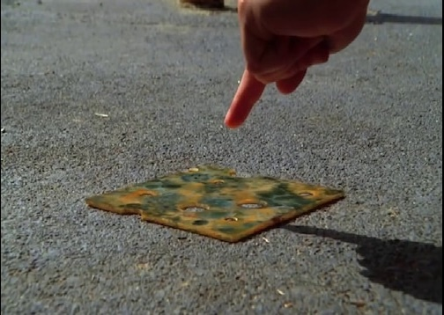
We need to see people the way that God sees them
#1 As Image Bearers
Intrinsic Value and Dignity
vs. Disgust

Slide 57
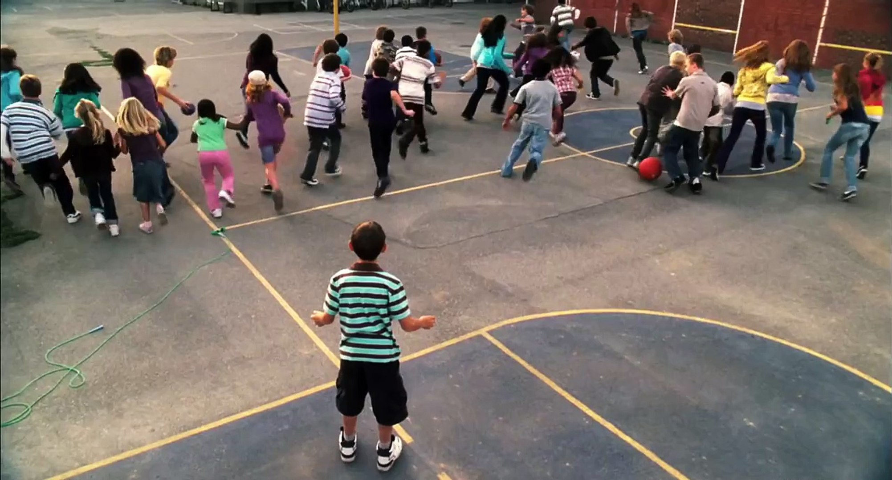
We need to see people the way that God sees them
#1 As Image Bearers
Intrinsic Value and Dignity
vs. Disgust

Slide 58
We need to see people the way that God sees them
#1 As Image Bearers
Intrinsic Value and Dignity
vs. Disgust
which is Dehumanizing

Slide 59
Disgust whittles an entire person down to one struggle, one sin, one issue. Disgust is dehumanizing and not of Jesus… Disgust halts any and all engagement. Like a bad odor or a revolting sight, disgust stops us in our tracks and prevents us from getting any closer to someone. (202-203)

Slide 60
Disgust will pervade our interactions, inform our quick dismissal of others, and even justify the harsh language we use to describe others. This is practically destructive to mission and highlights Christians at their worst…
And ultimately none of us can hide our feelings of revulsion. Disgust smells. And people catch the scent. (202-203)

Slide 61
Not only does disgust halt engagement, but it also distorts our view of our own sin… we reveal that … we think we are worthy and good while they are unworthy and bad. We cannot feel disgust without stating an opinion about ourselves in the process. (202-203)

Slide 62
We need to see people the way that God sees them
#1 As Image Bearers
Intrinsic Value and Dignity
vs. Disgust
which is Dehumanizing
Who disgusts you?

Slide 63
We need to see people the way that God sees them
#2 With Empathy

Slide 64
This is the solution to our disgust: cultivating the same love toward the world that Christ showed us. This empathic love – the ability to understand and relate to the experiences of others – is powerfully winsome… (205)

Slide 65
We need to see people the way that God sees them
#2 With Empathy
To understand that the world is broken, and people need God, not rejection
vs. fixating on what is wrong with them and acting out in outrage
^{Matt 9:36} Seeing the people, he felt compassion for them, because they were distressed and dispirited, like sheep without a shepherd.

Slide 66
We do not need to sacrifice our revulsion of sin …
Are you saying I should excuse evil and sin and pretend it isn’t wrong and destructive?

Slide 67
We do not need to sacrifice our revulsion of sin, but rather reframe how we see those caught in its power. We know the corrosive yet alluring power of sin that entangles this world (Heb 12:1), and we know the freedom and relief that come from being reconciled to the Father. We need to use that understanding to demonstrate an empathic love to the lost, ensuring that they know they can approach us with confidence that they will receive the mercy and grace that was first shown to us. (205)

Slide 68
We need to see people the way that God sees them
#3 With Humility
Pride drives us to obsession with winning and tribalism
Humility leads us to empathy, listening, and forbearance

Slide 69
Humility is not losing. It is not weakness or cowardliness. This is a lie of our outrage-fueled culture that meekness and humility are inferior to the screech and bellowing of the arrogant. In contrast… humble love that is submitted to Kingdom mission is incredibly powerful. The willingness to lower yourself by listening … reveals that you are interested in winning the person instead of the debate. (213)

Slide 70
We need to see people the way that God sees them
#3 With Humility
Pride drives us to obsession with winning and tribalism
Humility leads us to empathy, listening, and forbearance
^{1 Pet 5:5} God is opposed to the proud, but gives grace to the humble.

Slide 71
Nowhere is there a love that overcomes the barriers … except at the Cross. There is hope for racial reconciliation, for peace between the sexes, for ethnic harmony, and for healing when we rally around a common identity in Christ, love him as our Redeemer, and serve his Kingdom” (200)

Slide 72
We need to see people the way that God sees them
A beautiful aspect of God’s plan for salvation of mankind!
Worth keeping in mind when interacting with that person who makes you crazy!

Slide 73
We need to see people the way that God sees them
But how will He pull that off? Won’t we still be completely different and disagree on things?

Slide 74
We need to see people the way that God sees them
A wrong conclusion: we should shrink back and not engage one another on touchy matters

Slide 75
We need to see people the way that God sees them
With LOVE

Slide 76
So how will you respond to the Zacchaeus’s in your life?
Who disgusts you?
What is it that you wish for them?

Slide 77
We are all lost until we receive the forgiveness of Christ and begin a relationship with God
^{Revelation 3:20} Look! I stand at the door and knock. If you hear my voice and open the door, I will come in, and we will share a meal together as friends.

