Slide 1
The Confluence of Character and Competence
Part 2 – More Case Studies

Slide 2
Part 1 - XSI 2019
What is character?
What is competence?
How do character and competence relate to one another?

Slide 3
Part 1 - XSI 2019
What is character?
What is competence?
How do character and competence relate to one another?
Thesis: Growth in character ought to drive development in competency as a leader. Expanding leadership influence must be sustained by continued growth in character.

Slide 4
(1 Timothy 4) “Command and teach these things. ¹² Don’t let anyone look down on you because you are young, but set an example for the believers in speech, in conduct, in love, in faith and in purity. ¹³ Until I come, devote yourself to the public reading of Scripture, to preaching and to teaching. ¹⁴ Do not neglect your gift, which was given you through prophecy when the body of elders laid their hands on you. ¹⁵ Be diligent in these matters; give yourself wholly to them, so that everyone may see your progress. ¹⁶ Watch your life and doctrine closely. Persevere in them, because if you do, you will save both yourself and your hearers.”
Part 1 - XSI 2019
What is character?
What is competence?
How do character and competence relate to one another?
Thesis: Growth in character ought to drive development in competency as a leader. Expanding leadership influence must be sustained by continued growth in character.

Slide 5
Part 1 - XSI 2019
Four case studies:
Hospitable
Not self-willed
Gentle
Eager to serve
Today: let’s tackle 5-6 more!

Slide 6
Case Studies
Sensible
(Titus 1:8) loving what is good, sensible, just, devout…
(1 Peter 4:7) The end of all things is near; therefore, be of sound judgment and sober spirit for the purpose of prayer.
“Being in control of oneself, prudent, thoughtful, self-controlled.”(BDAG)

Slide 7
Case Studies
Sensible
(Titus 1:8) loving what is good, sensible, just, devout…
(1 Peter 5:8) Be alert and of sober mind. Your enemy the devil prowls around like a roaring lion looking for someone to devour.
“Careful consideration for responsible action…intent on the what, the how, and the when of doing what should be done” (BDAG)

Slide 8
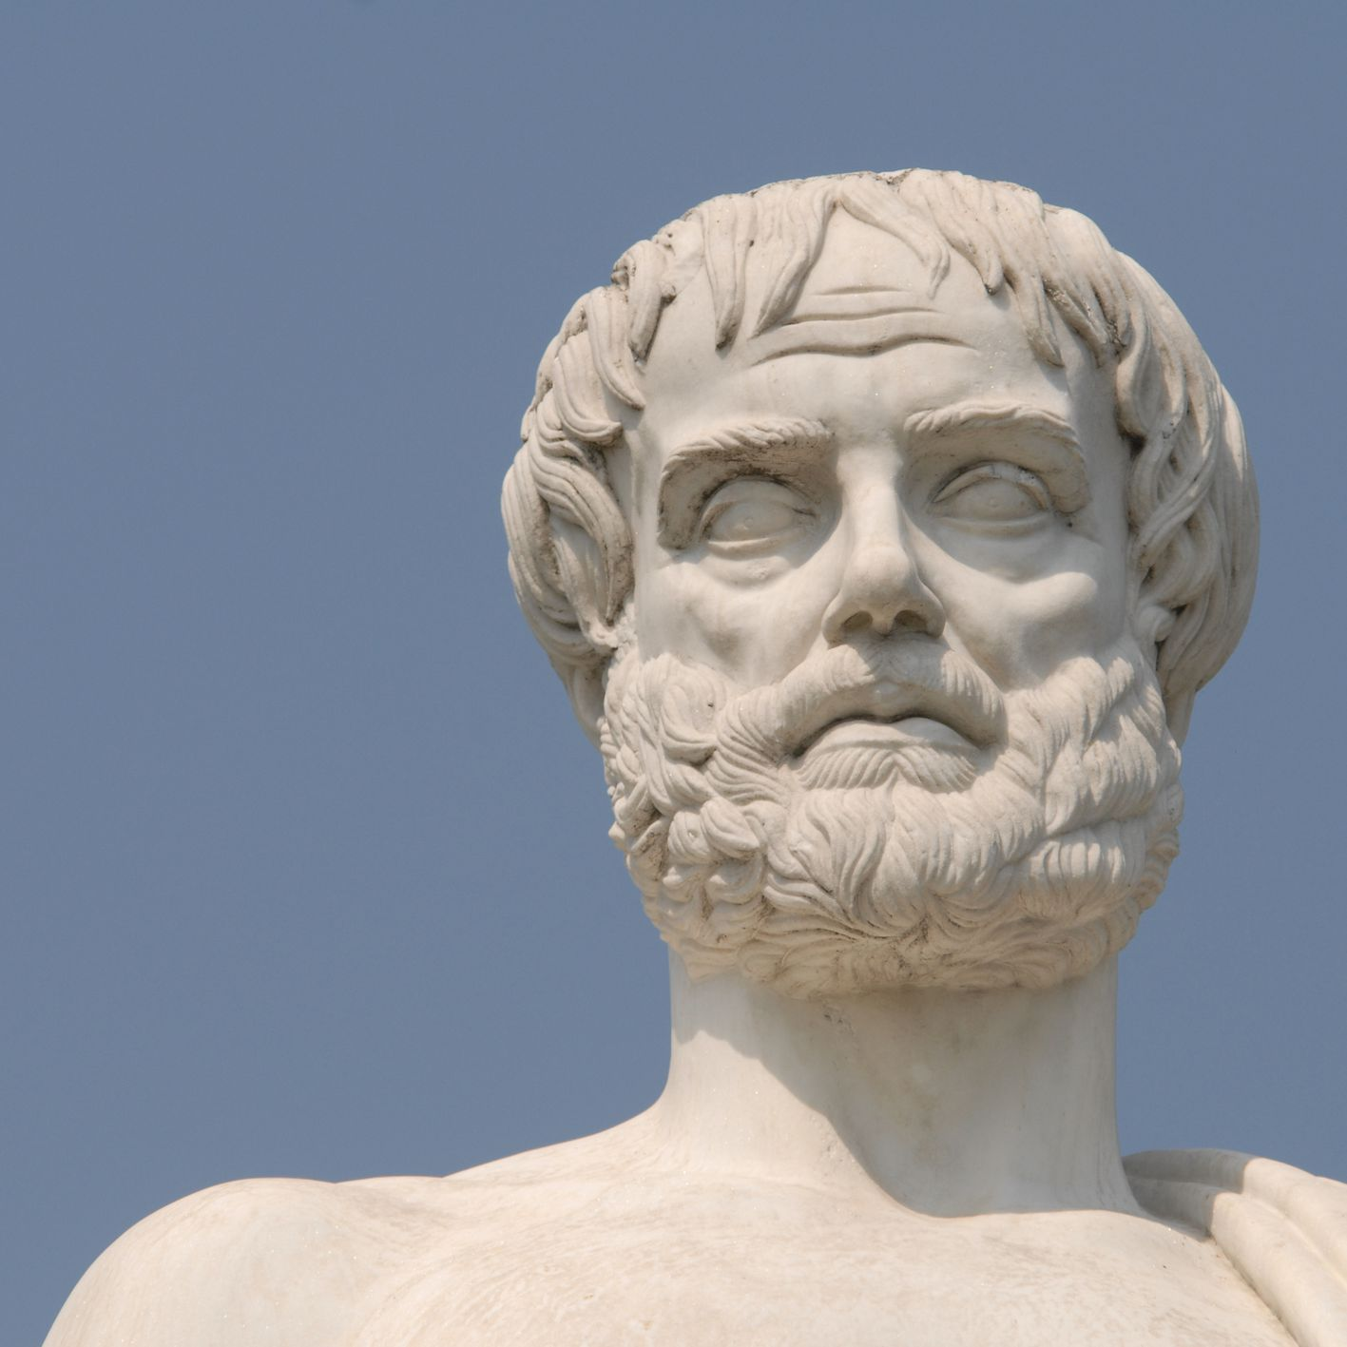
Case Studies
Sensible
(Titus 1:8) loving what is good, sensible, just, devout…
(1 Peter 5:8) Be alert and of sober mind. Your enemy the devil prowls around like a roaring lion looking for someone to devour.
“Careful consideration for responsible action…intent on the what, the how, and the when of doing what should be done” (BDAG)

Slide 9
Case Studies
Sensible
(Titus 1:8) loving what is good, sensible, just, devout…
Workers need to think critically, be vigilant, and ready to act
Not being dozy and distracted

Slide 10
Case Studies
Sensible
(Titus 1:8) loving what is good, sensible, just, devout…
Failure to anticipate what is coming can lead to discouraging setbacks and missed opportunities for growth

Slide 11
Case Studies
Sensible
(Titus 1:8) loving what is good, sensible, just, devout…
Able to weigh the pros and cons of major ministry moves
Paying attention to timing and pace

Slide 12
What would happen to your ministry if you failed to grow in this area over time?
Case Studies
Sensible
Being slow to make big calls leads to big fumbles
Failure to anticipate a problem can lead to major preventable damage
Barrier to greater responsibility
Leaders aren’t taken seriously

Slide 13
How would a person go about pursuing growth in this area?
Case Studies
Sensible
Don’t make personality based excuses
Make focused time to think and pray
Write down observations
Get help after thinking it through yourself and coming up with your own ideas
Ask God for growth!

Slide 14
Case Studies
“refers to a person who is interested in doing the right thing and chooses the good of society over personal advantage” (BDAG)
(Jer. 6.13) “From the least to the greatest, all are greedy for gain; prophets and priests alike, all practice deceit.
Just
(Titus 1:8) loving what is good, sensible, just, devout…
God is just and desires justice among his people
(Micah 6:8) He has shown you, O mortal, what is good. And what does the Lord require of you? To act justly and to love mercy and to walk humbly with your God.

Slide 15
Case Studies
Just
(Titus 1:8) loving what is good, sensible, just, devout…
Sensitive to what is fair and balanced
Refusing to abuse one’s position for personal gain
Remaining above reproach and free from accusation of corruption

Slide 16
What would happen to your ministry if you failed to grow in this area over time?
Case Studies
Just
God exposes corrupt leaders
Lose people’s trust
If undetected could eventually be the source of a major scandal
Grow increasingly autonomous
“Ministry greed” can lead to poor leadership decisions

Slide 17
How would a person go about pursuing growth in this area?
Case Studies
Just
Practice transparency and welcome accountability
Team leadership
Be wary of overly pragmatic decisions
Understand and critique ministry greed
Let God extrude you into new roles
Pray for growth!

Slide 18
Case Studies
Not double-tongued
(1 Timothy 3:8) …must be men of dignity, not double-tongued
Insincere
Someone who says one thing but does another
Not always a matter of blatant deceit, but from foolish conceit.

Slide 19
(Proverbs 25:19) Like a broken tooth or a lame foot is reliance on the unfaithful in a time of trouble.
Case Studies
Not double-tongued
(1 Timothy 3:8) …must be men of dignity, not double-tongued
Insincere
Someone who says one thing but does another
Not always a matter of blatant deceit, but from foolish conceit.
(Matthew 5:37) But let your ‘Yes’ be ‘Yes,’ and your ‘No,’ ‘No.’ For whatever is more than these is of evil.

Slide 20
(Ephesians 4:29) Do not let any unwholesome talk come out of your mouths, but only what is helpful for building others up according to their needs, that it may benefit those who listen.
Case Studies
Not double-tongued
(1 Timothy 3:8) …must be men of dignity, not double-tongued
Taking great care to be ingenuous and exact in speech engenders trust
Withholding or misrepresenting your opinion can be manipulative

Slide 21
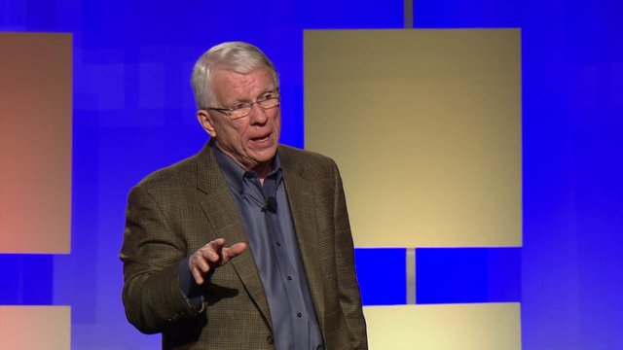
Case Studies
Not double-tongued
(1 Timothy 3:8) …must be men of dignity, not double-tongued
Taking great care to be ingenuous and exact in speech engenders trust
Withholding or misrepresenting your opinion can be manipulation
“Words can encourage, discourage, or do nothing. Shallow words accomplish little, death words discourage, and life words encourage.”

Slide 22
Case Studies
Not double-tongued
(1 Timothy 3:8) …must be men of dignity, not double-tongued
Taking great care to be ingenuous and exact in speech engenders trust
Withholding or misrepresenting your opinion can be manipulation
“We must learn to speak sincerely with positive impact, using our words to help other Christians pursue the pathway of obedience more zealously”

Slide 23
What would happen to your ministry if you failed to grow in this area over time?
Case Studies
Not double-tongued
Lose following due to lapsed commitments
You won’t be taken seriously
Fakeness repels believers and unbelievers
Shallow or broken friendships

Slide 24
How would a person go about pursuing growth in this area?
Case Studies
Not double-tongued
Study how God is a God of truth
Develop a devotional life where you work out clear convictions and direction
Root identity in Christ in order to defeat man pleasing tendencies.
Ask God for growth!

Slide 25
Case Studies
Holding fast the faithful Word
(Titus 1:9) holding fast the faithful Word which is in accordance with the teaching, so that he will be able both to exhort in sound doctrine and to refute those who contradict.

Slide 26
Case Studies
Holding fast the faithful Word
(Titus 1:9) holding fast the faithful Word…
Spiritual leadership requires a firm grasp of truth
Implies more than a surface level knowledge of scripture
Ignorance of God’s ways represents a moral problem

Slide 27
(2 Timothy 2:15) Be diligent to present yourself approved to God as a workman who does not need to be ashamed, accurately handling the word of truth.
Case Studies
Holding fast the faithful Word
(Titus 1:9) holding fast the faithful Word…
Spiritual leadership requires a firm grasp of truth
Implies more than a surface level knowledge of scripture
Ignorance of God’s ways represents a moral problem
(Matthew 22:29) But Jesus answered and said to them, “You are mistaken, not understanding the Scriptures nor the power of God.

Slide 28
Case Studies
Holding fast the faithful Word
(Titus 1:9) holding fast the faithful Word…
Not just memorization but consistent study and application
(1 Peter 2:2-3) like newborn babies, long for the pure milk of the word, so that by it you may grow in respect to salvation, if you have tasted the kindness of the Lord.

Slide 29
(1 Thessalonians 2:13) And we also thank God continually because, when you received the word of God, which you heard from us, you accepted it not as a human word, but as it actually is, the word of God, which is indeed at work in you who believe.
Case Studies
Holding fast the faithful Word
(Titus 1:9) holding fast the faithful Word…
Not just memorization but consistent study and application
Real spiritual fruit comes from the power of the Holy Spirit working through the Word

Slide 30
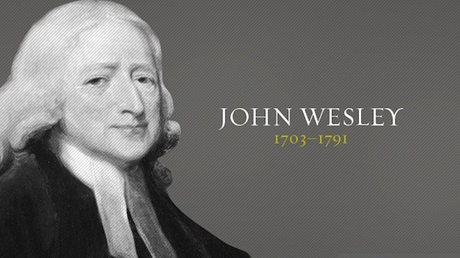
Case Studies
Holding fast the faithful Word
(Titus 1:9) holding fast the faithful Word…
Not just memorization but consistent study and application
Real spiritual fruit comes from the power of the Holy Spirit working through the Word
“He never indulged in a cheap disparagement of the intellect and was always trying to promote knowledge of the Scriptures and spiritual renewal among the people.”

Slide 31
Case Studies
Holding fast the faithful Word
(Titus 1:9) holding fast the faithful Word…
Not just memorization but consistent study and application
Real spiritual fruit comes from the power of the Holy Spirit working through the Word
“He was intellectually gifted and possessed an impressive command of English literature…Yet he was widely known as a person “of one Book.”

Slide 32
Case Studies
Holding fast the faithful Word
(Titus 1:9) holding fast the faithful Word…
Not just memorization but consistent study and application
Real spiritual fruit comes from the power of the Holy Spirit working through the Word
“That kind of breadth, focused on the Scriptures, is a high example of the consecrated intellect of the spiritual leader.”

Slide 33
What would happen to your ministry if you failed to grow in this area over time?
Case Studies
Holding fast the faithful Word
Struggle to produce long term convinced disciples
Shallow convictions regarding truth could lead to spiritual compromise
Prone to theological tangents.
Unable to discern satanic attacks or deception through the World system

Slide 34
How would a person go about pursuing growth in this area?
Case Studies
Holding fast the faithful Word
Commit to regular disciplined study
Challenge yourself to go deeper
Get around people who can help you
Put adequate time into teachings
Ask God for growth!

Slide 35
Case Studies
Able to teach
(2 Timothy 2:24) And the Lord’s servant must not be quarrelsome…able to teach
Private understanding may be personally edifying but can be stagnant in regards to its influence on others.
Knowledge that doesn’t build up others is deeply flawed

Slide 36
Case Studies
(1 Corinthians 8:1)…we know that we all have knowledge. Knowledge makes arrogant, but love edifies. Those who think they know something do not yet know as they ought to know. But whoever loves God is known by God.”
Able to teach
(2 Timothy 2:24) And the Lord’s servant must not be quarrelsome…able to teach
Private understanding may be personally edifying but can be stagnant in regards to its influence on others.
Knowledge that doesn’t build up others is deeply flawed

Slide 37
Case Studies
“refers to any type of instruction. Formal or informal.” (BDAG)
Able to teach
(2 Timothy 2:24) And the Lord’s servant must not be quarrelsome…able to teach
There are a wide variety of venues and levels at which a person can teach
Growing leaders constantly search for ways to make disciples more effectively

Slide 38
Case Studies
Able to teach
(2 Timothy 2:24) And the Lord’s servant must not be quarrelsome…able to teach
There are a wide variety of venues and levels at which a person can teach
Growing leaders constantly search for ways to make disciples more effectively
“When a man does not make me understand what he means, it is because he himself does not know what he means.”

Slide 39
Case Studies
Able to teach
(2 Timothy 2:24) And the Lord’s servant must not be quarrelsome…able to teach
There are a wide variety of venues and levels at which a person can teach
Growing leaders constantly search for ways to make disciples more effectively
“These Hebrew Christians had lost that zest to teach and were content to receive all they could for their sluggish, overfed souls. They had become spiritually self-absorbed.”

Slide 40
Case Studies
Able to teach
(2 Timothy 2:24) And the Lord’s servant must not be quarrelsome…able to teach
There are a wide variety of venues and levels at which a person can teach
Growing leaders constantly search for ways to make disciples more effectively
“Teaching others what we have learned is one of the best ways of stimulating our own appetite for the truth of God.”

Slide 41
What would happen to your ministry if you failed to grow in this area over time?
Case Studies
Able to teach
Make few disciples
Descend into self-centered spirituality
Less understanding (Matthew 13:11-12)

Slide 42
How would a person go about pursuing growth in this area?
Case Studies
Able to teach
Take Gary’s homiletics course
Find venues where you can excel
Make a habit of sharing what you learn
Try writing out thoughts and observations
Ask God for growth!

Slide 43
Conclusion
Do you aspire to grow in Christ-like character?
How might the Lord want to sharpen and equip you for ministry?
Is there an area where you sense God is drawing the line?

Slide 44
Reading List
The Normal Christian Worker, Watchman Nee
Absolute Surrender by Andrew Murray
Spiritual Leadership by J. Oswald Sanders
Paul the Leader by J. Oswald Sanders
The Cultivation of Christian Character by J. Oswald Sanders
The Man God Uses, by Chuck Smith

