Slide 1
FIRST PETER
THE BOOK OF

Slide 2
1 Peter 3
¹⁷ For it is better, if God should will it so, that you suffer for doing what is right rather than for doing what is wrong.
¹⁸ For Christ also died for sins once for all, the just for the unjust, so that He might bring us to God.

Slide 3
1 Peter 3
¹⁷ For it is better, if God should will it so, that you suffer for doing what is right rather than for doing what is wrong.
¹⁸ For Christ also died for sins once for all, the just for the unjust, so that He might bring us to God.

Slide 4
1 Peter 3
¹⁷ For it is better, if God should will it so, that you suffer for doing what is right rather than for doing what is wrong.
¹⁸ For Christ also died for sins once for all, the just for the unjust, so that He might bring us to God.

Slide 5
1 Peter 3
¹⁷ For it is better, if God should will it so, that you suffer for doing what is right rather than for doing what is wrong.
¹⁸ For Christ also died for sins once for all, the just for the unjust, so that He might bring us to God.

Slide 6
1 Peter 3
¹⁸ He was put to death in the body but made alive in the Spirit.
¹⁹ After being made alive, he went and made proclamation to the imprisoned spirits—
²⁰ to those who were disobedient long ago when God waited patiently in the days of Noah while the ark was being built. In it only a few people, eight in all, were saved through water.

Slide 7
1 Peter 3
¹⁸ He was put to death in the body but made alive in the Spirit.
¹⁹ After being made alive, he went and made proclamation to the imprisoned spirits—
²⁰ to those who were disobedient long ago when God waited patiently in the days of Noah while the ark was being built. In it only a few people, eight in all, were saved through water.
1 Peter 4:6: For this is the reason the gospel was preached even to those who are now dead, so that they might be judged according to human standards in regard to the body, but live according to God in regard to the spirit.

Slide 8
1 Peter 3
¹⁸ He was put to death in the body but made alive in the Spirit.
¹⁹ After being made alive, he went and made proclamation to the imprisoned spirits—
²⁰ to those who were disobedient long ago when God waited patiently in the days of Noah while the ark was being built. In it only a few people, eight in all, were saved through water.
What relationship did Peter see between his readers and the life of Noah?
» Peter keeps telling us that our peculiar behavior may draw ill-treatment from our family and friends.
» Noah faced this during his day.
“Noah was a righteous man, blameless among the people of his time, and he walked faithfully with God.” (Genesis 6:9).

Slide 9
1 Peter 3
¹⁸ He was put to death in the body but made alive in the Spirit.
¹⁹ After being made alive, he went and made proclamation to the imprisoned spirits—
²⁰ to those who were disobedient long ago when God waited patiently in the days of Noah while the ark was being built. In it only a few people, eight in all, were saved through water.
What relationship did Peter see between his readers and the life of Noah?
» The context in which Noah walked with God
“The LORD saw how great the wickedness of the human race had become on the earth, and that every inclination of the thoughts of the human heart was only evil all the time” (Genesis 6:5).

Slide 10
1 Peter 3
¹⁸ He was put to death in the body but made alive in the Spirit.
¹⁹ After being made alive, he went and made proclamation to the imprisoned spirits—
²⁰ to those who were disobedient long ago when God waited patiently in the days of Noah while the ark was being built. In it only a few people, eight in all, were saved through water.
What relationship did Peter see between his readers and the life of Noah?
» The context in which Noah walked with God
» God warned Noah about a catastrophic deluge and instructed him to build a barge.
Can you imagine the ridicule you would face building an enormous ark in the middle of a semi-arid region?

Slide 11
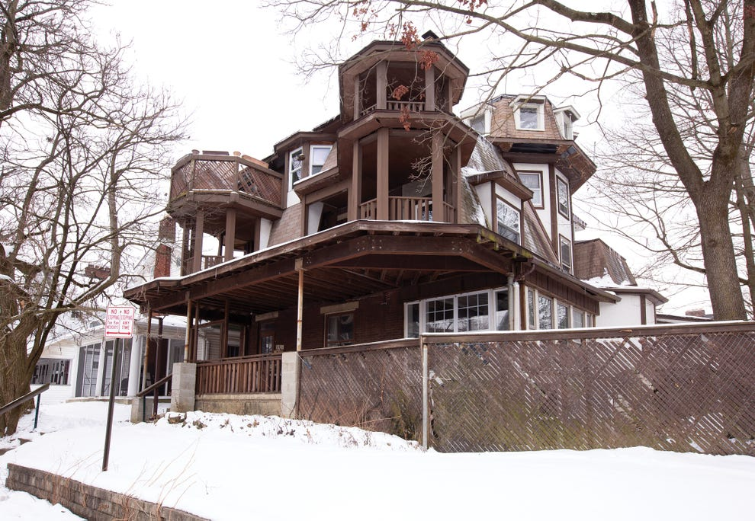

Slide 12
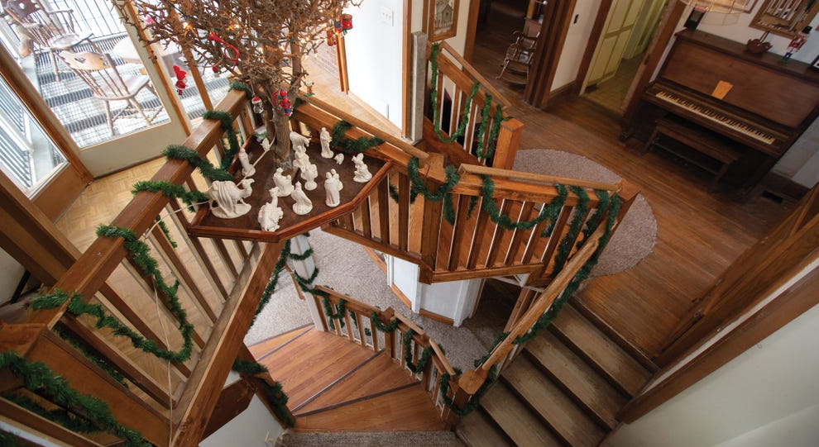
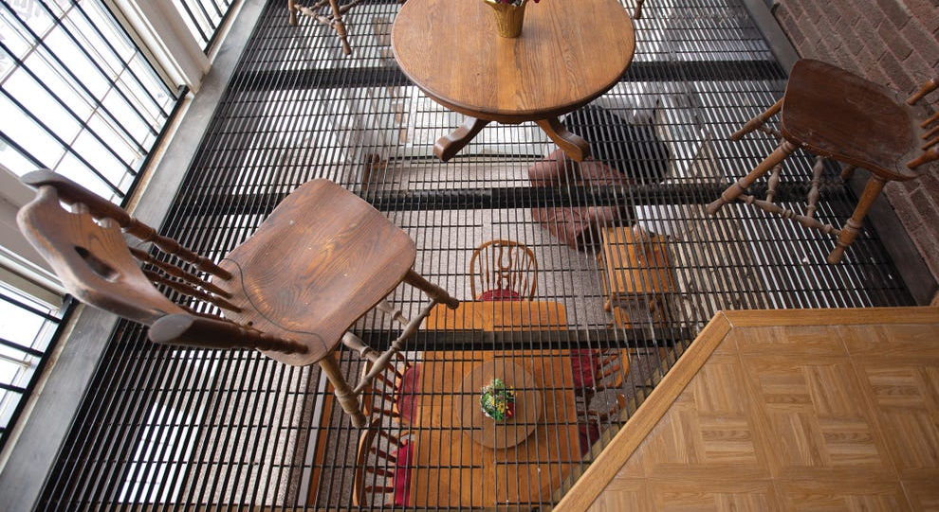
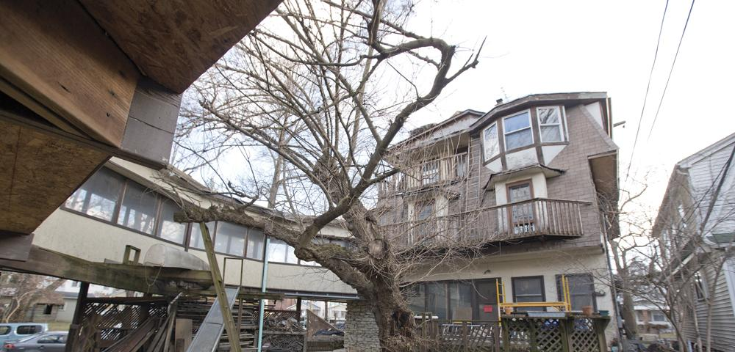
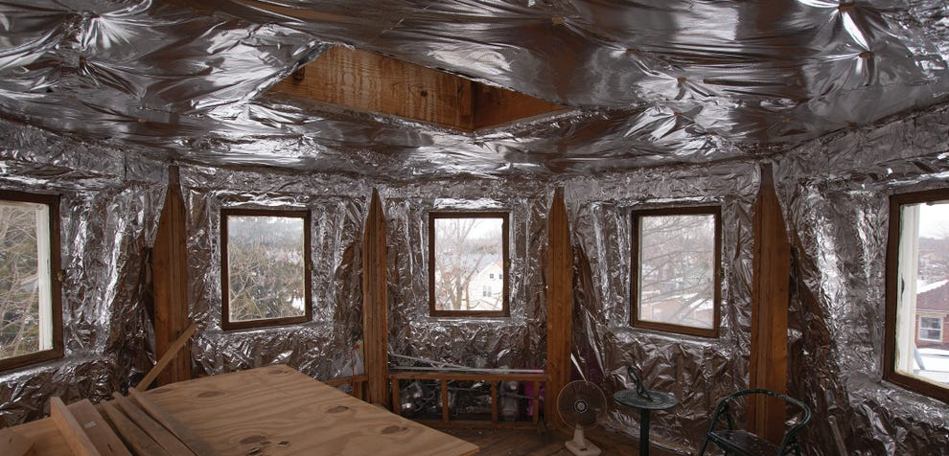

Slide 13
1 Peter 3
¹⁸ He was put to death in the body but made alive in the Spirit.
¹⁹ After being made alive, he went and made proclamation to the imprisoned spirits—
²⁰ to those who were disobedient long ago when God waited patiently in the days of Noah while the ark was being built. In it only a few people, eight in all, were saved through water.
What relationship did Peter see between his readers and the life of Noah?
» The context in which Noah walked with God
» God warned Noah about a catastrophic deluge he would send on the land and instructed him to build a barge.
» Noah must’ve endured this for years as he built the Ark.

Slide 14
1 Peter 3
¹⁸ He was put to death in the body but made alive in the Spirit.
¹⁹ After being made alive, he went and made proclamation to the imprisoned spirits—
²⁰ to those who were disobedient long ago when God waited patiently in the days of Noah while the ark was being built. In it only a few people, eight in all, were saved through water.
What relationship did Peter see between his readers and the life of Noah?
» The Apostle Peter sheds further light on Noah’s life.
“If [God]…protected Noah, a preacher of righteousness, and seven others... then the Lord knows how to rescue godly men from trials” (2 Peter 2:5).

Slide 15
1 Peter 3
¹⁸ He was put to death in the body but made alive in the Spirit.
¹⁹ After being made alive, he went and made proclamation to the imprisoned spirits—
²⁰ to those who were disobedient long ago when God waited patiently in the days of Noah while the ark was being built. In it only a few people, eight in all, were saved through water.
What relationship did Peter see between his readers and the life of Noah?
» The Apostle Peter sheds further light on Noah’s life.
» Put yourself in Noah’s shoes.

Slide 16
1 Peter 3
²¹ This water symbolizes baptism that now saves you also—not the removal of dirt from the body but the pledge of a clear conscience toward God. It saves you by the resurrection of Jesus Christ,
²² who has gone into heaven and is at God’s right hand—with angels, authorities and powers in submission to him.

Slide 17
1 Peter 3
²¹ This water symbolizes baptism that now saves you also—not the removal of dirt from the body but the pledge of a clear conscience toward God. It saves you by the resurrection of Jesus Christ,
²² who has gone into heaven and is at God’s right hand—with angels, authorities and powers in submission to him.
“Correspondingly”
3:20
3:21
A few
Were saved
Through water
You
Baptism saves you
Through the resurrection of Jesus

Slide 18
1 Peter 3
²¹ This water symbolizes baptism that now saves you also—not the removal of dirt from the body but the pledge of a clear conscience toward God. It saves you by the resurrection of Jesus Christ,
²² who has gone into heaven and is at God’s right hand—with angels, authorities and powers in submission to him.
Just as God placed Noah in the Ark to save him, God places us in Christ to save us from judgment.
Genesis 7:15-16: “Noah entered the ark...Then the LORD shut him in.”

Slide 19
1 Peter 4
¹ Therefore, since Christ suffered in his body, arm yourselves also with the same attitude, because whoever suffers in the body is done with sin.

Slide 20
1 Peter 4
² As a result, they do not live the rest of their earthly lives for evil human desires, but rather for the will of God.
³ For you have spent enough time in the past doing what [the people in the world] choose to do—living in debauchery, lust, drunkenness, orgies, carousing and detestable idolatry.

Slide 21
1 Peter 4
² As a result, they do not live the rest of their earthly lives for evil human desires, but rather for the will of God.
³ For you have spent enough time in the past doing what [the people in the world] choose to do—living in debauchery, lust, drunkenness, orgies, carousing and detestable idolatry.

Slide 22
1 Peter 4
² As a result, they do not live the rest of their earthly lives for evil human desires, but rather for the will of God.
³ For you have spent enough time in the past doing what [the people in the world] choose to do—living in debauchery, lust, drunkenness, orgies, carousing and detestable idolatry.
def. “to drink deeply and frequently”

Slide 23
1 Peter 4
² As a result, they do not live the rest of their earthly lives for evil human desires, but rather for the will of God.
³ For you have spent enough time in the past doing what [the people in the world] choose to do—living in debauchery, lust, drunkenness, orgies, carousing and detestable idolatry.

Slide 24
1 Peter 4
⁴ They are surprised that you do not join them in their reckless, wild living, and they heap abuse on you.
⁵ But they will have to give account to him who is ready to judge the living and the dead.

Slide 25
1 Peter 4
⁴ They are surprised that you do not join them in their reckless, wild living, and they heap abuse on you.
⁵ But they will have to give account to him who is ready to judge the living and the dead.

Slide 26
1 Peter 4
⁴ They are surprised that you do not join them in their reckless, wild living, and they heap abuse on you.
⁵ But they will have to give account to him who is ready to judge the living and the dead.

Slide 27
Conclusions
» The more serious you are about your walk with God, the more odd you will look.
» Just as in the days of Noah, so shall it be in the day when Jesus returns.
» The only safe place to be in this world is right in the center of God’s will.

Slide 28
FIRST PETER
THE BOOK OF

