Slide 1
Beyond Addiction Recovery:
Growing into being a disciple of Christ

Slide 2
Autobiography in Five Short Chapters by Portia Nelson “There’s a hole in my sidewalk”

Slide 3
Pat’s Story…

Slide 4
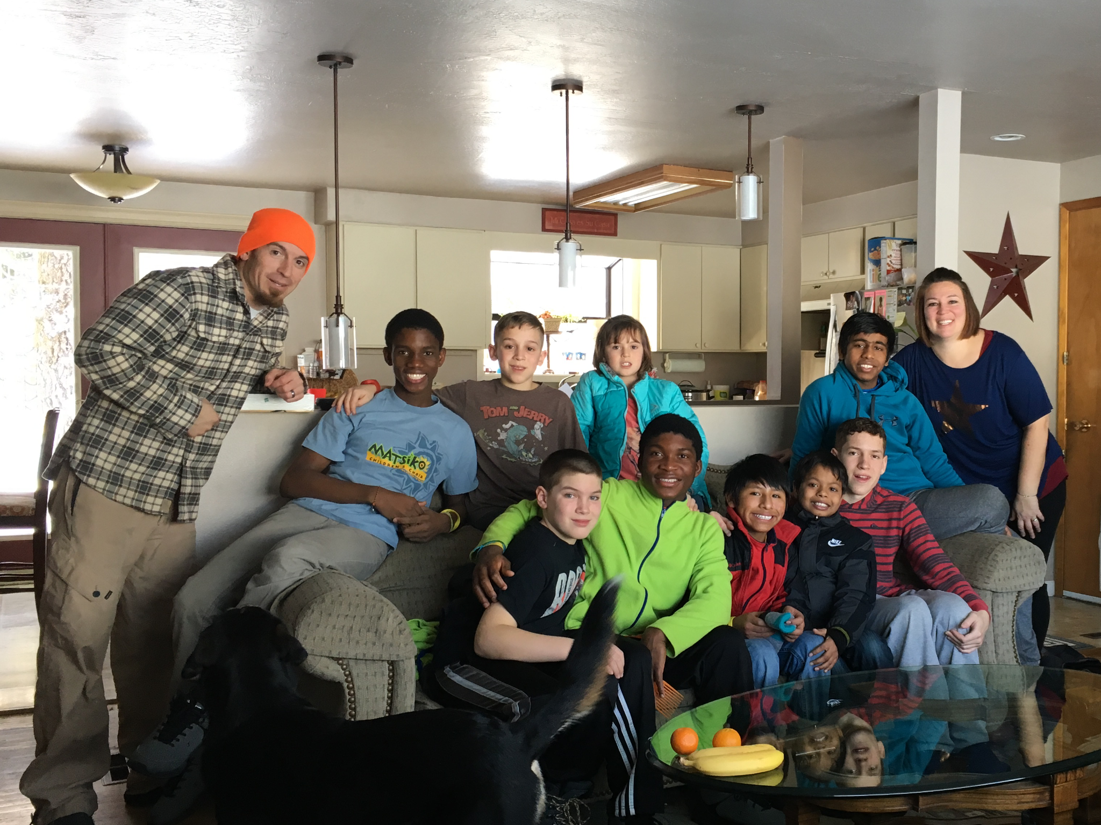

Slide 5
Pat’s Story…

Slide 6
“Recovery” is defined as…

Slide 7
“Recovery” is defined as…
to RETURN to a NORMAL state of health, mind, or strength

Slide 8
“Recovery” is defined as…
to RETURN to a NORMAL state of health, mind, or strength
To find or regain possession of something STOLEN or LOST

Slide 9
Recovery is not just…

Slide 10
Recovery is not just…
Sobriety

Slide 11
Recovery is not just…
Sobriety
Freedom from addiction

Slide 12
Recovery is not just…
Sobriety
Freedom from addiction
Attending meetings /doing the 12 Steps

Slide 13
Recovery is not just…
Sobriety
Freedom from addiction
Attending meetings /doing the 12 Steps
About drugs and alcohol

Slide 14
Recovery is not just…
Sobriety
Freedom from addiction
Attending meetings /doing the 12 Steps
About drugs and alcohol
Not sinning

Slide 16
Greatest Strength…
and what keeps people STAYING

Slide 17
Greatest Strengths of Recovery…
Safety

Slide 18
Greatest Strengths of Recovery…
Safety
Community

Slide 19
Greatest Strengths of Recovery…
Safety
Community
Brokenness

Slide 20
Greatest Strengths of Recovery…
Safety
Community
Brokenness
A Process for Change

Slide 21
Hope Formula

Slide 22
Greatest Strengths of Recovery…
Safety
Community
Brokenness
A Process for Change
A Front Door

Slide 23
Simple Wisdom…

Slide 24
RECOVERY’S SIMPLE WISDOM…
Nothing goes away until it’s RESOLVED.

Slide 25
Recovery’s Simple Wisdom…
God uses PAIN. (Hebrews 12:7-11, Galatians 6:7-8)

Slide 26
Recovery’s Simple Wisdom…
Definition of INSANITY: “Doing the SAME THING over and over and expecting different results”

Slide 27
Recovery’s Simple Wisdom…
You cannot do Recovery ALONE!

Slide 28
Recovery’s Simple Wisdom…
People do drugs for a reason…THEY WORK!

Slide 29
Greatest weaknesses…
and what keeps people STUCK

Slide 30
Greatest weaknesses of Recovery…
Blind leading the blind

Slide 31
Greatest weaknesses of Recovery…
Blind leading the blind
How we identify ourselves

Slide 32
Greatest weaknesses of Recovery…
Blind leading the blind
How we identify ourselves
Too focused on behaviors

Slide 33
Greatest weaknesses of Recovery…
Blind leading the blind
How we identify ourselves
Too focused on behaviors
Becoming an accidental Pharisee

Slide 34
Greatest weaknesses of Recovery…
Blind leading the blind
How we identify ourselves
Too focused on behaviors
Becoming an accidental Pharisee
Allowing a victim mentality

Slide 35
Greatest weaknesses of Recovery…
Blind leading the blind
How we identify ourselves
Too focused on behaviors
Becoming an accidental Pharisee
Allowing a victim mentality
Recovery first, Christianity second

Slide 36
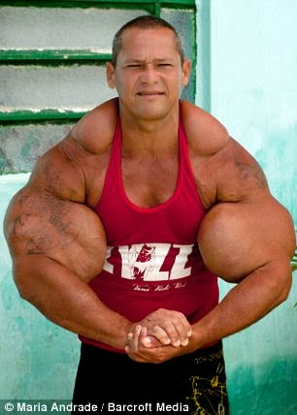

Slide 37
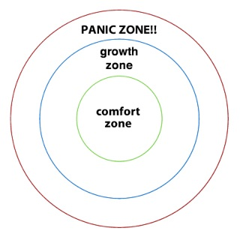

Slide 38
Church Strengths…
relating to Recovery

Slide 39
Church strengths…
Biblical VISION

Slide 40
Church strengths…
Biblical VISION
Biblical FAMILY

Slide 41
Church strengths…
Biblical VISION
Biblical FAMILY
Biblical IDENTITY

Slide 42
Church weaknesses…
relating to Recovery

Slide 43
Church weaknesses…
Not HONEST

Slide 44
Church weaknesses…
Not HONEST
Accidental PHARISEES

Slide 45
Church weaknesses…
Not HONEST
Accidental PHARISEES
Not SAFE

Slide 46
The end goal…

Slide 47
The end Goal of Recovery is to…
Help people become who God made them to be.

Slide 48
The end Goal of Recovery is to…
Help people become who God made them to be.
Who God has DESIGNED them to be

Slide 49
The end Goal of Recovery is to…
Help people become who God made them to be.
Who God has CALLED them to do

Slide 50
The end Goal of Recovery is to…
Help people become who God made them to be.
FREE from what’s kept them lost

Slide 51
The end Goal of Recovery is to…
Help people become who God made them to be.
LIVING OUT their design, calling, & freedom

Slide 52
Go Live it out…
and don’t forget where you came from!

