Slide 1
Sibling Rivalry: Ideas to foster peace/friendship

Slide 2
Sibling Rivalry
PRAY/Introduction:
Notes:
Name is Chris Deken. I am the youngest of six children. My husband has four siblings and I am blessed to have five children and now five grandchildren. Home Schooled through grade school>>Lots of sibling interaction-Best training for parenting was in law school-Class on Negotiation, Arbitration and Conflict resolution.
RANGE: fighting over toys as toddlers, clothes and makeup and bathroom time as teenage girls
After definition, what are some of your stories of sibing rivalry? Anybody have recent stories or examples….like this morning?

Slide 3
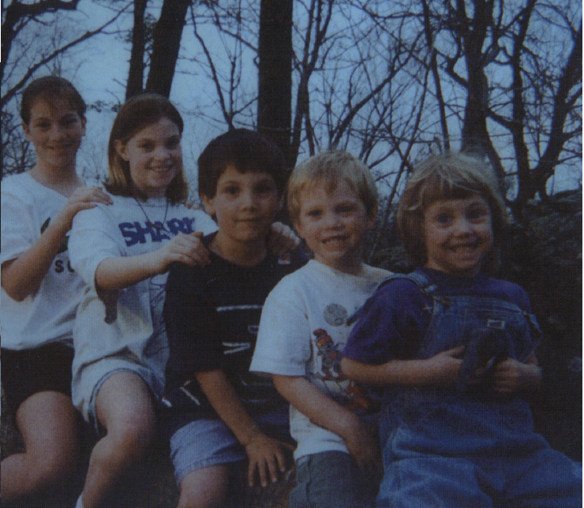

Slide 4
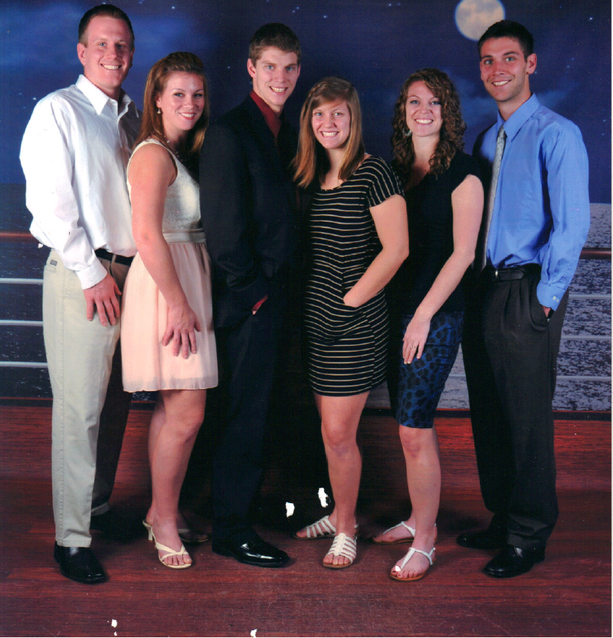

Slide 5
Sibling Rivalry
Introduction:
Definition:
The jealousy, competition, fighting between siblings (brothers and sisters)
Any examples, recent experiences?
Scope of the Problem: What are we really talking about?
Notes:
Name is Chris Deken. I am the youngest of six children. My husband has four siblings and I am blessed to have five children and now five grandchildren. Lots of sibling interaction-Best training for parenting was in law school-Class on Negotiation, Arbitration and Conflict resolution.
RANGE: fighting over toys as toddlers, clothes and makeup and bathroom time as teenage girls
After definition, what are some of your stories of sibing rivalry? Anybody have recent stories or examples….like this morning?

Slide 6
Problem for kids
Range of issues:
Fighting over things, respecting others and property,
Other stuff: Hungry, tired
Developmental stages
Notes:
From fighting over a toy, or candy….which have their own issues of selfishness and sharing, respecting property, how to go about getting something, stealing…important issues….
Older child can verbalize, maybe have more self control….

Slide 7
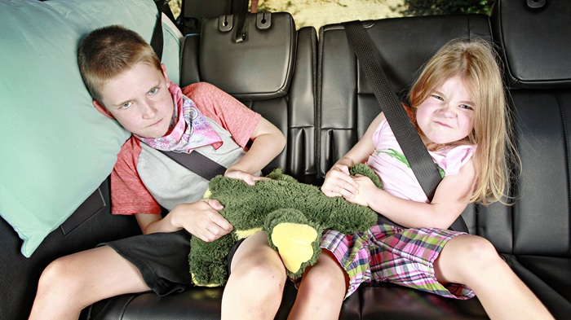

Slide 8
Problem for kids
Range of issues:
Fighting over things, respecting others and property,
Other stuff: Hungry, tired
Developmental stages
Ambivalent Emotions: love/hate
Notes:
From fighting over a toy, or candy….which have their own issues of selfishness and sharing, respecting property, how to go about getting something, stealing…important issues….
Older child can verbalize, maybe have more self control….

Slide 9
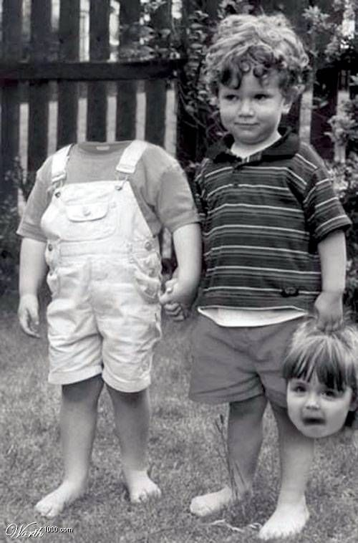
Notes:
Example of Cait with baby Rory

Slide 10
Sibling Rivalry: Scope of the Problem: children
Deep Issues of identity, love, self-worth and significance
A child trying to get needs of love, value and significance met apart from God. (Like Us) Usually from one or both of the parents….
Notes:
Deep seated stuff-

Slide 11
Sibling Rivalry: Scope of problem for Parents
Exhausting, referee, all I do is discipline, nothing seems to work or help….
Tired, hungry, stressed about other things
Concern over the heart issues…want them to feel loved and valued because they are….Overwhelmed by the responsibility and feelings of inadequacy
Caveat:
1 Not responsible to make your child love their sibling
2 No sure fire remedy, ideas
Notes:
NOT RESPONSIBLE FOR MAKING YOUR CHILD LOVE THEIR SIBLING-Can’t do that…I HAVE NO SURE FIRE REMEDY…Just ideas….based on God’s word who is the perfect parent

Slide 12
Benefits/Encouragement
Opportunities for Growth: ….Not center of the world…
Daily laboratory for training in relationships-Cooperating, Seeing another’s point of view….Good relationships key
Teaching conflict resolution skills, respectful disagreements, sharing,
Teach God’s view and value of other humans
Potentially a lifelong friend…someone to care for each other when gone
Significant work! Help shape eternal beings
Realistic expectation: sibling rivalry will be an issue but hope is friendship/support

Slide 13
Biblical Examples: NEGATIVE
Cain and Abel: Jealous that God was pleased with Abel’s offering
(Gen. 4:1-5)
Jacob and Esau: Envy/Jealousy over first born>scheming, deceit
(Gen. 25-35)
Joseph and brothers: Jealousy/Envy Father showed distinct favoritism (beautiful robe) (Gen. 30-50)
Joseph boasted about a dream that brothers would bow down to him.
Prodigal Son/Older Brother: Bitterness, Jealousy (Luke 15:11-32)

Slide 14
Biblical Examples: POSITIVE
Moses and Aaron: Worked together doing God’s work a long time
(Exodus 4: ff)
Peter/Andrew: Andrew met Jesus first, he brought Peter to Jesus, Both became disciples of Jesus (John 1:40-42)
Martha, Mary and Lazarus: Martha cooked/cleaned, Mary sat at Jesus’ feet…Martha complained…conflicts … overall good relationship.
(Luke 10:38-42, John 11)

Slide 15
Biblical Examples: What can we learn?
Common thread: Favoritism: Real or Perceived
Abel: firstborn of flock and fat portions, Cain: some of his crops
God was pleased with Abel’s choice…Cain perceived the different response as favoritism but because of his choice
Isaac favored Esau as first born, Rachel loved Jacob
Jacob favored Joseph because born to wife, Rachel, that Jacob loved
Joseph boasted about his dream: Lack of Humility
Older brother to prodigal-perceived favoritism by his father

Slide 16
Biblical Examples: What can we learn?
Common thread: Preference or Favoritism: Real or Perceived
Don’t show favoritism

Slide 17
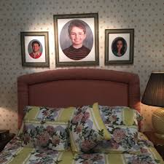

Slide 18
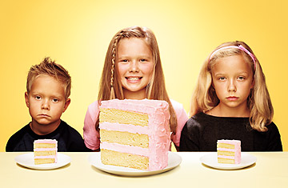

Slide 19
Biblical Examples: What can we learn?
No Favoritism:
Does this mean Treat equally? Yes when you can
Does this mean treat exactly the same? No-Impossible and not desirable
Example: Flip flops, underwear, didn’t videotape 1st, did the 2nd, Math, High School parent panel
Treat uniquely: Acknowledge feelings, (know them)recognize differences in needs, abilities, interests etc…KNOWN and LOVED
Special needs, Strong willed child-squeaky wheel gets the grease
Notes:
# Presents, Easter eggs, each gets a weekly date…No coat of many colors for one without the other getting something,
Every Christmas-Got the exact same gift….treated equally but not valuing who they were,
Same # of gifts, Same # of Reese’s eggs…
Older child can drive at 16, explain the differences…

Slide 20
Biblical Examples: What can we learn?
Common thread: Preference or Favoritism: Real or Perceived
What if we feel like we have a favorite?
Notes:
Feelings-can’t control ….May not like one at the time so much…Infants in middle of night, kid that runs outside and starts screaming help, child abuse, .But you love them….
Feelings of struggle with a particular child but don’t mean you love them less…..Easy right now….but don’t love less…..

Slide 21
Feelings of Favoritism?
65% moms/70% dads have favorites but won’t admit
Birth Order, Gender, Appearance, Accomplishments, Personality
Cait- “nothing special”
Birth order gives rise to different treatment sometimes…

Slide 22
Lean against showing favoritism
Fight hard not to show it! -Perception of favoritism feels hurtful….Can’t control it all but can try…
and when know they perceive favoritism…try to explain why….
“Talking about the situation openly is the best and most direct way to limit resentment. Parents should give reasons the differential treatment is important….Research suggests that differential treatment may have no negative effects when children understand why.”
(TIME, 10/3/2011, Vol. 178 Issue 13, p 44-50).
Notes:
Reiterates the biblical story

Slide 23
Biblical Examples: What can we learn?
Father of Prodigal and Older brother
“²⁸ But he (older brother) became angry and was not willing to go in; and his father came out and began pleading with him. ²⁹ But he answered and said to his father, ‘Look! For so many years I have been serving you and I have never neglected a command of yours; and yet you have never given me a young goat, so that I might celebrate with my friends; but when this son of yours came, who has devoured your wealth with prostitutes, you killed the fattened calf for him.’”
And he said to him, ‘Son, you have always been with me, and all that is mine is yours. But we had to celebrate and rejoice, for this brother of yours was dead and has begun to live, and was lost and has been found.’”
(Luke 15:28-32)
Notes:
Reiterates the biblical story

Slide 24
Positive Biblical Examples: What can we learn?
Common thread: All positive examples of sibling relationships had a close relationship with God or Jesus and demonstrated humility
Moses and Aaron: Aaron probably older brother yet Moses more prominent…Aaron helper to Moses, Moses appreciated Aaron’s strengths and how he complemented Moses
Moses was a very humble man…more humble than anyone else….Numbers 12:3
Peter and Andrew: Andrew met Jesus first, recognized Jesus worth …he went to tell Peter, Peter receives extra attention, training, Peter becomes prominent
Martha and Mary: Mary received praise for her choice while Martha was corrected. Yet, Martha tells Mary when Jesus came at death of Lazarus.

Slide 25
Humility and Love of God
Through their relationship with God experienced his love and humility
Ultimate example of Humility: God (Jesus) on a cross
Also,
Ultimate Love displayed on the cross

Slide 26
Sibling Rivalry
Point our children to God to learn humility and perfect love
How is God’s example of humility and love he demonstrated on the cross connected to sibling rivalry?
Humility: Calls us to treat others-(incl. siblings) with humility
Do nothing from selfishness or empty conceit, but with humility of mind regard one another as more important than yourselves; do not merely look out for your own personal interests, but also for the interests of others. (Phil. 2:3-4)
Love of God >Issues of identity, love and self-worth-
Can love others siblings, forebear with others, give up rights,etc…when draw strength from love of God…
Communicate God’s perfect love and our love …HOW? feel like a favorite-Not as above or against others but so valued. Eg. Favorite middle child
Notes:
You’re my favorite second child. You’re my favorite boy twin……
DAD’s Funeral….communicated delight in us-He enjoyed us and was interested in us…he was warm…

Slide 27
Sibling Rivalry
We’re EACH GOD’s FAVORITE!
If you were the only person, Jesus would have died for you…
99 sheep…Goes after the lost one…..(Luke 15)
Infinite-so can be fully know, fully attended to, fully and perfectly loved
Notes:
KIDS HAD TO WAIT IN LINE-MOM, MOM, MOM,….If have blood, come to the front…

Slide 28
Sibling Rivalry
Summary: Don’t show favoritism,
Try to Treat equally …Treat Uniquely (acknowledge/celebrate differences)
When treat differently be able to EXPLAIN…
Address even perceived unfairness….
Try to be fair/don’t expect perfect fairness
Point to God: Communicate his unfathomable love, his example of humility and his call to imitate him in love and humility….
Notes:
YOU MUST BE PERFECT as OUR FATHER IN HEAVEN
ALL HAVE SINNED AND FALL SHORT OF GLORY OF GOD
Wages of Sin is death, separation from GOD
BUT FREE GIFT OF GOD is ETERNAL LIFE THROUGH JESUS death-JUST MUST RECEIVE that DEATH
Bible is full of principles applied equally, fairly

Slide 29
Sibling Rivalry: Other Ideas?
To express love -Delight in the child/children God has given you
I know you and love who you are: You each are my favorites
Children are a gift (Psalm 127:3)
Study them, listen, marvel how God made them
Maintain this perspective even in the difficult, hard, painful stuff
Notes:
DAD Warm, relational fun loving…took an interest in each of us…when we were there….nothing else to focus on….

Slide 30
Sibling Rivalry: Other Ideas?
Principle based: Fair because without regard to the person
Ex: Don’t take toys, clothes without asking-Gets enforced no matter who
Cain/Abel: Abel chose well:
Principle: Choose well it will go well-Peace in righteousness
-not always easy
Notes:
YOU MUST BE PERFECT as OUR FATHER IN HEAVEN
ALL HAVE SINNED AND FALL SHORT OF GLORY OF GOD
Wages of Sin is death, separation from GOD
BUT FREE GIFT OF GOD is ETERNAL LIFE THROUGH JESUS death-JUST MUST RECEIVE that DEATH
Bible is full of principles applied equally, fairly
We don’t take toys from one another….If want something, ask for it….Took the toy away….your sibling is more important than things…recognize that…most cases no one gets it….blanket, favorite toy…get to have all own…

Slide 31
Sibling Rivalry: Other Ideas?
Deal with our children’s heart rather than only behavior:
Are you sad, angry? What are you feeling? (maybe not always)
Who had the toy first? VS Who are you thinking of right now? yourself or others?
What are some ways could serve your sibling? Will this be hard?
Notes:
Developmentally different-Sometimes the behavior must be dealt with….

Slide 32
Sibling Rivalry: Other Ideas
Distinguish between behavior and identity:
Our children’s Worth is in God’s never changing view as his beloved-without regard to behavior
In our speech, don’t connect worth with performance. (He’s such a good boy, he got all A’s or she is so good because she obeyed mommy)
“That was a great choice you made to work hard or to listen to daddy.” “So cool how you gave up your turn to use the car this weekend…”
Notes:
MORAL and ACHIEVEMENT BEHAVIOR…Value no matter what you do,

Slide 33
Sibling Rivalry: Other Ideas
Comparison
Not usually a good thing-(Why can’t you be like your sibling?) Favorable>pride, Unfavorable>dejection, anger
They will compare themselves. Will struggle with envy-Others will get attention and praise-Opportunities to talk about how God designed them:
GOD’s Masterpiece: POEMA. (Eph.2:10) “For we are God’s masterpiece. He has created us anew in Christ Jesus, so we can do the good things he planned for us long ago.”
Emphasize cooperation over competition
Notes:
THEY WILL COMPARE: different abilities in MATH
MORAL and ACHIEVEMENT BEHAVIOR…Value no matter what you do,

Slide 34
Sibling Rivalry: Other Ideas
Ban Physical Violence as a Principle: No hitting, biting, kicking….
And Verbal violence: Discipline Hurtful words:
Let no unwholesome word proceed from your mouth, but only such a word as is good for edification according to the need of the moment, so that it will give grace to those who hear. Eph 4:29
Praise Humility when see it: sharing, giving up something to sibling, apologies, confession-truth telling, patience in not going first… being like Jesus
Notes:
CAN”T DISCIPLINE WHAT DIDN”T SEETRUST that GOD will reveal….

Slide 35
Sibling Rivalry: Other Ideas
Don’t reward Tattling: He who goes about as a talebearer reveals secrets, But he who is trustworthy conceals a matter (Prov. 11:13 NASB Gossip (NIV)
Can’t discipline what didn’t see: Many times...if trust what child said…get it wrong, the retaliation gets tattled on…
Notes:
RYLIE and ANDIE…DID SHE BITE HERSELF?

Slide 36
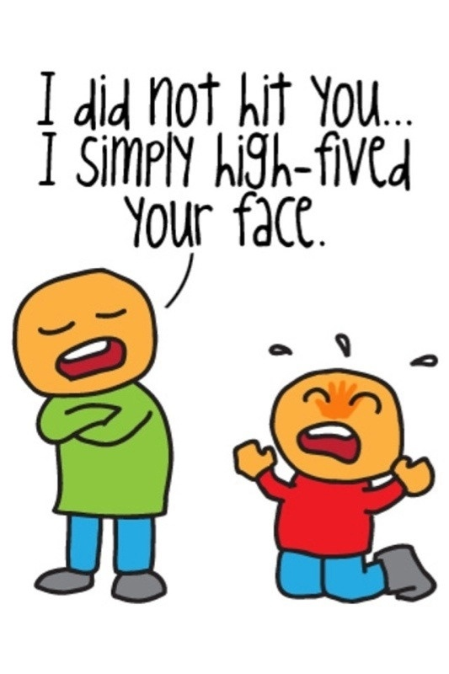
Notes:
RYLIE-Andie bit me…

Slide 37
Sibling Rivalry: Other Ideas
Don’t allow/reward Tattling
Can’t discipline what didn’t see: …
Creates bad feelings toward the sibling who tattled-Pits them against each other as plaintiff and defendant in a court of law
Pray/Trust that God will reveal what needs exposed
**Except if sibling is about to get seriously hurt
Notes:
CAN”T DISCIPLINE WHAT DIDN”T SEE TRUST that GOD will reveal….

Slide 38
Sibling Rivalry Other Ideas
Conflict resolution principles: Table
Listen to each other, each gets to say the problem
What was your part? (Matt. 7: Look First to log in eye, then speck in other)
How can we solve this? Forebear? Forgive? What could each do differently?
What consequences might be appropriate?
Notes:
CONFLICT TABLE>>>>AFTER THEY GET OLDER

Slide 39
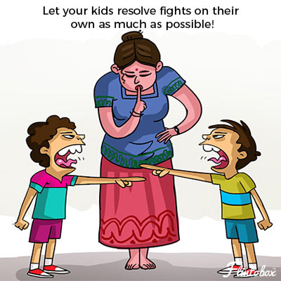
Notes:
Heard screaming…..Started listening…Then heard the F bomb….Weren’t working it out….

Slide 40
Sibling Rivalry Other Ideas
Always a process: Never arrive-
Still trying to be fair: Same amount on Gift card, different gift cards to where they like, same candy in Easter baskets….communicate love
Notes:
CONFLICT TABLE

Slide 41
Practical things:
TIME Parent-One on one with each: Weekly or Biweekly Dates, Daily Bed time, Sibling time with one another
Family Meal times builds family identity, unity, shared exp.
Fun experiences together: Yearly camping weekend, vacations, family traditions, A Family Code word, backyard and board games…
Notes:
LOVE to a kid is spelled T-I-M-E

Slide 42
Practical things:
Intentional thought/development of sibling relationships:
Prepare for new one
Pray for siblings, Thank God for them (built in friend, really knows what it’s like in this family)
Ask periodically what do you think is great about your sibling? Read books/talk positively about having a sibling
How can you help your sibling?
Notes:
Draw on strength of God…

Slide 43
Practical things:
Self care:
Time with God, Time with spouse
Fellowship ( time with other adults-siblings in God’s family)
Extra long showers….
Notes:
Draw on strength of God…

Slide 44
Practical things:
Model love and concern for own siblings
Notes:
Larry, Ruth

Slide 45
Practical things:
Any other suggestions?

Slide 46
Final Encouragement
Point them to God who loves perfectly
Don't worry, you don't have to make up for not being a perfect parent. No one is. You're modeling how to be a graciously imperfect human, and how to apologize and repair, which is what your child needs to grow into a gracious human herself. Just resolve to keep choosing love as often as possible when you're interacting with your child. That's all anyone can do, and it really is enough.
Laura Markham, Peaceful Parents, Happy Kids

Slide 47
Resources for Parents
Beyond Sibling Rivalry, How to Help your Children become Cooperative, Caring, and Compassionate, Peter Goldenthal
Baffled Parent’s Guide to Sibling Rivalry, Marian Edelman Borden
Making Brothers and Sisters Best Friends: How to Fight the Good Fight at Home, Sarah, Stephen and Grace Mally
Siblings without Rivalry, Adele Faber and Elaine Mazlish
Preventing Sibling Rivalry, Sybil Hart
Peaceful parent, Happy Siblings, Dr. Laura Markham

Slide 48
Children’s Books
My Brother, My Sister and Me: A First Look at Sibling Rivalry, Pat Thomas
I Want to be the Only Dog: A Story about Sibling Rivalry, Julia Cook
You’re All My Favorites, Sam McBratney
Naughty Toes, Ann Bonwill
Sheila Rae’s Peppermint Stick, Kevin Henkes
I Love You the Purplest, Barbara M. Joosse
Do Like Kyla, Angela Johnson
Soupy Saturday with the Pain and the Great One, Judy Blume

