Slide 2
Jesus One on One
^{Revelation 1:9}

Slide 3
Jesus One on One
^{Revelation 1:9} I, John, your brother and fellow partaker in the tribulation and kingdom and perseverance which are in Jesus, was on the island called Patmos because of the word of God and the testimony of Jesus.

Slide 4
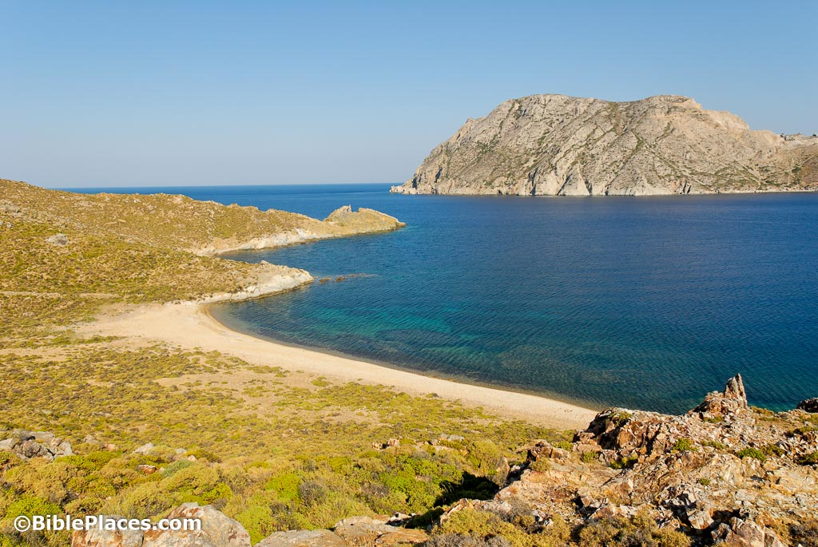
Jesus One on One
^{Revelation 1:9} I, John, your brother and fellow partaker in the tribulation and kingdom and perseverance which are in Jesus, was on the island called Patmos because of the word of God and the testimony of Jesus.

Slide 5
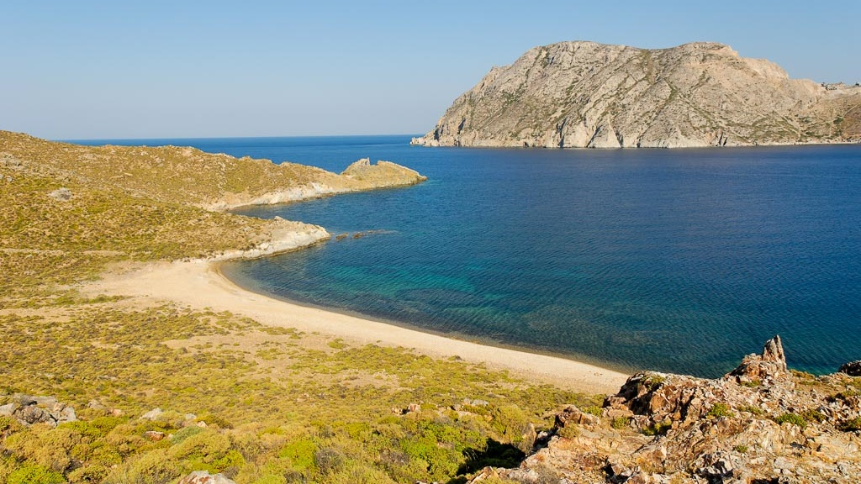
Jesus One on One
^{Revelation 1:9} I, John, your brother and fellow partaker in the tribulation and kingdom and perseverance which are in Jesus, was on the island called Patmos because of the word of God and the testimony of Jesus.

Slide 6
Jesus One on One
¹⁰ I was in the Spirit on the Lord’s day, and I heard behind me a loud voice like the sound of a trumpet,

Slide 7
Jesus One on One
¹⁰ I was in the Spirit on the Lord’s day, and I heard behind me a loud voice like the sound of a trumpet, ¹¹ saying, “Write in a book what you see, and send it to the seven churches: to Ephesus and to Smyrna and to Pergamum and to Thyatira and to Sardis and to Philadelphia and to Laodicea.”

Slide 8
Jesus One on One: Jesus and John
¹⁰ I was in the Spirit on the Lord’s day, and I heard behind me a loud voice like the sound of a trumpet, ¹¹ saying, “Write in a book what you see, and send it to the seven churches: to Ephesus and to Smyrna and to Pergamum and to Thyatira and to Sardis and to Philadelphia and to Laodicea.”

Slide 9
Jesus One on One: Jesus and John
^{Revelation 1:12} Then I turned to see the voice that was speaking with me.

Slide 10
Jesus One on One: Jesus and John
^{Rev 1:12} And having turned I saw seven golden lampstands; ¹³ and in the middle of the lampstands I saw one like a son of man, clothed in a robe reaching to the feet, and girded across His chest with a golden sash. ¹⁴ His head and His hair were white like white wool, like snow; and His eyes were like a flame of fire. ¹⁵ His feet were like burnished bronze, when it has been made to glow in a furnace, and His voice was like the sound of many waters. ¹⁶ In His right hand He held seven stars, and out of His mouth came a sharp two-edged sword; and His face was like the sun shining in its strength. ¹⁷ When I saw Him, I fell at His feet like a dead man.

Slide 11
1) It uses perspectival language
^{Rev 1:12} And having turned I saw seven golden lampstands; ¹³ and in the middle of the lampstands I saw one like a son of man, clothed in a robe reaching to the feet, and girded across His chest with a golden sash. ¹⁴ His head and His hair were white like white wool, like snow; and His eyes were like a flame of fire. ¹⁵ His feet were like burnished bronze, when it has been made to glow in a furnace, and His voice was like the sound of many waters. ¹⁶ In His right hand He held seven stars, and out of His mouth came a sharp two-edged sword; and His face was like the sun shining in its strength. ¹⁷ When I saw Him, I fell at His feet like a dead man.

Slide 12
1) It uses perspectival language
^{Rev 1:12} And having turned I saw seven golden lampstands; ¹³ and in the middle of the lampstands I saw one like a son of man, clothed in a robe reaching to the feet, and girded across His chest with a golden sash. ¹⁴ His head and His hair were white like white wool, like snow; and His eyes were like a flame of fire. ¹⁵ His feet were like burnished bronze, when it has been made to glow in a furnace, and His voice was like the sound of many waters. ¹⁶ In His right hand He held seven stars, and out of His mouth came a sharp two-edged sword; and His face was like the sun shining in its strength. ¹⁷ When I saw Him, I fell at His feet like a dead man.

Slide 13
2) It’s deeply rooted in the Old Testament
^{Rev 1:12} And having turned I saw seven golden lampstands; ¹³ and in the middle of the lampstands I saw one like a son of man, clothed in a robe reaching to the feet, and girded across His chest with a golden sash. ¹⁴ His head and His hair were white like white wool, like snow; and His eyes were like a flame of fire. ¹⁵ His feet were like burnished bronze, when it has been made to glow in a furnace, and His voice was like the sound of many waters. ¹⁶ In His right hand He held seven stars, and out of His mouth came a sharp two-edged sword; and His face was like the sun shining in its strength. ¹⁷ When I saw Him, I fell at His feet like a dead man.
^{Dan 10:5} I lifted my eyes and looked, and behold, there was a certain man dressed in linen, whose waist was girded with a belt of pure gold of Uphaz. ⁶ His body also was like beryl, his face had the appearance of lightning, his eyes were like flaming torches, his arms and feet like the gleam of polished bronze, and the sound of his words like the sound of a tumult.

Slide 14
2) It’s deeply rooted in the Old Testament
^{Rev 1:12} And having turned I saw seven golden lampstands; ¹³ and in the middle of the lampstands I saw one like a son of man, clothed in a robe reaching to the feet, and girded across His chest with a golden sash. ¹⁴ His head and His hair were white like white wool, like snow; and His eyes were like a flame of fire. ¹⁵ His feet were like burnished bronze, when it has been made to glow in a furnace, and His voice was like the sound of many waters. ¹⁶ In His right hand He held seven stars, and out of His mouth came a sharp two-edged sword; and His face was like the sun shining in its strength. ¹⁷ When I saw Him, I fell at His feet like a dead man.
Dan 7:13 – King Messiah is called “one like a Son of Man”

Slide 15
2) It’s deeply rooted in the Old Testament
^{Rev 1:12} And having turned I saw seven golden lampstands; ¹³ and in the middle of the lampstands I saw one like a son of man, clothed in a robe reaching to the feet, and girded across His chest with a golden sash. ¹⁴ His head and His hair were white like white wool, like snow; and His eyes were like a flame of fire. ¹⁵ His feet were like burnished bronze, when it has been made to glow in a furnace, and His voice was like the sound of many waters. ¹⁶ In His right hand He held seven stars, and out of His mouth came a sharp two-edged sword; and His face was like the sun shining in its strength. ¹⁷ When I saw Him, I fell at His feet like a dead man.
robe of a high priest

Slide 16
2) It’s deeply rooted in the Old Testament
^{Rev 1:12} And having turned I saw seven golden lampstands; ¹³ and in the middle of the lampstands I saw one like a son of man, clothed in a robe reaching to the feet, and girded across His chest with a golden sash. ¹⁴ His head and His hair were white like white wool, like snow; and His eyes were like a flame of fire. ¹⁵ His feet were like burnished bronze, when it has been made to glow in a furnace, and His voice was like the sound of many waters. ¹⁶ In His right hand He held seven stars, and out of His mouth came a sharp two-edged sword; and His face was like the sun shining in its strength. ¹⁷ When I saw Him, I fell at His feet like a dead man.
Dan 7:9 The Ancient of Days has hair “like pure wool” and garments “like white snow”

Slide 17
2) It’s deeply rooted in the Old Testament
^{Rev 1:12} And having turned I saw seven golden lampstands; ¹³ and in the middle of the lampstands I saw one like a son of man, clothed in a robe reaching to the feet, and girded across His chest with a golden sash. ¹⁴ His head and His hair were white like white wool, like snow; and His eyes were like a flame of fire. ¹⁵ His feet were like burnished bronze, when it has been made to glow in a furnace, and His voice was like the sound of many waters. ¹⁶ In His right hand He held seven stars, and out of His mouth came a sharp two-edged sword; and His face was like the sun shining in its strength. ¹⁷ When I saw Him, I fell at His feet like a dead man.
Isaiah 49:2 the Messiah has a mouth like a sharp sword

Slide 18
3) It uses symbols
^{Rev 1:12} And having turned I saw seven golden lampstands; ¹³ and in the middle of the lampstands I saw one like a son of man, clothed in a robe reaching to the feet, and girded across His chest with a golden sash. ¹⁴ His head and His hair were white like white wool, like snow; and His eyes were like a flame of fire. ¹⁵ His feet were like burnished bronze, when it has been made to glow in a furnace, and His voice was like the sound of many waters. ¹⁶ In His right hand He held seven stars, and out of His mouth came a sharp two-edged sword; and His face was like the sun shining in its strength. ¹⁷ When I saw Him, I fell at His feet like a dead man.

Slide 19
3) It uses symbols
^{Rev 1:12} And having turned I saw seven golden lampstands; ¹³ and in the middle of the lampstands I saw one like a son of man, clothed in a robe reaching to the feet, and girded across His chest with a golden sash. ¹⁴ His head and His hair were white like white wool, like snow; and His eyes were like a flame of fire. ¹⁵ His feet were like burnished bronze, when it has been made to glow in a furnace, and His voice was like the sound of many waters. ¹⁶ In His right hand He held seven stars, and out of His mouth came a sharp two-edged sword; and His face was like the sun shining in its strength. ¹⁷ When I saw Him, I fell at His feet like a dead man.
^{Rev 1:20} “As for the mystery of the seven stars which you saw in My right hand, and the seven golden lampstands: the seven stars are the angels of the seven churches, and the seven lampstands are the seven churches.”

Slide 20
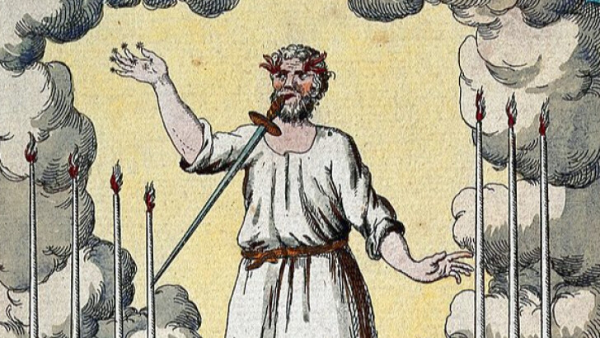
3) It uses symbols
^{Rev 1:12} And having turned I saw seven golden lampstands; ¹³ and in the middle of the lampstands I saw one like a son of man, clothed in a robe reaching to the feet, and girded across His chest with a golden sash. ¹⁴ His head and His hair were white like white wool, like snow; and His eyes were like a flame of fire. ¹⁵ His feet were like burnished bronze, when it has been made to glow in a furnace, and His voice was like the sound of many waters. ¹⁶ In His right hand He held seven stars, and out of His mouth came a sharp two-edged sword; and His face was like the sun shining in its strength. ¹⁷ When I saw Him, I fell at His feet like a dead man.

Slide 21
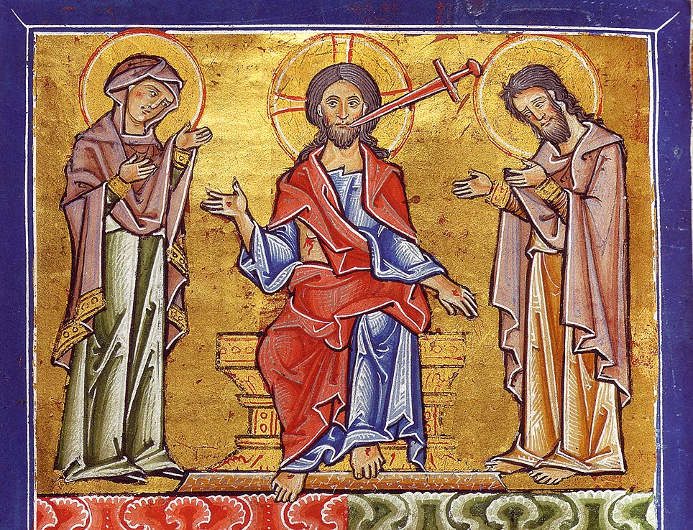
3) It uses symbols
^{Rev 1:12} And having turned I saw seven golden lampstands; ¹³ and in the middle of the lampstands I saw one like a son of man, clothed in a robe reaching to the feet, and girded across His chest with a golden sash. ¹⁴ His head and His hair were white like white wool, like snow; and His eyes were like a flame of fire. ¹⁵ His feet were like burnished bronze, when it has been made to glow in a furnace, and His voice was like the sound of many waters. ¹⁶ In His right hand He held seven stars, and out of His mouth came a sharp two-edged sword; and His face was like the sun shining in its strength. ¹⁷ When I saw Him, I fell at His feet like a dead man.

Slide 22
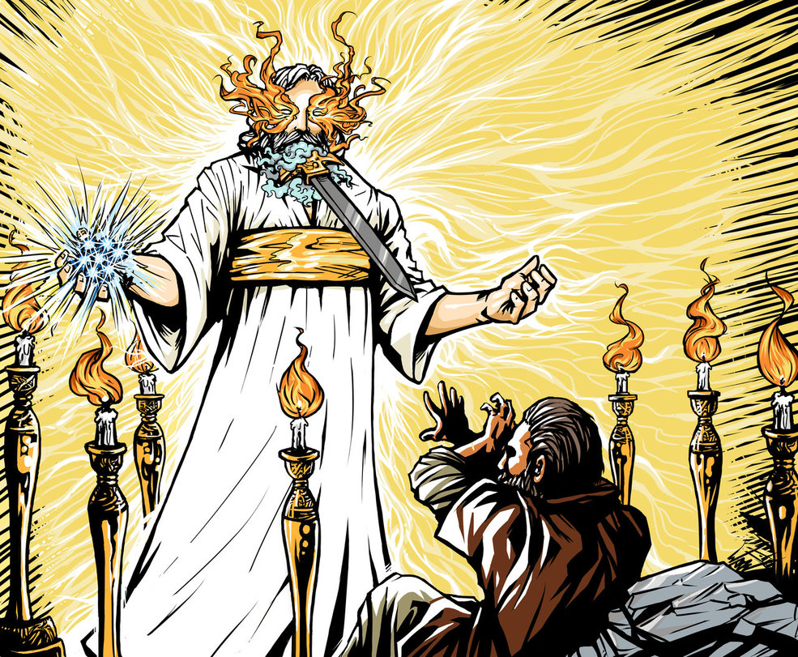
3) It uses symbols
^{Rev 1:12} And having turned I saw seven golden lampstands; ¹³ and in the middle of the lampstands I saw one like a son of man, clothed in a robe reaching to the feet, and girded across His chest with a golden sash. ¹⁴ His head and His hair were white like white wool, like snow; and His eyes were like a flame of fire. ¹⁵ His feet were like burnished bronze, when it has been made to glow in a furnace, and His voice was like the sound of many waters. ¹⁶ In His right hand He held seven stars, and out of His mouth came a sharp two-edged sword; and His face was like the sun shining in its strength. ¹⁷ When I saw Him, I fell at His feet like a dead man.

Slide 23
4) It’s Scary!
^{Rev 1:12} And having turned I saw seven golden lampstands; ¹³ and in the middle of the lampstands I saw one like a son of man, clothed in a robe reaching to the feet, and girded across His chest with a golden sash. ¹⁴ His head and His hair were white like white wool, like snow; and His eyes were like a flame of fire. ¹⁵ His feet were like burnished bronze, when it has been made to glow in a furnace, and His voice was like the sound of many waters. ¹⁶ In His right hand He held seven stars, and out of His mouth came a sharp two-edged sword; and His face was like the sun shining in its strength. ¹⁷ When I saw Him, I fell at His feet like a dead man.

Slide 24
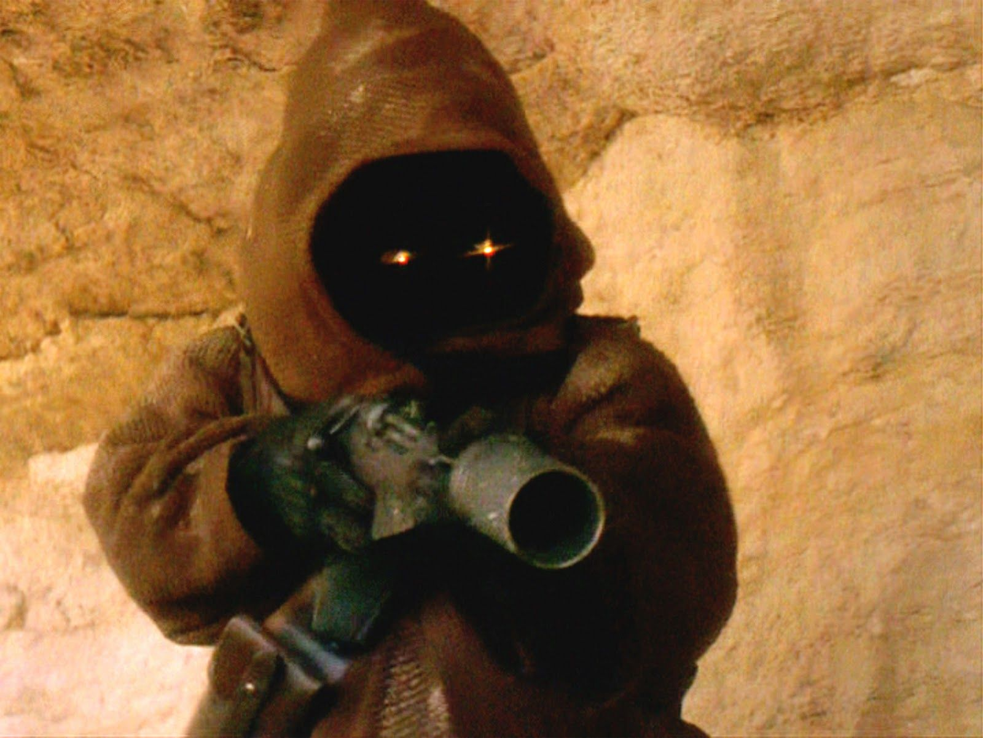
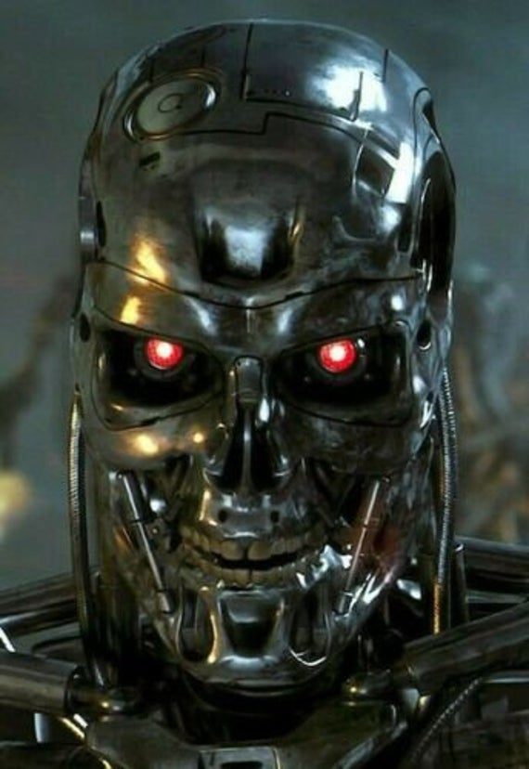
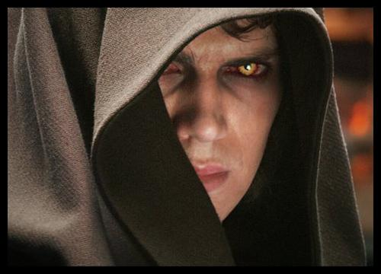
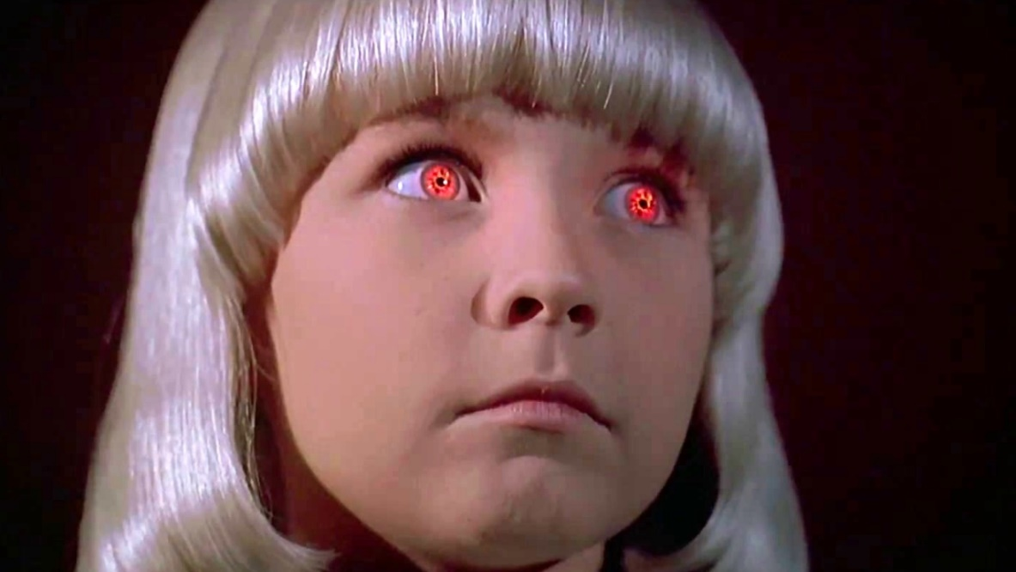
4) It’s Scary!
^{Rev 1:12} And having turned I saw seven golden lampstands; ¹³ and in the middle of the lampstands I saw one like a son of man, clothed in a robe reaching to the feet, and girded across His chest with a golden sash. ¹⁴ His head and His hair were white like white wool, like snow; and His eyes were like a flame of fire. ¹⁵ His feet were like burnished bronze, when it has been made to glow in a furnace, and His voice was like the sound of many waters. ¹⁶ In His right hand He held seven stars, and out of His mouth came a sharp two-edged sword; and His face was like the sun shining in its strength. ¹⁷ When I saw Him, I fell at His feet like a dead man.

Slide 25
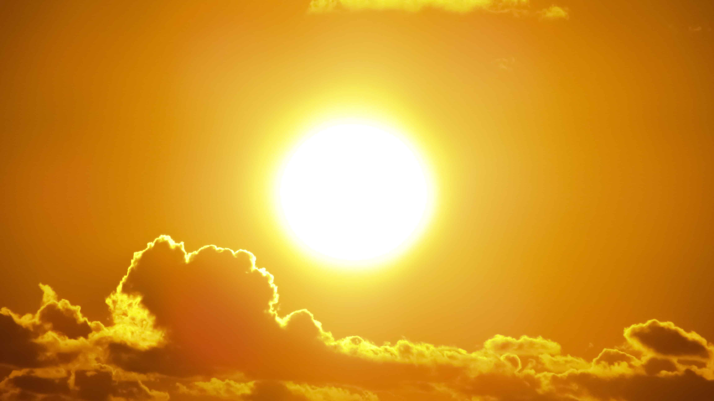
4) It’s Scary!
^{Rev 1:12} And having turned I saw seven golden lampstands; ¹³ and in the middle of the lampstands I saw one like a son of man, clothed in a robe reaching to the feet, and girded across His chest with a golden sash. ¹⁴ His head and His hair were white like white wool, like snow; and His eyes were like a flame of fire. ¹⁵ His feet were like burnished bronze, when it has been made to glow in a furnace, and His voice was like the sound of many waters. ¹⁶ In His right hand He held seven stars, and out of His mouth came a sharp two-edged sword; and His face was like the sun shining in its strength. ¹⁷ When I saw Him, I fell at His feet like a dead man.

Slide 26
4) It’s Scary!
^{Rev 1:12} And having turned I saw seven golden lampstands; ¹³ and in the middle of the lampstands I saw one like a son of man, clothed in a robe reaching to the feet, and girded across His chest with a golden sash. ¹⁴ His head and His hair were white like white wool, like snow; and His eyes were like a flame of fire. ¹⁵ His feet were like burnished bronze, when it has been made to glow in a furnace, and His voice was like the sound of many waters. ¹⁶ In His right hand He held seven stars, and out of His mouth came a sharp two-edged sword; and His face was like the sun shining in its strength. ¹⁷ When I saw Him, I fell at His feet like a dead man.

Slide 27
4) It’s Scary!
^{Rev 1:12} And having turned I saw seven golden lampstands; ¹³ and in the middle of the lampstands I saw one like a son of man, clothed in a robe reaching to the feet, and girded across His chest with a golden sash. ¹⁴ His head and His hair were white like white wool, like snow; and His eyes were like a flame of fire. ¹⁵ His feet were like burnished bronze, when it has been made to glow in a furnace, and His voice was like the sound of many waters. ¹⁶ In His right hand He held seven stars, and out of His mouth came a sharp two-edged sword; and His face was like the sun shining in its strength. ¹⁷ When I saw Him, I fell at His feet like a dead man.

Slide 28
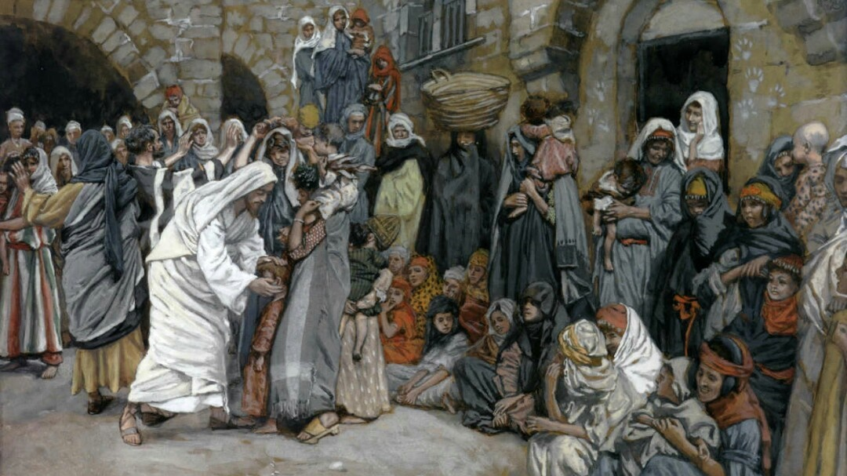
How does this square with the Jesus we have been studying?
^{Rev 1:12} And having turned I saw seven golden lampstands; ¹³ and in the middle of the lampstands I saw one like a son of man, clothed in a robe reaching to the feet, and girded across His chest with a golden sash. ¹⁴ His head and His hair were white like white wool, like snow; and His eyes were like a flame of fire. ¹⁵ His feet were like burnished bronze, when it has been made to glow in a furnace, and His voice was like the sound of many waters. ¹⁶ In His right hand He held seven stars, and out of His mouth came a sharp two-edged sword; and His face was like the sun shining in its strength. ¹⁷ When I saw Him, I fell at His feet like a dead man.

Slide 29
How does this square with the Jesus we have been studying?
^{Rev 1:12} And having turned I saw seven golden lampstands; ¹³ and in the middle of the lampstands I saw one like a son of man, clothed in a robe reaching to the feet, and girded across His chest with a golden sash. ¹⁴ His head and His hair were white like white wool, like snow; and His eyes were like a flame of fire. ¹⁵ His feet were like burnished bronze, when it has been made to glow in a furnace, and His voice was like the sound of many waters. ¹⁶ In His right hand He held seven stars, and out of His mouth came a sharp two-edged sword; and His face was like the sun shining in its strength. ¹⁷ When I saw Him, I fell at His feet like a dead man.
Can this be the same man?
^{Rev 5:5} behold, the Lion that is from the tribe of Judah, the Root of David, has overcome so as to open the book and its seven seals.” …
⁶ And I saw … a Lamb standing, as if slain …

Slide 30
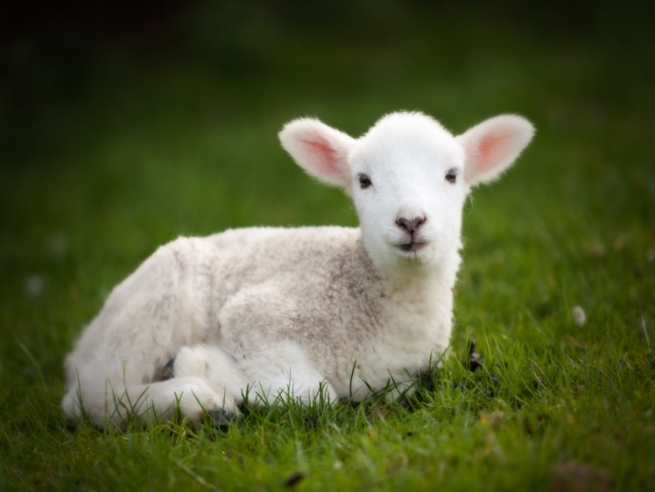
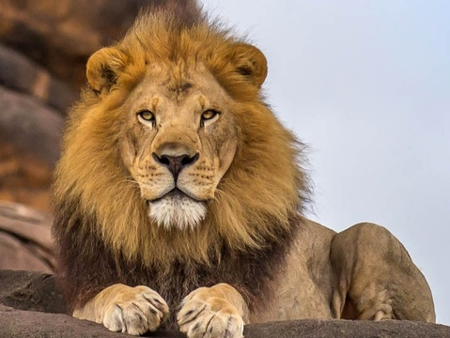
So which is it??

Slide 31
So which is it??
Maybe He was a lamb, but now He’s a lion …

Slide 32
So which is it??
Maybe He switches between personalities …

Slide 33
So which is it??
Maybe He’s moody …

Slide 34
So which is it??
Maybe he acts like a lamb…

Slide 35
So which is it?? It’s both.
^{Rev 1:17} When I saw Him, I fell at His feet like a dead man. And He placed His right hand on me, saying, “Do not be afraid; ¹⁷ I am the first and the last, ¹⁸ and the living One; and I was dead, and behold, I am alive forevermore, and I have the keys of death and of Hades.
So which is it??

Slide 36
Immanence Transcendence
^{Rev 1:17} When I saw Him, I fell at His feet like a dead man. And He placed His right hand on me, saying, “Do not be afraid; ¹⁷ I am the first and the last, ¹⁸ and the living One; and I was dead, and behold, I am alive forevermore, and I have the keys of death and of Hades.
So which is it??

Slide 37
Immanence Transcendence
^{Rev 1:17} When I saw Him, I fell at His feet like a dead man. And He placed His right hand on me, saying, “Do not be afraid; ¹⁷ I am the first and the last, ¹⁸ and the living One; and I was dead, and behold, I am alive forevermore, and I have the keys of death and of Hades.
These two concepts are not contradictory,
they are complementary
So which is it??

Slide 38
Jesus is transcendent
^{Rev 1:17} When I saw Him, I fell at His feet like a dead man. And He placed His right hand on me, saying, “Do not be afraid; ¹⁷ I am the first and the last, ¹⁸ and the living One; and I was dead, and behold, I am alive forevermore, and I have the keys of death and of Hades.
So which is it??

Slide 39
Jesus is transcendent
Transcendence refers to being out of the reach of our experience; beyond
^{Rev 1:17} When I saw Him, I fell at His feet like a dead man. And He placed His right hand on me, saying, “Do not be afraid; ¹⁷ I am the first and the last, ¹⁸ and the living One; and I was dead, and behold, I am alive forevermore, and I have the keys of death and of Hades.
So which is it??

Slide 40
Jesus is transcendent
Transcendence refers to being out of the reach of our experience; beyond
^{Rev 1:17} When I saw Him, I fell at His feet like a dead man. And He placed His right hand on me, saying, “Do not be afraid; ¹⁷ I am the first and the last, ¹⁸ and the living One; and I was dead, and behold, I am alive forevermore, and I have the keys of death and of Hades.
So which is it??

Slide 41
Creator
Jesus is transcendent
^{John 1:1} In the beginning was the Word, and the Word was with God, and the Word was God. ² He was in the beginning with God. ³ All things came into being through Him, and apart from Him nothing came into being that has come into being.
^{Rev 1:17} When I saw Him, I fell at His feet like a dead man. And He placed His right hand on me, saying, “Do not be afraid; ¹⁷ I am the first and the last, ¹⁸ and the living One; and I was dead, and behold, I am alive forevermore, and I have the keys of death and of Hades.
So which is it??

Slide 42
Creator
Eternal
Jesus is transcendent
^{Rev 1:8} “I am the Alpha and the Omega,” says the Lord God, “who is and who was and who is to come, the Almighty.”
^{Rev 1:17} When I saw Him, I fell at His feet like a dead man. And He placed His right hand on me, saying, “Do not be afraid; ¹⁷ I am the first and the last, ¹⁸ and the living One; and I was dead, and behold, I am alive forevermore, and I have the keys of death and of Hades.
So which is it??

Slide 43
Creator
Eternal
All knowing & powerful
Jesus is transcendent
^{Rev 1:8} “I am the Alpha and the Omega,” says the Lord God, “who is and who was and who is to come, the Almighty.”
^{Rev 1:17} When I saw Him, I fell at His feet like a dead man. And He placed His right hand on me, saying, “Do not be afraid; ¹⁷ I am the first and the last, ¹⁸ and the living One; and I was dead, and behold, I am alive forevermore, and I have the keys of death and of Hades.
So which is it??

Slide 44
Creator
Eternal
All knowing & powerful
Jesus is transcendent
^{Rev 1:17} When I saw Him, I fell at His feet like a dead man. And He placed His right hand on me, saying, “Do not be afraid; ¹⁷ I am the first and the last, ¹⁸ and the living One; and I was dead, and behold, I am alive forevermore, and I have the keys of death and of Hades.
So which is it??

Slide 45
Creator
Eternal
All knowing & powerful
Authority over death
Authority over angels, demons, nature
Rightful ruler of Earth
Jesus is transcendent
^{Rev 1:17} When I saw Him, I fell at His feet like a dead man. And He placed His right hand on me, saying, “Do not be afraid; ¹⁷ I am the first and the last, ¹⁸ and the living One; and I was dead, and behold, I am alive forevermore, and I have the keys of death and of Hades.
So which is it??

Slide 46
Creator
Eternal
All knowing & powerful
Authority over death
Authority over angels, demons, nature
Rightful ruler of Earth
Jesus is transcendent
^{Rev 1:7} Behold, He is coming with the clouds, and every eye will see Him, even those who pierced Him; and all the tribes of the earth will mourn over Him. So it is to be. Amen.
So which is it??

Slide 47
Creator
Eternal
All knowing & powerful
Authority over death
Authority over angels, demons, nature
Rightful ruler of Earth
Righteous judge
Jesus is transcendent
^{Rev 1:7} Behold, He is coming with the clouds, and every eye will see Him, even those who pierced Him; and all the tribes of the earth will mourn over Him. So it is to be. Amen.
So which is it??

Slide 48
Creator
Eternal
All knowing & powerful
Authority over death
Authority over angels, demons, nature
Rightful ruler of Earth
Righteous judge
Jesus is transcendent
^{Rev 1:7} Behold, He is coming with the clouds, and every eye will see Him, even those who pierced Him; and all the tribes of the earth will mourn over Him. So it is to be. Amen.
^{Matt 16:27} “For the Son of Man is going to come in the glory of His Father with his angels, and will then repay every man according to his deeds.”
So which is it??

Slide 49
Jesus is transcendent
^{Rev 1:7} Behold, He is coming with the clouds, and every eye will see Him, even those who pierced Him; and all the tribes of the earth will mourn over Him. So it is to be. Amen.

Slide 50
Jesus is immanent
Jesus is transcendent
^{Rev 1:7} Behold, He is coming with the clouds, and every eye will see Him, even those who pierced Him; and all the tribes of the earth will mourn over Him. So it is to be. Amen.
So which is it??

Slide 51
Jesus is immanent
Immanence refers to Jesus’s presence and accessibility

Slide 52
Jesus is immanent
The “incarnation”
^{John 1:14} And the Word became flesh, and dwelt among us, and we saw His glory, glory as of the only begotten from the Father, full of grace and truth.
Immanence refers to Jesus’s presence and accessibility

Slide 53
Jesus is immanent
Relational
Emotional
Compassionate
Touched people
Served people
Befriended people
Values togetherness
^{John 15:15} but I have called you friends
Immanence refers to Jesus’s presence and accessibility

Slide 54
Jesus is immanent
Relational
Emotional
Compassionate
Touched people
Served people
Befriended people
Values togetherness
Immanence refers to Jesus’s presence and accessibility
^{John 14:2} In My Father’s house are many dwelling places … ³ Since I go and prepare a place for you, I will come again and receive you to Myself, that where I am, there you may be also.

Slide 55
Jesus is immanent
Jesus is transcendent
Jesus: both King and Friend
Which qualifies him to be savior

Slide 56
^{Rev 1:5} and from Jesus Christ, the faithful witness, the firstborn of the dead, and the ruler of the kings of the earth. To Him who loves us and released us from our sins by His blood— ⁶ and He has made us to be a kingdom, priests to His God and Father—to Him be the glory and the dominion forever and ever. Amen.
Only a transcendent and immanent savior could remedy the problem between man and God
Jesus: both King and Friend
Which qualifies him to be savior

Slide 57
^{Rev 1:5} and from Jesus Christ, the faithful witness, the firstborn of the dead, and the ruler of the kings of the earth. To Him who loves us and released us from our sins by His blood— ⁶ and He has made us to be a kingdom, priests to His God and Father—to Him be the glory and the dominion forever and ever. Amen.
Only a transcendent and immanent savior could remedy the problem between man and God
Jesus: both King and Friend
Which qualifies him to be savior

Slide 58
^{Rev 1:5} and from Jesus Christ, the faithful witness, the firstborn of the dead, and the ruler of the kings of the earth. To Him who loves us and released us from our sins by His blood— ⁶ and He has made us to be a kingdom, priests to His God and Father—to Him be the glory and the dominion forever and ever. Amen.
Only a transcendent and immanent savior could remedy the problem between man and God
Jesus: both King and Friend
Which qualifies him to be savior

Slide 59
^{Rev 1:5} and from Jesus Christ, the faithful witness, the firstborn of the dead, and the ruler of the kings of the earth. To Him who loves us and released us from our sins by His blood— ⁶ and He has made us to be a kingdom, priests to His God and Father—to Him be the glory and the dominion forever and ever. Amen.
Only a transcendent and immanent savior could remedy the problem between man and God
Jesus: both King and Friend
Which qualifies him to be savior

Slide 60
^{Rev 1:5} and from Jesus Christ, the faithful witness, the firstborn of the dead, and the ruler of the kings of the earth. To Him who loves us and released us from our sins by His blood— ⁶ and He has made us to be a kingdom, priests to His God and Father—to Him be the glory and the dominion forever and ever. Amen.
Only a transcendent and immanent savior could remedy the problem between man and God
Jesus: both King and Friend
Which qualifies him to be savior

Slide 61
^{Rev 1:5} and from Jesus Christ, the faithful witness, the firstborn of the dead, and the ruler of the kings of the earth. To Him who loves us and released us from our sins by His blood— ⁶ and He has made us to be a kingdom, priests to His God and Father—to Him be the glory and the dominion forever and ever. Amen.
Only an immanent savior could identify with
humanity and take up our debt
Only an transcendent savior could fully pay the bill

Slide 62
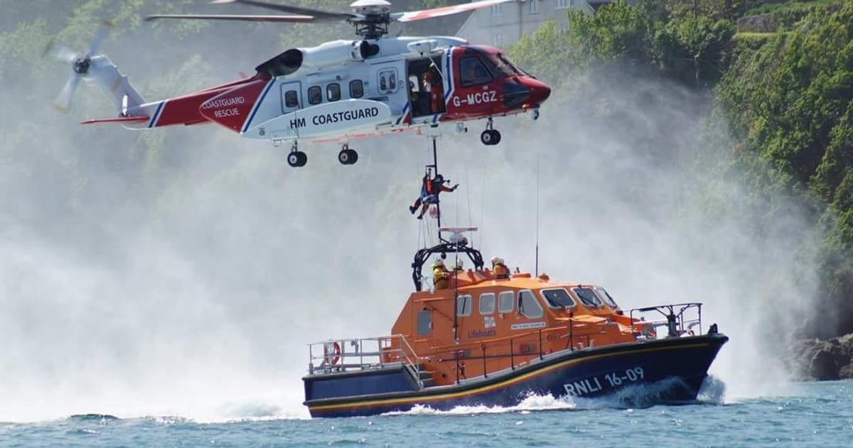
^{Rev 1:5} and from Jesus Christ, the faithful witness, the firstborn of the dead, and the ruler of the kings of the earth. To Him who loves us and released us from our sins by His blood— ⁶ and He has made us to be a kingdom, priests to His God and Father—to Him be the glory and the dominion forever and ever. Amen.
Only an immanent savior could identify with
humanity and take up our debt
Only an transcendent savior could fully pay the bill

Slide 63
^{Rev 1:5} and from Jesus Christ, the faithful witness, the firstborn of the dead, and the ruler of the kings of the earth. To Him who loves us and released us from our sins by His blood— ⁶ and He has made us to be a kingdom, priests to His God and Father—to Him be the glory and the dominion forever and ever. Amen.
^{John 1:10} He was in the world, and the world was made through Him, and the world did not know Him. ¹¹ He came to His own, and those who were His own did not receive Him. ¹² But as many as received Him, to them He gave the right to become children of God, even to those who believe in His name
Only an immanent savior could identify with
humanity and take up our debt
Only an transcendent savior could fully pay the bill

Slide 64
Jesus is immanent
Jesus is transcendent
If we want to relate to Him as He really is, we have to get both of these in view

Slide 65
Jesus is immanent
Jesus is transcendent
Distant Authority
Heartless judge
Disinterested
Touchy
Steam Roller
Threatening
Scary!
MISERABLE way to relate with God!

Slide 66
Jesus is transcendent
Jesus is immanent
Nice…
Domesticated
My therapeutic helper

Slide 67
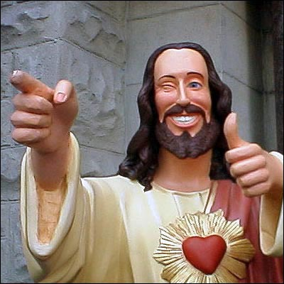
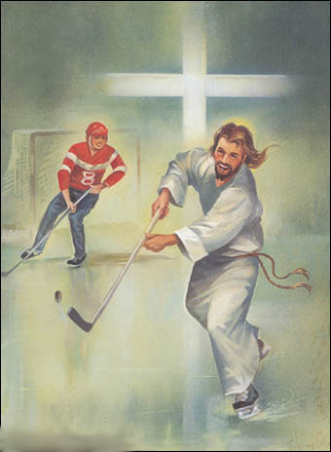
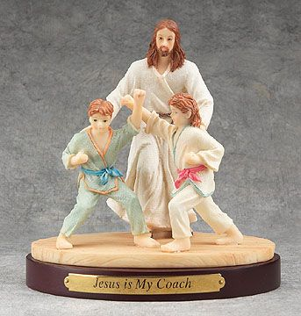
Jesus is immanent
Nice…
Domesticated
My therapeutic helper

Slide 68
Jesus is immanent
Nice…
Domesticated
My therapeutic helper
Offers optional advice
Malleable
Weak
Unjust
MISERABLE way to relate with God!

Slide 69
Jesus is immanent
Jesus is transcendent
Neither of those versions of Jesus are biblical
Neither of those versions can save!

Slide 70
Jesus is immanent
Jesus is transcendent
Both errors skew our view of Jesus, and result in us not wanting to draw near to Him!

Slide 71
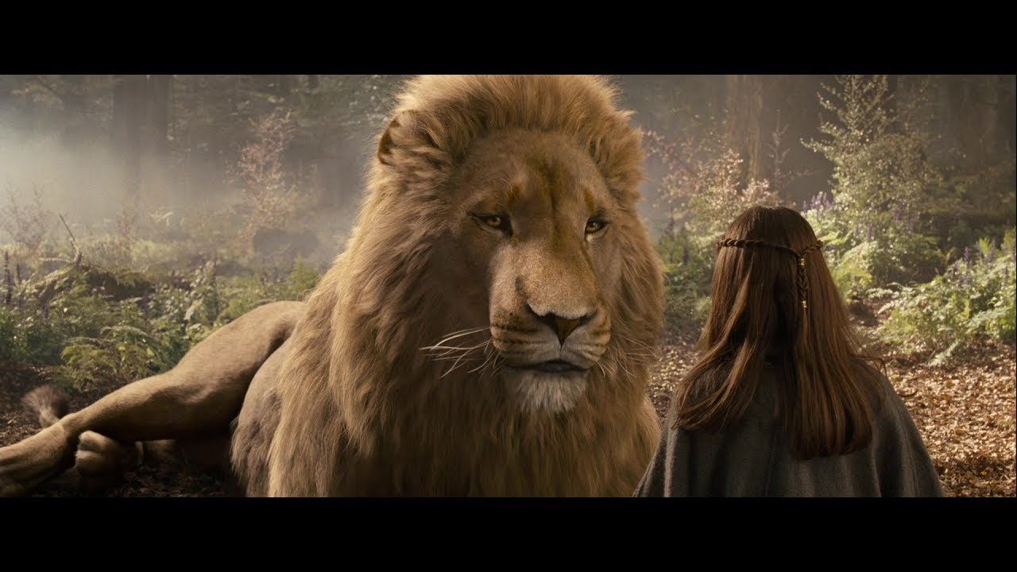
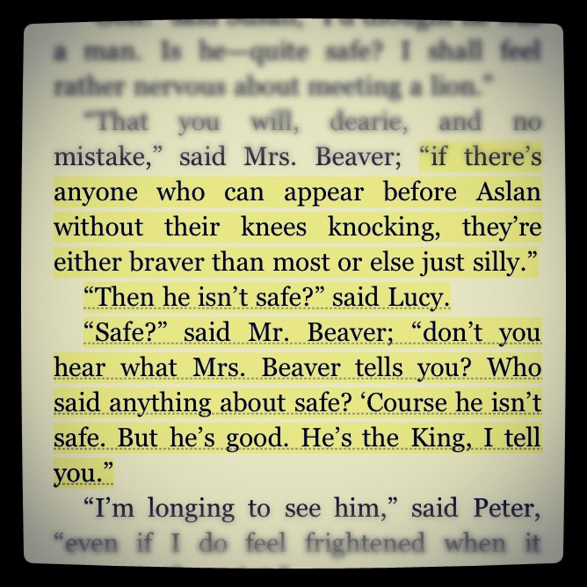

Slide 72
Jesus is immanent
Jesus is transcendent
Which error predominates for you?

Slide 73
Jesus is immanent
Jesus is transcendent
Our goal then, should be to cultivate a balanced view of Jesus

Slide 74
Jesus is immanent
Jesus is transcendent
Our goal then, should be to cultivate a balanced FULL view of Jesus

Slide 75
Jesus is immanent
Jesus is transcendent
Our goal then, should be to cultivate a balanced FULL view of Jesus

Slide 76
Jesus is immanent
Jesus is transcendent
Our goal then, should be to cultivate a balanced FULL view of Jesus

Slide 77
Jesus is immanent
Jesus is transcendent
We will benefit greatly from having an accurate view of Jesus: fully transcendent and fully immanent

Slide 78
When I approach God . . .
Because of His immanence:
I can come to Him personally anytime,
anywhere, and tell him anything
Because of His transcendence:
The one I come to sits on the throne!
^{Hebrews 4:16} Therefore let us draw near with confidence to the throne of grace, so that we may receive mercy and find grace to help in time of need.

Slide 79
When I approach God . . .
Because of His immanence:
I can come to Him personally anytime,
anywhere, and tell him anything
Because of His transcendence:
The one I come to sits on the throne!
I have a standing invitation before throne of the most high God, who is always delighted to see me and interested in my life!

Slide 80
When I pray . . .
Because of His immanence:
I can be confident the one I’m speaking to listens, cares, and intercedes for me
Because of His transcendence:
He is powerful to act
And already knows my thoughts and heart
Therefore I can speak to him with transparent honesty, and ask bold things with confidence

Slide 81
When I am anxious about something …
Because of His immanence:
He is not aloof to the decisions and uncertainties I face – He is involved and concerned
Because of His transcendence:
He is not flustered, because the world is neither uncertain nor out of control to Him.
^{1 Pet 5:6} Therefore, humble yourselves under the mighty hand of God, that He may exalt you at the proper time, casting all your anxiety on Him, because He cares for you.

Slide 82
When I sin . . .
Because of His immanence:
He can sympathize with the human condition, and extends grace to me personally
Because of His transcendence:
He knows all, takes issue with my sin, and is the judge
Therefore, I do not need to hide from God. Instead, I can own my failures under grace, and draw near to Him knowing that He has shed His blood to release me from the guilt and power of sin

Slide 83
When others sin against me . . .
Because of His immanence:
He is sympathetic to my anger, pain, and frustration. He comforts me in my distress
Because of His transcendence:
He is totally righteous and just; vengeance for all evil belongs to Him
Therefore I can forgive, entrusting retribution to Him, and knowing that He has forgiven me as well

Slide 84
When I try in ministry . . .
Because of His immanence:
He involves us in His work, and proactively leads us as the head of the church
Because of His transcendence:
All ministry endeavors are His mission, and can only ever succeed if He ultimately carries them out.
^{Matt 28:20 ”}I am with you always, even to the end of the age.”

Slide 85
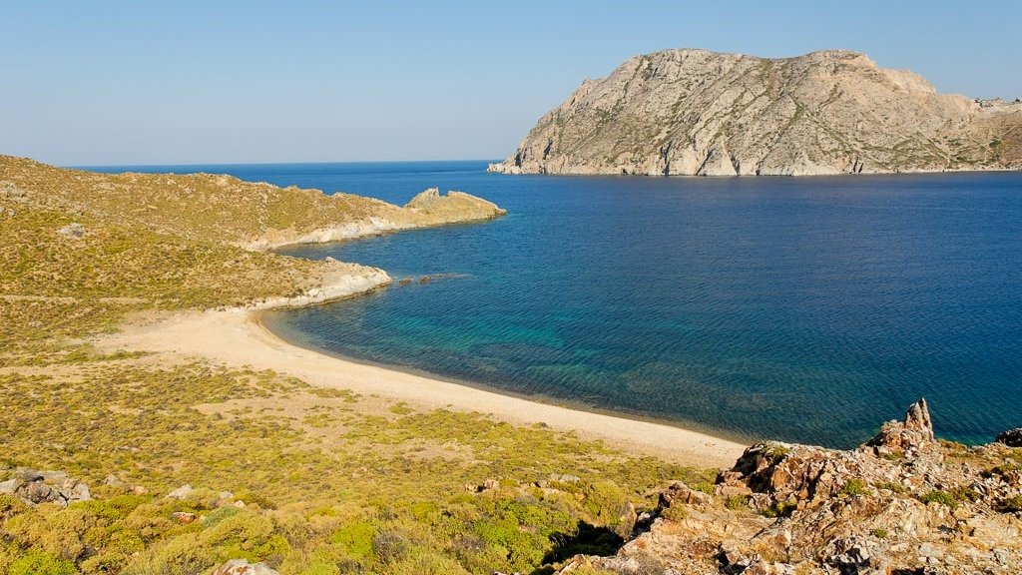
Have you met
this Jesus?

