Slide 1
The Book of James
Mature Faith in Action

Slide 2
James 1:1 (NASB95)
1 James, a bond-servant of God and of the Lord Jesus Christ, To the twelve tribes who are dispersed abroad: Greetings.

Slide 3
The Importance of Historical Background
Who wrote this letter?
Who is the original audience?
What is the purpose?
What was the author trying to say?

Slide 4
James (The Just)
Jesus’ half-brother (Gal 1:19)
James a late convert (John 7:5)
Experienced the risen Lord (1 Cor 15:7)
Key leader in the Jerusalem church (Gal 2:9)
Had great concern that freedom in Christ not become a barrier to Jews understanding Christianity

Slide 5
James (The Just)
Acts 15:19–21 (NASB95) — 19 “Therefore it is my judgment that we do not trouble those who are turning to God from among the Gentiles, 20 but that we write to them that they abstain from things contaminated by idols and from fornication and from what is strangled and from blood. 21 “For Moses from ancient generations has in every city those who preach him, since he is read in the synagogues every Sabbath.”
Jesus’ half-brother (Gal 1:19)
James a late convert (John 7:5)
Experienced the risen Lord (1 Cor 15:7)
Key leader in the Jerusalem church (Gal 2:9)
Had great concern that freedom in Christ not become a barrier to Jews understanding Christianity

Slide 6
James (The Just)
James concern for Jewish law has caused some to accuse him of being legalistic
Beaten to death by Pharisees at the temple Cir. 62 AD (Hegesippus/Josephus)

Slide 7
Audience
Jas 1:1…To the twelve tribes who are dispersed abroad: Greetings
Jewish Christians living among the Greeks
At least nineteen times he addressed them as “brethren,” indicating not only “brothers in the flesh” (fellow Jews), but also “brothers in the Lord.”
Wiersbe, Warren W.. Be Mature (James): Growing Up in Christ (The BE Series Commentary) (p. 22). David C Cook. Kindle Edition.

Slide 8
Audience
Trying to understand how faith and action work together
Was Christianity a part of Judaism or not?
Should they be circumcised? Follow dietary laws?

Slide 9
Audience
Used to living apart from Gentiles, and looking down on them as inferior
Suspicious that Christianity to the Gentiles was “easy believism”
What does a life of faith look like?
What are the distinctives of a mature Christian?
How do faith and action work together?

Slide 10
Theme
James 1:21–22 (NASB95) — 21 Therefore, putting aside all filthiness and all that remains of wickedness, in humility receive the word implanted, which is able to save your souls. 22 But prove yourselves doers of the word, and not merely hearers who delude themselves.
Let go of your rebellion and receive grace
Believe sincerely enough that it impacts the way you live

Slide 11
Theme
James’ practical letter finds its focus in one set of topics: it is a letter about relationships. He calls us, for example, to care for orphans and widows (1:27), to be impartial in our courtesy and care of others (2:1); he emphasizes the duty of love for our neighbour (2:8), speaking of it as ‘the royal law’; he scorns a profession of faith which fails in love and compassion (2:15–16) and applauds the life that risks itself for the sake of those who are at risk (2:25);

Slide 12
Theme
he warns against feelings which imperil fellowship (3:14) and words which denigrate a brother (4:11); we are to discharge our honourable debts (5:4), guard our reactions (5:9), minister to the sick (5:14), share with the distressed (5:16) and urgently pursue those who stray from Christ (5:19–20). His letter is quite a catalogue, quite a sustained emphasis on this single set of topics.
Motyer, J. A. (1985). (p. 25). Leicester, England; Downers Grove, IL: Inter-Varsity Press.

Slide 13
Theme
James is a super practical book
Casting a vision for what mature spirituality should look like
Emphasizing the importance of character
Emphasizing the importance of action

Slide 14
The Controversy
Does James overdo it?
James 2:17–18 (NASB95) — 17 Even so faith, if it has no works, is dead, being by itself. 18 But someone may well say, “You have faith and I have works; show me your faith without the works, and I will show you my faith by my works.”

Slide 15
The Controversy
He has been accused of being a legalist
He has been accused of having a works version of salvation

Slide 16
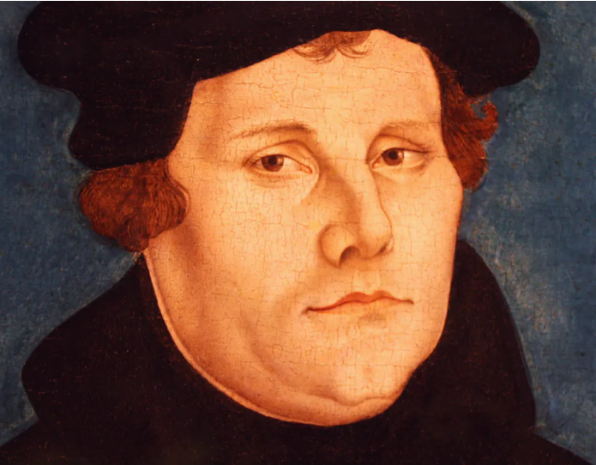
The Controversy
“St. James’s epistle is really a right strawy epistle, compared to these others [Romans, Galatians, Ephesians, 1 Peter, and 1 John], for it has nothing of the nature of the gospel about it.”
Martin Luther 1522 preface of German translation of the New Testament
James emphasizes action and adherence to moral character very strongly
He has been accused of being a legalist
He has been accused of having a works version of salvation

Slide 17
The Controversy
This is where understanding the author and the intended audience becomes so important in interpretation
James as the leader in Jerusalem wanted Gentiles and Jews to come to Christ, and was concerned that one not stumble the other

Slide 18
Acts 21:18–20 (NASB95)
18 And the following day Paul went in with us to James, and all the elders were present. 19 After he had greeted them, he began to relate one by one the things which God had done among the Gentiles through his ministry. 20 And when they heard it they began glorifying God; and they said to him, “You see, brother, how many thousands there are among the Jews of those who have believed, and they are all zealous for the Law;

Slide 19
James and Paul
Were they at odds?
They had different callings to different people
James to the Jews of Jerusalem
Paul to the Gentiles
Different approaches were necessary with different people groups
But they believed in the same gospel

Slide 20
1 Corinthians 9:20 (NASB95)
20 To the Jews I became as a Jew, so that I might win Jews; to those who are under the Law, as under the Law though not being myself under the Law, so that I might win those who are under the Law;

Slide 21
1 Corinthians 9:20 (NASB95)
20 To the Jews I became as a Jew, so that I might win Jews; to those who are under the Law, as under the Law though not being myself under the Law, so that I might win those who are under the Law;
Acts 16:3 (NASB95) — 3 Paul wanted this man to go with him; and he took him and circumcised him because of the Jews who were in those parts, for they all knew that his father was a Greek.

Slide 22
Contextualization
The Gospel
To someone raised in a strict religious background
You don’t HAVE to…
Go to church
Take communion
Give your money
Go to confession
To someone who has never been to church
You don’t HAVE to…
Dress like little house on the prairie
Quit listening to pop music

Slide 23
Contextualization
The Gospel
To someone raised in a strict religious background
Of course true faith will cause you to live a more moral life
Living as a Christian isn’t easy and will be a bumpy road
To someone who has never been to church
Of course you will continue to struggle with sin
There is real freedom finding God and having Him in your life

Slide 24
Most of the NT is written to Gentiles
We are used to Paul’s approach and for most of us it is more appropriate
But James’ approach is important too and we can learn a lot from it
In fact reading the book of James will tell you a lot about yourself

Slide 25
James will show you your tendencies
It may depend on your background
If you are reacting against legalism (like Luther or Paul)
If you are worried about “Christians” who never do anything with their faith (like James)
Paul and James are not at odds
In this study we will see how they harmonize

Slide 26
It’s important
That we understand the gift of grace
That we understand that true faith changes how we live
Understand how different parts of the Bible harmonize with each other
Understand that it is valid to take different approaches with different audiences

Slide 27
If you lean toward James
Be careful not to judge those who do not live the way you do
Do not add conditions to the gospel
Be patient with the rate at which others change
Let your example of good deeds be an inviting example to others
Remember that spiritual growth is a process

Slide 28
If you lean toward James
James 1:19–22 (NASB95) — 19 This you know, my beloved brethren. But everyone must be quick to hear, slow to speak and slow to anger; 20 for the anger of man does not achieve the righteousness of God. 21 Therefore, putting aside all filthiness and all that remains of wickedness, in humility receive the word implanted, which is able to save your souls. 22 But prove yourselves doers of the word, and not merely hearers who delude themselves.
Be careful not to judge those who do not live the way you do
Do not add conditions to the gospel
Be patient with rate at which others change
Let your example of good deeds be an inviting example to others
Remember that spiritual growth is a process

Slide 29
If you lean towards Paul
Remember that your faith is best understood by others through the way you live
Enjoy your freedom but don’t flaunt it towards those who are stumbled by it
Use your freedom to glorify God

Slide 30
If you lean towards Paul
Galatians 5:13–16 (NASB95) — 13 For you were called to freedom, brethren; only do not turn your freedom into an opportunity for the flesh, but through love serve one another. 14 For the whole Law is fulfilled in one word, in the statement, “You shall love your neighbor as yourself.” 15 But if you bite and devour one another, take care that you are not consumed by one another. 16 But I say, walk by the Spirit, and you will not carry out the desire of the flesh.
Remember that your faith is best understood by others through the way you live
Enjoy your freedom but don’t flaunt it towards those who are stumbled by it
Use your freedom to glorify God

Slide 31
Outline (Suggested by Warren Wiersbe)
The marks of the mature Christian…
Patient in testing (Chapter 1)
Practices the truth (Chapter 2)
Power over the tongue (Chapter 3)
A Peacemaker not a troublemaker (Chapter 4)
Prayerful in times of trouble (Chapter 5)

Slide 32
Next Week
The marks of the mature Christian…
Patient in testing (Chapter 1)

Slide 33
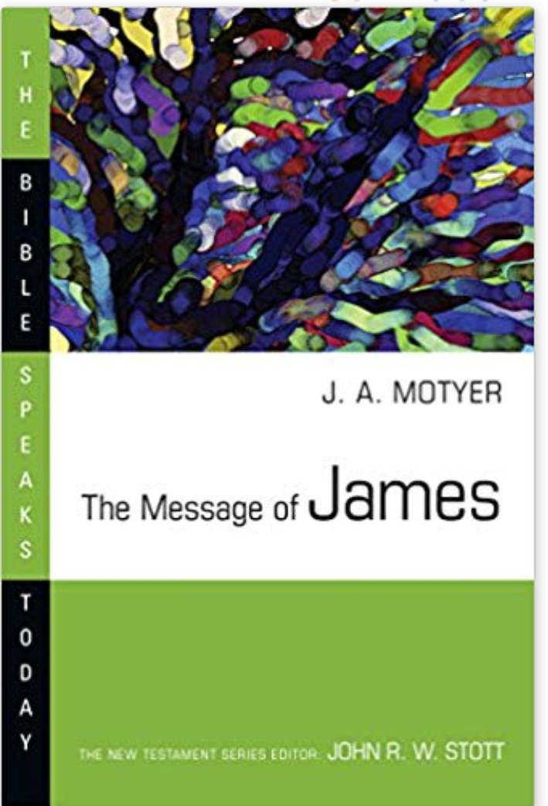
Reading for this series

