Slide 1
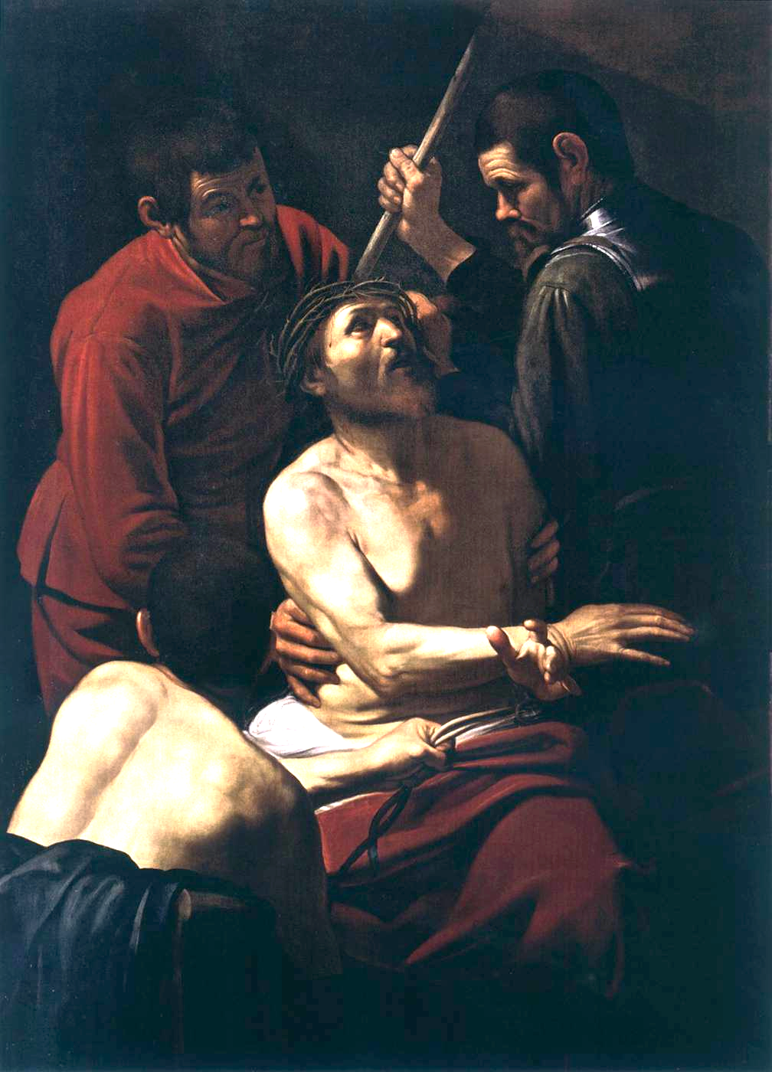
Live to your Fullest Potential!
A Plea to Lose Your Life for Christ

Slide 2
Live to your Fullest Potential
This is a common slogan, and there are variations. At root, there is an obsession with success and aspiration.
7 Habits of Highly Effective People
Self-Help Guru, Tony Robbins’ Unlimited Power, and Awaken the Giant Within
People like Grant Cardone…

Slide 3
Grant Cardone works with Fortune 500 companies to grow sales by finding overlooked opportunities and customizing the sales process to be more effective.
Grant Cardone preaches that success is your duty, obligation and responsibility.

Slide 4
“The problem with [mere] realistic thinking is that it’s usually based on what others think is possible. They don’t know your potential.”
“Reaching your full potential requires massive actions.”
“Have monster goals and attack them hard.”

Slide 5
Live to your Fullest Potential
What does this look like for students?
Achieve a higher GPA, higher SAT/GRE score
Lower body fat percentage, higher bench weight
New PR in cross country; another extracurricular
For adults/parents?
Buy home in great neighborhood, invest and save
Get kids into good schools, best soccer clubs, best piano lessons
Keep lawn green, enviable

Slide 6
Brief Qualification
There are some among us who are genuinely lazy and foolish. You would do well to heed passages like these:
Prov 28:19 [NIV] Sluggards do not plow in season; so at harvest time they look but find nothing.
I Tim 5:8 [NIV] Anyone who does not provide for their relatives, and especially for their own household, has denied the faith and is worse than an unbeliever.

Slide 7
A Biblical Perspective
You don’t need to be a Christian to see through extreme forms of “potential” thinking.
But there are ways it gets a grip:
Laziness is sinful. If you aren’t living up to your potential, isn’t that laziness?
We are stewards of our resources: time, money, career. What would God say if we neglect our great potential in these areas?

Slide 8
On Stewardship
Being a faithful (responsible) financial steward does not require the kind of extremes required by our “fullest potential.”
Often times people infer that we must be fantastic stewards of all areas of our lives because we must be good stewards of our whole life.
Fallacy of Division––The Washington monument is taller than the average person. Therefore, every stone in the Washington monument is taller than the average person.

Slide 9
On Stewardship
Even if this weren’t fallacious, there are purely practical considerations:
This is practically impossible. Try to do “everything” well, you’ll do very few (if any) of them well, let alone perfect.
People obsessed with career, wealth or sports often do so at the cost of relationships and family, let alone serving Christ.
No wonder everyone’s anxious given the prevalence of perfectionistic teaching! You’d go crazy if you think, “I could do more!”

Slide 10
Some Losers from the Bible
We’ll examine three men from the bible who have blown it big time with regards to their “potential.”
Peter
Paul
Jesus

Slide 11
Big Loser: Simon Peter
Luke 5:4-7 [NIV] When he had finished speaking, [Jesus] said to Simon, “Put out into deep water, and let down the nets for a catch.” Simon answered, “Master, we’ve worked hard all night and haven’t caught anything. But because you say so, I will let down the nets.” When they had done so, they caught such a large number of fish that their nets began to break. So they signaled their partners in the other boat to come and help them, and they came and filled both boats so full that they began to sink.
Starting Point Business owner, provider
Life for God Itinerant preacher, martyred?!
Second Look Luke 5:4-7

Slide 12
Big Loser: Simon Peter
Starting Point Business owner, provider
Life for God Itinerant preacher, martyred?!
Second Look Luke 5:4-7
Some takeaways
Peter’s own resources were inadequate for his own trade
Jesus provides abundantly well beyond Peter’s own normal abilities

Slide 13
Bigger Loser: Paul
Phil 3:7-10 [NIV]⁷ But whatever were gains to me I now consider loss for the sake of Christ. ⁸ What is more, I consider everything a loss because of the surpassing worth of knowing Christ Jesus my Lord, for whose sake I have lost all things. I consider them garbage, that I may gain Christ ⁹ and be found in him, not having a righteousness of my own that comes from the law, but that which is through faith in Christ—the righteousness that comes from God on the basis of faith. ¹⁰ I want to know Christ—yes, to know the power of his resurrection and participation in his sufferings, becoming like him in his death…
Starting Point Brilliant, zealous, wealthy scholar
Life for God Missionary, Tentmaker?! Martyred?!
Second Look Philippians 3:7-10

Slide 14
Bigger Loser: Paul
Starting Point Brilliant, zealous, wealthy scholar
Life for God Missionary, Tentmaker?! Martyred?!
Second Look Philippians 3:7-10
Some takeaways
Paul is not pining for his “glory days”: compared to closeness with Christ, they’re filth
Closeness with Christ is so valuable that Paul wants to “participate in his suffering”!

Slide 15
Biggest Loser: Jesus
Philippians 2:5-11 [NIV] Christ Jesus: ⁶ Who, being in very nature God, did not consider equality with God something to be used to his own advantage;⁷ rather, he made himself nothing by taking the very nature of a servant, being made in human likeness. ⁸ And being found in appearance as a man, he humbled himself by becoming obedient to death—even death on a cross! ⁹ Therefore God exalted him to the highest place and gave him the name that is above every name,¹⁰ that at the name of Jesus every knee should bow, in heaven and on earth and under the earth¹¹ and every tongue acknowledge that Jesus Christ is Lord, to the glory of God the Father.
Starting Point …GOD!
Life for God Incarnated, Homeless, Martyred!
Second Look Philippians 2:5-11

Slide 16
Biggest Loser: Jesus
Starting Point …GOD!
Life for God Incarnated, Homeless, Martyred!
Second Look Philippians 2:5-11
Some takeaways
In the biblical economy, the way up is down, exemplified in the greatest extremes by Jesus Christ himself.
What does it say that God (max potential) voluntarily went to the cross?

Slide 17
Live to Fullest Surrender
Luke 9:23-25 [NIV] Then he said to them all: “Whoever wants to be my disciple must deny themselves and take up their cross daily and follow me. For whoever wants to save their life will lose it, but whoever loses their life for me will save it. What good is it for someone to gain the whole world, and yet lose or forfeit their very self?”
I recommend we reject this thinking altogether.

Slide 18
Live to Fullest Surrender
I recommend we reject this thinking altogether.
Living to Fullest Potential = Gaining the Whole World, whereas Christ says, “Lose your life for me,” “Pick up your cross daily.”
This isn’t just weirdo self-punishment:
Those who lose their lives for Christ save it
The cross is followed by the resurrection.

Slide 19
Hebrews 13:13-14 [NIV] Let us, then, go to him outside the camp, bearing the disgrace he bore. For here we do not have an enduring city, but we are looking for the city that is to come.
reederp@xenos.org

