Slide 1
1 Corinthians 1
Paul in Corinth

Slide 2
1 Cor 1
1 Paul, called as an apostle of Jesus Christ by the will of God…
2 to the church of God which is at Corinth…

Slide 3
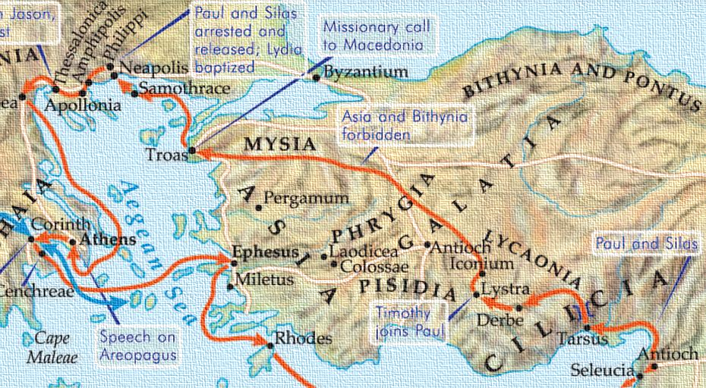
Acts 18:1 – Then Paul left Athens and went to Corinth.

Slide 4
Corinth
At its zenith it boasted a population of 800,000
Razed by Romans in 146 BCE, beautifully rebuilt by Julius Caesar in 46 BCE
In Paul’s day, it was back up to 200,000 people and was a major commercial center
It hosted the Isthmian games
And one other important detail…

Slide 5
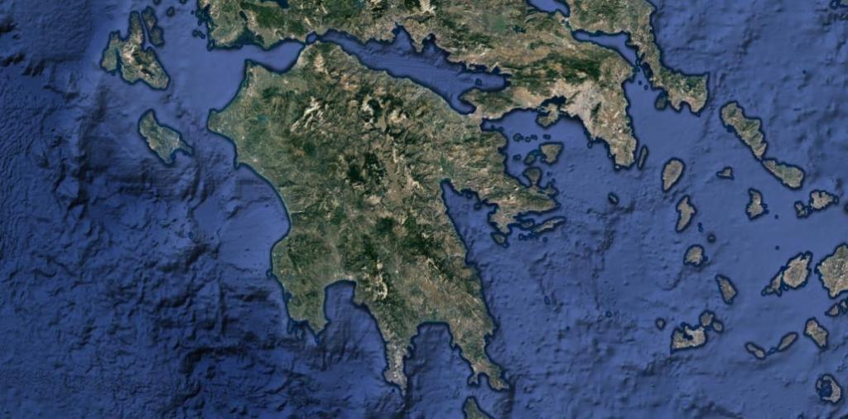
Corinth

Slide 6
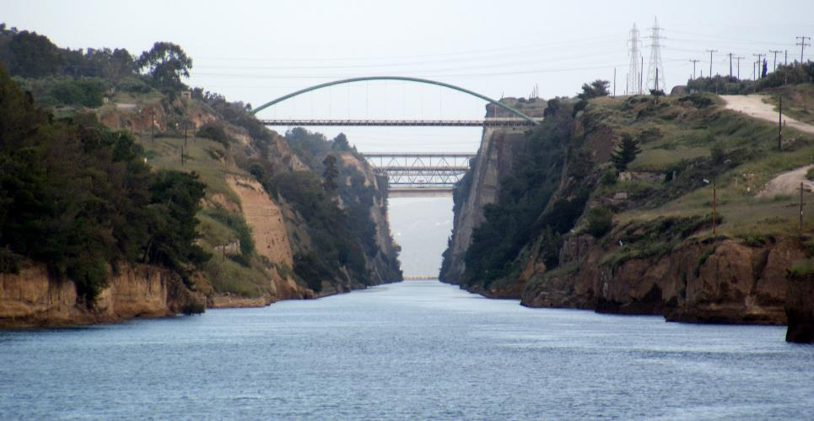
Corinth

Slide 7
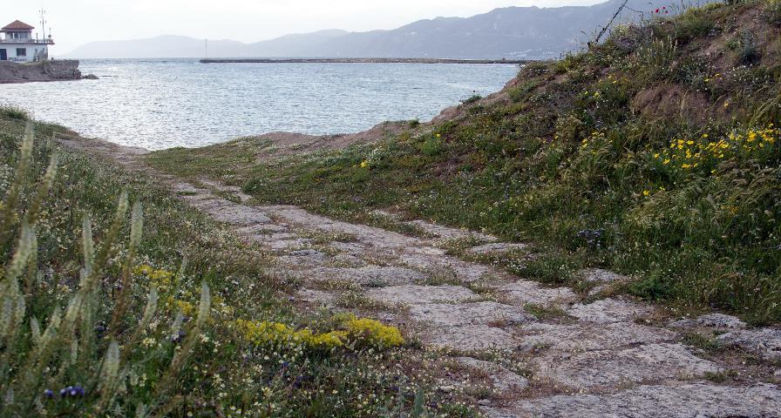
Corinth

Slide 8
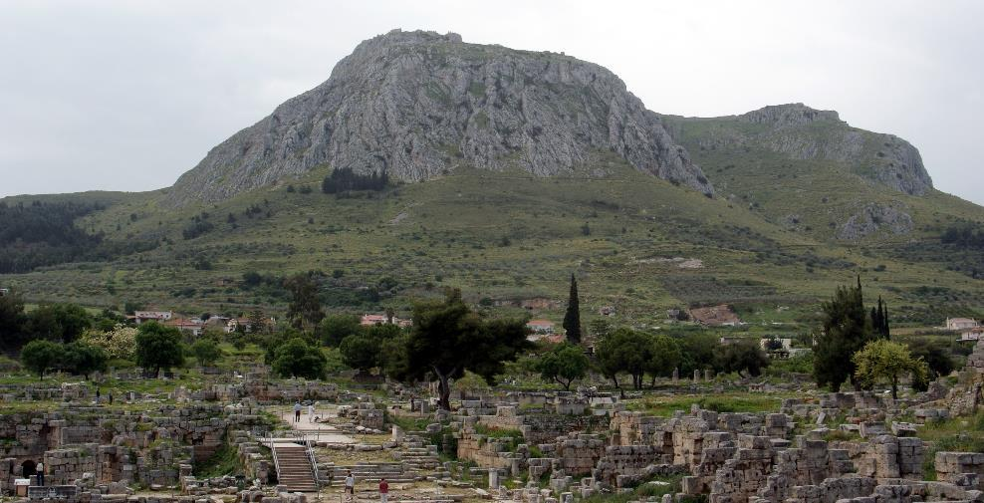
Corinth

Slide 9
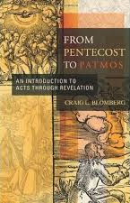
Craig Blomberg
Christian Theologian
Craig Blomberg, From Pentecost to Patmos: an Introduction to Acts through Revelation (Nashville, TN: B & H Academic, 2006), 163.
A huge stone mountain known as Acrocorinth, with its temple to Aphrodite perched atop it, towered over the city, and symbolized the dominance of Pagan cults.
One ancient author referred to “Aphrodite of the Beautiful Buttocks.”

Slide 10
Craig Blomberg
Christian Theologian
Craig Blomberg, From Pentecost to Patmos: an Introduction to Acts through Revelation (Nashville, TN: B & H Academic, 2006), 163.
In pre-Christian times it was said to have employed as many as one thousand sacred priests or priestesses who doubled as prostitutes.
Still more prostitutes plied their wares at ground level for the many visitors to the town, as well as the local populace.

Slide 11
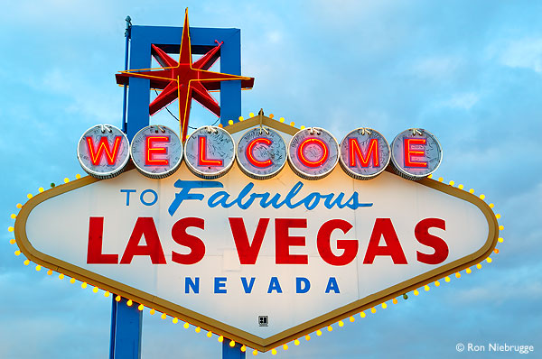
Corinth

Slide 12
1 Corinthians 2:3
I was with you in weakness and in fear and in much trembling…

Slide 13
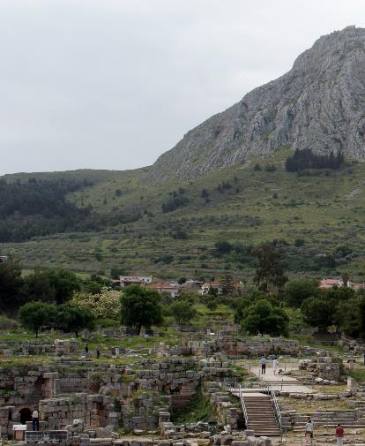
Acts 18
2 There he became acquainted with a Jew named Aquila, born in Pontus, who had recently arrived from Italy with his wife, Priscilla.
They had left Italy when Claudius Caesar deported all Jews from Rome.

Slide 14
Acts 18
3 Paul lived and worked with them, for they were tentmakers just as he was.

Slide 15
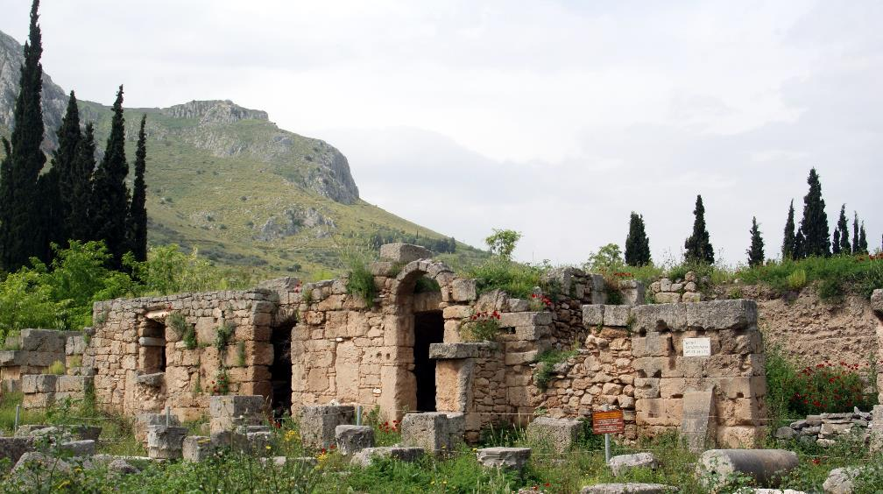
Acts 18
3 Paul lived and worked with them, for they were tentmakers just as he was.

Slide 16
Priscilla and Aquila
Jewish Christians, kicked out of Rome by Claudius

Slide 17
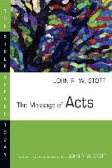
John Stott
20th c. Christian Author and Pastor
John R. W. Stott, The Message of Acts: The Spirit, the Church & the World, The Bible Speaks Today (Leicester, England; Downers Grove, IL: InterVarsity Press, 1994), 296.
Suetonius referred to this in his Life of Claudius (25:4):
‘as the Jews were making constant disturbances at the instigation of Chrestus (impulsore Chresto), he banished them from Rome’.

Slide 18
John Stott
20th c. Christian Author and Pastor
John R. W. Stott, The Message of Acts: The Spirit, the Church & the World, The Bible Speaks Today (Leicester, England; Downers Grove, IL: InterVarsity Press, 1994), 296.
The people expelled he called ‘Jews’, but ‘Chrestus’ seems to mean Christ (the pronunciation of ‘Christus’ and ‘Chrestus’ will have been very similar),
in which case the Jews were Christians and the disturbances in the Jewish community had been caused by the gospel.

Slide 19
Priscilla and Aquila
Jewish Christians, kicked out of Rome by Claudius
Already Christians
Became lifelong friends of Paul (Rom 16:4)
Priscilla usually mentioned first

Slide 20
Acts 18
4 Each Sabbath found Paul at the synagogue, trying to convince the Jews and Greeks alike.
5 And after Silas and Timothy came down from Macedonia, Paul spent all his time preaching the word.
He testified to the Jews that Jesus was the Messiah.

Slide 21
Acts 18
6 But when they opposed and insulted him, Paul shook the dust from his clothes and said,
“Your blood is upon your own heads—I am innocent. From now on I will go preach to the Gentiles.”

Slide 22
Acts 18
7 Then he left and went to the home of Titius Justus,
a Gentile who worshiped God
and lived next door to the synagogue.
8 Crispus, the leader of the synagogue, and everyone in his household believed in the Lord.

Slide 23
1 Corinthians1:14
…I baptized none of you except Crispus and Gaius…

Slide 24
Acts 18
7 Then he left and went to the home of Titius Justus,
a Gentile who worshiped God
and lived next door to the synagogue.
8 Crispus, the leader of the synagogue, and everyone in his household believed in the Lord.
Many others in Corinth also heard Paul, became believers, and were baptized.

Slide 25
Acts 18
7 Then he left and went to the home of Titius Justus,
a Gentile who worshiped God
and lived next door to the synagogue.
8 Crispus, the leader of the synagogue, and everyone in his household believed in the Lord.
Many others in Corinth also heard Paul, became believers, and were baptized.
The people who are farthest from God might be the closest to admitting their need for him.

Slide 26
1 Corinthians1:26-29
For consider your calling, brethren, that there were not many wise according to the flesh, not many mighty, not many noble;
but God has chosen the foolish things of the world to shame the wise, and God has chosen the weak things of the world to shame the things which are strong,

Slide 27
1 Corinthians1:26-29
and the base things of the world and the despised God has chosen, the things that are not, so that He may nullify the things that are,
so that no man may boast before God.

Slide 28
Acts 18
9 One night the Lord spoke to Paul in a vision and told him,
“Don’t be afraid! Speak out! Don’t be silent!
10 For I am with you, and no one will attack and harm you, for many people in this city belong to me.”

Slide 29
Acts 18
9 One night the Lord spoke to Paul in a vision and told him,
“Don’t be afraid! Speak out! Don’t be silent!
10 For I am with you, and no one will attack and harm you, for many people in this city belong to me.”
“…for I have many people in this city.”

Slide 30
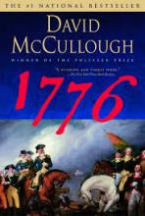
David McCullough
Pulitzer-Prize Winning Author
David McCullough, 1776 (NY, NY: Simon & Schuster, 2005), 294.
[Washington] was not a brilliant strategist, not a gifted orator, not an intellectual.
At several crucial moments he had shown marked indecisiveness.
He had made serious mistakes in judgment…

Slide 31
David McCullough
Pulitzer-Prize Winning Author
David McCullough, 1776 (NY, NY: Simon & Schuster, 2005), 294.
[But] above all, Washington never forgot what was at stake
and he never gave up.

Slide 32
Acts 18
11 So Paul stayed there for the next year and a half, teaching the word of God.
Thank God he had at least 18 more months there!

Slide 33
The Church at Corinth
Consider the initial members of this group:
-A former rabbi/Pharisee/persecutor
-2 Jewish Christians from Rome
-A wealthy “God-fearer” from the synagogue
-The former synagogue leader
-Crazy pagan party-ers
-A high-ranking Roman official!
Rom 16:23 – Erastus, the city treasurer greets you…

Slide 34
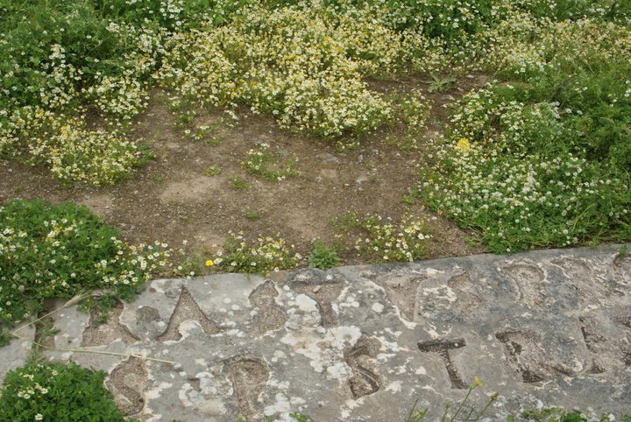
“Erastus”

Slide 35
The Church at Corinth
1 Corinthians: Very different groups trying to do life together
-Chapters 1-4: division/competition
-Chapters 5-6: immorality, lawsuits
-Chapter 10: arrogance
-Chapter 11: drunk at communion

Slide 36
Acts 18
11 So Paul stayed there for the next year and a half, teaching the word of God.
12 But when Gallio became governor of Achaia,

Slide 37
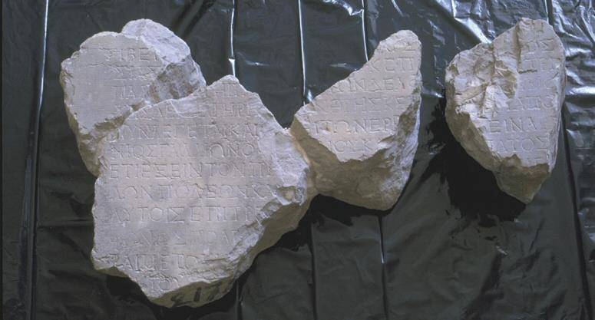
Gallio Inscription

Slide 38
Acts 18
11 So Paul stayed there for the next year and a half, teaching the word of God.
12 But when Gallio became governor of Achaia,
some Jews rose up together against Paul and brought him before the governor for judgment.

Slide 39
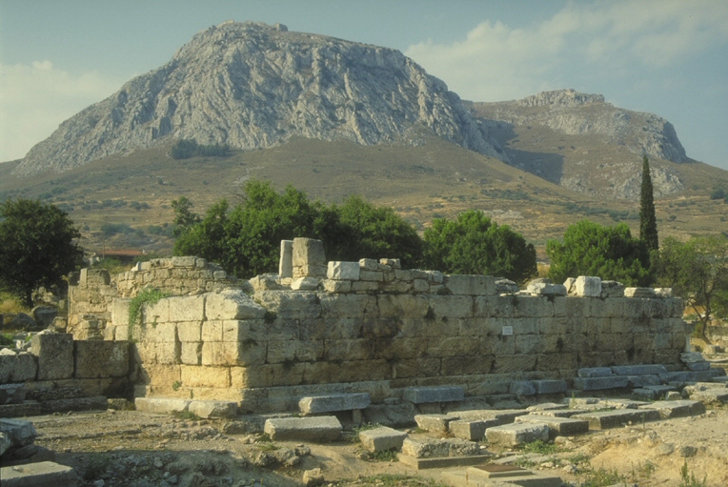

Slide 40
Acts 18
13 They accused Paul of “persuading people to worship God in ways that are contrary to our law.”
14 But just as Paul started to make his defense, Gallio turned to Paul’s accusers and said,
“Listen, you Jews, if this were a case involving some wrongdoing or a serious crime, I would have a reason to accept your case.

Slide 41
Acts 18
15 But since it is merely a question of words and names and your Jewish law, take care of it yourselves.
I refuse to judge such matters.”
16 And he threw them out of the courtroom.

Slide 42
Acts 18
17 The crowd then grabbed Sosthenes, the leader of the synagogue,
and beat him right there in the courtroom.
But Gallio paid no attention.
18 Paul stayed in Corinth for some time…
4 years later…

Slide 43
1 Cor 1
1 Paul, called as an apostle of Jesus Christ by the will of God,
and Sosthenes our brother,

Slide 44
1 Cor 1
1 Paul, called as an apostle of Jesus Christ by the will of God,
and Sosthenes our brother,
2 To the church of God which is at Corinth, to those who have been sanctified in Christ Jesus, saints by calling, with all who in every place call on the name of our Lord Jesus Christ, their Lord and ours:
“Church” = “Called-out ones”
Notes:
Church = “Called-out ones.”

Slide 45
1 Cor 1
1 Paul, called as an apostle of Jesus Christ by the will of God,
and Sosthenes our brother,
2 To the church of God which is at Corinth, to those who have been sanctified in Christ Jesus, saints by calling, with all who in every place call on the name of our Lord Jesus Christ, their Lord and ours:
Notes:
There are two locations: In Christ Jesus and In Corinth. All your problems are in the first address.

Slide 46
1 Cor 1
3 Grace to you and peace from God our Father and the Lord Jesus Christ.
4 I thank my God always concerning you for the grace of God which was given you in Christ Jesus,
5 that in everything you were enriched in Him, in all speech and all knowledge,

Slide 47
1 Cor 1
6 even as the testimony concerning Christ was confirmed in you,
7 so that you are not lacking in any gift, awaiting eagerly the revelation of our Lord Jesus Christ,
8 who will also confirm you to the end, blameless in the day of our Lord Jesus Christ.

Slide 48
1 Cor 1
9 God is faithful, through whom you were called into fellowship with His Son, Jesus Christ our Lord.
1 Thess 5:24 – He who calls you is faithful, and he will do it.
Notes:
Paul is going to try to help them live out their calling – to become who they really are

Slide 49
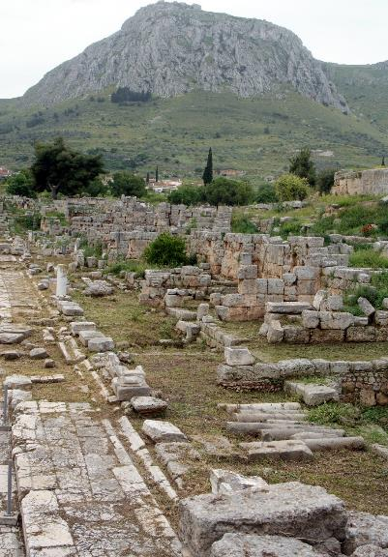
Conclusions
It’s always too soon to quit
You might be surprised by who responds to the gospel
God is committed to the people he calls

