Slide 1
Ecclesiastes
Chapter 3, 11,12

Slide 2
Time
The passage of time is an inedibility.
Time does not comfort.
Time does not care.
Time does not show favoritism.
Time haunts us.
Time hunts us down, mercilessly.
Time works against all that lives.

Slide 3
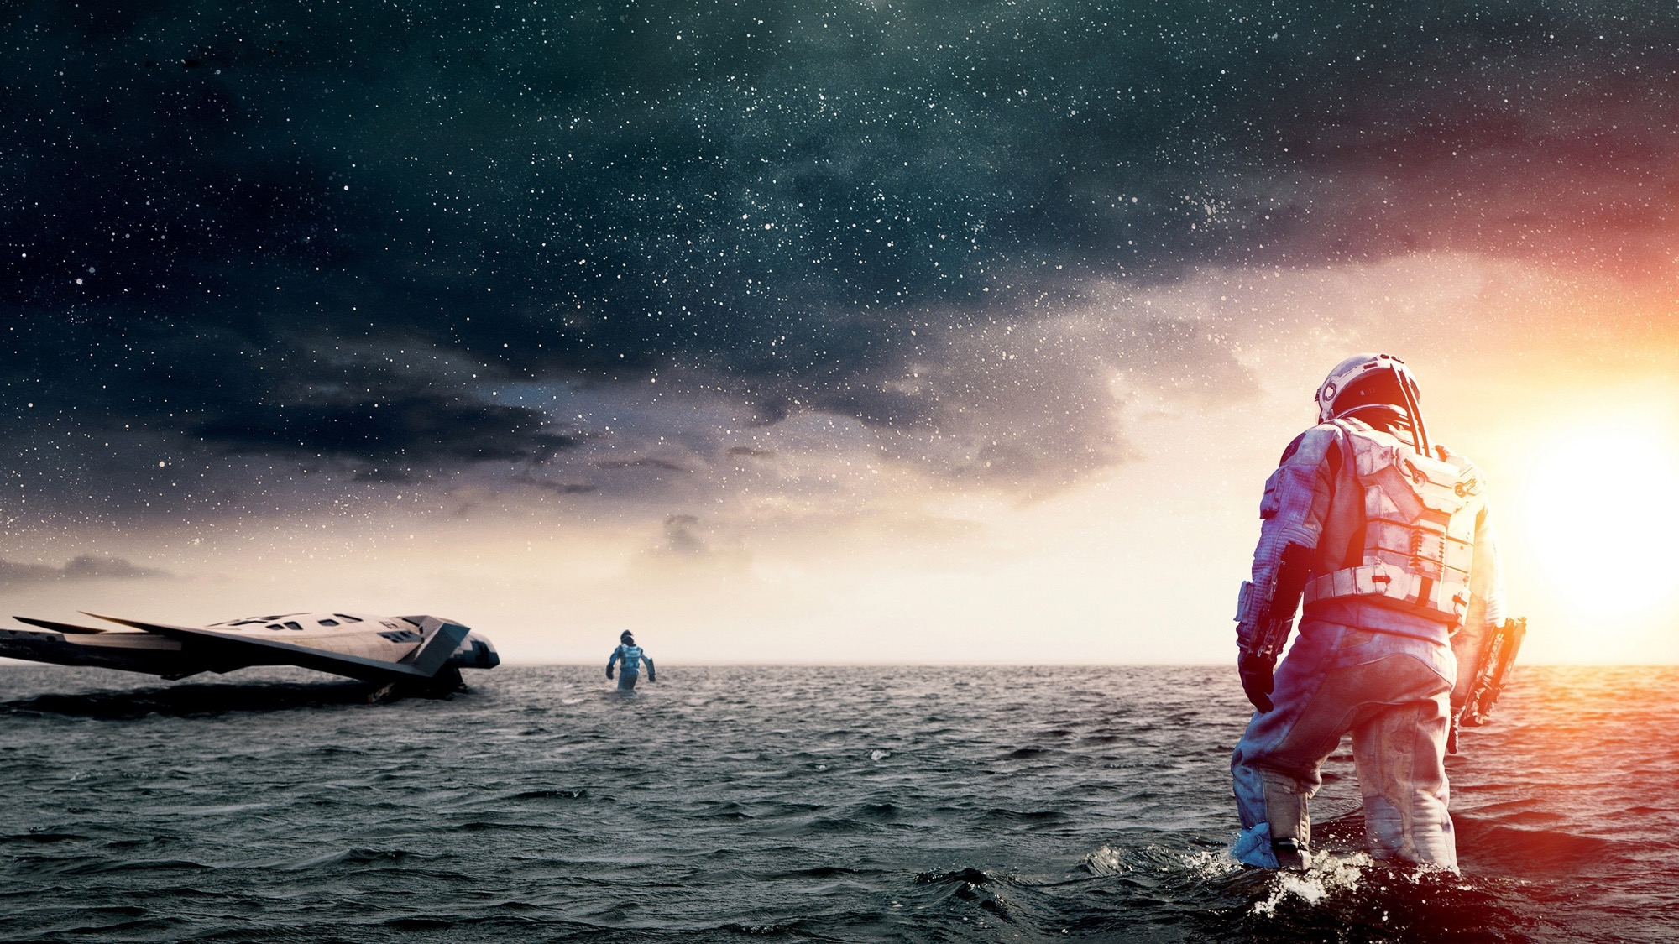

Slide 4
3:1. For everything there is an appointed time, and an appropriate time for every activity on earth:
Ecclesiastes

Slide 5
2. A time to be born, and a time to die; a time to plant, and a time to uproot what was planted;
Ecclesiastes

Slide 6
3-4. A time to kill, and a time to heal; a time to break down, and a time to build up; A time to weep, and a time to laugh; a time to mourn, and a time to dance.
Cow
Ecclesiastes

Slide 7
3-4. A time to kill, and a time to heal; a time to break down, and a time to build up; A time to weep, and a time to laugh; a time to mourn, and a time to dance.
Ecclesiastes

Slide 8
3-4. A time to kill, and a time to heal; a time to break down, and a time to build up; A time to weep, and a time to laugh; a time to mourn, and a time to dance.
Ecclesiastes

Slide 9
5-6. A time to throw away stones, and a time to gather stones; a time to embrace, and a time to refrain from embracing; A time to search, and a time to give something up as lost; a time to keep, and a time to throw away;
Ecclesiastes

Slide 10
5-6. A time to throw away stones, and a time to gather stones; a time to embrace, and a time to refrain from embracing; A time to search, and a time to give something up as lost; a time to keep, and a time to throw away;
Ecclesiastes

Slide 11
5-6. A time to throw away stones, and a time to gather stones; a time to embrace, and a time to refrain from embracing; A time to search, and a time to give something up as lost; a time to keep, and a time to throw away;
Ecclesiastes

Slide 12
5-6. A time to throw away stones, and a time to gather stones; a time to embrace, and a time to refrain from embracing; A time to search, and a time to give something up as lost; a time to keep, and a time to throw away;
Ecclesiastes

Slide 13
7-8. A time to rip, and a time to sew; a time to keep silent, and a time to speak. A time to love, and a time to hate; a time for war, and a time for peace.
Ecclesiastes

Slide 14
7-8. A time to rip, and a time to sew; a time to keep silent, and a time to speak. A time to love, and a time to hate; a time for war, and a time for peace.
(Prov. 26:4-5) Don’t answer the foolish arguments of fools, or you will become as foolish as they are. Be sure to answer the foolish arguments of fools, or they will become wise in their own estimation.
Ecclesiastes

Slide 15
7-8. A time to rip, and a time to sew; a time to keep silent, and a time to speak. A time to love, and a time to hate; a time for war, and a time for peace.
Ecclesiastes

Slide 16
7-8. A time to rip, and a time to sew; a time to keep silent, and a time to speak. A time to love, and a time to hate; a time for war, and a time for peace.
14 pluses & 14 minuses
= NOTHING!
Ecclesiastes

Slide 17
9. What benefit can a worker gain from his toil?
Ecclesiastes

Slide 18
10. I have observed the burden that God has given to people to keep them occupied.
Ecclesiastes

Slide 19
10. I have observed the burden that God has given to people to keep them occupied.
Ecclesiastes

Slide 20
11. Yet God has made everything appropriate for its own time. He has planted eternity in the human heart, but even so, people cannot see the whole scope of God’s work from beginning to end.
Ecclesiastes

Slide 21
11. Yet God has made everything appropriate for its own time. He has planted eternity in the human heart, but even so, people cannot see the whole scope of God’s work from beginning to end.
Ecclesiastes

Slide 22
11. Yet God has made everything appropriate for its own time. He has planted eternity in the human heart, but even so, people cannot see the whole scope of God’s work from beginning to end.
We sense deep down, that something isn’t right…
Ecclesiastes

Slide 23
11. Yet God has made everything appropriate for its own time. He has planted eternity in the human heart, but even so, people cannot see the whole scope of God’s work from beginning to end.
Ecclesiastes

Slide 24
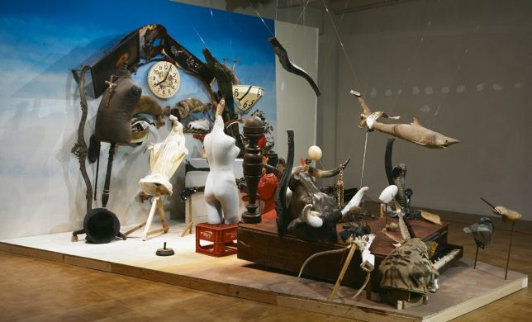

Slide 25
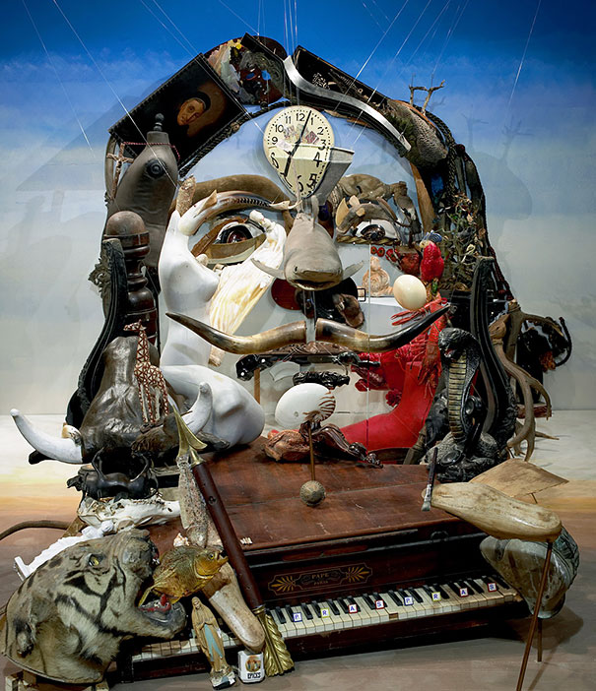

Slide 26
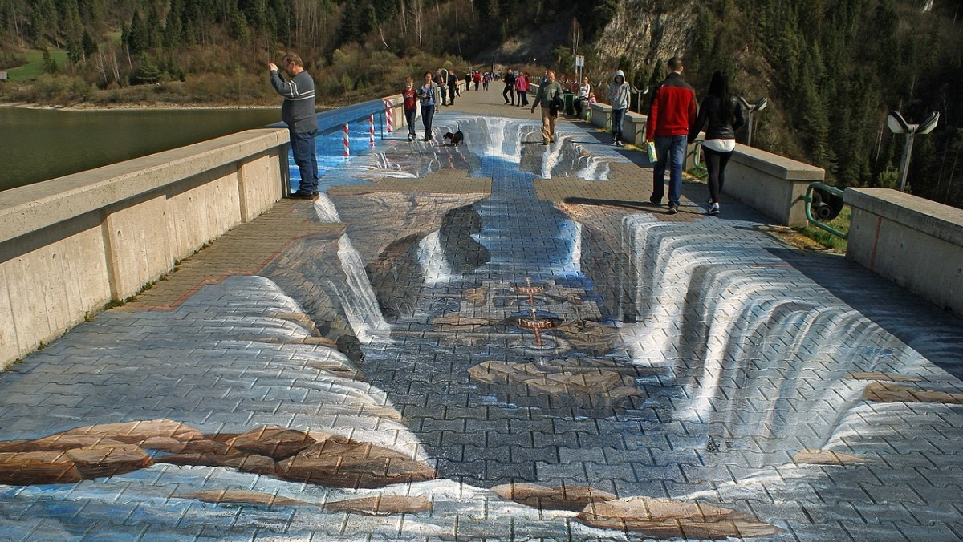

Slide 27
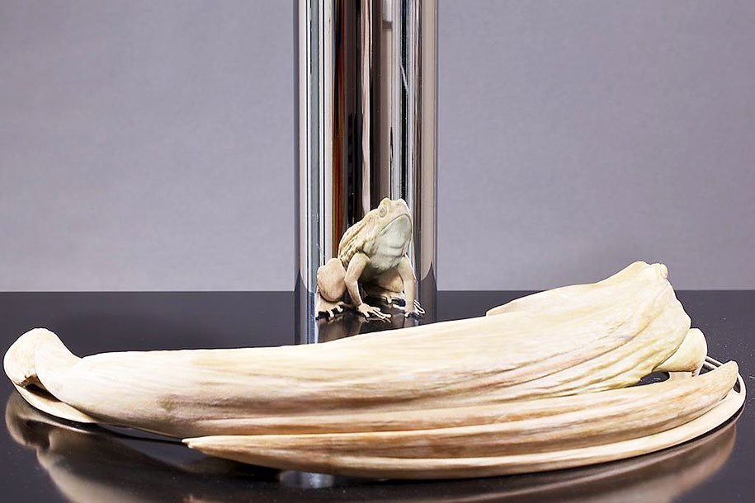

Slide 28
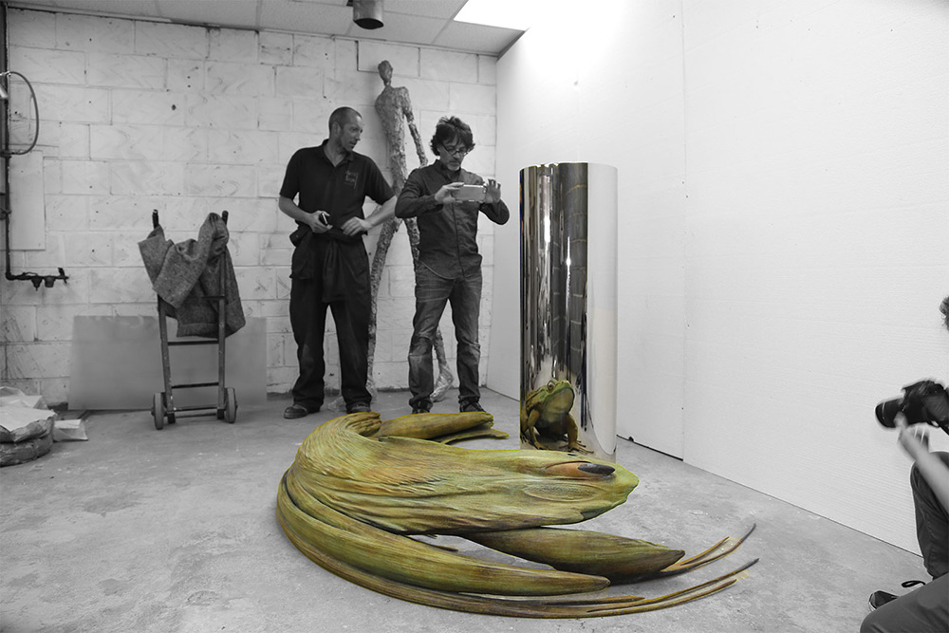

Slide 29
11. Yet God has made everything appropriate for its own time. He has planted eternity in the human heart, but even so, people cannot see the whole scope of God’s work from beginning to end.
(Deut. 29:29) Secret things belong to the Lord our God, but those that are revealed belong to us and our descendants forever, so that we might obey all the words of this law.
Ecclesiastes

Slide 30
(1 Cor. 13:12) For now we see in a mirror indirectly, but then we will see face to face. Now I know in part, but then I will know fully, just as I have been fully known.
11. Yet God has made everything appropriate for its own time. He has planted eternity in the human heart, but even so, people cannot see the whole scope of God’s work from beginning to end.
We are trapped between time and eternity!
(Deut. 29:29) Secret things belong to the Lord our God, but those that are revealed belong to us and our descendants forever, so that we might obey all the words of this law.
Ecclesiastes

Slide 31
14. I know everything God does endures forever; nothing can be added to it, and nothing can be taken from it, for God so acts that humans might stand in awe before him.
Ecclesiastes

Slide 32
14. I know everything God does endures forever; nothing can be added to it, and nothing can be taken from it, for God so acts that humans might stand in awe before him.
(Eph. 1:9-11) God has now revealed to us his mysterious will regarding Christ—which is to fulfill his own good plan. And this is the plan: At the right time he will bring everything together under the authority of Christ…because we are united with Christ, we have received an inheritance from God…he makes everything work out according to his plan.
Ecclesiastes

Slide 33
11:9. Rejoice, young one, while you are young, and let your heart cheer you in the days of your youth. Follow the impulses of your heart and the desires of your eyes,
Ecclesiastes

Slide 34
11:9. Rejoice, young one, while you are young, and let your heart cheer you in the days of your youth. Follow the impulses of your heart and the desires of your eyes,
Ecclesiastes

Slide 35
(Eph. 2:4-5) But God is so rich in mercy, and he loved us so much, that even though we were dead because of our sins, he gave us life when he raised Christ from the dead. It is only by God’s grace that you have been saved!
11:9. Rejoice, young one, while you are young, and let your heart cheer you in the days of your youth. Follow the impulses of your heart and the desires of your eyes,
but know that God will judge your motives and actions.
[NLT]…But remember that you must give an account to God for everything you do.
Ecclesiastes

Slide 36
10…for youth and the prime of life are fleeting.
Ecclesiastes

Slide 37
12:1. So remember your Creator in the days of your youth—before the difficult days come, and the years draw near when you will say, “I have no pleasure in them”
Ecclesiastes

Slide 38
12:1. So remember your Creator in the days of your youth—before the difficult days come, and the years draw near when you will say, “I have no pleasure in them”
Prepare for the long run:
Form good spiritual habits now.
Remember that your time is short.
Make the most of any opportunity while you have it.
Consider life choices in light of God’s will.
Learn from good and bad role models.
Learn humility and dependance from God.
Develop a deep seated gratitude.
Ecclesiastes

Slide 39
2. before the sun and the light of the moon and the stars grow dark, and the clouds disappear after the rain
Ecclesiastes

Slide 40
3. when those who keep watch over the house begin to tremble, and the virile men begin to stoop over, and the grinders begin to cease because they grow few, and those who look through the windows grow dim,
Ecclesiastes

Slide 41
4. and the doors along the street are shut; when the sound of the grinding mill grows low, and one is awakened by the sound of a bird, and all their songs grow faint,
Ecclesiastes

Slide 42
5. and they are afraid of heights and the dangers in the street; the almond blossoms grow white, and the grasshopper drags itself along, and the caper berry shrivels up— because man goes to his eternal home, and the mourners go about in the streets
Ecclesiastes

Slide 43
6. before the silver cord is removed, or the golden bowl is broken, or the pitcher is shattered at the well, or the water wheel is broken at the cistern—
Ecclesiastes

Slide 44
7. and the dust returns to the earth as it was, and the life’s breath returns to God who gave it.
Ecclesiastes

Slide 45
Why?
Imagine a world where time is not related to death in any way.
Imagine a world where aging is irrelevant.
Imagine a world where sickness, death and pain will disappear.
If you know Jesus, this will be a reality one second after death!
If this sounds desirable, remember the reason is that God has placed eternity in your heart!

Slide 46
Ecclesiastes
Chapters 3, 11,12
Comments?
Questions?
Experiences?

