Slide 1
Teaching our kids to be givers not takers

Slide 2
Acts 20:35
In all things I have shown you that by working hard in this way we must help the weak and remember the words of the Lord Jesus, how he himself said, ‘It is more blessed to give than to receive.’”

Slide 3
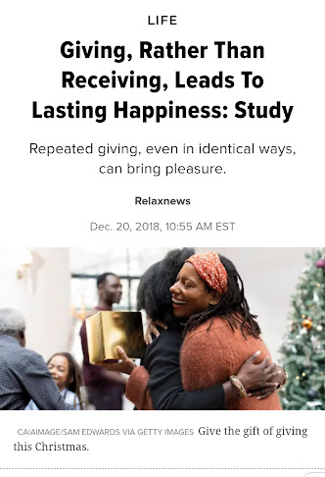
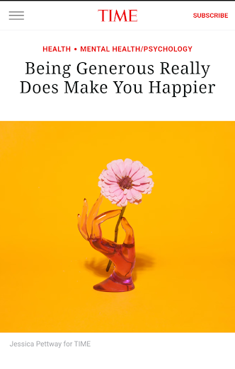
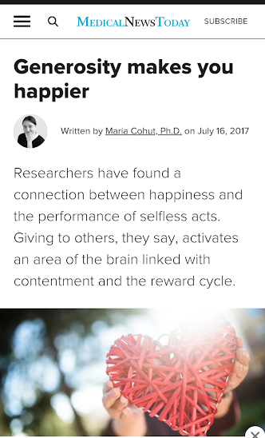
Acts 20:35
In all things I have shown you that by working hard in this way we must help the weak and remember the words of the Lord Jesus, how he himself said, ‘It is more blessed to give than to receive.’”
Happy/Happier

Slide 4
Acts 20:35
In all things I have shown you that by working hard in this way we must help the weak and remember the words of the Lord Jesus, how he himself said, ‘It is more blessed to give than to receive.’”
Happy/Happier

Slide 5
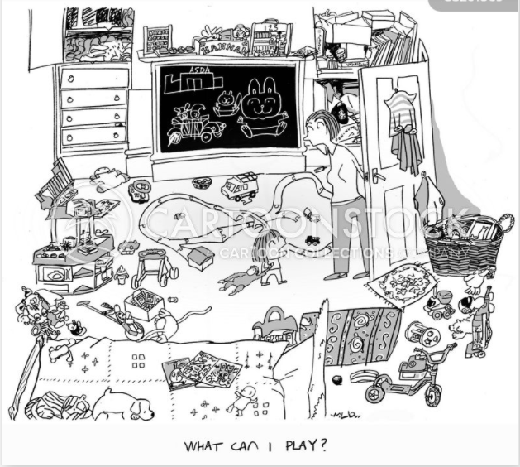
Acts 20:35
In all things I have shown you that by working hard in this way we must help the weak and remember the words of the Lord Jesus, how he himself said, ‘It is more blessed to give than to receive.’”
Happy/Happier

Slide 6
Our Condition
When Adam sinned, sin entered the world. Adam’s sin brought death, so death spread to everyone, for everyone sinned. Romans 5:12
Born sinners

Slide 7
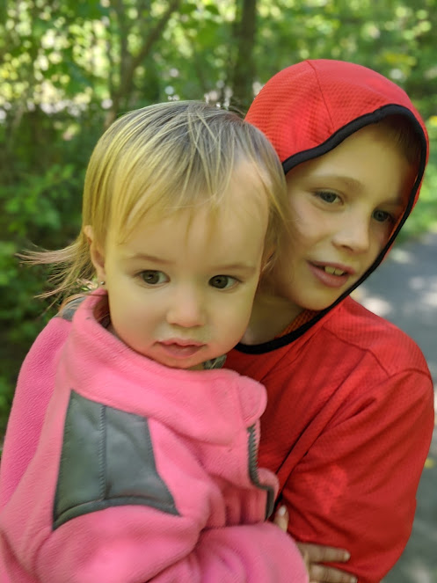
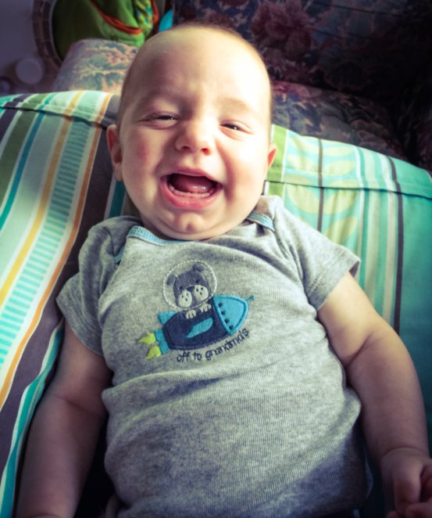
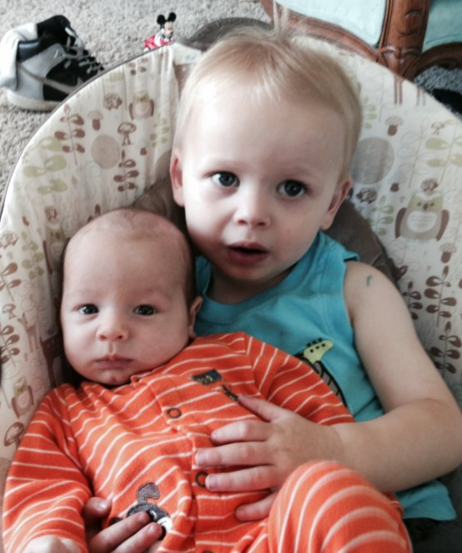
Our Condition
When Adam sinned, sin entered the world. Adam’s sin brought death, so death spread to everyone, for everyone sinned. Romans 5:12
Born sinners

Slide 8
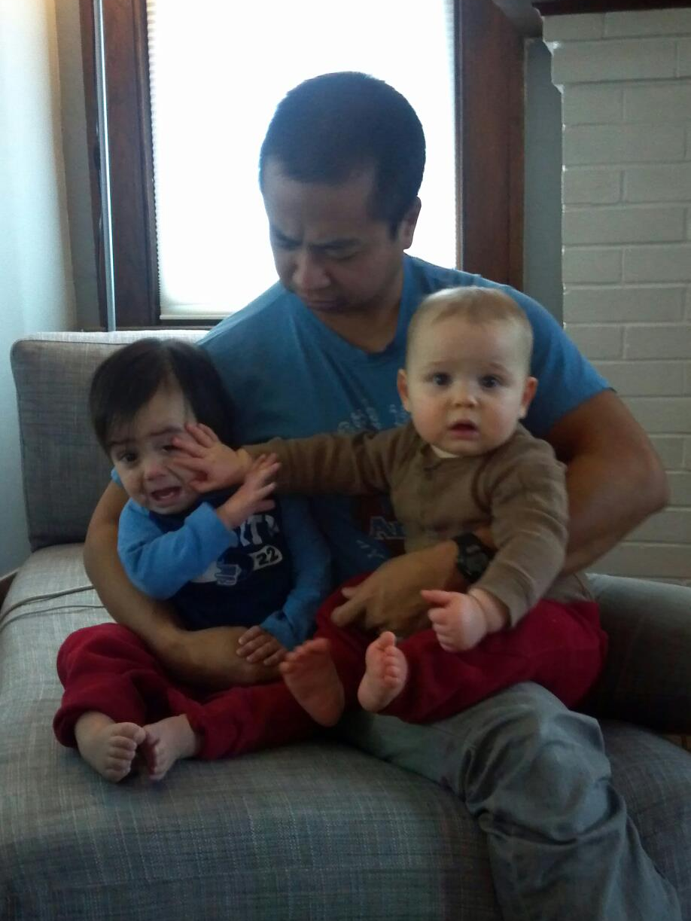
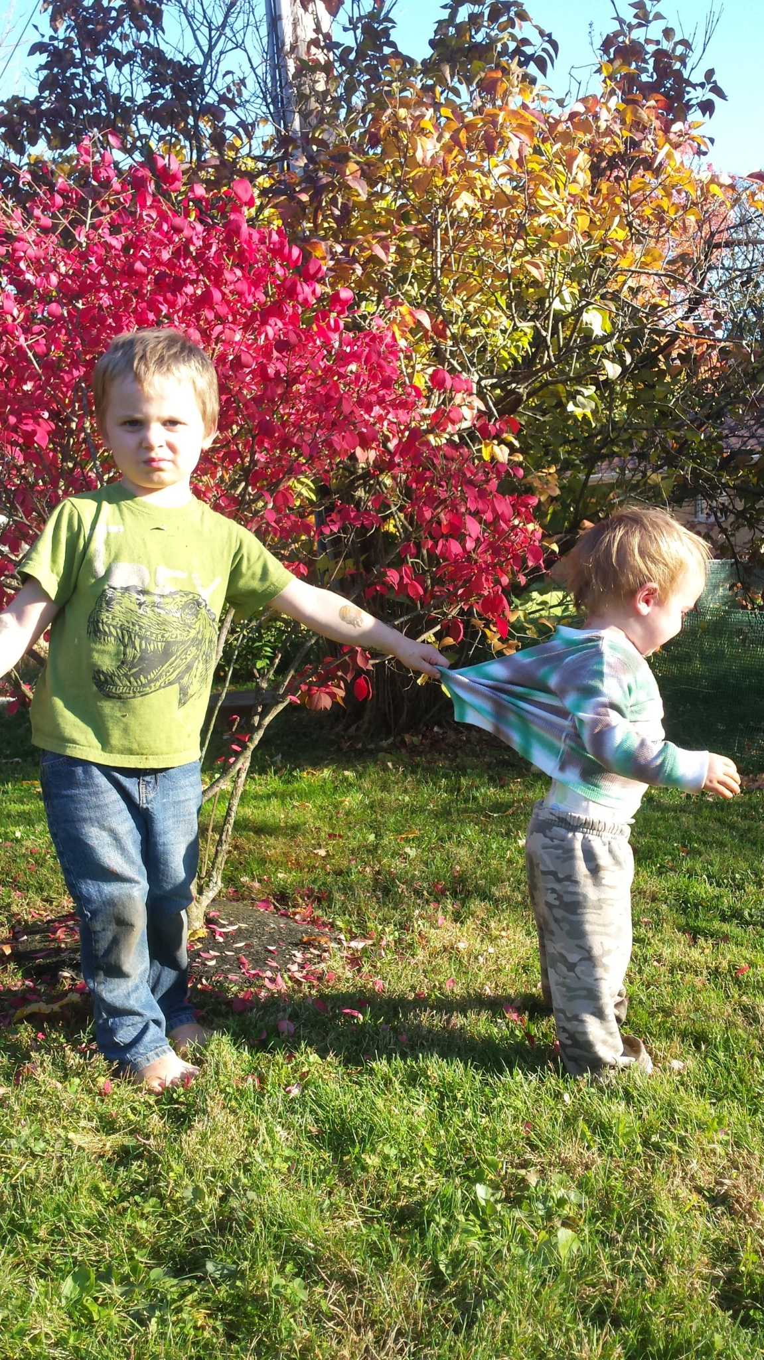
Transition Headline
Maybe not so hard to believe?...

Slide 9
Transition Headline
Maybe not so hard to believe?...
How the remembrance that their children have inherited their evil natures from their parents ought to humble those parents… And it should lead them to seek what alone can cure and conquer this evil- the grace and life that comes from above.
Andrew Murray Raising Your Children for Christ

Slide 10
2 Corinthians 5:14-15 For Christ’s love compels us, because we are convinced that one died for all, and therefore all died. And he died for all, that those who live should no longer live for themselves but for him who died for them and was raised again.

Slide 11
2 Corinthians 5:14-15 For Christ’s love compels us, because we are convinced that one died for all, and therefore all died. And he died for all, that those who live should no longer live for themselves but for him who died for them and was raised again.
If you want your kids to believe this, you have to live it!
It starts with us!

Slide 12
Dangers from our Culture
Child Centered Parenting
Defined: Parenting organized around the needs and interests of the child (eat, play, attend, plan) The child is put 1st.
Fosters autonomy, initiative, and creativity
Feel good about themselves by praising their initiative, effort and accomplishments and avoid critical feedback that can diminish a child’s confidence or self-esteem
“Child-centered parenting runs the risk of producing entitled, narcissistic children who lack capacity to persevere and cope with difficulty… Parents need to be both directive and supportive; to have high expectations and provide loving care; to praise success but also teach children how to cope with and persevere through failure…Children come into the world incomplete. They need active direction and sensitive support of loving parents to help complete them.”
Psychology Today, Michael F. Mascolo, Ph.D.

Slide 13
Dangers from our Culture
Child Centered Parenting
Defined: Parenting organized around the needs and interests of the child (eat, play, attend, plan) The child is put 1st.
Too much direction will squash our children’s creativity
We don't want to infringe on our children’s rights to make his or her own choices

Slide 14
Dangers from our Culture
“Child-centered parenting runs the risk of producing entitled, narcissistic children who lack capacity to persevere and cope with difficulty… Parents need to be both directive and supportive; to have high expectations and provide loving care; to praise success but also teach children how to cope with and persevere through failure…Children come into the world incomplete. They need active direction and sensitive support of loving parents to help complete them.”
Psychology Today, Michael F. Mascolo, Ph.D.
Child Centered Parenting
Defined: Parenting organized around the needs and interests of the child (eat, play, attend, plan) The child is put 1st.
Too much direction will squash our children’s creativity
We don't want to infringe on our children’s rights to make his or her own choices

Slide 15
Dangers from our Culture
Child Centered Parenting
Think about the long term:
Authority issues
Unteachable
Self-centered
Reality check

Slide 16
Dangers from our Culture
Child Centered Parenting
Think about the long term:
Authority issues
Unteachable
Self-centered
Reality check
This doesn’t equal a giver

Slide 17
Dangers from our Culture
Overprotective Parenting
Define: Parents seek to shelter their children from physical, mental, or emotional pain
Example
Failure is important
Problem solving
Endurance, strength, confidence
Giving out to others is hard!

Slide 18
Dangers from our Culture
Turning inward
Difficulty in balancing ministering to others and parenting
It is messy
It is hard
Maybe God has something for us to learn
What message are we sending to our kids if we retreat when it’s hard?

Slide 19
Dangers from our Culture
Turning inward
Difficulty in balancing ministering to others and parenting
It is messy
It is hard
Maybe God has something for us to learn
What message are we sending to our kids if we retreat when it’s hard?
If we want our kids to be interested in giving out, they need to see us doing it!

Slide 20
This starts with us
Our kids learn from what we value and model
Develop your convictions-are you convinced?
Matthew 6:12 For where your treasure is, there your heart will be also.

Slide 21
This starts with us
Is there one of these dangers you tend towards? Why?
Do you believe that God will come through if you sacrifice?
This time of life is crazy- But God has provisions for us!

Slide 22
This starts with us
And God is able to bless you abundantly, so that in all things at all times, having all that you need, you will abound in every good work. 2 Cor 9:8
Is there one of these dangers you tend towards? Why?
Do you believe that God will come through if you sacrifice?
This time of life is crazy- But God has provisions for us!
He tends his flock like a shepherd:
He gathers the lambs in his arms
and carries them close to his heart;
he gently leads those that have young.
Isaiah 40:11

Slide 23
This starts with us
Am I a giver or a taker?
How have I been giving out lately?
Do I complain or model gratitude?
We can show our kids the joy of giving and that this is a good life

Slide 24
Lets get Practical
Start small
Read books: Global Babies
Pray for other people together
Serve the family
Serve someone in need
Teach God’s love for the poor
Critique our culture’s view of happiness
Set a vision
Serve together as a family

Slide 25
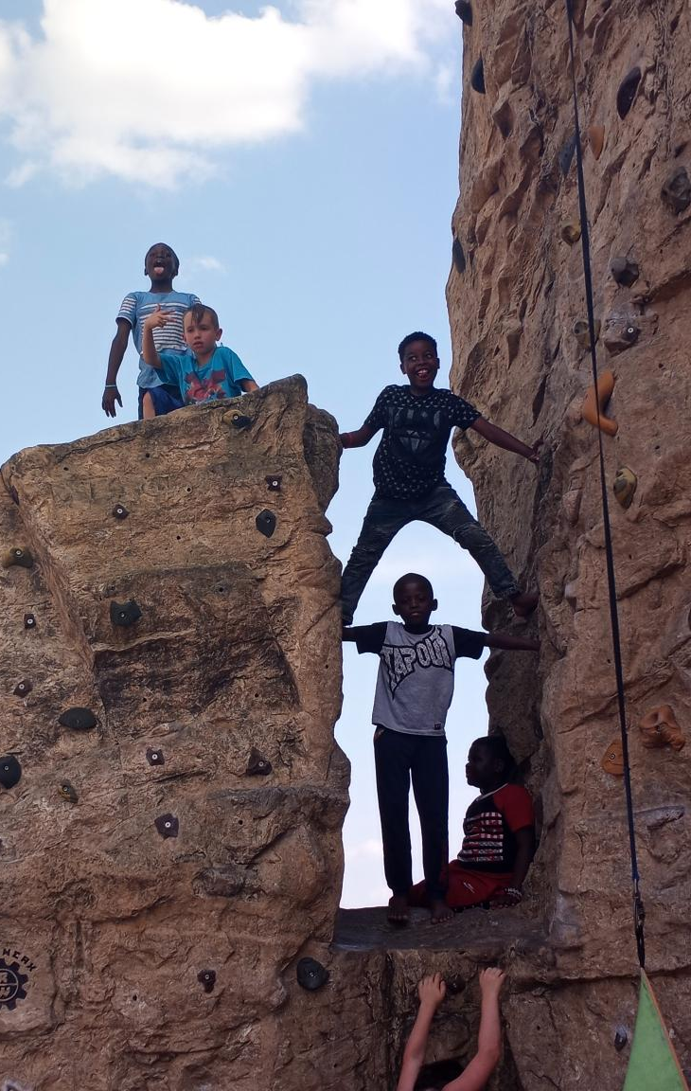
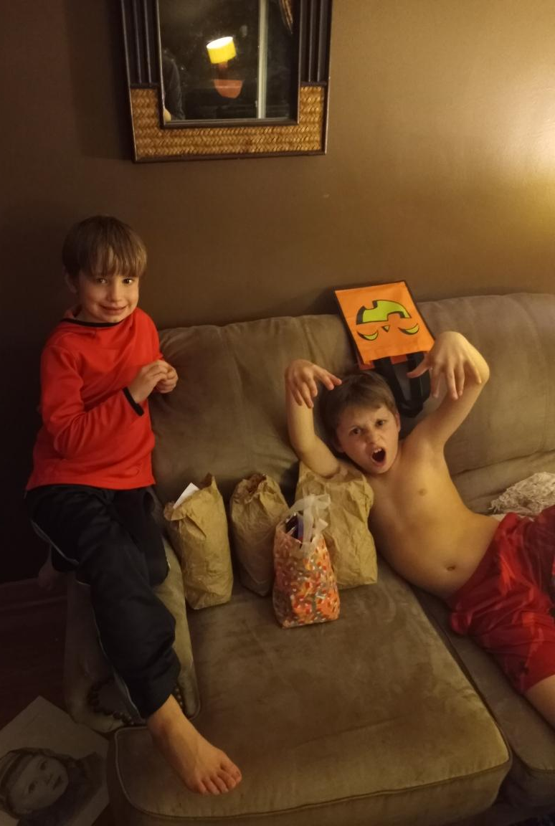
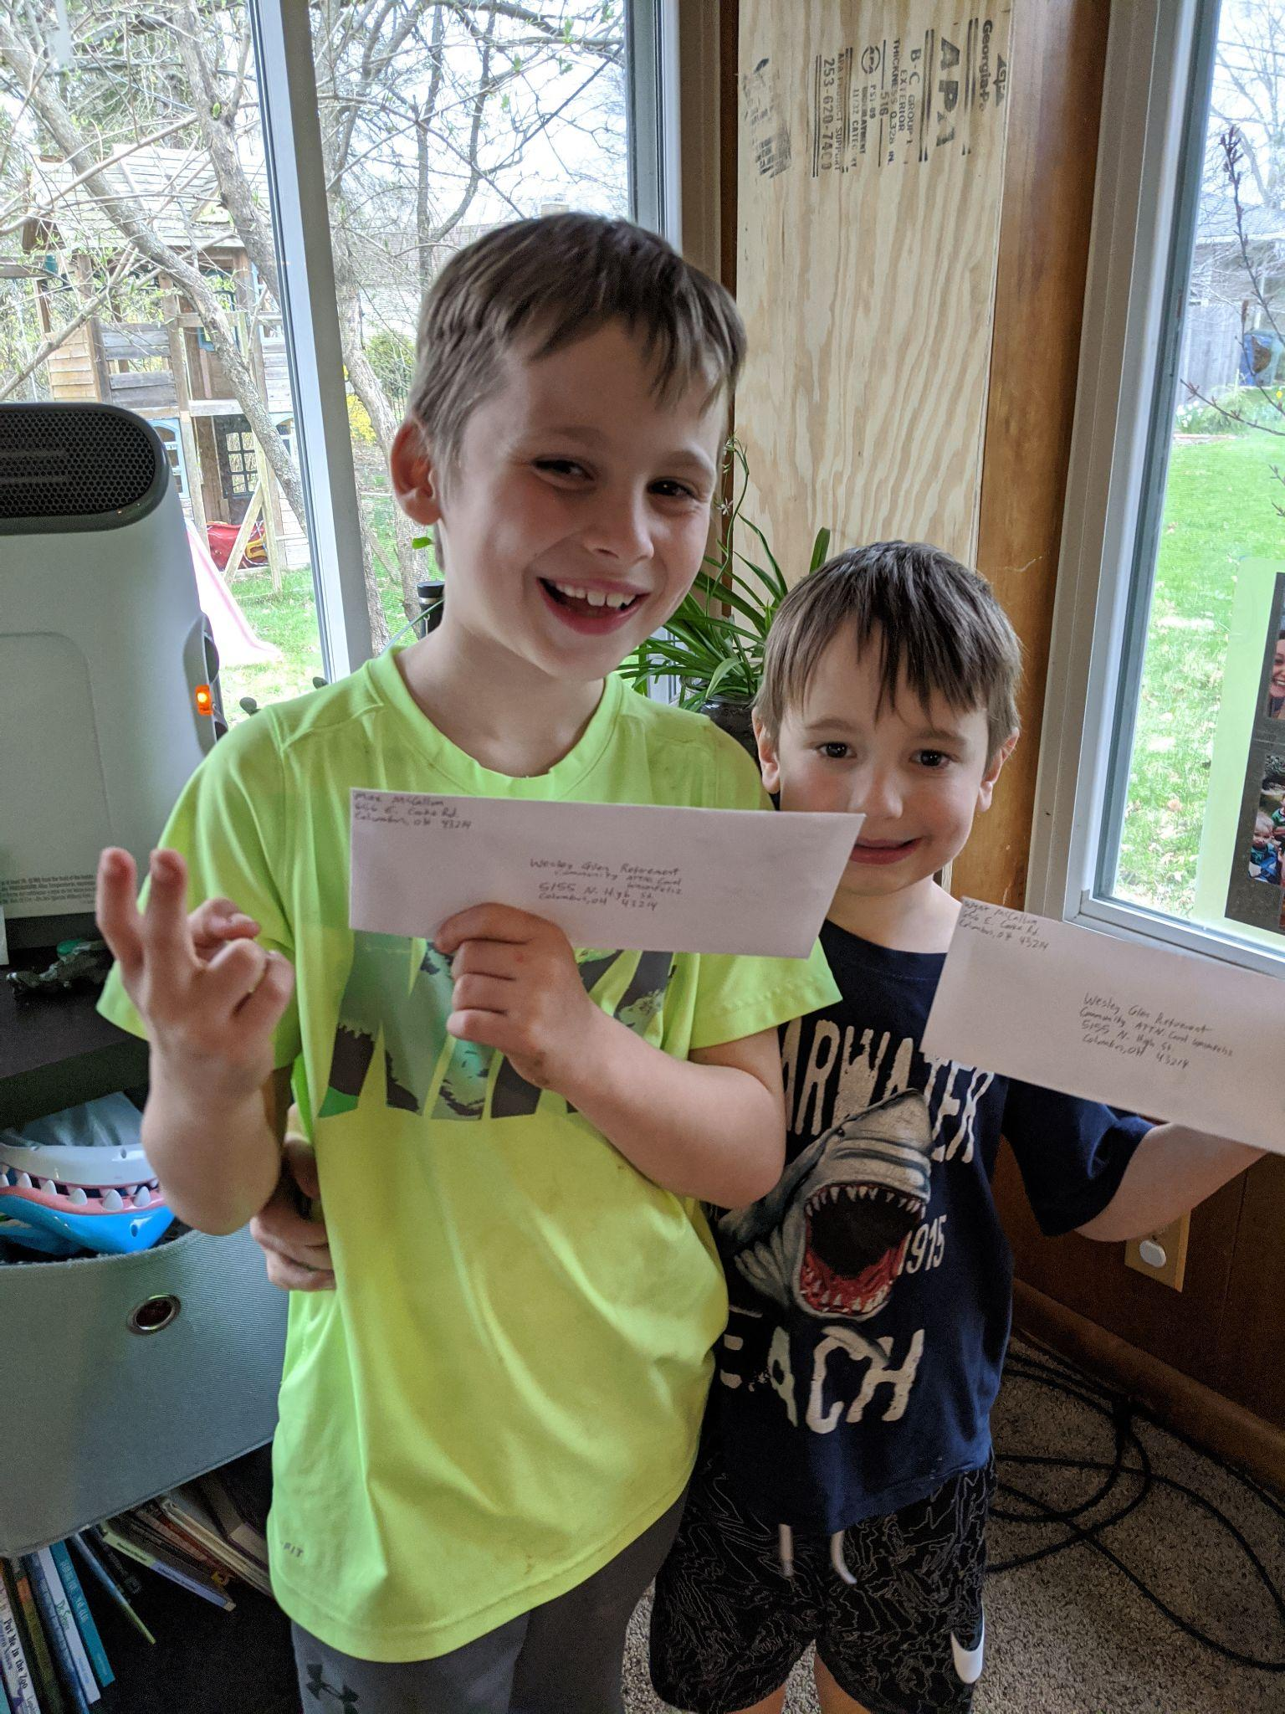
Lets get Practical
Start small
Read books: Global Babies
Pray for other people together
Serve the family
Serve someone in need
Teach God’s love for the poor
Critique our culture’s view of happiness
Set a vision
Serve together as a family

Slide 26
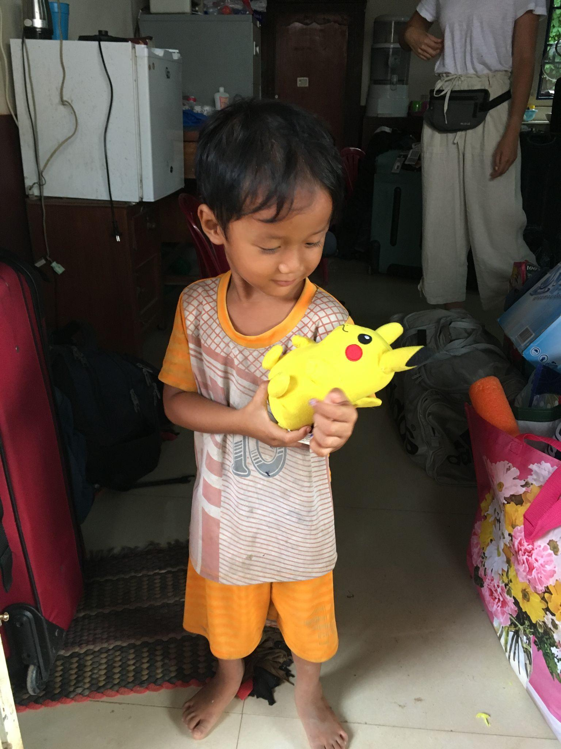
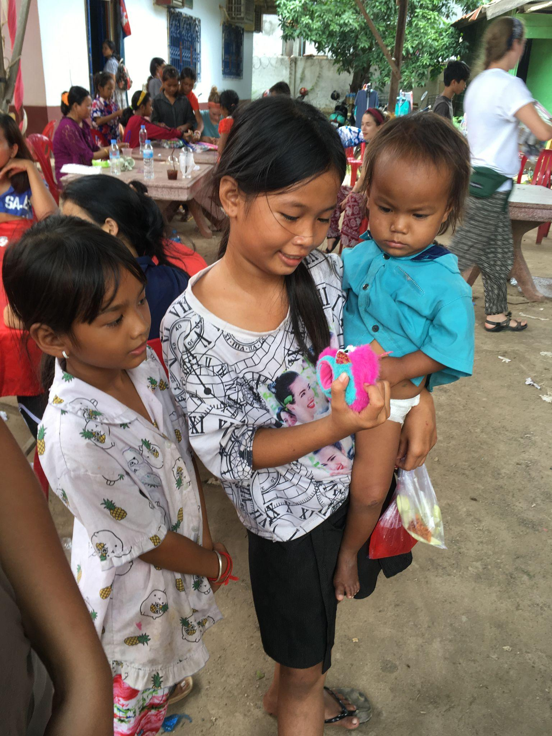
Lets get Practical
Start small
Read books: Global Babies
Pray for other people together
Serve the family
Serve someone in need
Teach God’s love for the poor
Critique our culture’s view of happiness
Set a vision
Serve together as a family
Meet and pray for people together
Raise money for epic or missions trip
Get you kids in a community
Experience the joy of giving!
Encouragement and Praise!

Slide 27
Acts 20:35 It is more blessed to GIVE than to receive

