Slide 1
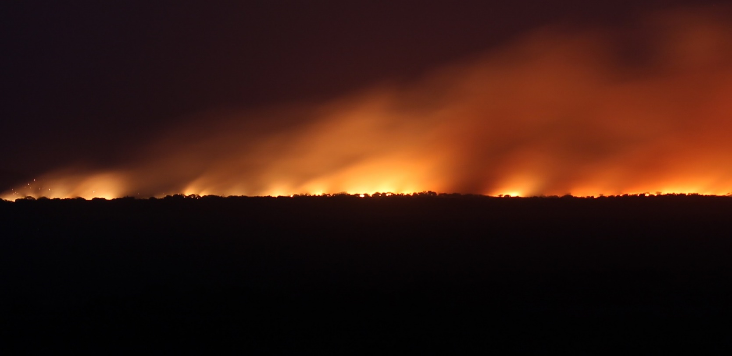
1 Peter 5
Essential attitudes for the “fiery ordeal”
^{1 Peter 5:8} Be of sober spirit, be on the alert. Your adversary, the devil, prowls around like a roaring lion, seeking someone to devour. ⁹ So resist him, firm in your faith, knowing that the same experiences of suffering are being accomplished by your brothers and sisters who are in the world. ¹⁰ After you have suffered for a little while, the God of all grace, who called you to His eternal glory in Christ, will Himself perfect, confirm, strengthen, and establish you. ¹¹ To Him be dominion forever and ever. Amen.

Slide 2
1 Peter 5
Essential attitudes for the “fiery ordeal”
^{1 Peter 5:8} Be of sober spirit, be on the alert. Your adversary, the devil, prowls around like a roaring lion, seeking someone to devour. ⁹ So resist him, firm in your faith, knowing that the same experiences of suffering are being accomplished by your brothers and sisters who are in the world. ¹⁰ After you have suffered for a little while, the God of all grace, who called you to His eternal glory in Christ, will Himself perfect, confirm, strengthen, and establish you. ¹¹ To Him be dominion forever and ever. Amen.

Slide 3
1 Peter 5
Essential attitudes for the “fiery ordeal”
^{1 Peter 5:8} Be of sober spirit, be on the alert. Your adversary, the devil, prowls around like a roaring lion, seeking someone to devour. ⁹ So resist him, firm in your faith, knowing that the same experiences of suffering are being accomplished by your brothers and sisters who are in the world. ¹⁰ After you have suffered for a little while, the God of all grace, who called you to His eternal glory in Christ, will Himself perfect, confirm, strengthen, and establish you. ¹¹ To Him be dominion forever and ever. Amen.

Slide 4
Lion Awareness
^{1 Peter 5:8} Be of sober spirit, be on the alert. Your adversary, the devil, prowls around like a roaring lion, seeking someone to devour. ⁹ So resist him, firm in your faith, knowing that the same experiences of suffering are being accomplished by your brothers and sisters who are in the world. ¹⁰ After you have suffered for a little while, the God of all grace, who called you to His eternal glory in Christ, will Himself perfect, confirm, strengthen, and establish you. ¹¹ To Him be dominion forever and ever. Amen.

Slide 5
Lion Awareness
1) Know your enemy, 2) Be on the alert, 3) Resist him
^{1 Peter 5:8} Be of sober spirit, be on the alert. Your adversary, the devil, prowls around like a roaring lion, seeking someone to devour. ⁹ So resist him, firm in your faith, knowing that the same experiences of suffering are being accomplished by your brothers and sisters who are in the world. ¹⁰ After you have suffered for a little while, the God of all grace, who called you to His eternal glory in Christ, will Himself perfect, confirm, strengthen, and establish you. ¹¹ To Him be dominion forever and ever. Amen.

Slide 6
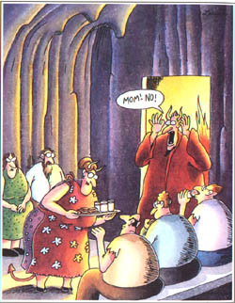
Know Your Enemy

Slide 7
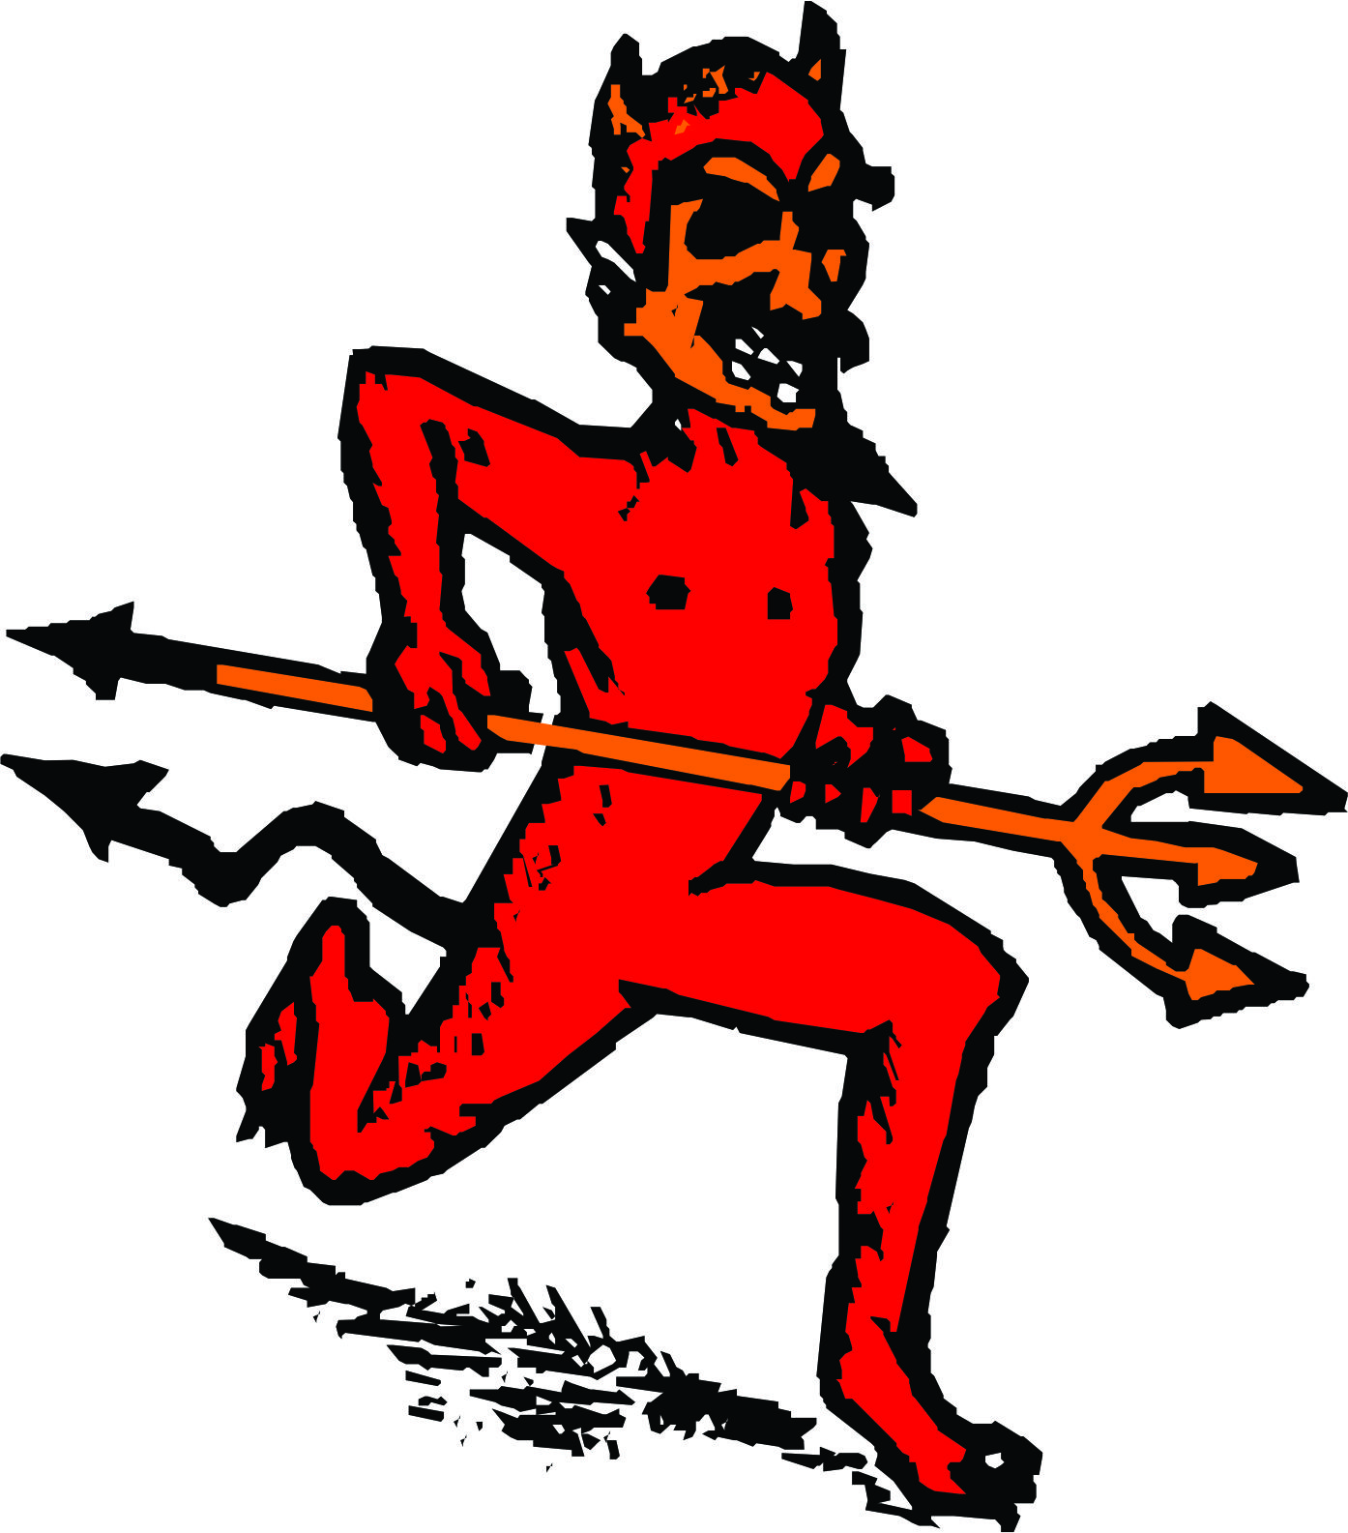
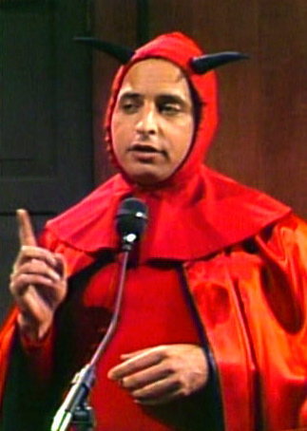
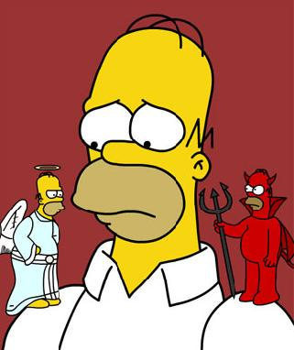
Know Your Enemy

Slide 8
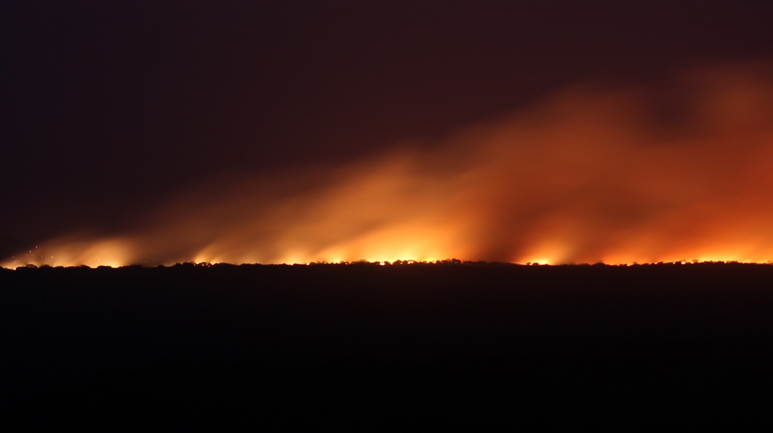
Know Your Enemy
Can we take this seriously?
Is there a possibility of a spiritual dimension?

Slide 9
Know Your Enemy
^{1 Peter 5:8} Be of sober spirit, be on the alert. Your adversary, the devil, prowls around like a roaring lion, seeking someone to devour.

Slide 10
Know Your Enemy:
Who is he?
^{1 Peter 5:8} Be of sober spirit, be on the alert. Your adversary, the devil, prowls around like a roaring lion, seeking someone to devour.

Slide 11
Know Your Enemy:
Who is he?
Created, Fallen
^{1 Peter 5:8} Be of sober spirit, be on the alert. Your adversary, the devil, prowls around like a roaring lion, seeking someone to devour.

Slide 12
Know Your Enemy:
Who is he?
Created, Fallen
^{Ezekiel 28:12} You were the model of perfection, full of wisdom and perfect in beauty… ¹⁴ You were the anointed cherub who covers, for so I ordained you. You were on the holy mount of God; you walked among the fiery stones. ¹⁵ You were blameless in your ways from the day you were created until wickedness was found in you.

Slide 13
Know Your Enemy:
Who is he?
Created, Fallen
^{Ezekiel 28:12} You were the model of perfection, full of wisdom and perfect in beauty… ¹⁴ You were the anointed cherub who covers, for so I ordained you. You were on the holy mount of God; you walked among the fiery stones. ¹⁵ You were blameless in your ways from the day you were created until wickedness was found in you.

Slide 14
Know Your Enemy:
Who is he?
Created, Fallen
^{Ezekiel 28:12} You were the model of perfection, full of wisdom and perfect in beauty… ¹⁴ You were the anointed cherub who covers, for so I ordained you. You were on the holy mount of God; you walked among the fiery stones. ¹⁵ You were blameless in your ways from the day you were created until wickedness was found in you.

Slide 15
Know Your Enemy:
Who is he?
Created, Fallen
War in Heaven
^{Ezekiel 28:16} … So I drove you in disgrace from the mount of God, and I expelled you, O guardian cherub… ¹⁷ Your heart became proud on account of your beauty, and you corrupted your wisdom because of your splendor.

Slide 16
Know Your Enemy:
Who is he?
Created, Fallen
War in Heaven
The War Comes to Earth
^{Ezekiel 28:16} … So I drove you in disgrace from the mount of God, and I expelled you, O guardian cherub… ¹⁷ Your heart became proud on account of your beauty, and you corrupted your wisdom because of your splendor.

Slide 17
Know Your Enemy:
Who is he?
Created, Fallen
War in Heaven
The War Comes to Earth
^{Eph 2:2} You used to live in sin, just like the rest of the world, obeying the devil—the commander of the powers in the unseen world. He is the spirit at work in the hearts of those who refuse to obey God. ³… By our very nature we were subject to God’s anger, just like everyone else.

Slide 18
Know Your Enemy:
Who is he?
Created, Fallen
War in Heaven
The War Comes to Earth
Jesus to the rescue
^{Galatians 1:4} … Jesus Christ, who gave Himself for our sins so that he might rescue us from this present evil age.

Slide 19
Know Your Enemy:
Who is he?
Created, Fallen
War in Heaven
The War Comes to Earth
Jesus to the rescue
And the offer stands
^{Colossians 1:13} For He rescued us from the domain of darkness, and transferred us to the kingdom of His beloved Son.

Slide 20
Know Your Enemy:
What does he want?

Slide 21
Know Your Enemy:
What does he want?
He wants dominion
He opposes God
He opposes the Gospel
¹¹ To Him be dominion forever and ever. Amen.

Slide 22
Know Your Enemy:
What does he want?
He wants dominion
He opposes God
He opposes the Gospel
^{2 Corinthians 4:4} Satan, who is the god of this world, has blinded the minds of those who don’t believe. They are unable to see the glorious light of the Good News.

Slide 23
Know Your Enemy:
What does he want?
He wants dominion
He opposes God
He opposes the Gospel
^{Luke 8:12} Those beside the road are those who have heard; then the devil comes and takes away the word from their heart, so that they will not believe and be saved.

Slide 24
Know Your Enemy:
What does he want?
He wants dominion
He opposes God
He opposes the Gospel
He opposes anyone who aligns with God
^{Luke 8:12} Those beside the road are those who have heard; then the devil comes and takes away the word from their heart, so that they will not believe and be saved.

Slide 25
Know Your Enemy:
What does he want?
He wants dominion
He opposes God
He opposes the Gospel
He opposes anyone who aligns with God
^{1 Peter 5:8} Be of sober spirit, be on the alert. Your adversary, the devil, prowls around like a roaring lion, seeking someone to devour.

Slide 26
Know Your Enemy:
He is your true opponent
^{Eph 6:12} For our struggle is not against flesh and blood, but against the rulers, against the powers, against the world forces of this darkness, against the spiritual forces of wickedness in the heavenly places.
^{1 Peter 5:8} Be of sober spirit, be on the alert. Your adversary, the devil, prowls around like a roaring lion, seeking someone to devour.

Slide 27
Know Your Enemy:
He is your true opponent
^{Luke 22:31} “Simon, Simon, behold, Satan has demanded permission to sift you like wheat.”
^{1 Peter 5:8} Be of sober spirit, be on the alert. Your adversary, the devil, prowls around like a roaring lion, seeking someone to devour.

Slide 28
Know Your Enemy:
What does he do?
^{1 Peter 5:8} Be of sober spirit, be on the alert. Your adversary, the devil, prowls around like a roaring lion, seeking someone to devour.

Slide 29
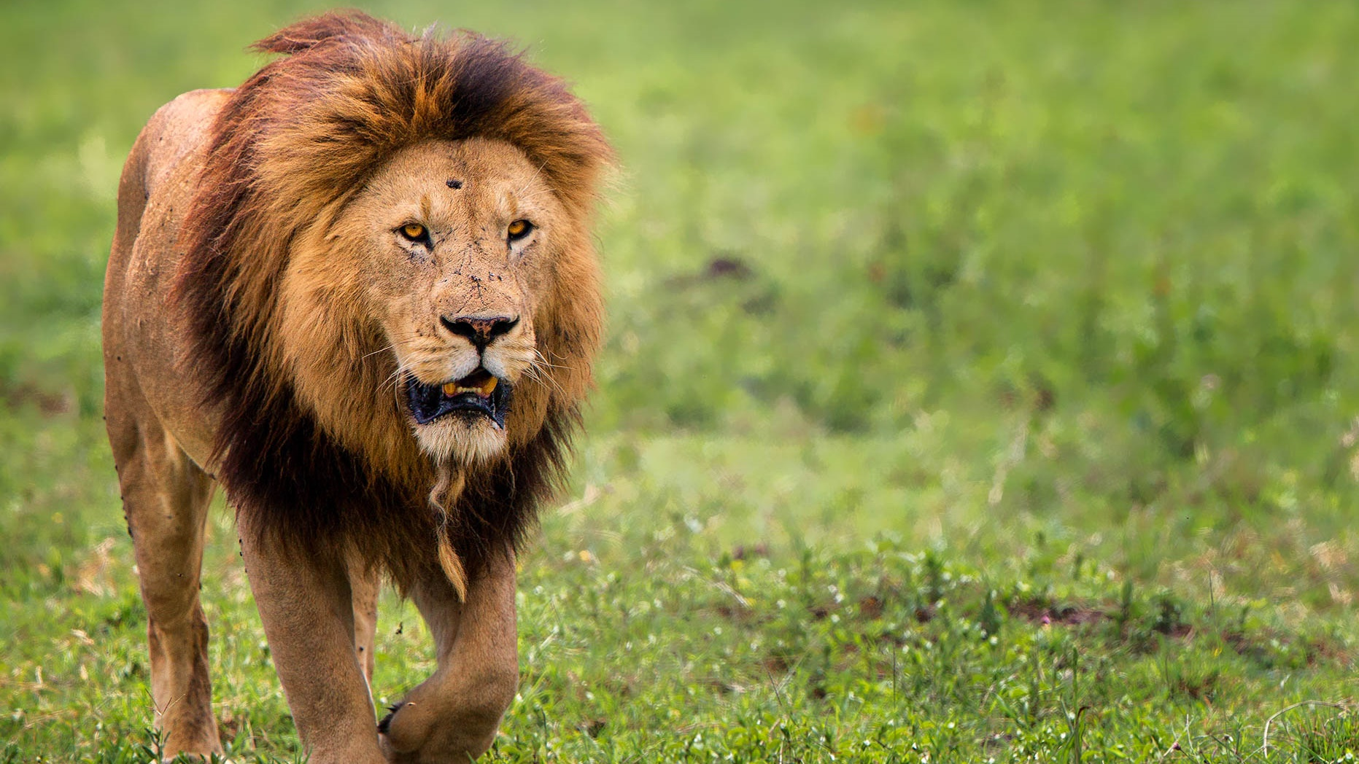
Know Your Enemy
What does he do?
^{1 Peter 5:8} Be of sober spirit, be on the alert. Your adversary, the devil, prowls around like a roaring lion, seeking someone to devour.

Slide 30
Know Your Enemy
^{1 Peter 5:8} Be of sober spirit, be on the alert. Your adversary, the devil, prowls around like a roaring lion, seeking someone to devour.

Slide 31
Know Your Enemy
His goal is to render you ineffective any way he can
overt tactics
covert tactics
^{1 Peter 5:8} Be of sober spirit, be on the alert. Your adversary, the devil, prowls around like a roaring lion, seeking someone to devour.

Slide 32
Know Your Enemy
His goal is to render you ineffective any way he can
“Devil” = diabolos: slanderous, accusing falsely
^{1 Peter 5:8} Be of sober spirit, be on the alert. Your adversary, the devil, prowls around like a roaring lion, seeking someone to devour.

Slide 33
Know Your Enemy
His goal is to render you ineffective any way he can
^{John 8:44} there is no truth in him. Whenever he speaks a lie, he speaks from his own nature, for he is a liar and the father of lies.
^{1 Peter 5:8} Be of sober spirit, be on the alert. Your adversary, the devil, prowls around like a roaring lion, seeking someone to devour.

Slide 34
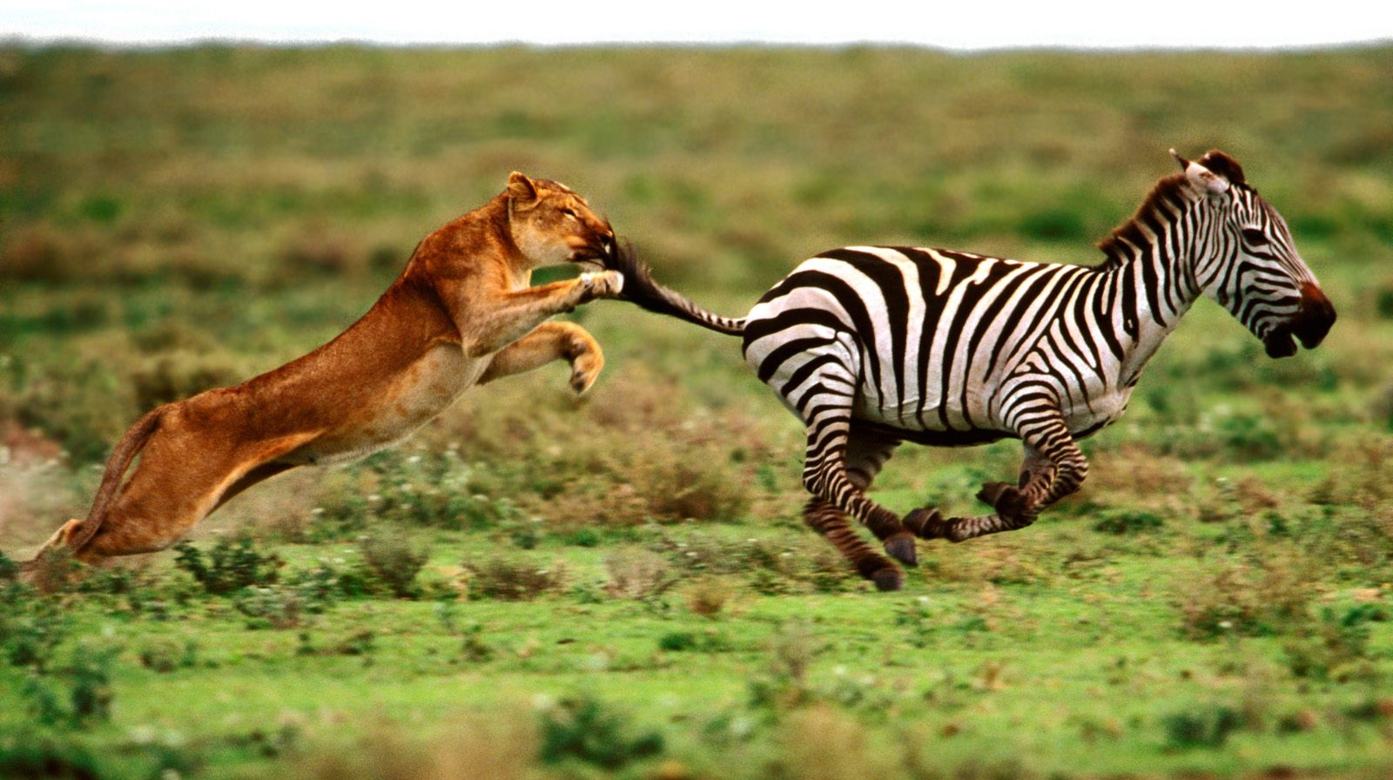
LIE: If you follow God , You are going to look stupid…
… Fail …
… Suffer …
… be exposed …
Intimidation

Slide 35
LIE: Your work for God is futile
… doomed …
… a joke…
… a waste of time…
What’s the point?
You don’t matter in this fight
There’s something wrong with you or something wrong with God… either way… you should give up.
Discouragement

Slide 36
LIE: you would be happier if you just …
What’s the big deal?
It’s not so unreasonable to give in here or there…
This is just who you are
Temptation

Slide 37
EW! I can’t believe you did that!
You’re a Fraud!
You suck. So give up.
You should stay away from God for a while… he’s probably disgusted with you
Temptation
Accusation

Slide 38
LIE: you don’t belong in to the Community of Christ
No one gets you
You’d be safer and happier if you just kept things on your own
Look how others let you down.... Maybe they’re the real enemy?
Isolation

Slide 39
What’s on TV tonight?
#1:

Slide 40
What’s on TV tonight?
What war?
You’re too busy with the “important” things in life
The real fight is over there
The point is that you’re lulled into forgetting that you’re even in a fight
#1: Distraction

Slide 41
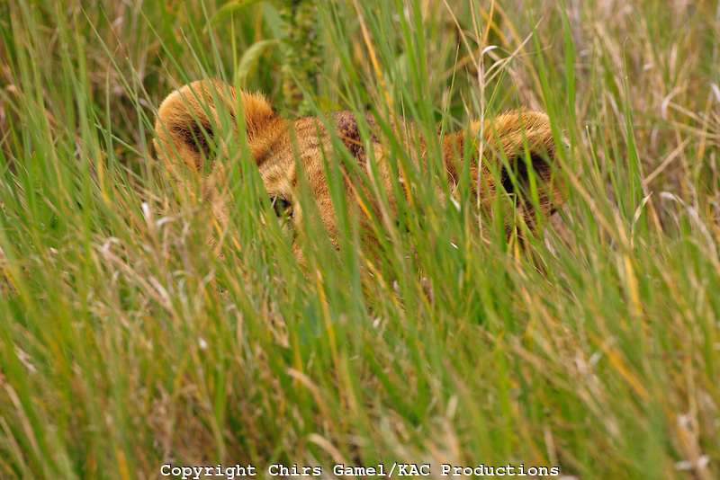
What war?
What’s on TV tonight?
I doubt all that stuff’s real
Often, the easiest way to neutralize us is to let us neutralize ourselves!
#1: Distraction

Slide 42
^{1 Peter 5:8} Be of sober spirit, be on the alert. Your adversary, the devil, prowls around like a roaring lion, seeking someone to devour.
#1: Distraction

Slide 43
Be on the Alert
The most dangerous place to be is on the battlefield
… and not know it
nēphō: “sober”
grēgoreō : “stay awake, be vigilant, keep watch”
^{1 Peter 5:8} Be of sober spirit, be on the alert. Your adversary, the devil, prowls around like a roaring lion, seeking someone to devour.

Slide 44
Be on the Alert
Are you “awake” to the schemes of the lion?
^{1 Peter 5:8} Be of sober spirit, be on the alert. Your adversary, the devil, prowls around like a roaring lion, seeking someone to devour.

Slide 45
Be on the Alert
Have you learned to recognize his roar?
^{1 Peter 5:8} Be of sober spirit, be on the alert. Your adversary, the devil, prowls around like a roaring lion, seeking someone to devour.

Slide 46
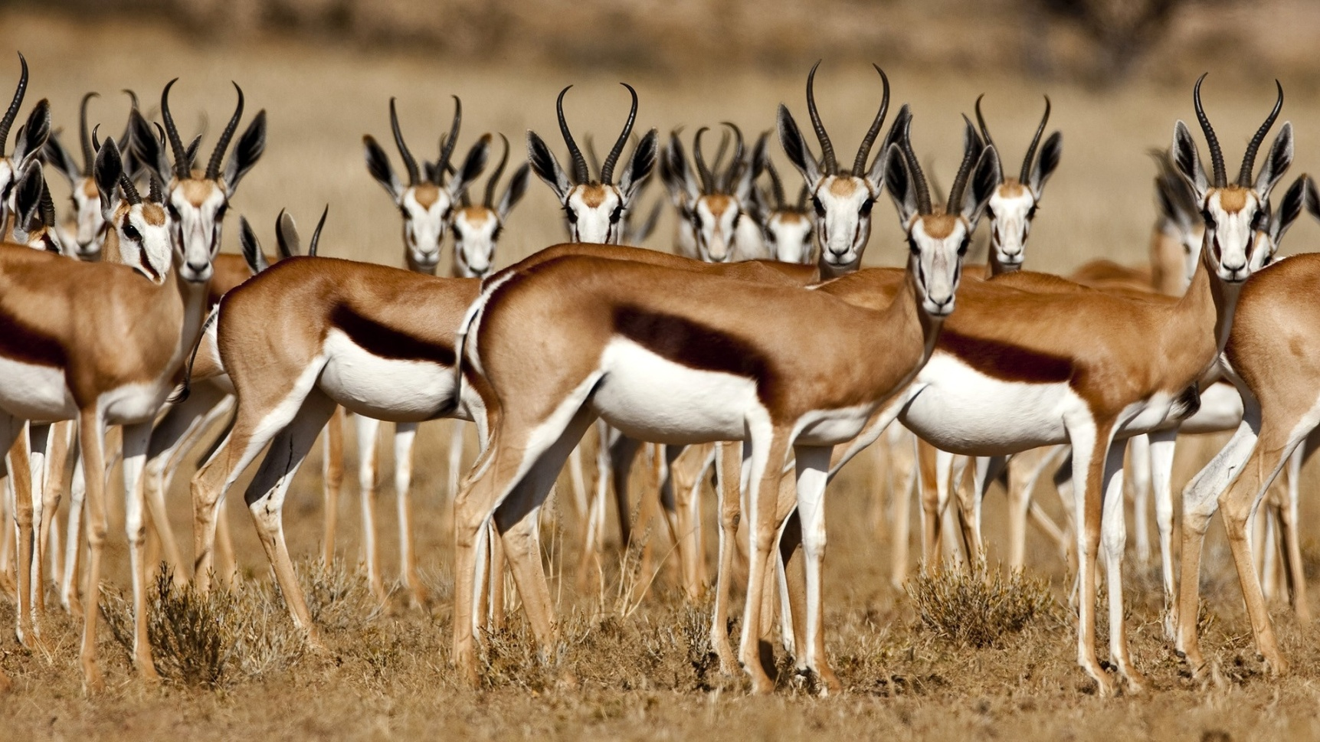
Be on the Alert
Do you have a herd?
^{1 Peter 5:8} Be of sober spirit, be on the alert. Your adversary, the devil, prowls around like a roaring lion, seeking someone to devour.

Slide 47
Resist
anthistēmi : “to stand against,” “to withstand”
^{1 Peter 5:9} So resist him, firm in your faith, knowing that the same experiences of suffering are being accomplished by your brothers and sisters who are in the world. ¹⁰ After you have suffered for a little while, the God of all grace, who called you to His eternal glory in Christ, will Himself perfect, confirm, strengthen, and establish you.

Slide 48
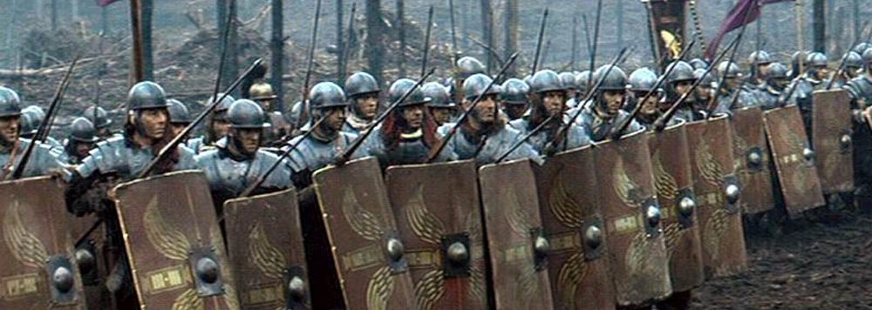
Resist
anthistēmi : “to stand against,” “to withstand”
^{1 Peter 5:9} So resist him, firm in your faith, knowing that the same experiences of suffering are being accomplished by your brothers and sisters who are in the world. ¹⁰ After you have suffered for a little while, the God of all grace, who called you to His eternal glory in Christ, will Himself perfect, confirm, strengthen, and establish you.

Slide 49
Resist:
Firm in your Faith
Confident alertness
Faith: Active trust in biblical truth
^{1 Peter 5:9} So resist him, firm in your faith, knowing that the same experiences of suffering are being accomplished by your brothers and sisters who are in the world. ¹⁰ After you have suffered for a little while, the God of all grace, who called you to His eternal glory in Christ, will Himself perfect, confirm, strengthen, and establish you.

Slide 50
Resist:
Firm in your Faith
Confident alertness
Jesus Christ’s superiority
Jesus Christ’s victory
Jesus Christ’s authority
^{1 Peter 5:9} So resist him, firm in your faith, knowing that the same experiences of suffering are being accomplished by your brothers and sisters who are in the world. ¹⁰ After you have suffered for a little while, the God of all grace, who called you to His eternal glory in Christ, will Himself perfect, confirm, strengthen, and establish you.

Slide 51
Resist:
Firm in your Faith
Confident alertness
Jesus Christ’s superiority
Jesus Christ’s victory
Jesus Christ’s authority
^{1 Peter 5:9} So resist him, firm in your faith, knowing that the same experiences of suffering are being accomplished by your brothers and sisters who are in the world. ¹⁰ After you have suffered for a little while, the God of all grace, who called you to His eternal glory in Christ, will Himself perfect, confirm, strengthen, and establish you.

Slide 52
Resist:
Firm in your Faith
Confident alertness
Jesus Christ’s superiority
Jesus Christ’s victory
Jesus Christ’s authority
^{1 Peter 5:9} So resist him, firm in your faith, knowing that the same experiences of suffering are being accomplished by your brothers and sisters who are in the world. ¹⁰ After you have suffered for a little while, the God of all grace, who called you to His eternal glory in Christ, will Himself perfect, confirm, strengthen, and establish you.

Slide 53
Resist:
Firm in your Faith
trusting God’s word over Satan’s lies
^{1 Peter 5:9} So resist him, firm in your faith, knowing that the same experiences of suffering are being accomplished by your brothers and sisters who are in the world. ¹⁰ After you have suffered for a little while, the God of all grace, who called you to His eternal glory in Christ, will Himself perfect, confirm, strengthen, and establish you.

Slide 54
Resist:
Firm in your Faith
LIE: If you follow God , You are going to look stupid…
… have the backing of the Almighty!
^{Romans 8:31} If God is for us, who can ever be against us?
^{Nehemiah} ^{4:14} Do not be afraid of them; remember the Lord who is great and awesome, and fight!

Slide 55
Resist:
Firm in your Faith
Is an act of eternal significance and glory!
LIE: Your work for God is a waste of time
^{2 Corinthians 2:14} But thanks be to God, who always leads us in triumph in Christ

Slide 56
Resist:
Firm in your Faith
delights in you
LIE: God is disgusted with you
^{Psalm 103:12} As far as the east is from the west, so far has he removed our transgressions from us.
^{Romans 8:33} Who dares accuse us whom God has chosen for his own? No one – for God himself has given us right standing with himself.

Slide 57
Resist:
Firm in your Faith
Enjoying the community in which I have placed you!
LIE: You’d be better off on your own
^{1 Cor 12:28} But now God has arranged the parts, each one of them in the body, just as He desired.

Slide 58
Resist:
Firm in your Faith
If you don’t resist Satan’s lies, they will take root in your life
^{2 Cor 10:3} For though we walk in the flesh, we do not war according to the flesh, ⁴ for the weapons of our warfare are not of the flesh, but divinely powerful for the destruction of fortresses. ⁵ We are destroying speculations and every lofty thing raised up against the knowledge of God, and we are taking every thought captive to the obedience of Christ.

Slide 59
Resist:
Firm in your Faith
What would it look like to not be firm in your faith?
^{1 Peter 5:9} So resist him, firm in your faith, knowing that the same experiences of suffering are being accomplished by your brothers and sisters who are in the world. ¹⁰ After you have suffered for a little while, the God of all grace, who called you to His eternal glory in Christ, will Himself perfect, confirm, strengthen, and establish you.

Slide 60
Resist:
Firm in your Faith
Determination to act
^{1 Peter 5:9} So resist him, firm in your faith, knowing that the same experiences of suffering are being accomplished by your brothers and sisters who are in the world. ¹⁰ After you have suffered for a little while, the God of all grace, who called you to His eternal glory in Christ, will Himself perfect, confirm, strengthen, and establish you.

Slide 61
Resist:
in Solidarity
^{1 Peter 5:9} So resist him, firm in your faith, knowing that the same experiences of suffering are being accomplished by your brothers and sisters who are in the world. ¹⁰ After you have suffered for a little while, the God of all grace, who called you to His eternal glory in Christ, will Himself perfect, confirm, strengthen, and establish you.

Slide 62
Resist:
in Solidarity
^{1 Peter 5:9} So resist him, firm in your faith, knowing that the same experiences of suffering are being accomplished by your brothers and sisters who are in the world. ¹⁰ After you have suffered for a little while, the God of all grace, who called you to His eternal glory in Christ, will Himself perfect, confirm, strengthen, and establish you.

Slide 63
Resist:
“Eternal Perspective”
^{1 Peter 5:9} So resist him, firm in your faith, knowing that the same experiences of suffering are being accomplished by your brothers and sisters who are in the world. ¹⁰ After you have suffered for a little while, the God of all grace, who called you to His eternal glory in Christ, will Himself perfect, confirm, strengthen, and establish you.

Slide 64
Resist:
“Eternal Perspective”
^{1 Peter 5:9} So resist him, firm in your faith, knowing that the same experiences of suffering are being accomplished by your brothers and sisters who are in the world. ¹⁰ After you have suffered for a little while, the God of all grace, who called you to His eternal glory in Christ, will Himself perfect, confirm, strengthen, and establish you.

Slide 65
Resist:
“Eternal Perspective”
^{1 Peter 5:9} So resist him, firm in your faith, knowing that the same experiences of suffering are being accomplished by your brothers and sisters who are in the world. ¹⁰ After you have suffered for a little while, the God of all grace, who called you to His eternal glory in Christ, will Himself perfect, confirm, strengthen, and establish you.

Slide 66
Resist:
Know his promises
^{1 Peter 5:9} So resist him, firm in your faith, knowing that the same experiences of suffering are being accomplished by your brothers and sisters who are in the world. ¹⁰ After you have suffered for a little while, the God of all grace, who called you to His eternal glory in Christ, will Himself perfect, confirm, strengthen, and establish you.

Slide 67
1 Peter
^{1 Peter 5:11} To Him be dominion forever and ever. Amen.

