Slide 1
Simple Living and Family Life

Slide 2
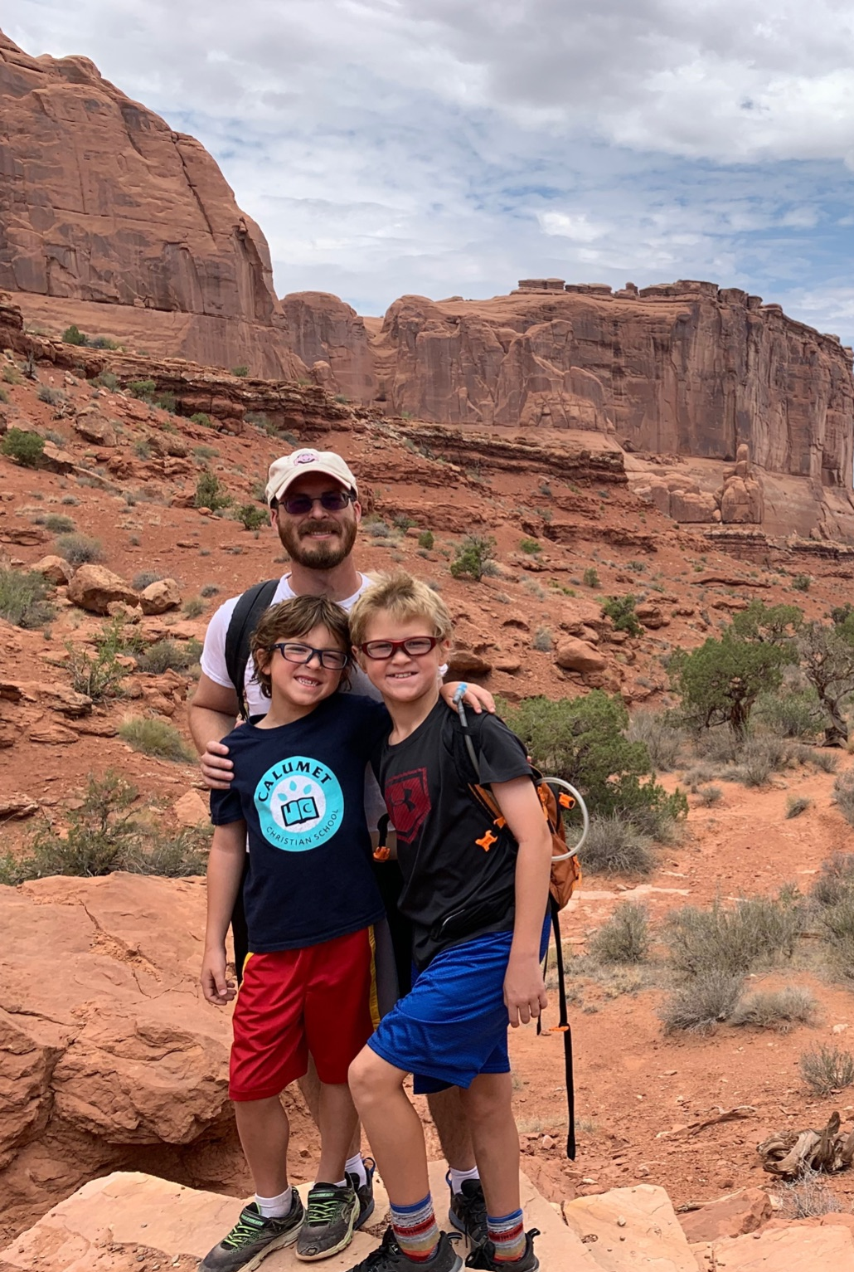
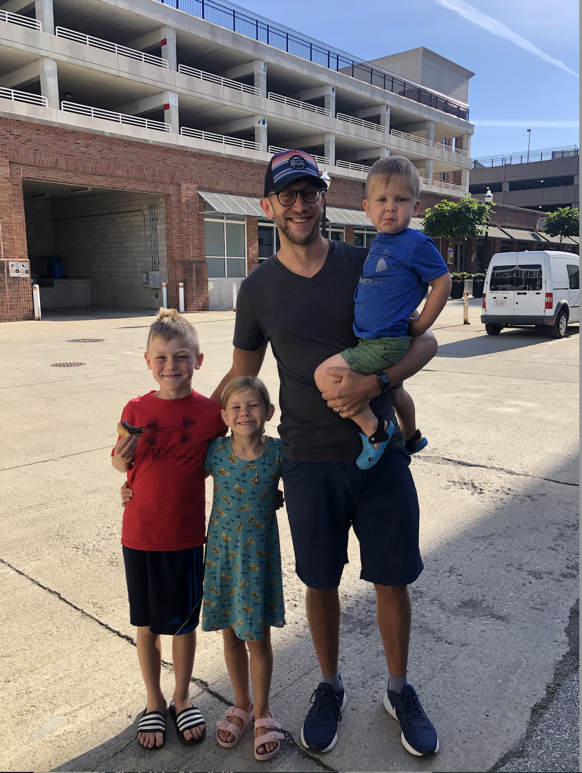
Simple Living & Family Life

Slide 3
Our Economic Moment

Slide 4
Simple Living & Family Life
But godliness with contentment is great gain. For we brought nothing into this world and we can take nothing out of it. But if we have food and clothing, we will be content with that. (1 Tim. 6:6-8)

Slide 5
Living in Light of Eternity
But godliness with contentment is great gain. For we brought nothing into this world and we can take nothing out of it. But if we have food and clothing, we will be content with that. (1 Tim. 6:6-8)
Contentment with material things
Discontentment with spiritual growth

Slide 6
Living in Light of Eternity
We live by faith, not by sight. (2 Cor. 5:7)
But godliness with contentment is great gain. For we brought nothing into this world and we can take nothing out of it. But if we have food and clothing, we will be content with that. (1 Tim. 6:6-8)
Contentment with material things
Discontentment with spiritual growth
So we fix our eyes not on what is seen, but on what is unseen, since what is seen is temporary, but what is unseen is eternal. (2 Cor. 4:18)

Slide 7
Simple Living & Family Life
But godliness with contentment is great gain. For we brought nothing into this world and we can take nothing out of it. But if we have food and clothing, we will be content with that. (1 Tim. 6:6-8)

Slide 8
Simple Living & Family Life
What is Simple Living?
Minimalism?
Frugality?
A bummer?

Slide 9
Simple Living & Family Life
What is Simple Living?
Practical living in light of eternity
Cultivating a heart that belongs to eternal things
Freedom!

Slide 10
Simple Living & Family Life
Those who want to get rich fall into temptation and a trap and into many foolish and harmful desires that plunge people into ruin and destruction. For the love of money is a root of all kinds of evil. Some people, eager for money, have wandered from the faith and pierced themselves with many griefs. (1 Tim. 6:9-10)

Slide 11
Simple Living & Family Life
16 And he told them this parable: “The ground of a certain rich man yielded an abundant harvest. 17 He thought to himself, ‘What shall I do? I have no place to store my crops.’ 18 “Then he said, ‘This is what I’ll do. I will tear down my barns and build bigger ones, and there I will store my surplus grain.

Slide 12
Simple Living & Family Life
19 And I’ll say to myself, “You have plenty of grain laid up for many years. Take life easy; eat, drink and be merry.”’ (Luke 12:16-19)

Slide 13
Simple Living & Family Life
16 And he told them this parable: “The ground of a certain rich man yielded an abundant harvest. 17 He thought to himself, ‘What shall I do? I have no place to store my crops.’ 18 “Then he said, ‘This is what I’ll do. I will tear down my barns and build bigger ones, and there I will store my surplus grain.

Slide 14
Simple Living & Family Life
Think of how WE do this…
16 And he told them this parable: “The ground of a certain rich man yielded an abundant harvest. 17 He thought to himself, ‘What shall I do? I have no place to store my crops.’ 18 “Then he said, ‘This is what I’ll do. I will tear down my barns and build bigger ones, and there I will store my surplus grain.

Slide 15
Simple Living & Family Life
“Watch out! Be on your guard against all kinds of greed; life does not consist in an abundance of possessions.” (Luke 12:15)

Slide 16
Simple Living & Family Life
‘You fool! This very night your life will be demanded from you. Then who will get what you have prepared for yourself?’ (Luke 12:20)
Why waste your life on something so temporary?

Slide 17
Simple Living & Family Life
“Naked I came from my mother’s womb,
and naked I will depart.” (Job 1:21)
“For we brought nothing into the world, and we can take nothing out of it.” (1 Timothy 6:7)
‘You fool! This very night your life will be demanded from you. Then who will get what you have prepared for yourself?’ (Luke 12:20)
Why waste your life on something so temporary?
Ex: my high school friend

Slide 18
Simple Living & Family Life
But you, man of God, flee from all this, and pursue righteousness, godliness, faith, love, endurance and gentleness. Fight the good fight of faith. Take hold of the eternal life to which you were called. (1 Tim. 6:11-12a)
Fleeing the love of money is synonymous with Fleeing Materialism/Consumerism

Slide 19
Simple Living & Family Life
Materialism/Consumerism
Debt
Student Loan Crisis
Cashouts (on Refi’s)
“Money is cheap”
Credit Cards

Slide 20
Simple Living & Family Life
Materialism/Consumerism
Debt
Student Loan Crisis
Cashouts (on Refi’s)
“Money is cheap”
Credit Cards
The rich rule over the poor and the borrower is slave to the lender. (Proverbs 22:7).

Slide 21
Simple Living & Family Life
But you, man of God, flee from all this, and pursue righteousness, godliness, faith, love, endurance and gentleness. Fight the good fight of faith. Take hold of the eternal life to which you were called. (1 Tim. 6:11-12a)

Slide 22
Simple Living & Family Life
So from now on we regard no one from a worldly point of view…if anyone is in Christ, he is a new creation. The old has gone, the new is here! (2 Cor. 5:16,17)

Slide 23
Simple Living & Family Life
But you, man of God, flee from all this, and pursue righteousness, godliness, faith, love, endurance and gentleness. Fight the good fight of faith. Take hold of the eternal life to which you were called. (1 Tim. 6:11-12a)
Gratitude

Slide 24
Simple Living & Family Life
“A grateful heart focuses on the riches provided and not on the things that may be lacking… This means financial health and debt and trouble are the products of the meditations of your heart.”
(Paul David Tripp, Redeeming Money p. 47)
But you, man of God, flee from all this, and pursue righteousness, godliness, faith, love, endurance and gentleness. Fight the good fight of faith. Take hold of the eternal life to which you were called. (1 Tim. 6:11-12a)
Gratitude

Slide 25
Simple Living & Family Life
But you, man of God, flee from all this, and pursue righteousness, godliness, faith, love, endurance and gentleness. Fight the good fight of faith. Take hold of the eternal life to which you were called. (1 Tim. 6:11-12a)
Gratitude
Practice Generosity

Slide 26
Simple Living & Family Life
But you, man of God, flee from all this, and pursue righteousness, godliness, faith, love, endurance and gentleness. Fight the good fight of faith. Take hold of the eternal life to which you were called. (1 Tim. 6:11-12a)
Live below your means
If you’re a high earner…
Giving is an investment in our children
Gratitude
Practice Generosity

Slide 27
Simple Living & Family Life
But you, man of God, flee from all this, and pursue righteousness, godliness, faith, love, endurance and gentleness. Fight the good fight of faith. Take hold of the eternal life to which you were called. (1 Tim. 6:11-12a)
Gratitude
Practice Generosity
Be Skeptical towards Convention

