Slide 1
September 29-30, 2017
The Church at Mill Run
Columbus, OH

Slide 2
God’s living word: mightier than a double edge sword
Bridging the Gospel

Slide 3
Bridging the Gospel
After this session you will understand
The basic similarities and differences between Islam and Christianity
How some Muslim beliefs can serve as bridges to the Gospel
How to communicate the truth of Jesus’ life, death and resurrection to a Muslim

Slide 5
Basic Similarities
GOD IS ONE
Both Muslims and Christians believe in one God.
Names of God that Muslims and Christians agree on:
Al-Barry = the Creator
Al-Qudoos = Holy One
Al-Raheem = the Merciful
Al-Malek = the King
Al-Adil = the Just
Al-Wadud = the Affectionate

Slide 6
Basic Similarities
MAN IS SINFUL
While Muslims believe everyone sins, they do not believe in original sin.
Jesus was the only sinless prophet
Sin = not meeting God’s righteous standards

Slide 7
Basic Similarities
JESUS CHRIST
Muslims believe Jesus:
Was born of the Virgin Mary
Was conceived by the power of the Holy Spirit
Is the Word of God – (Kalimat Allah)
Was pure and sinless from birth
Raised the dead and healed the sick
Will be the intercessor on Judgment Day
Is coming back to earth

Slide 8
Qur’an 4:171
“The Messiah, Jesus the son of Mary, is but the apostle of God and His Word which He cast into Mary and a spirit from Him…”
Although the Qur’an agrees that Jesus is the word of God and the Spirit of God, Islamic leaders teach he was just a man who was never crucified and will return to earth someday.

Slide 9
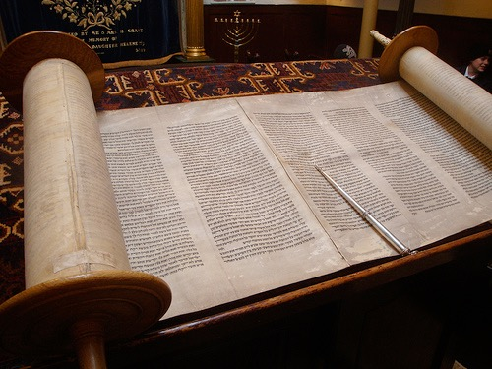
Basic Similarities
HOLY BOOKS
Tawrat – first five books of the Old Testament
Zabur – the Psalms
Injeel – New Testament, Book of Jesus

Slide 10
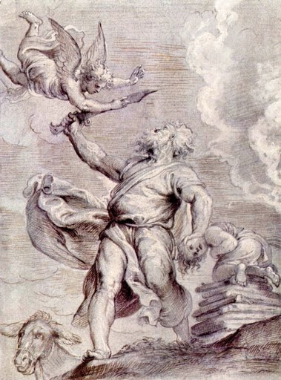
Basic Similarities
PROPHETS
Adam
Noah
Abraham (God redeemed the son of Abraham with a ram. Muslims call this the “Adha” sacrifice.)
Moses
Jonah
John the Baptist
Notes:
Or use this image: http://commons.wikimedia.org/wiki/File:ReuternAbraham.jpg

Slide 11
What the Bible says about Jesus
John 1:1
In the beginning was the Word, and the Word was with God and the Word was God
John 1:14
The Word became flesh and made his dwelling among us. We have seen his glory, the glory of the One and Only, who came from the Father, full of grace and truth.

Slide 12
What the Bible says about Jesus
Hebrews 1:1-2
In the past God spoke to our forefathers through the prophets at many times and in various ways, but in these last days he has spoken to us by his Son, whom he appointed heir of all things, and through whom he made the universe.

Slide 13
Basic Differences
THE SONSHIP OF JESUS
Muslims think Christians believe that Mary had a physical relationship with God, which is blasphemous.

Slide 14
Basic Differences
THE TRINITY
Muslims think Christians worship three gods –God, Jesus and Mary.
Christians believe in a complex One while Muslims believe in a simple one.

Slide 16
Basic Differences
CRUCIFIXION AND RESURRECTION OF CHRIST
If Christ was a prophet sent from God, he should win and not loose by dying.
Muslims interpret the Qur’an to say that Christ was not really killed, but taken up into heaven.

Slide 17
Basic Differences
AUTHORITY OF THE BIBLE
Muslims believe that the Bible has been changed.
Muslims believe the Qur’an replaces the Bible.
The Qur’an tells Muslims to read the Tawrat, Zabur and the Injeel.
The Qur’an says that Christians have the power to judge the message of the Qur’an.

Slide 18
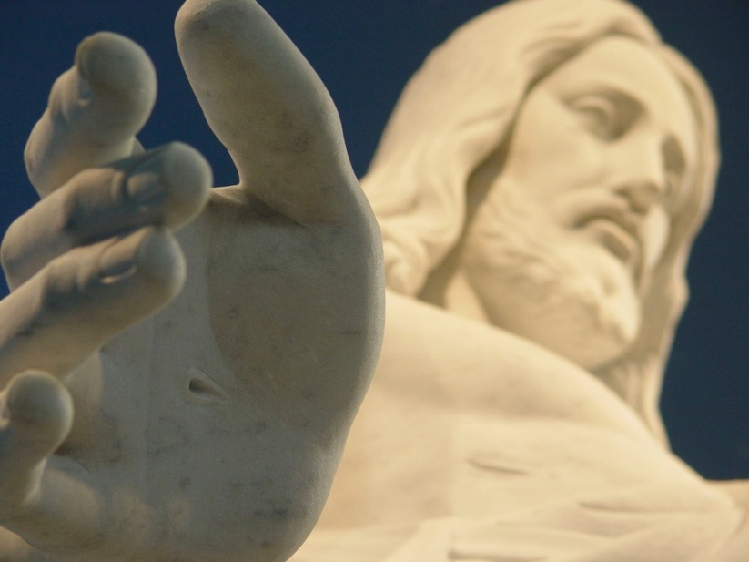
Basic Differences
SALVATION BY GRACE
Muslims believe that they take responsibility for their sins while Christians just stick them to Christ.

Slide 19
Basic Differences
Address the differences but focus on the similarities.
The 5 pillars of Christianity are:
One God
One Savior
One Spirit
One Message
One Family

